Slide 1
Progress Report Stuttgart
Dezember Meeting 2018
Stuttgart

Slide 2
Measurement Setup
Wire Grid
=
Source
Mirror
Optical Isolator
Faraday (45°)
Mirror
Mirror
Sample +
Sample Holder
ZBD
ZBD:
170 – 260 GHz
260 – 400 GHz
325 – 500 GHz (new)
Mirror

Slide 3
Effect of Optical Isolator
Optical Isolator:
Here are presented pure transmission spectra without any signal processing (sample holder inside, no sample mounted):
➔ Introducing an optical isolator into the signal path reduces the standing waves significantly and underlines as origin of the waves the path between source and detector. Half wavelength of the oscillations is approx. 1.2 m, which also fits to this distance between source and detector.

Slide 4
Effect of Frequency Modulation
Frequency Modulation:
Here are presented pure transmission spectra without any signal processing (sample holder inside, Sample 3, antennas not aligned with MW beam):
➔ Standing waves can be almost fully suppressed by frequency modulation of the MW beam.
➔ The following measurements are performed with 6 GHz FM, and little smoothing (Savitzky-Golay filtering) and no optical isolator.

Slide 5

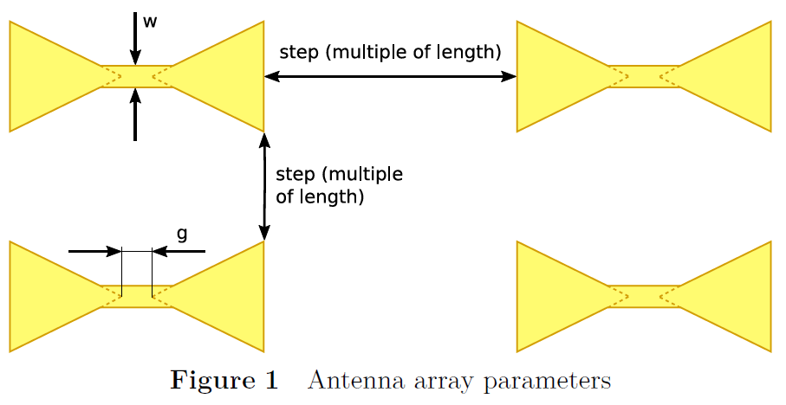
Comparison of Different g; 350 GHz
➔ Broad resonance at a frequency of approx. 330 GHz
➔ Higher g-value seems to increase absorption.
350 GHz antenna

Slide 6
Comparison of Different w; 350 GHz
➔ Resonance vanishes at w = 0
350 GHz antenna

Slide 7
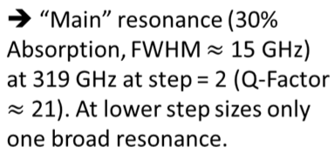
Comparison of Different Steps; 350 GHz
366 GHz
342 GHz
319 GHz
350 GHz antenna

Slide 8
Resonances in Extended Range
➔ Maybe a small resonance around 300 GHz.
210 GHz antenna

Slide 9
New Sample Holders
Automized (Stepper Motor)
Lock-in Amplification possible (Servo Motor)
Better Reproducibility
But still problems!

Slide 10
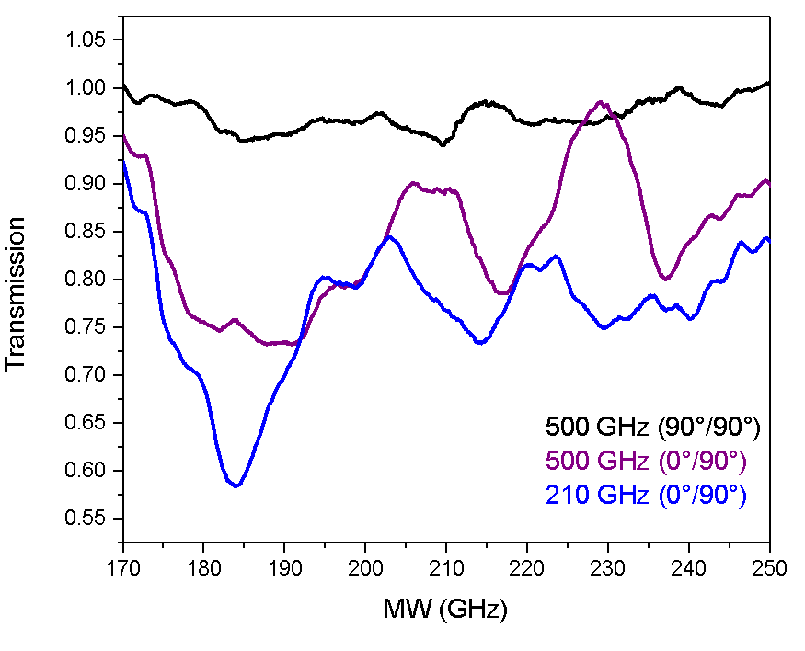
Problems with Unexpected Signals
Sample Holder:
Version 2
210 GHz Signal?
Modulation:
6 GHz
Isolator:
no
Sample:
New single antennas
210 GHz & 510 GHz
Unexpected Signals
Sign of Resonance?

Slide 11
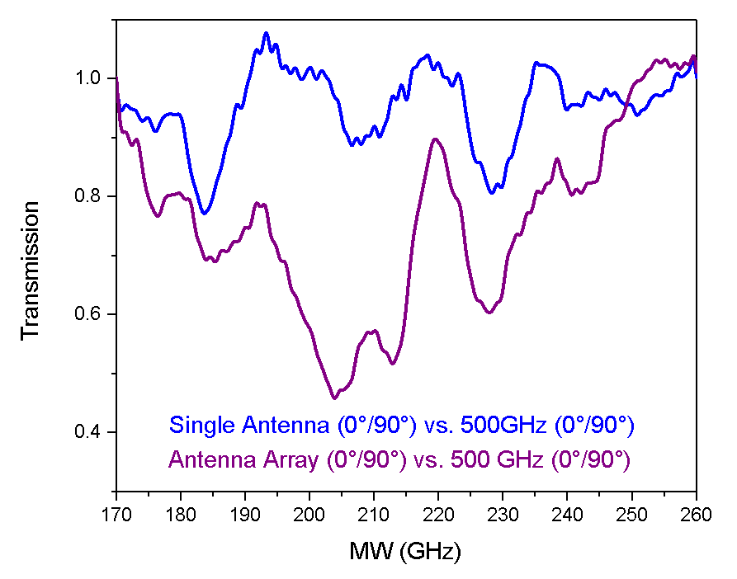
Problems with Unexpected Signals
210 GHz
Sample Holder:
Version 2
Modulation:
6 GHz
Isolator:
no
Sample:
New single antennas
210 GHz & 510 GHz
Unexpected Signals still there. Not scaling whether an array or single antenna.
Sign of Resonance? Scaling with amount of antennas

Slide 12
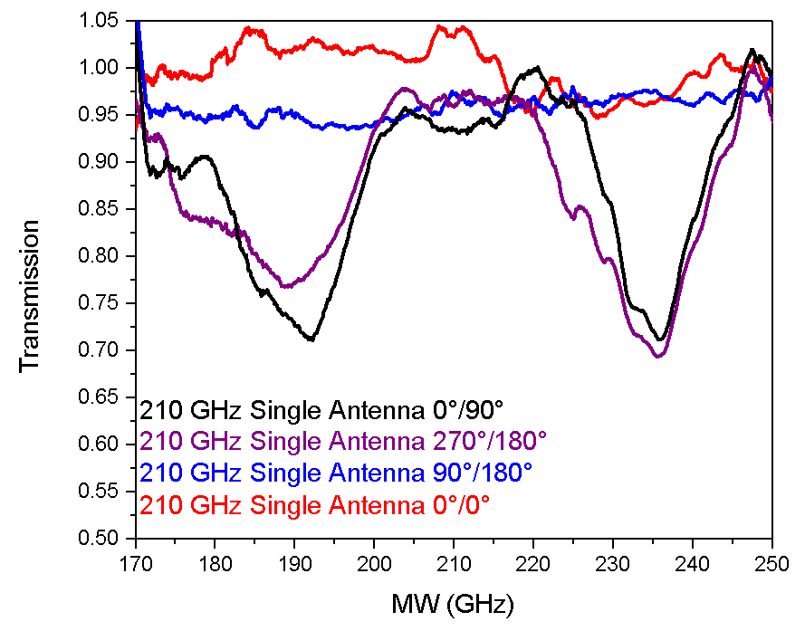
Problems with Unexpected Signals
Sample Holder:
Version 3
Modulation:
6 GHz
Isolator:
yes
Sample:
New single antennas
210 GHz
Background improved. Unexpected Signals still there
Sign of Resonance?

Slide 13
Ideas for Improving Background Signal
Alignment of Center of the beam with rotation axis of the sample holder
Lock-in Amplification (Servo Motor)
Sample Holder material MW absorber (up to now Al)
???

