Slide 1
P.E.T.E.R.
Progress Meeting
Thomas Keating Ltd.
13/06/2018 – TK, Billingshurst

Slide 2
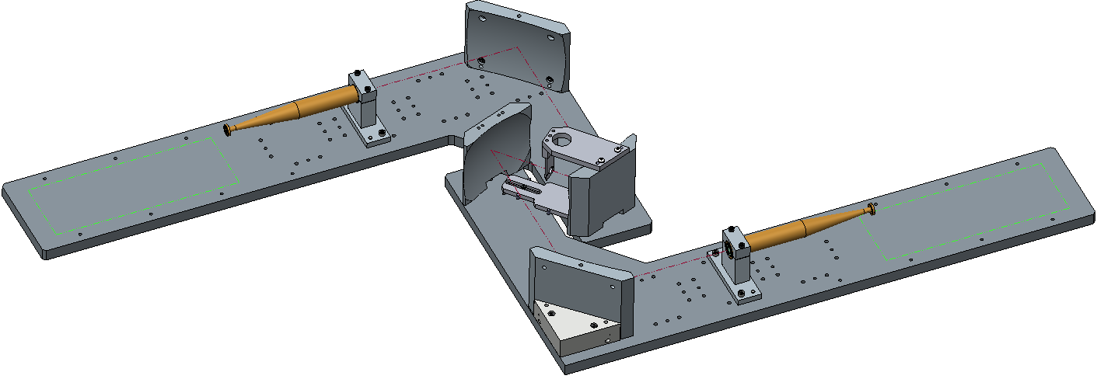
Manufacture: TK free-space measurement bench
Free-space materials measurement bench designed and manufactured
To be used for characterising antennas
Sent to University of Stuttgart
New horns not supplied (existing horns to be used)

Slide 3
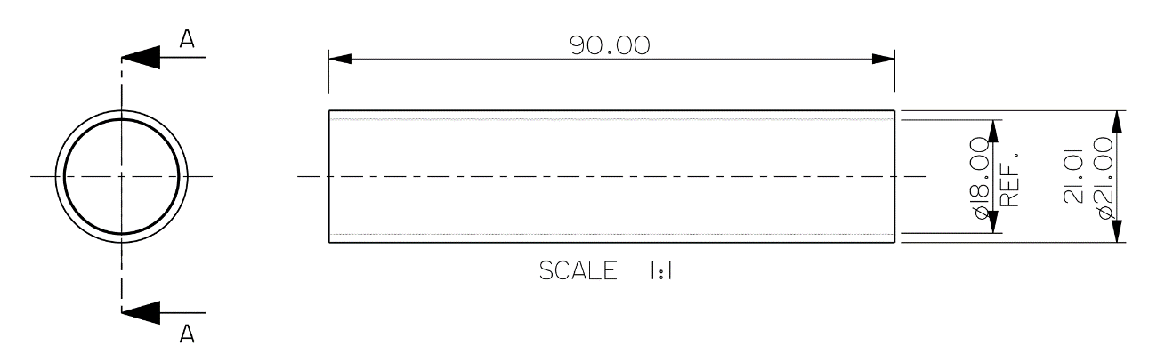
Manufacture: corrugated waveguide
Manufacturing of nickel silver corrugated waveguide sections begun
Sections will be soldered together using external tubes

Slide 4
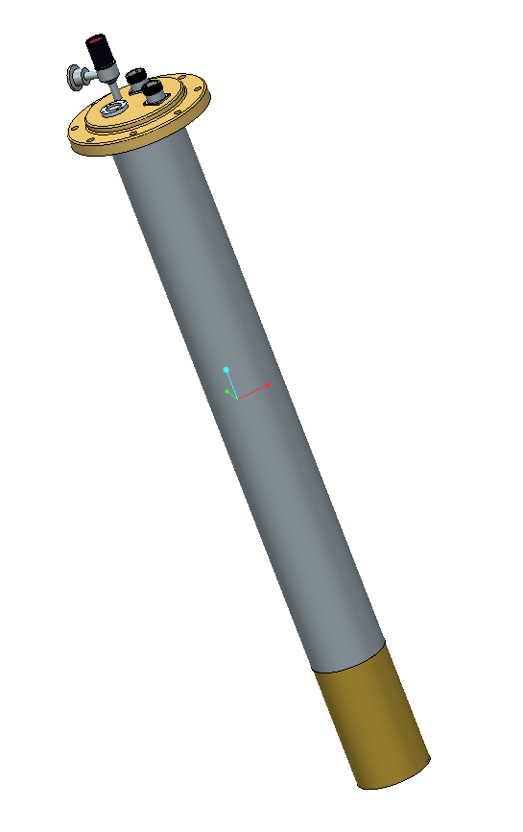
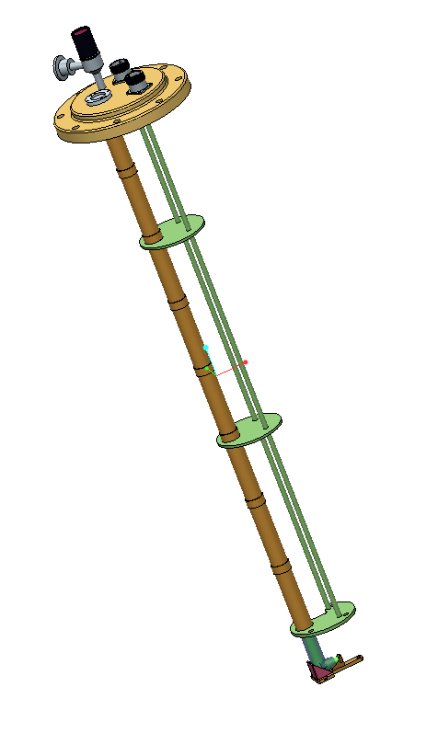
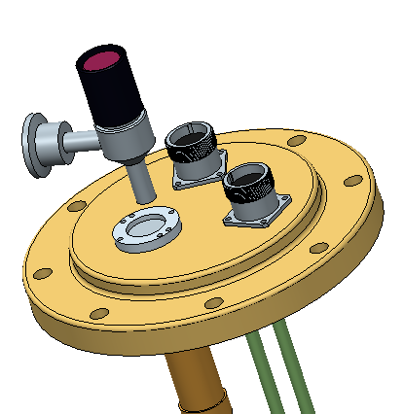
TK probe parts
Brass or stainless steel probe head
Vacuum valve
Microwave window
Nickel silver waveguide and probe struts
Stainless steel tube
Electrical connectors
Brass cup
Probe with casing
Probe – TK internal parts
Probe top

Slide 5
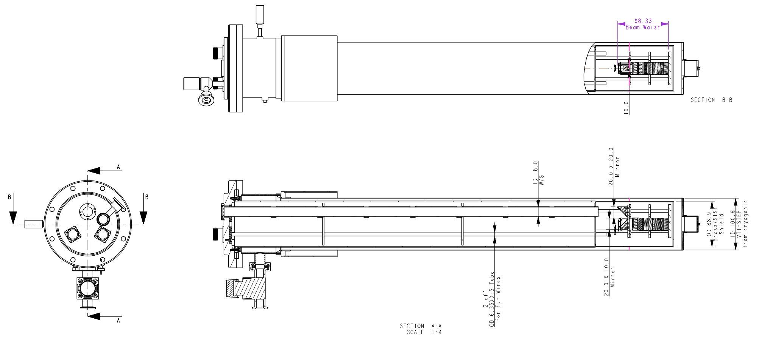
PETER probe with VTI
Manufacturing of nickel silver corrugated waveguide sections has begun.
Sections will be soldered together using external tubes.
General assembly drawing for the PETER probe in the VTI (variable temperature insert) with some key dimensions.

Slide 6
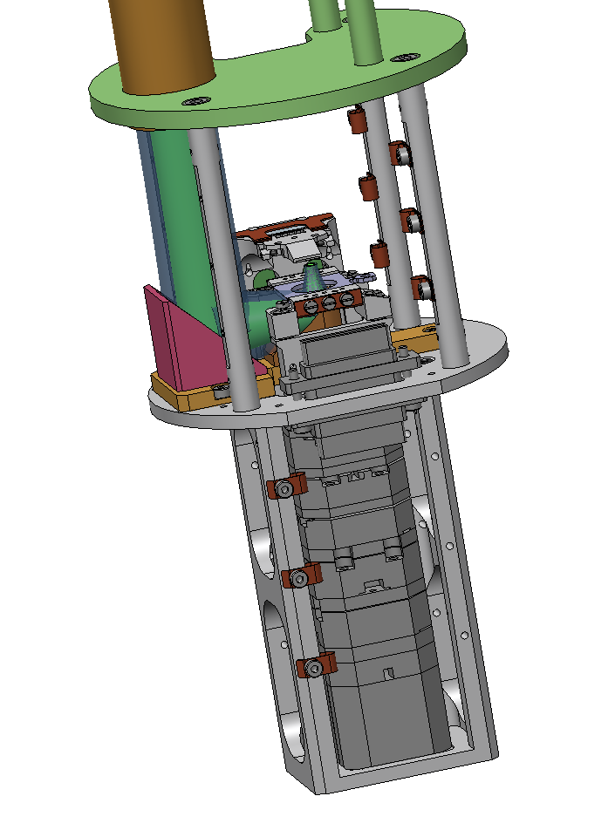
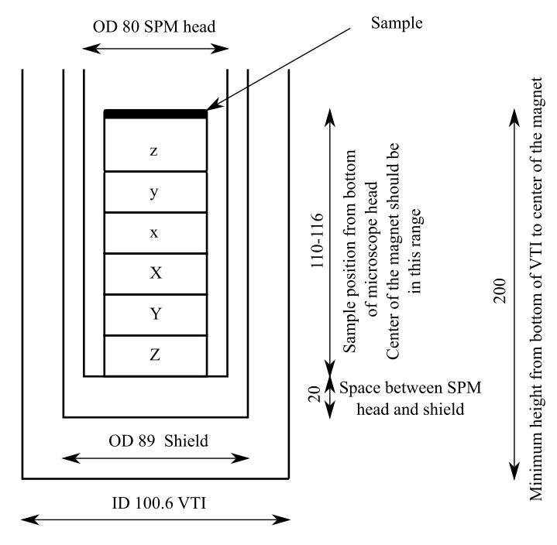
Probe head
Overlap
TK Gaussian Beam Mode simulation overlay
Proposed dimensions incorporated into mechanical design
Probe head design

Slide 7
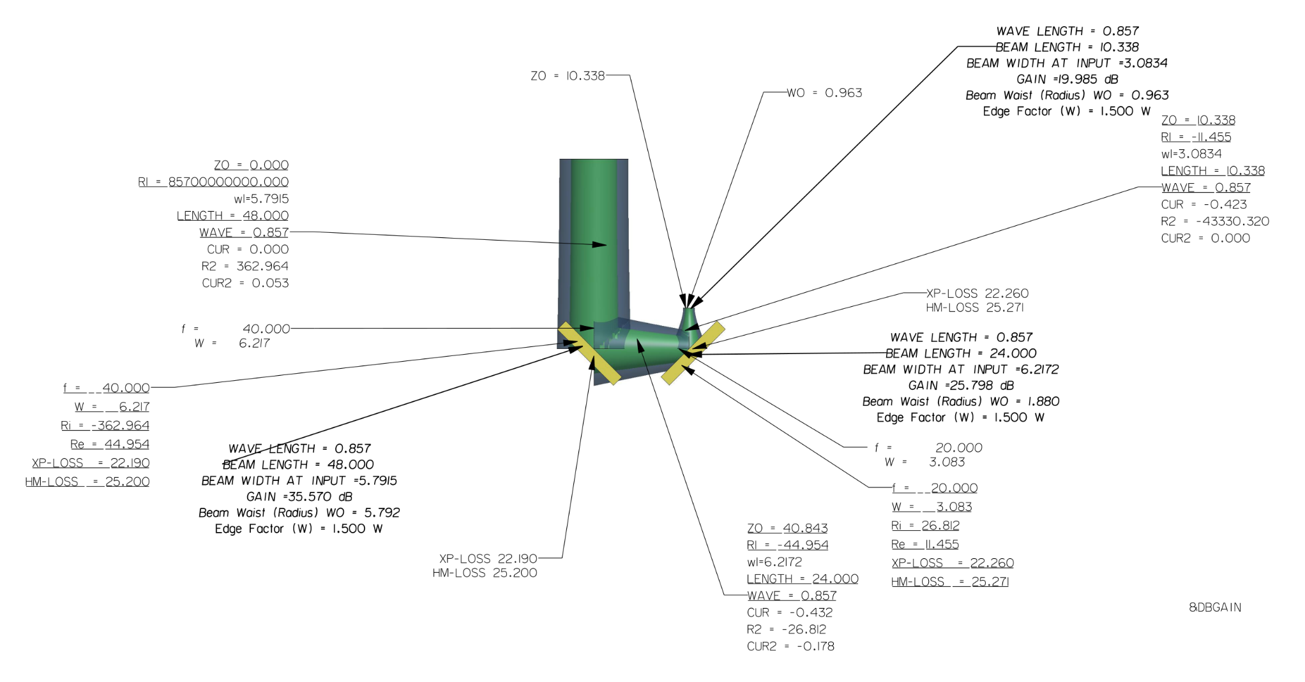
TK Gaussian Beam Mode simulation
TK RF design influences:
Mirrors should reflect almost 100 % of beam power (defined by the outer volume shown)
Small beam must be focussed by strongly-curved mirror
Curvature of mirrors cause polarisation distortion

Slide 8
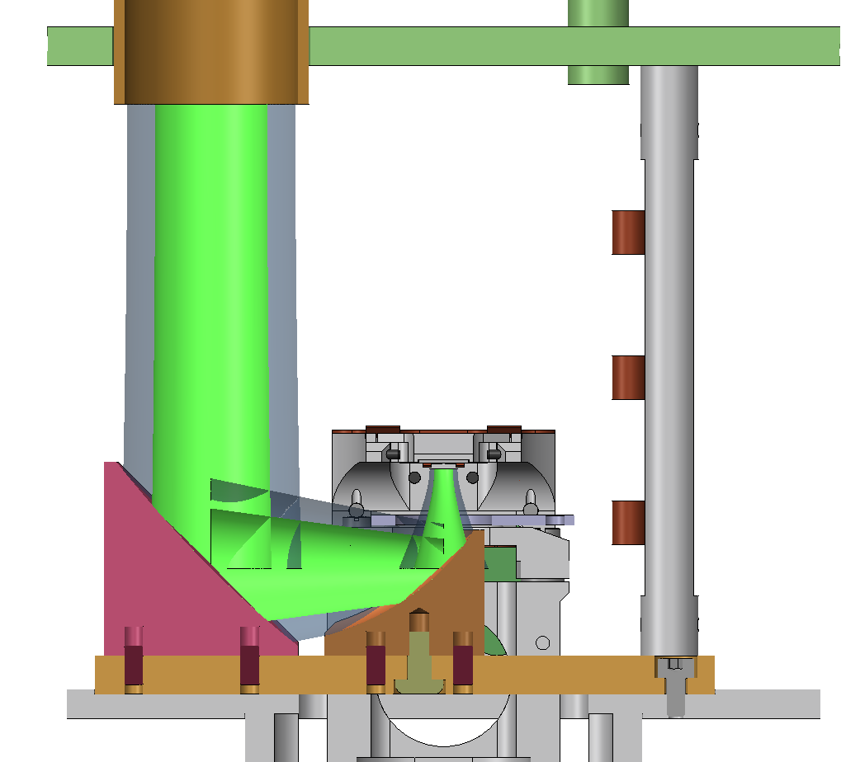
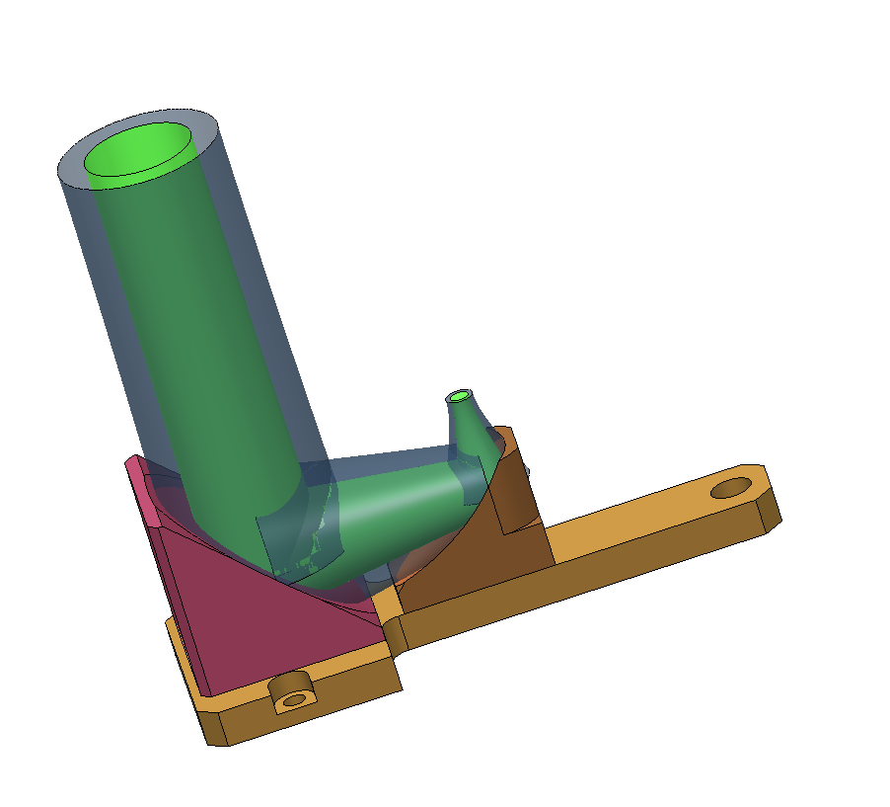
TK Gaussian Beam Mode simulation overlay
Mechanical design cross-section with microwave beam overlays
Microwave beam overlays with mirrors and mount

