Slide 1


Progresses on
Project
UNISTUTT
28. 1. 2021

Slide 2
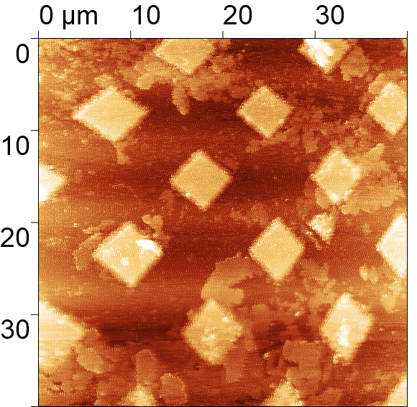
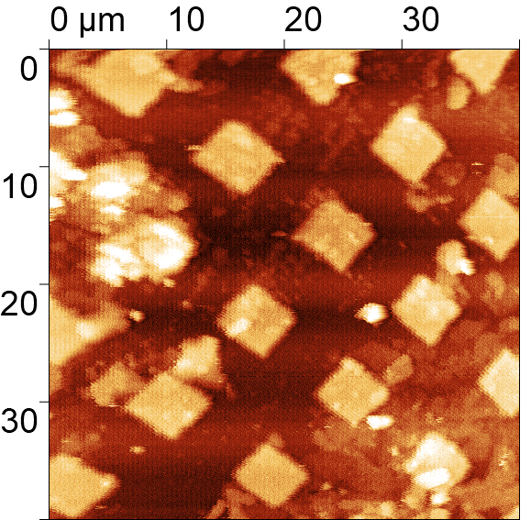
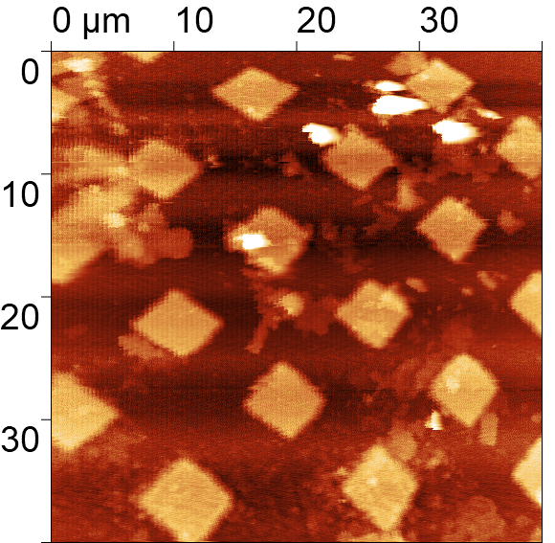
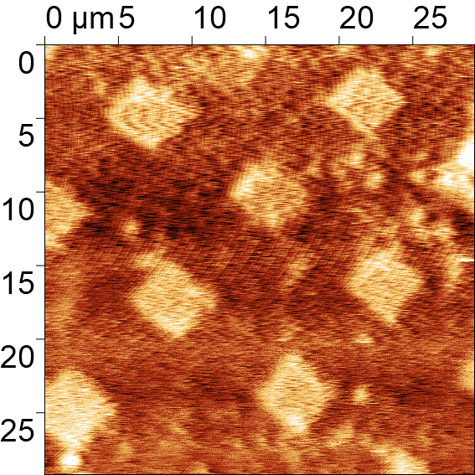
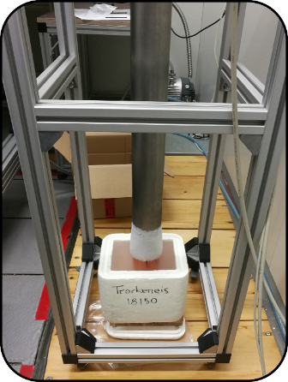
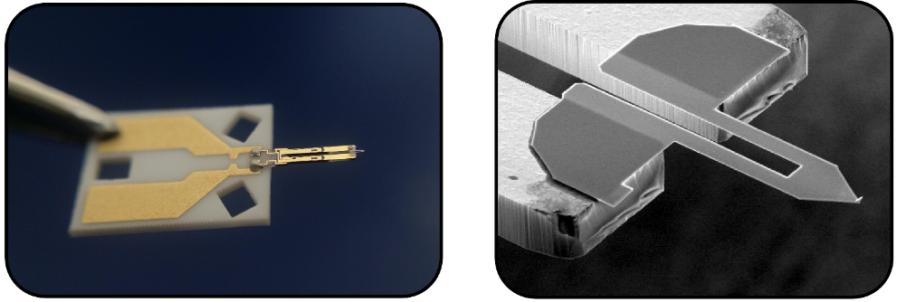
SPM LT measurement of calibration sample with Akiyama probe
11. 8. 2020
7. 10. 2020
8. 10. 2020
11. 11. 2020
Akiyama probe,
RT
outside cryostat
Akiyama probe,
82 K at 1 bar He,
Nitrogen bath
Akiyama probe,
77 K at 1 bar He,
in cryostat
Akiyama probe,
10 K at 1 bar He,
in cryostat
Height of squares is 120 nm
Akiyama probe

Slide 3
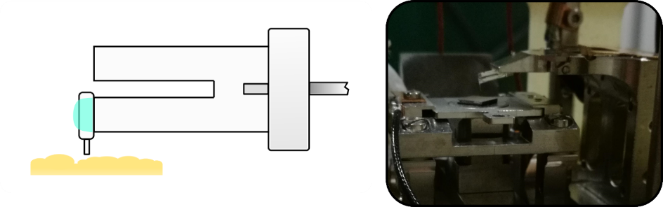
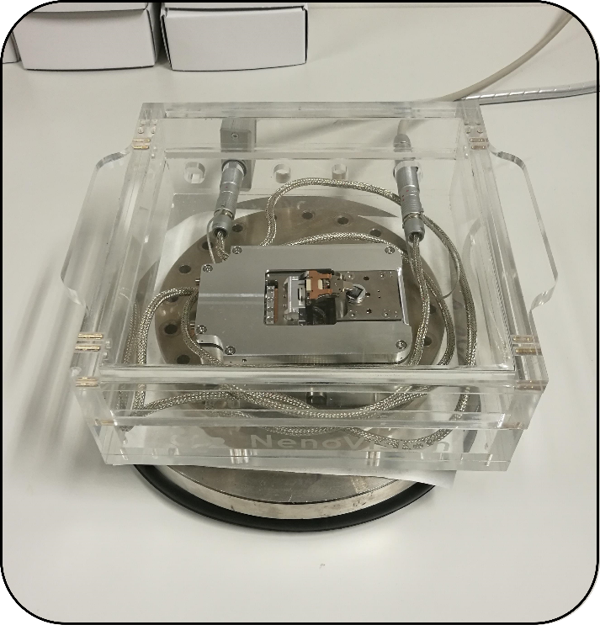
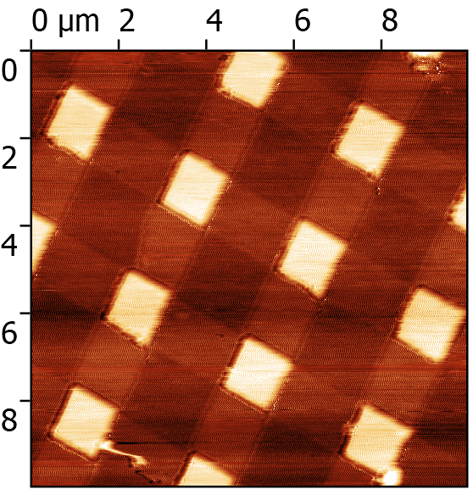
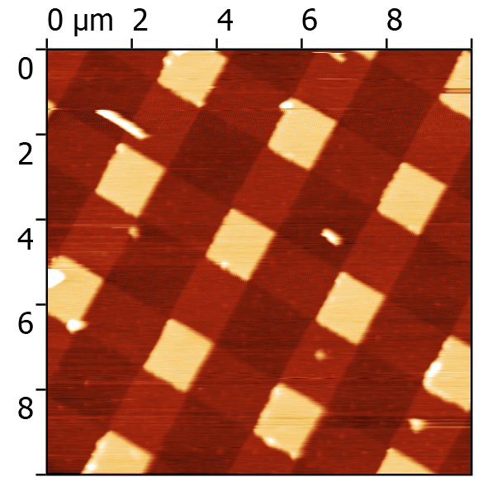
Testing of TF probes with etched optical fiber tip on microscope LiteScope (NenoVision)
TF probe with etched optical fiber tip
Microscope LiteScope
TF probe 1
TF probe 2
Height of squares is 20 nm

Slide 4
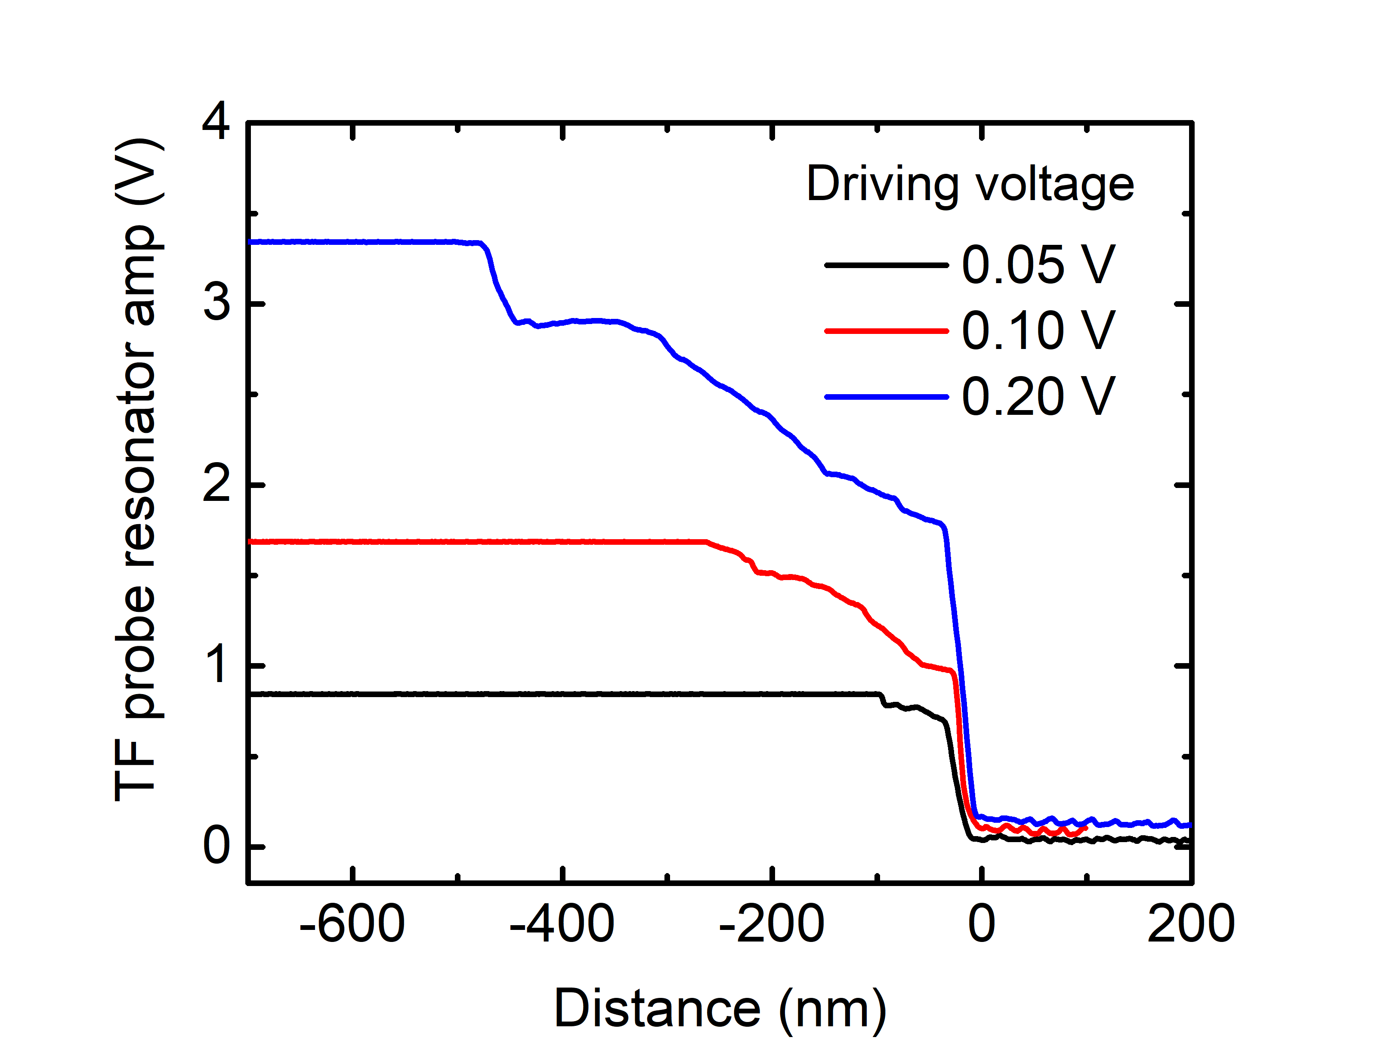
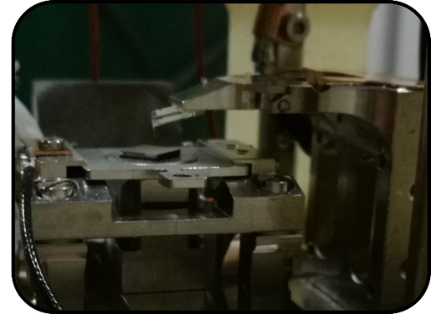
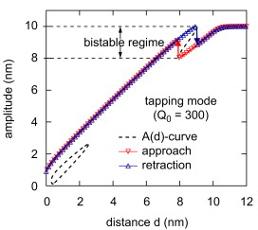
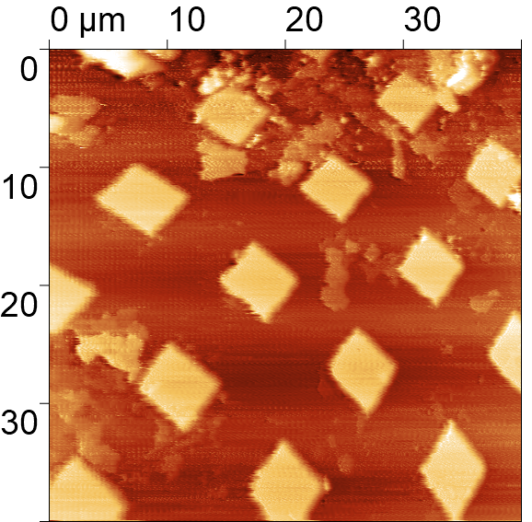
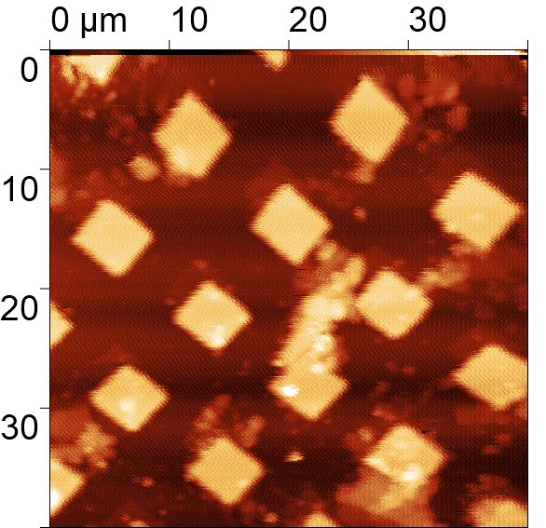
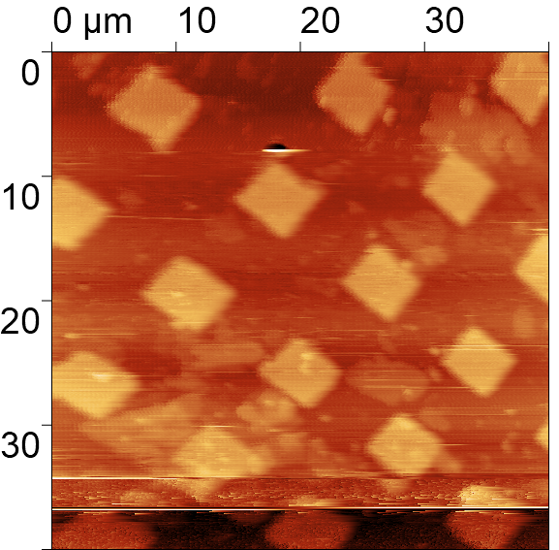
Measurement of amplitude vs distance curves
Classical AFM cantilever
Approaching
Approaching
TF probe
Sample
SPM measurement of calibration sample with TF probes at RT
In nitrogen bath (84 K)
Height of squares is 120 nm
Height of squares is 120 nm

Slide 5
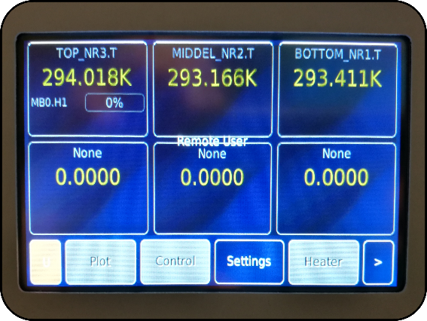
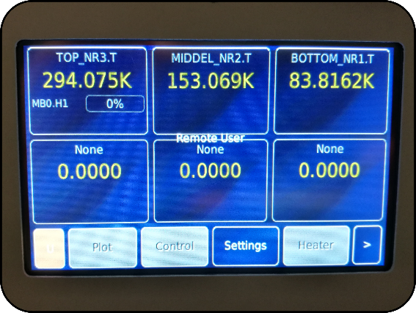
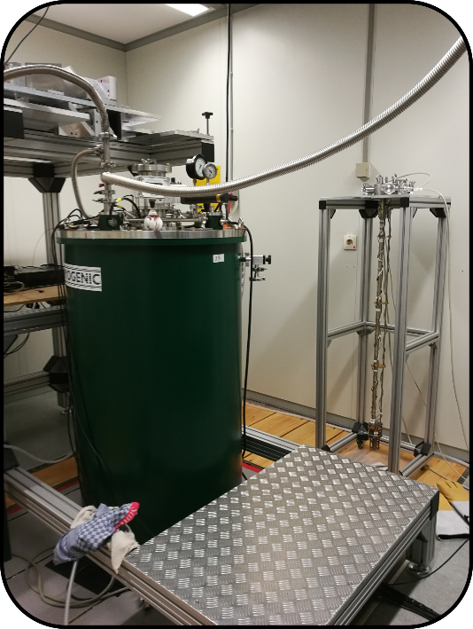
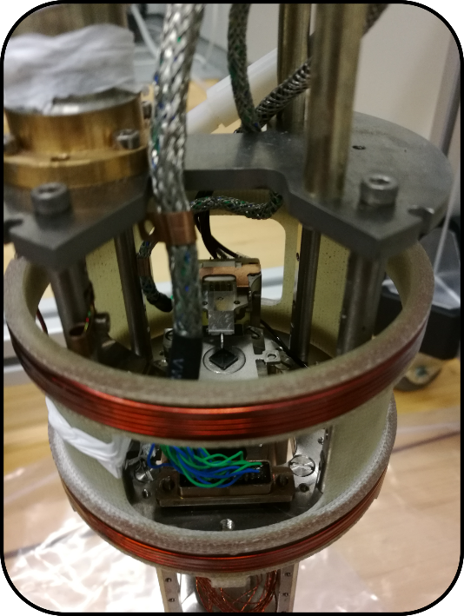
Temperature response
in nitrogen bath
Installing and testing of NTC temperature sensors
Room temperature
Top
Middle
Bottom
Top sensor
Middle sensor
Nitrogen bath
SPM probe + probe holder
Bottom sensor
Sample
TF probe
Sample
SPM unit

Slide 6
Sample preparation in Brno – NiFe discs (fabricated by Peter Kepic)
Samples:
for PETER setup
10x10 mm undoped Si with 3x3 mm field of NiFe discs
10x10 mm quarz substrate with 3x3 mm field of NiFe discs
3x3mm undoped Si with 3x3 mm field of NiFe discs
3x3 mm quarz substrate with 3x3 mm field of NiFe discs
Discs thickness - 115 nm
Reference for HFEPR setup

Slide 7
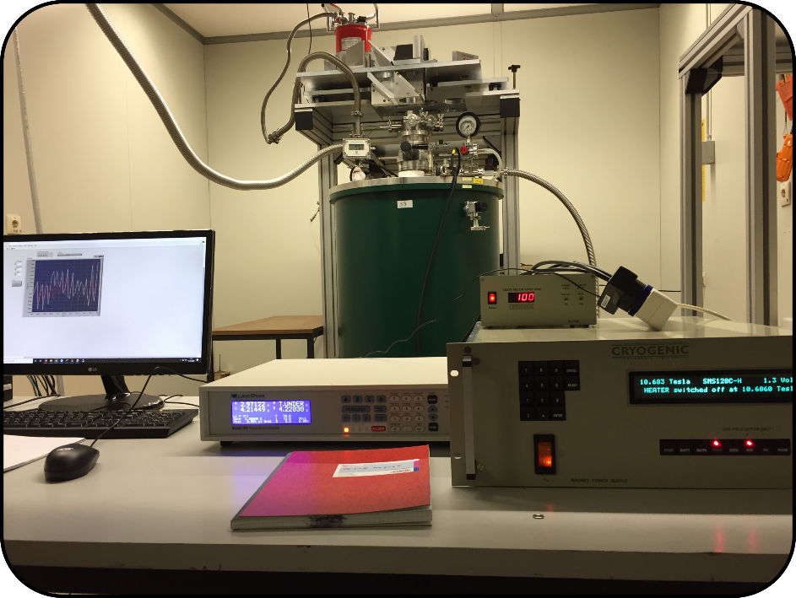
PETER laboratory
Microwave waveguide
PETER sample rod
with SPM unit
SPM probe + probe holder
Bolometer
Microwave quasi-optics
Sample
Superconducting magnet, 0 - 12 T (Cryogenic Ltd.)
with cryostat enabling EPR measurements from 4 K to RT
SPM unit
Piezoscanner + stepping motors
Coils for magnetic field modulation

