Slide 1

Fabrication of 5 μm disks from Permalloy and Copper phthalocyanines
PETER project
Peter Kepič, Jiří Liška, Tomáš Krajňák, Martin Konečný, Jan Čechal, Tomáš Šikola
Brno PETER meeting 2021/04/29

Slide 2
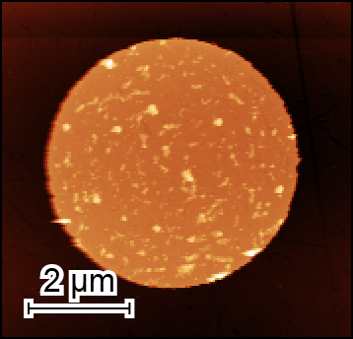
Fabrication of Permalloy disks, film (done)
Peter Kepič
Resist
NiFe
NiFe disk
Fused silica
Fused silica
Fused silica
Fused silica
Fused silica
Substrate
cutting & cleaning
(Acetone, IPA, ultrasound)
Resist spincoating & EBL
CSAR AR-P6200.09
Developing
AR 600-564
+ IPA + DEMI
NiFe deposition
E-Beam Evaporator
Lift-off
Dioxolane for CSAR (AR 600-71)
Final sample (I.)
Sample (II.)
NiFe disks in central area 3x3 mm²
Diameter 5 μm, Pitch 80 μm
Height 90 nm
Fused silica substrate 10x10x0.5 mm³

Slide 3
Fabrication of Copper phthalocyanines (CuPC) disks
JL, Tomáš Krajňák, Peter Kepič
Resist
CuPC
CuPC disk
Silicon
Silicon
Silicon
Silicon
Silicon
Substrate
cutting & cleaning
(Acetone, IPA, ultrasound)
Resist spincoating & EBL
CSAR AR-P6200.09
PMMA AR-P649.04
PMMA AR-P679.04
Developing
AR 600-564
AR 600-56
+ IPA + DEMI
CuPC deposition
MBE in UHV
(sample space limitation)
Lift-off
× Dioxolane for CSAR (AR 600-71),
CuPC destroyed quickly
OK Acetone for PMMA CuPC, destroyed slowly
Expected sample
Diameter 5 μm
Height ~100 nm
Pitch 10 μm

Slide 4
Fabrication of Copper phthalocyanines (CuPC) disks
JL, Tomáš Krajňák, Peter Kepič
Resist
CuPC
CuPC disk
Silicon
Silicon
Silicon
Silicon
Silicon
Substrate
cutting & cleaning
(Acetone, IPA, ultrasound)
Resist spincoating & EBL
CSAR AR-P6200.09
PMMA AR-P649.04
PMMA AR-P679.04
Developing
AR 600-564
AR 600-56
+ IPA + DEMI
CuPC deposition
MBE in UHV
(sample space limitation)
Lift-off
× Dioxolane for CSAR (AR 600-71),
CuPC destroyed quickly
OK Acetone for PMMA CuPC, destroyed slowly
Expected sample
Diameter 5 μm
Height ~100 nm
Pitch 10 μm

Slide 5
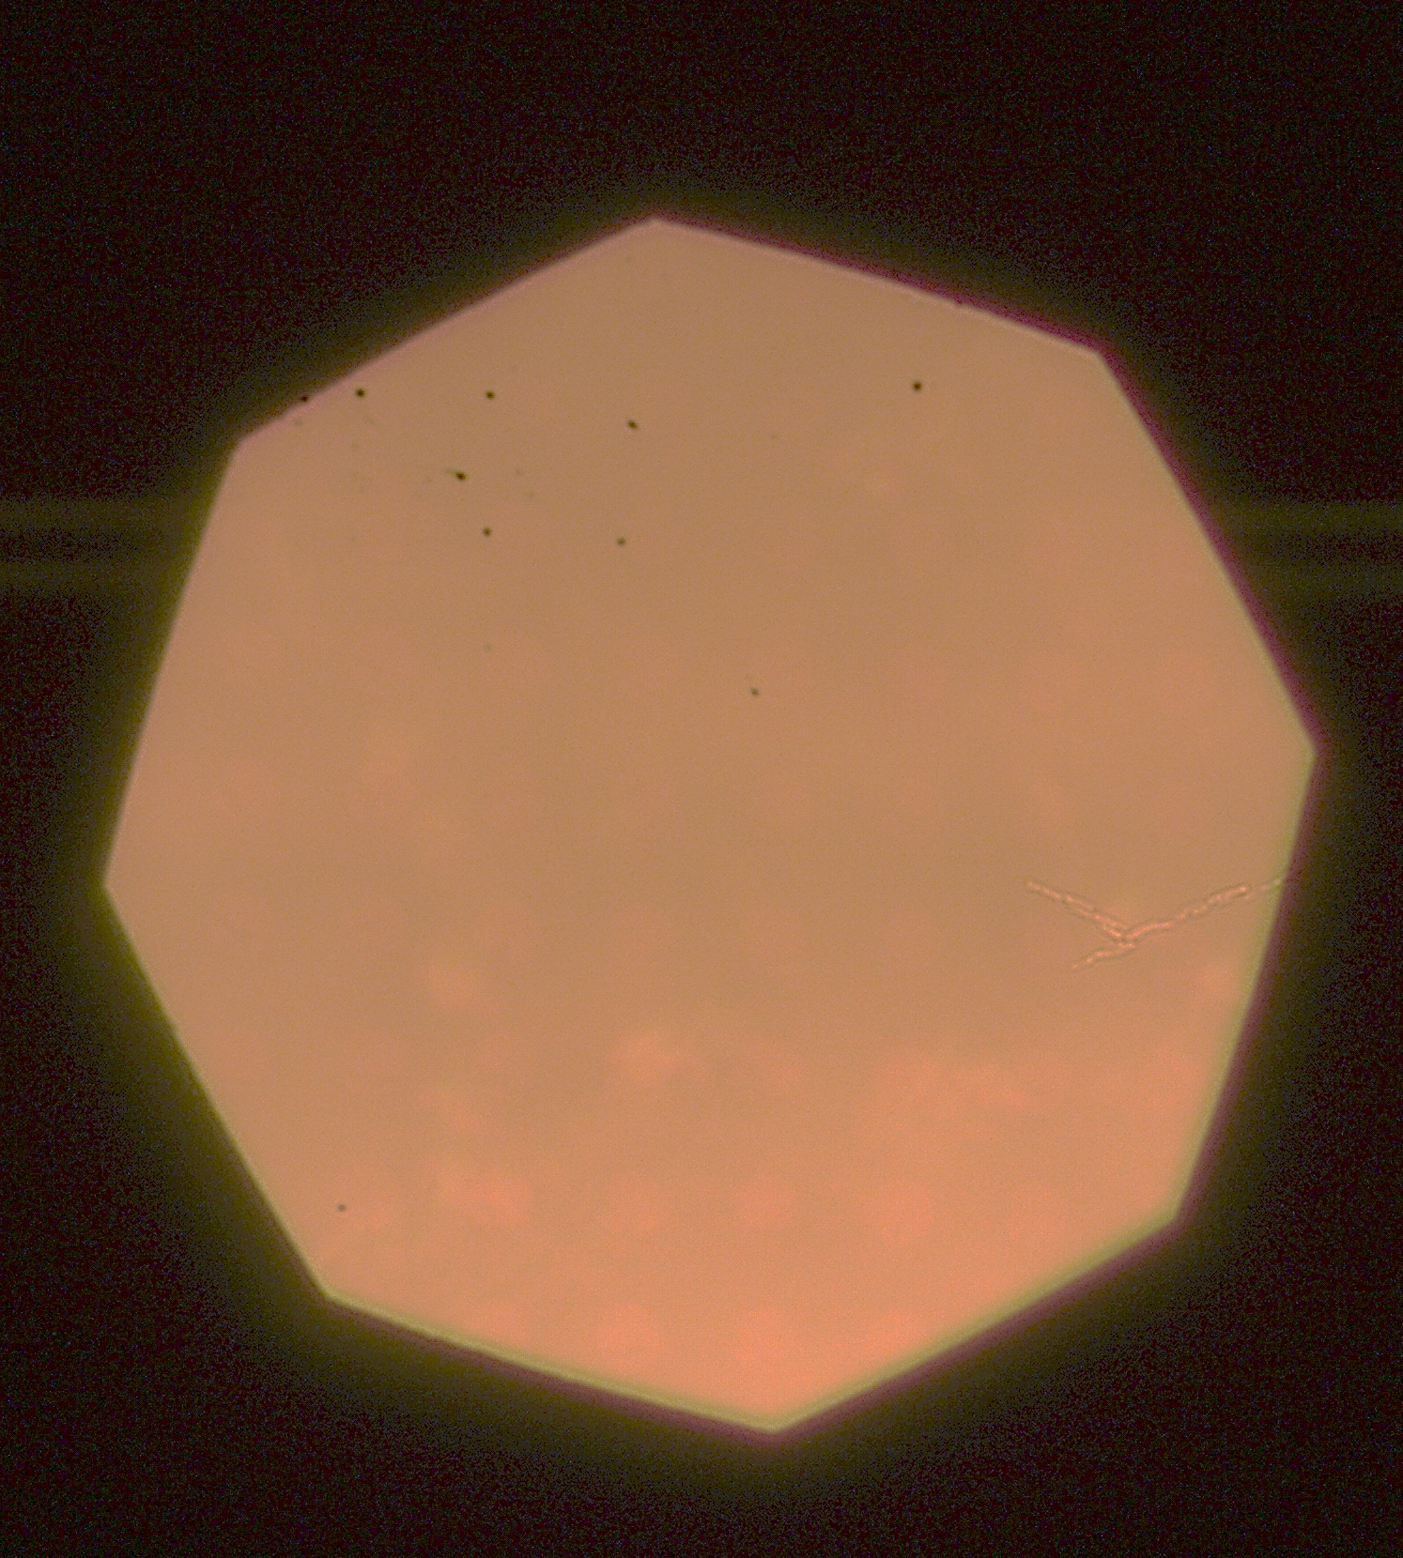
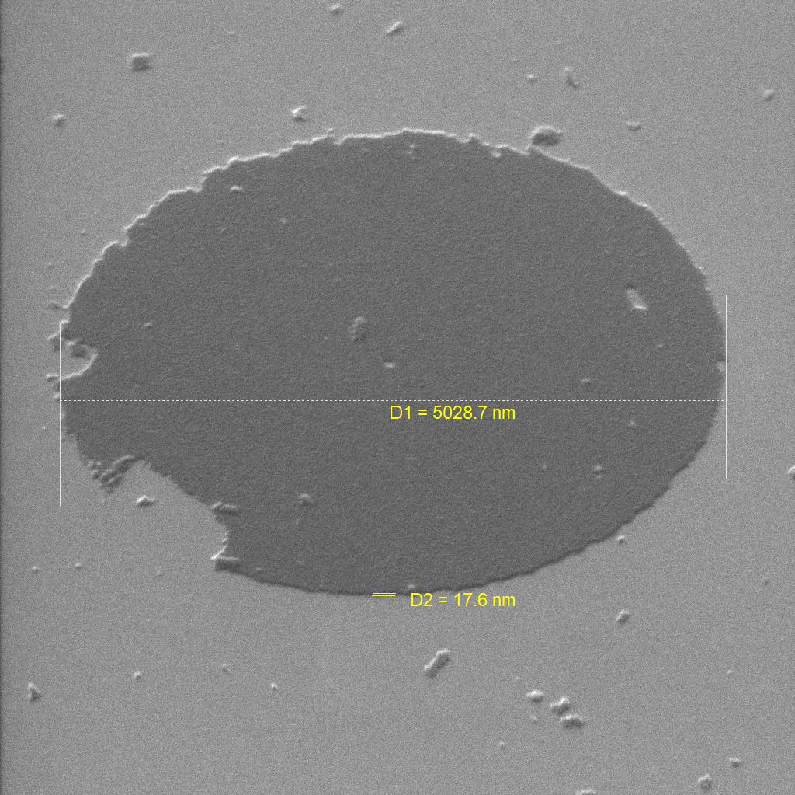
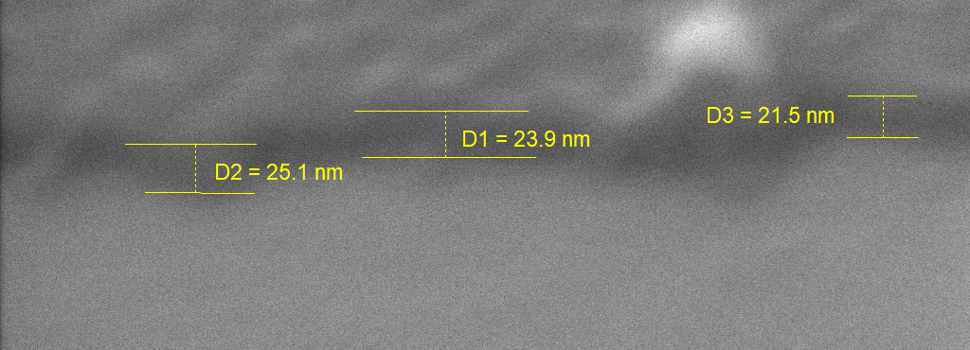
CuPC disks (optimization in progress)
JL, Tomáš Krajňák, Peter Kepič
Silicon substrate (3x3 mm²), PMMA AR-P 649.04, CuPC deposition (30 min), Lift-off using Acetone (10 s, ultrasound)
CuPC disk
~15 nm
Silicon
CuPC disks stable in SEM
In-beam BSE (poor contrast)
Very faint CuPC disks present
in optical microscopy BF/DF
15-25 nm

Slide 6
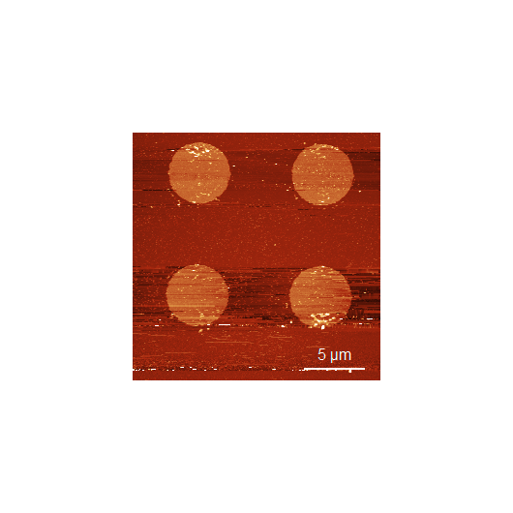
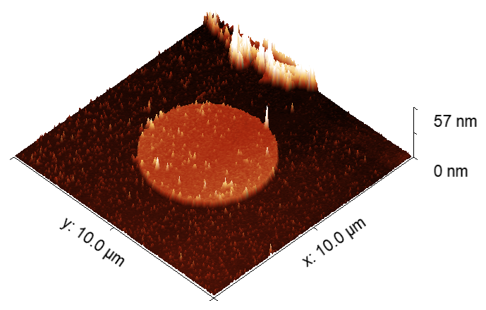
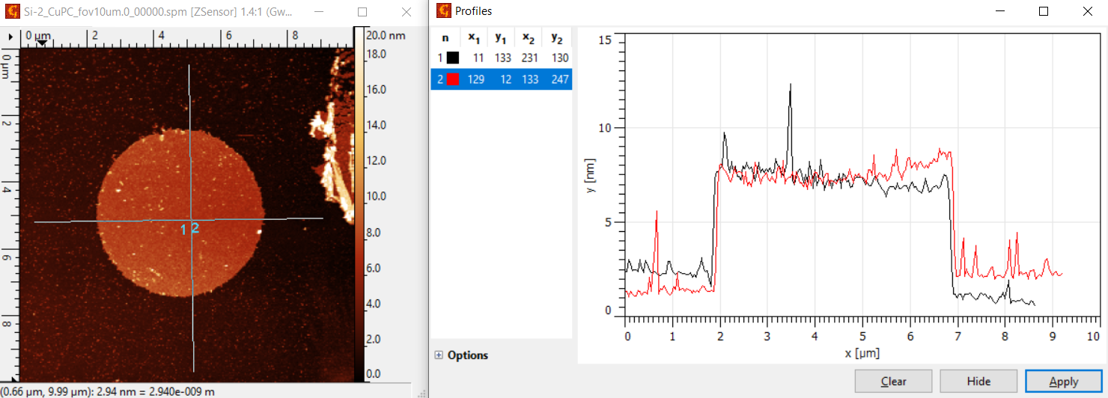
CuPC disks (optimization in progress)
JL, Tomáš Krajňák, Peter Kepič
Silicon substrate (3x3 mm²), PMMA AR-P 649.04, CuPC deposition (15 min), Lift-off using Acetone (60 s)
CuPC disk
~7 nm
Silicon
6-8 nm

Slide 7
Near future (close to finish)
JL, Tomáš Krajňák, Peter Kepič
Finishing fabrication 2 samples with appropriate thickness of CuPC film/disks (EBL done, CuPC deposition in progress – material refilled, pumping, new calibration, degassing)
Silicon or fused silica substrate is tested
Sample (III.)
Sample (IV.)
CuPC film in central area 3x3 mm²
Thickness ~100 nm,
Si/Fused silica substrate 10x10x0.5 mm³
CuPC disks in central area 3x3 mm²
Diameter 5 μm, Pitch 10 μm
Height ~100 nm
Si/Fused silica substrate 10x10x0.5 mm³

