Slide 1

eGrants
Grant management – amendments
HORIZON 2020 Coordinators' Day
12 May 2020
Brussels
Attila BERCZIK
Common Implementation Centre (CIC)
CIC B3 – Common service for business processes
"The views expressed in this presentation are those of the author and do not necessarily reflect the views of the European Commission"

Slide 2
Amendments - key characteristics
    E-flow, paperless, endorsed with e-signature
    No evolution, no negotiation of requests: no modification
    Agreement or rejection
    Request for complementary information
    Time-bound process: 45‑day time limit for processing
    Extension possible
    Tacit rejection - if no reaction within 45 days deadline
    Withdrawal is possible by the requesting party

Slide 3
Request for amendment – in 4 steps
  Launch the amendment preparation in PPGMS
  Prepare – compose amendment
  Consultation – optional
  Sign & Submit the amendment to EU services
Disclaimer: The following screenshots are used for demonstration purposes only.

Slide 4

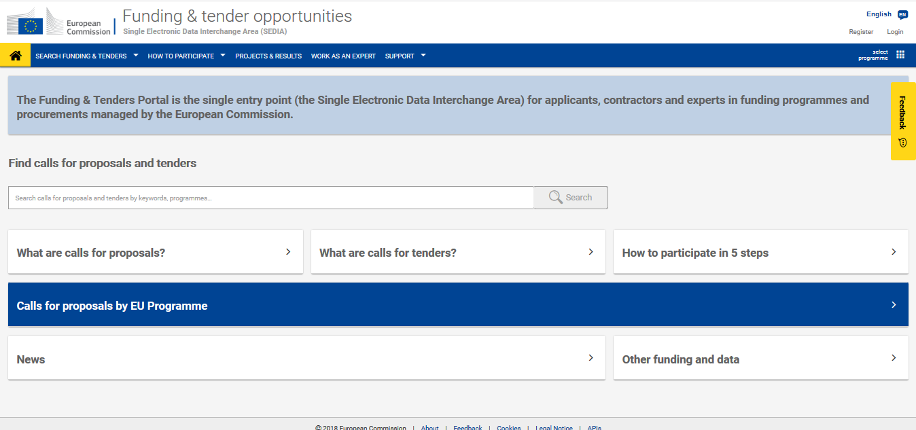
Log in to the Funding & Tenders Portal.

Slide 5

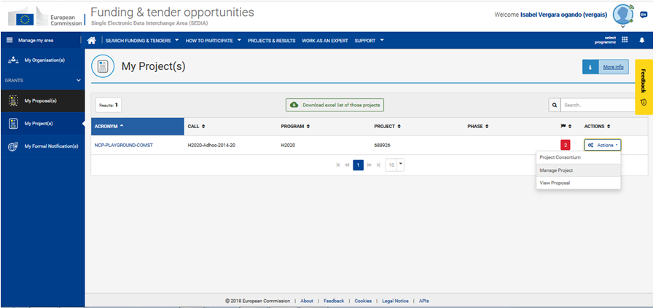
Go to 'My Projects' section.
Then click on Manage Projects in Actions menu

Slide 6
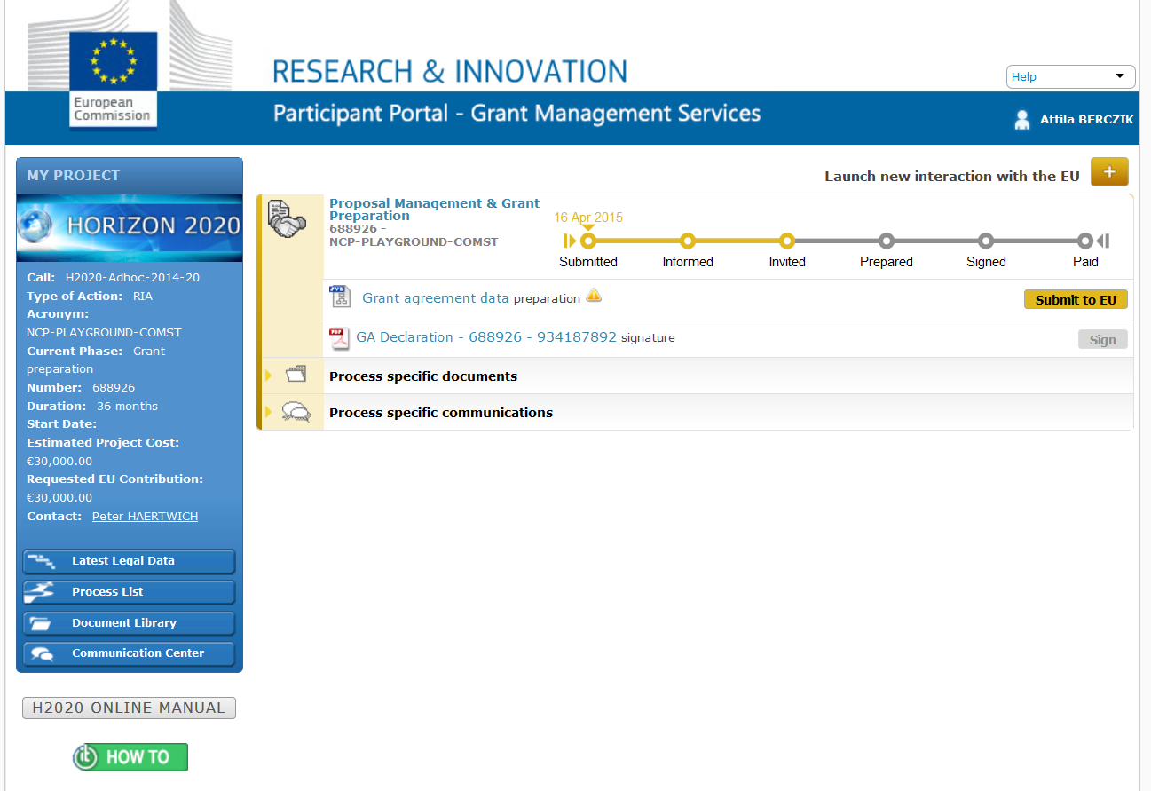
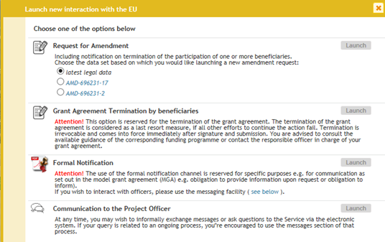
STEP 1: Launch
STEP 1: Launch the amendment preparation
Precondition: The GA is valid and signed by both parties.

Slide 7
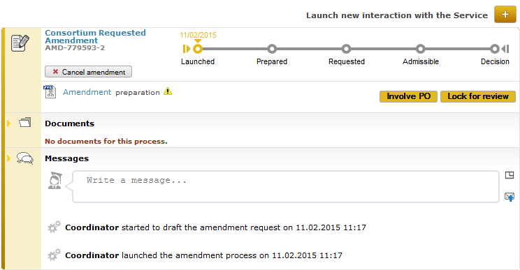

Slide 8
STEP 2: preparation
Automatic selection of the relevant Amendment Types (GA clauses), based on the GA data modified
Listing of relevant (compulsory) supporting documents
Better overview and tracking of all changes
Note: an amendment may consists of a number of possible clauses which are pre-defined

Slide 10
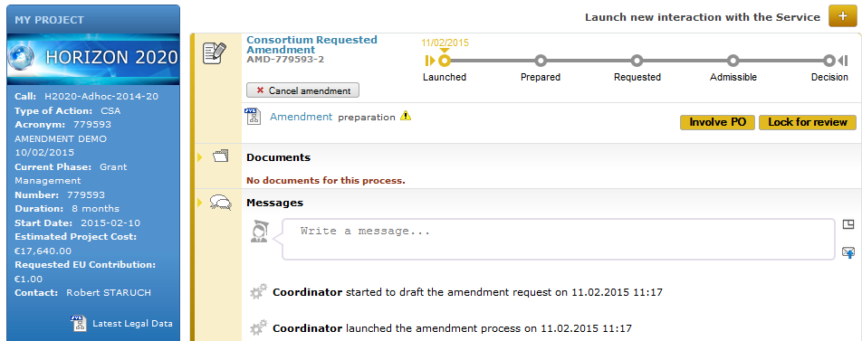
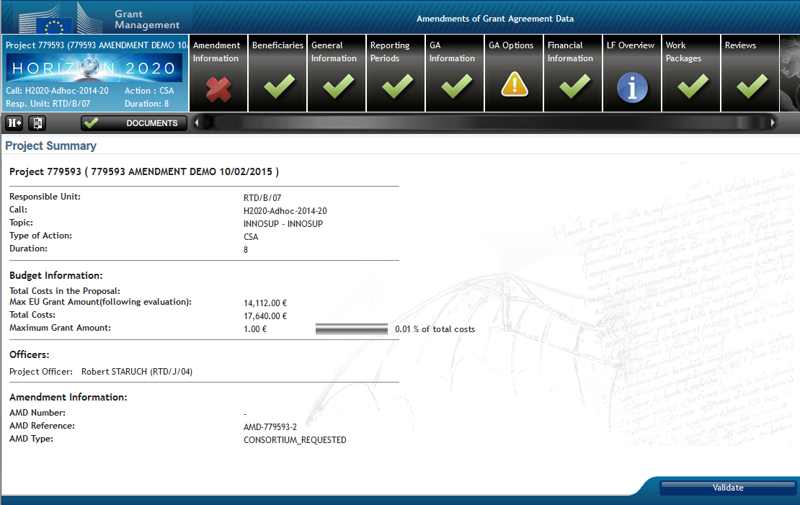

Slide 11
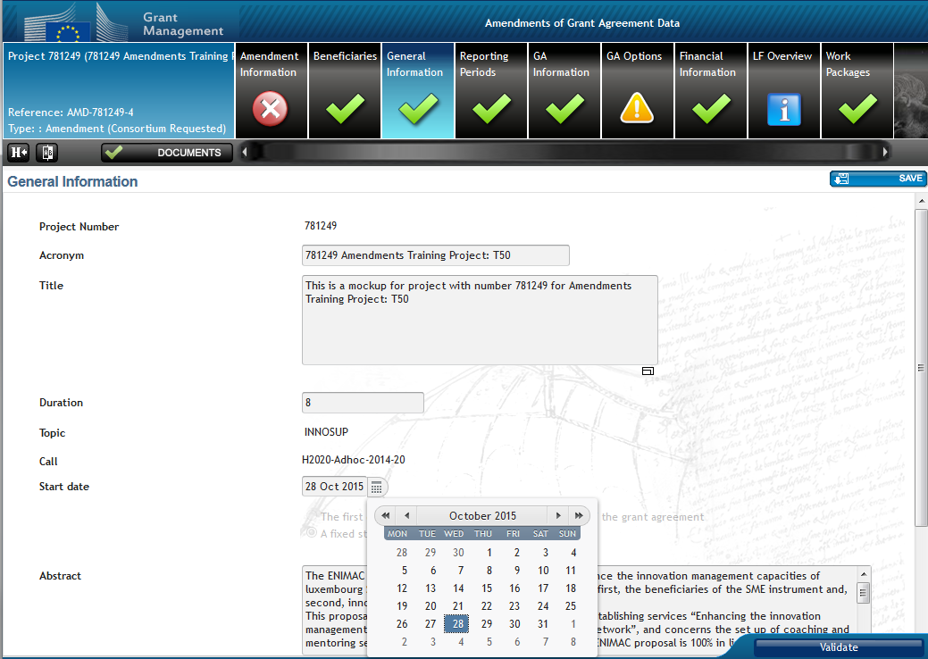
Preparing amendment request:
Example #1 – Change of start date

Slide 12
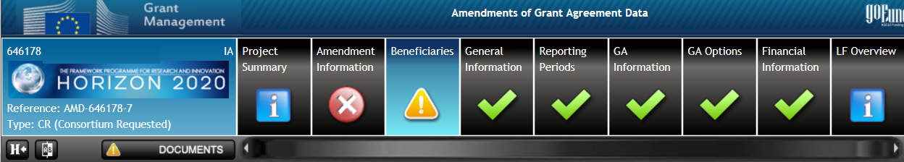

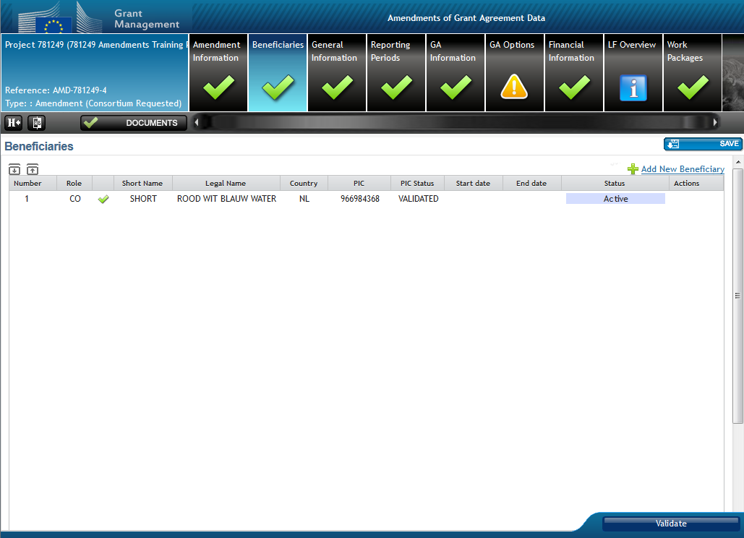
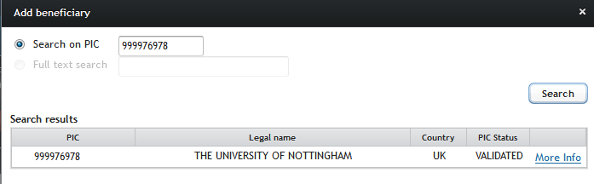
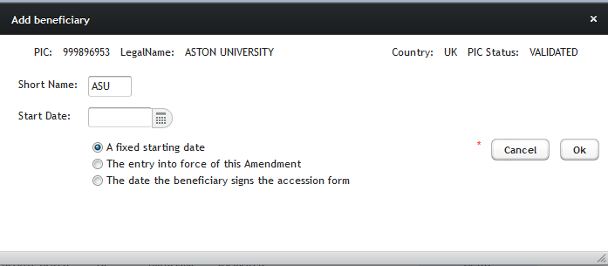
Preparing amendment request:
Example #2 - Addition of new beneficiary

Slide 13


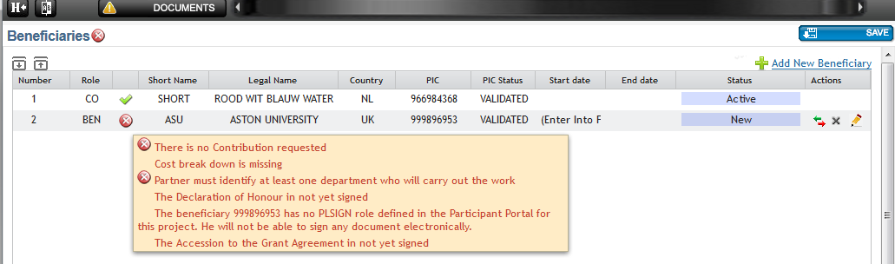
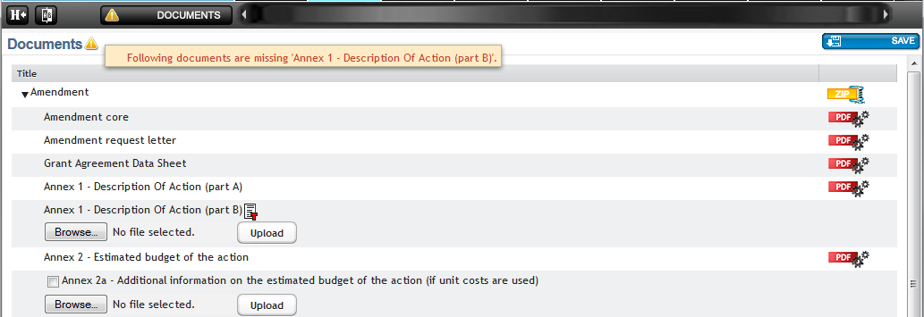
Preparing amendment request:
Example #2 - Addition of new beneficiary
… consequent tasks to do
Inherent obligation:
New Beneficiary must sign
Declaration of Honour
Accession Form see next slide
The It system will prompt for a revised
Annex 1 – description of Action.

Slide 14
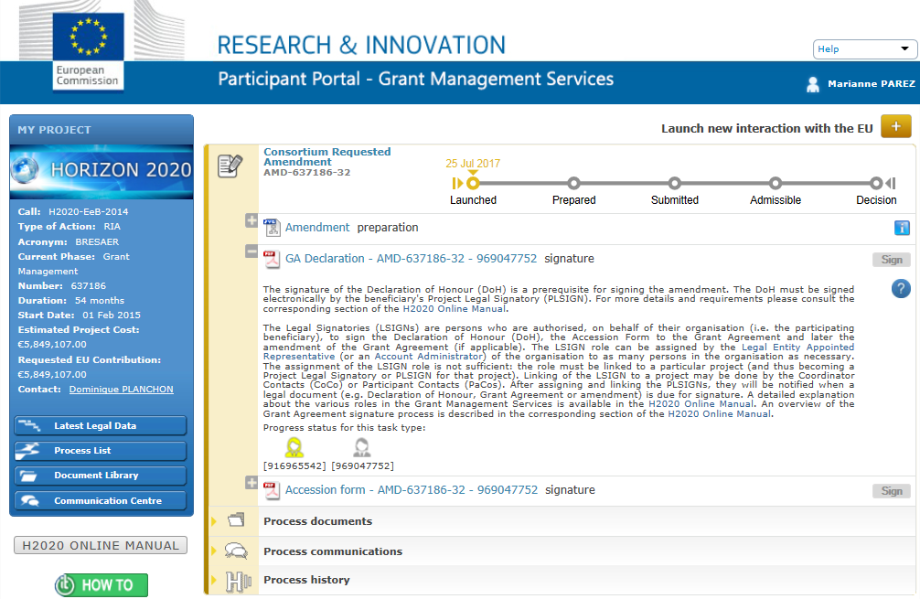
Preparing amendment request:
Example #2 - Addition of new beneficiary
New beneficiary must sign…

Slide 15
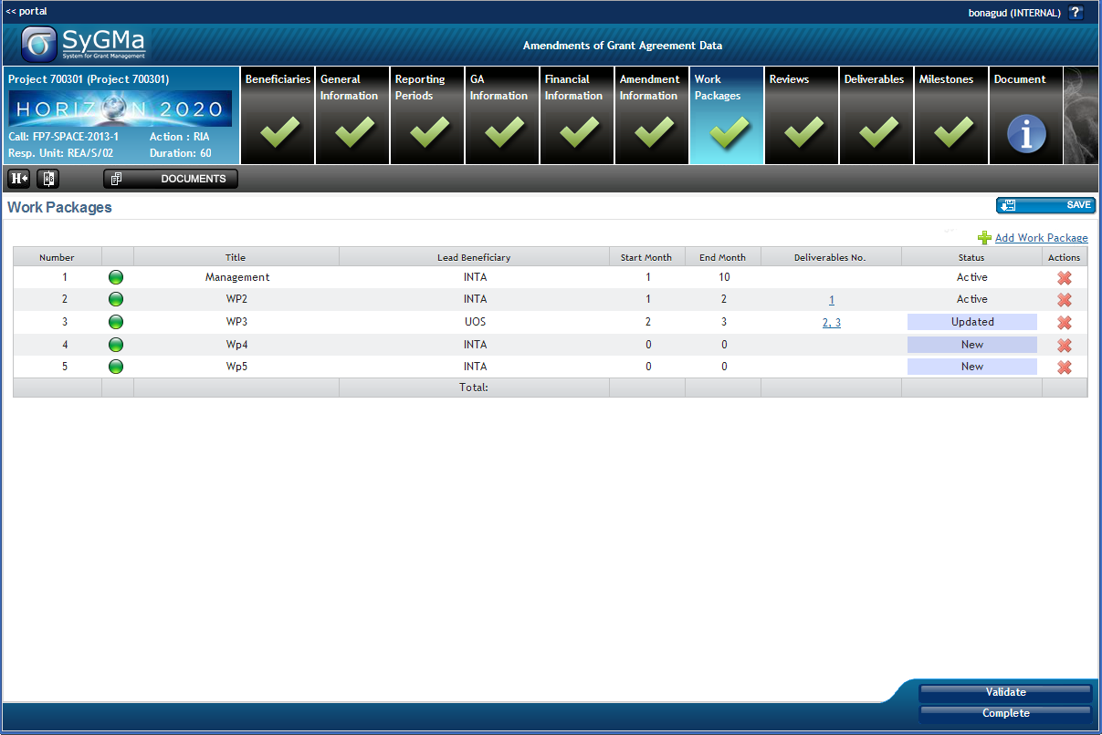
Preparing amendment request:
Example #3 – changes to work packages
Addition
Revision
Deletion

Slide 16
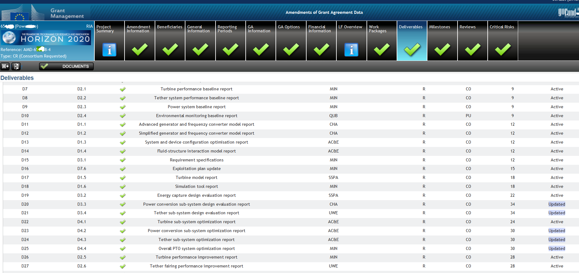
Preparing amendment request:
Example #4 – changes to deliverables
The coordinator may edit exiting one: type, dissemination level, due date, description, link to WPs
'Ethics' type deliverables can only be modified by the EU officer

Slide 17
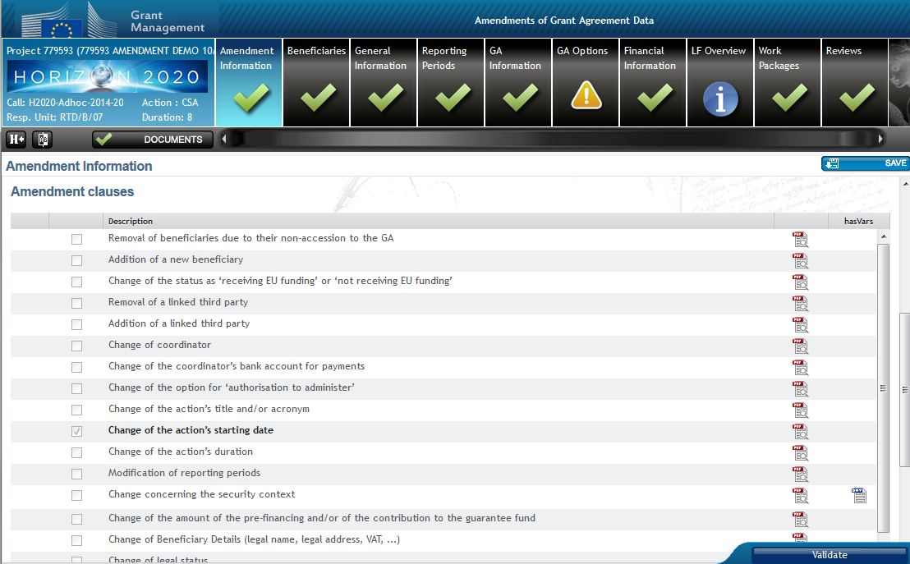
➔ Amendment types are automatically selected
→ Overview of the modifications

Slide 18
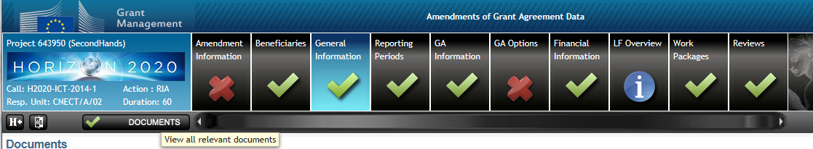
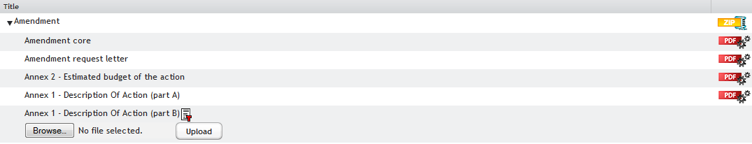
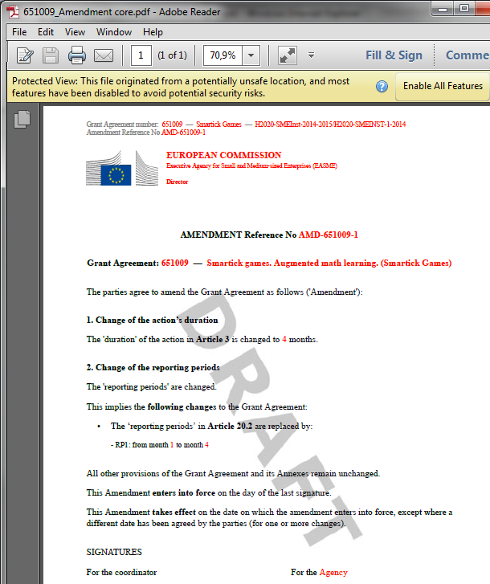
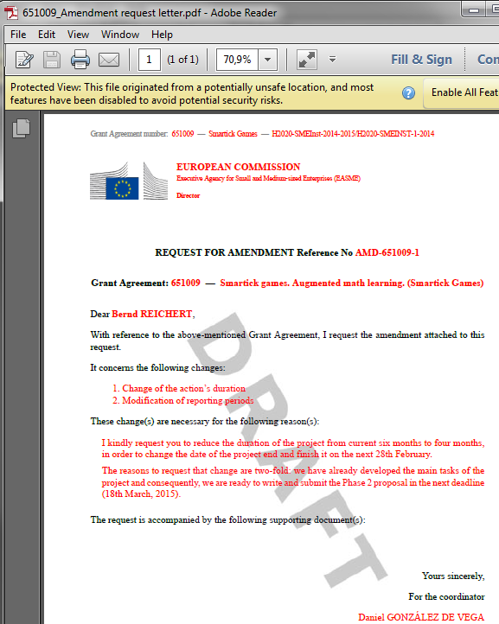
Justification

Slide 19
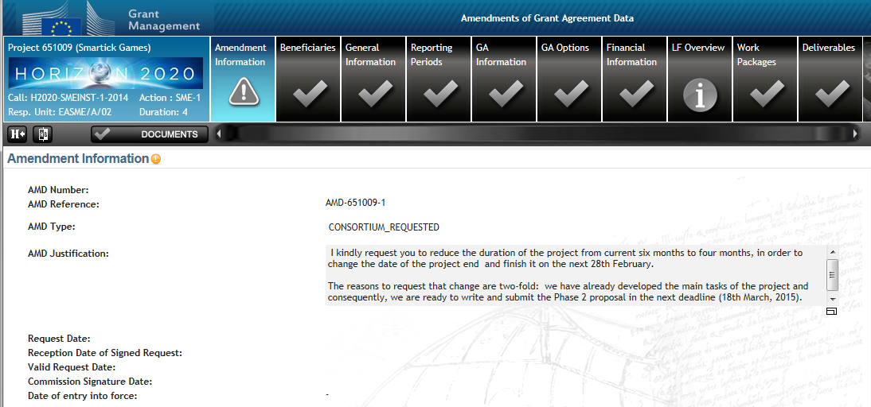
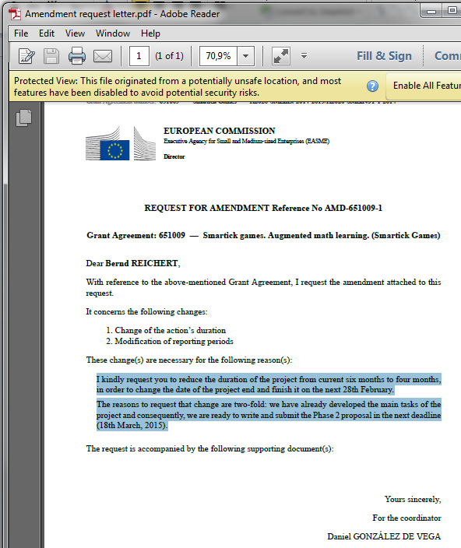
Justification

Slide 20
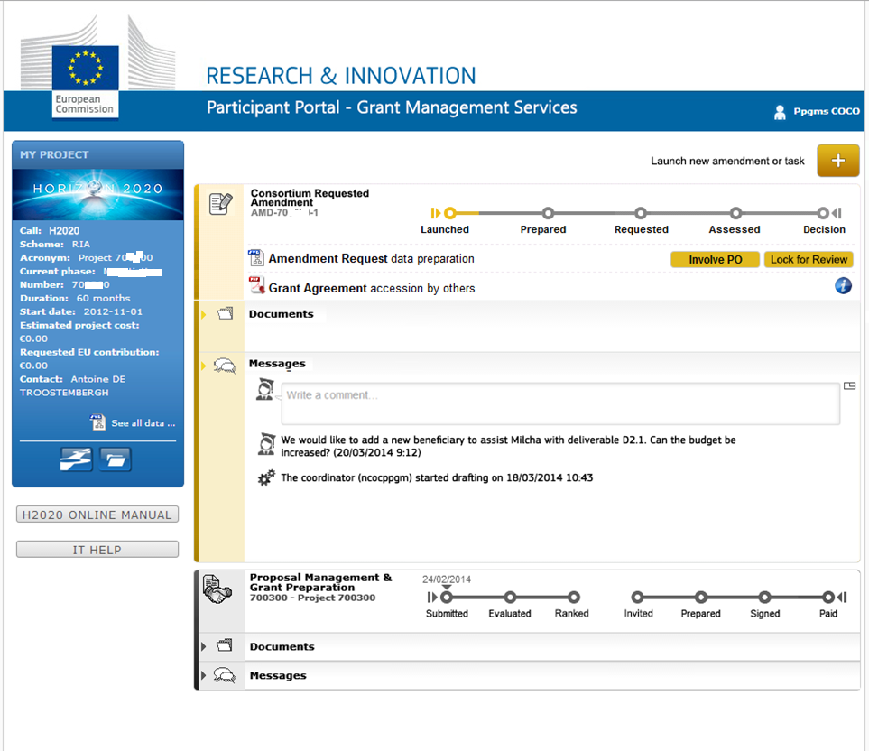
STEP 3: Consultation (optional)
STEP 3: Consultation (optional)

Slide 21
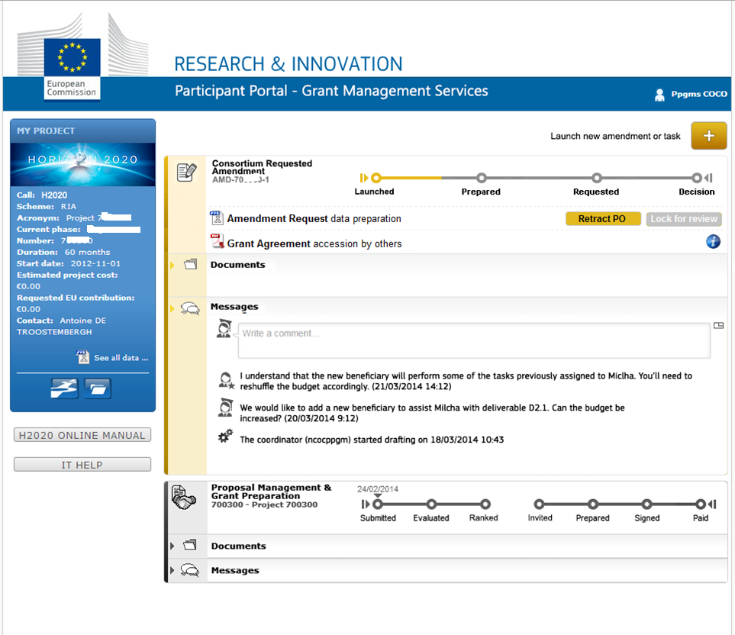

Slide 22
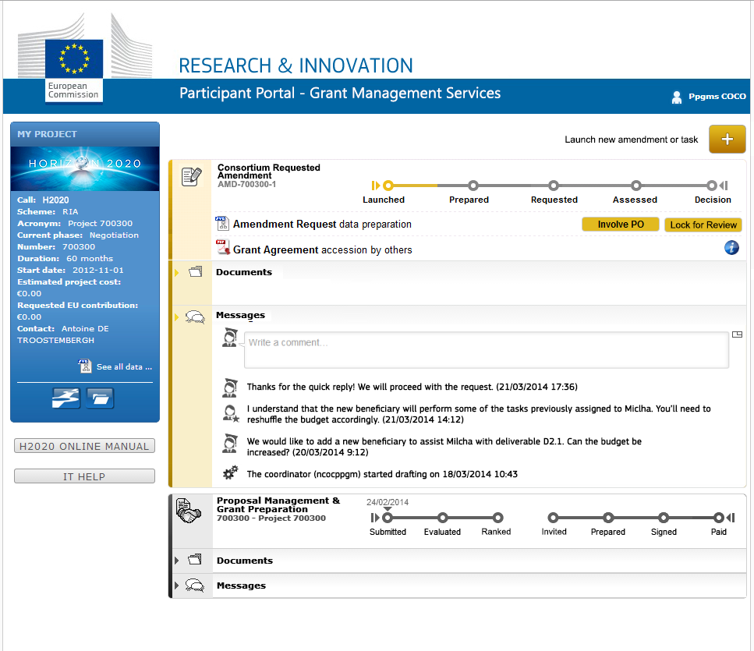

Slide 23
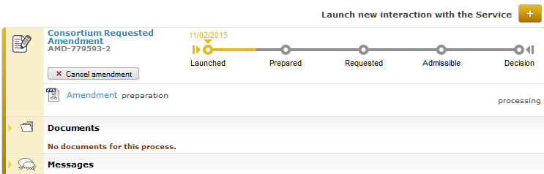
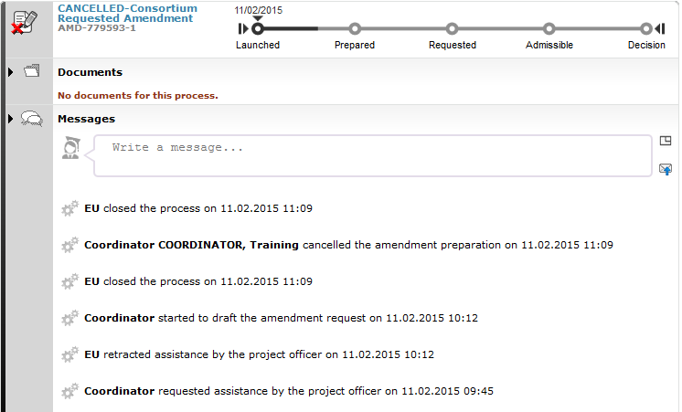
Possibility to cancel at any moment before Signature

Slide 24
STEP 4: Sign and submit
Who: The coordinator PLSIGN (on behalf of the consortium)
How: prompted for e-signature
What: amendment request letter
+
core amendment sealed, signed
The formal submission triggers the 45-days clock

Slide 25
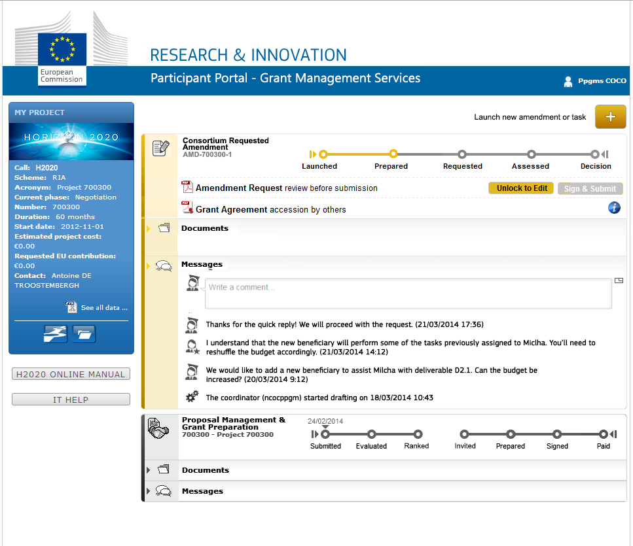

Slide 26
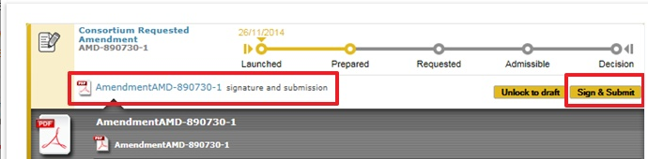
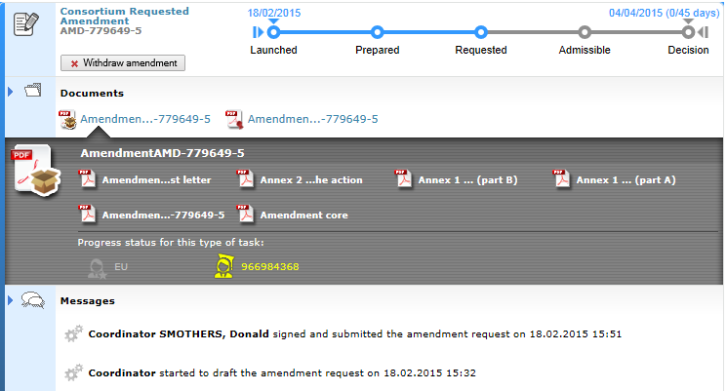

Slide 27
What happens after the submission of the amendment request?
The EU services have 45 (*) calendar days to assess the request.
May request additional information/clarification
May reject the request
May agree and accept it

Slide 28
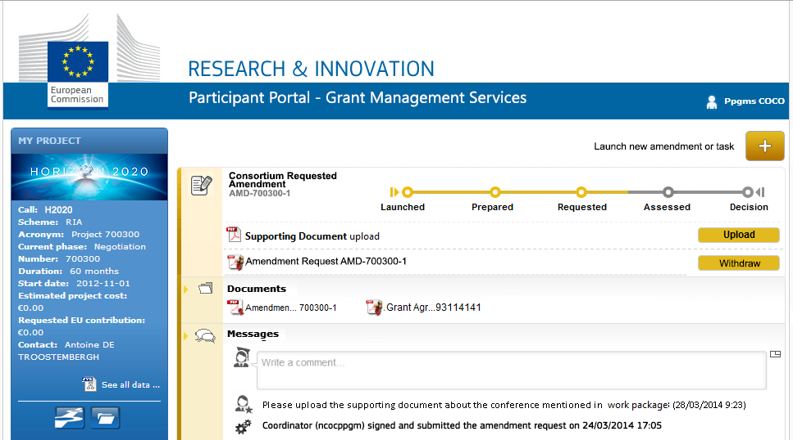

Request for additional information

Slide 29
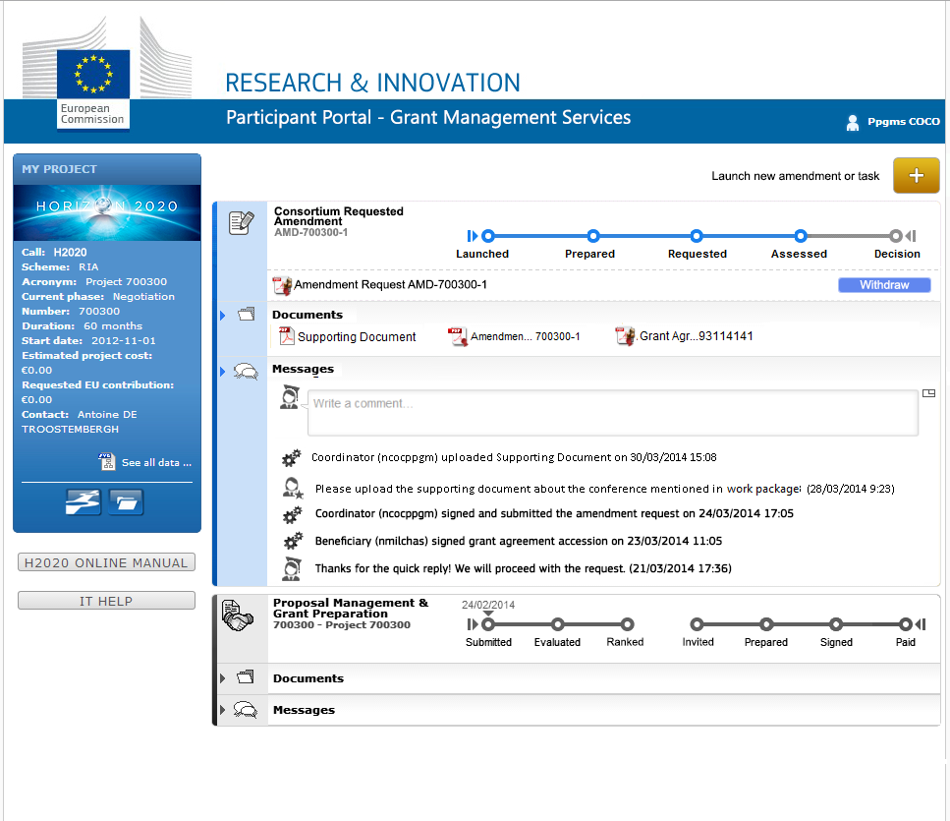


Slide 30
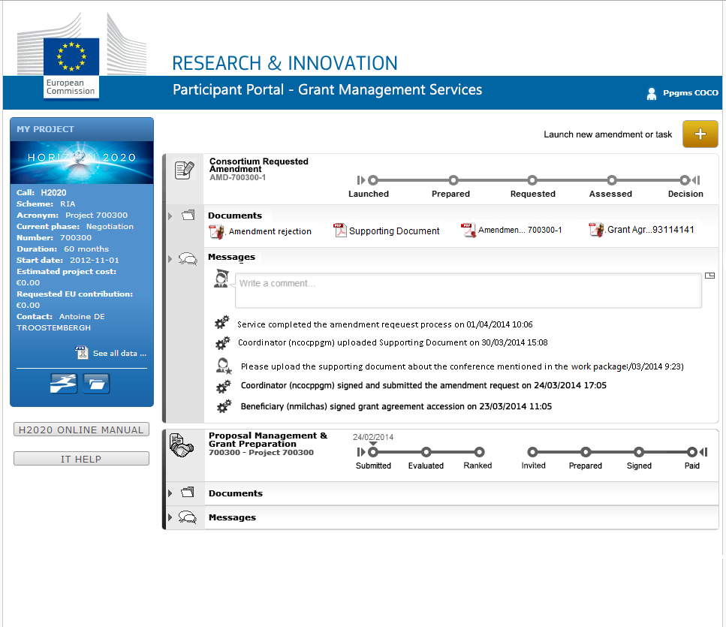
Rejection

Slide 31
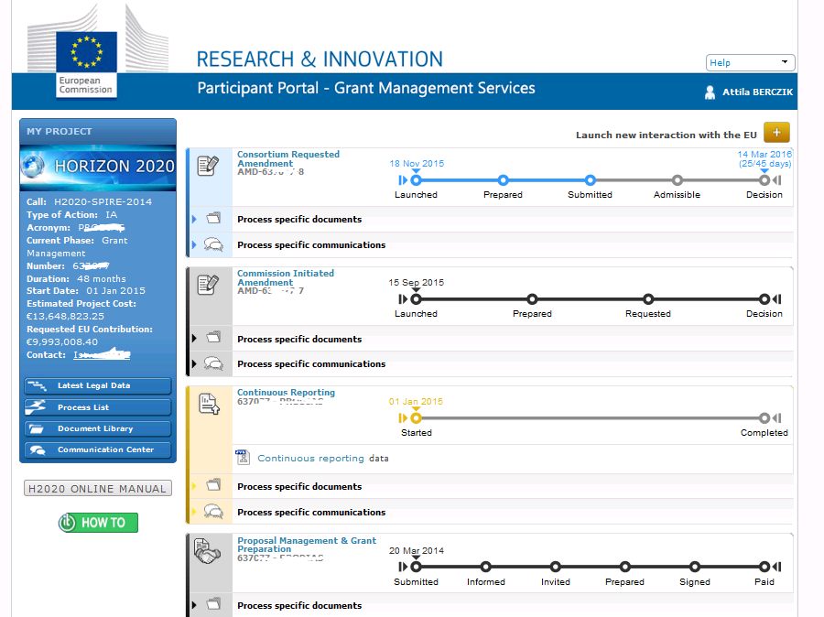
Launching new request after rejection
STEP 1: Launch the amendment preparation
Precondition: The GA is valid and signed by both parties.

Slide 32
Agreement: acceptance of the request
The request will be counter-signed electronically
The coordinator is informed about the acceptance
The grant agreement data is updated in the system according to the amendment.

Slide 33
Clarification:
Termination of participation – MGA Art.50.2
…"The coordinator must formally notify termination…
How?
The formal notification of termination is part of an amendment request. This design allows reflecting the necessary changes which are the results of (due to) the termination of participation and minimize the risk of improper termination.
What happens if the amendment request (to which the formal notification is linked) is being withdrawn or rejected?
The notification of termination is valid. The amendment request may be withdrawn or rejected but the termination remains effective and the system captures the termination date accordingly.

Slide 34
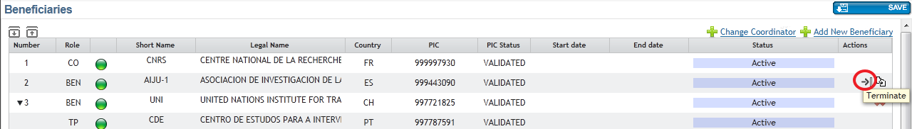
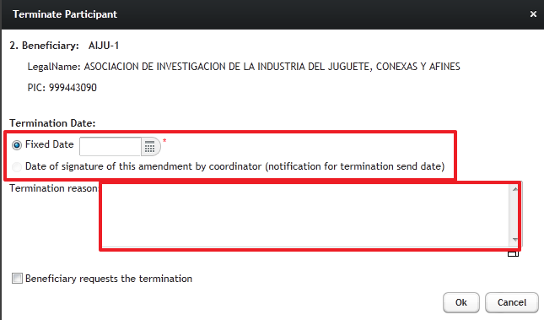
Termination of participation – MGA Art.50.2
End Date must be in the future !!

Slide 35
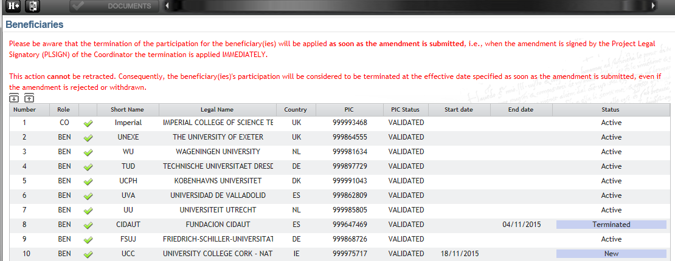
Termination of participation – MGA Art.50.2

Slide 36
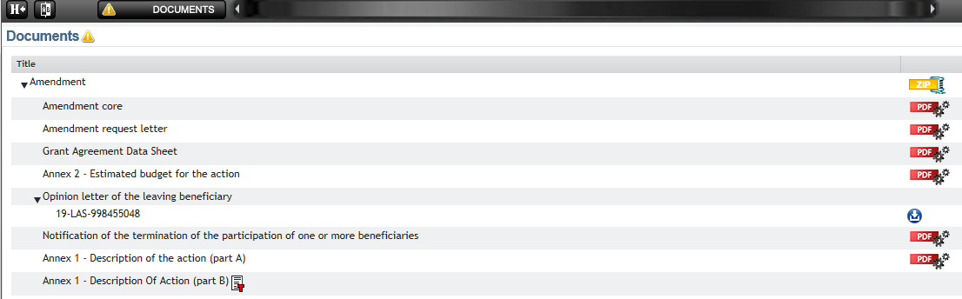
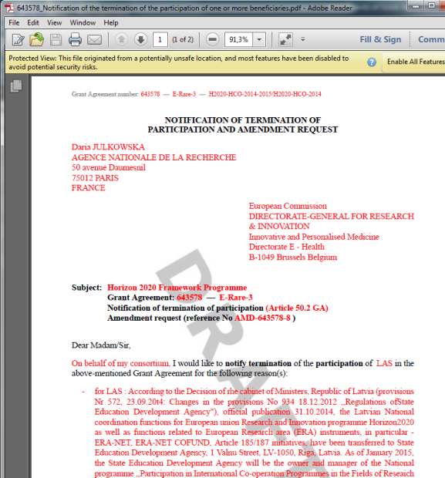
Termination of participation – MGA Art.50.2
Compulsory supporting document: 'evidence' letter

Slide 37

Residual obligation: reporting for terminated beneficiaries
Effective date triggers the reporting obligations
  Deadline
  Beneficiary: "Termination report" containing an overview of the progress of the work, use of resources, individual financial statement of beneficiary (+ any LTP), CFS (when required)
  Coordinator: Report on the distribution of the payments to the beneficiary concerned (not mandatory)
    If not received, it is considered that the coordinator did not distribute any payment to the beneficiary concerned and that the beneficiary concerned must not repay any amount to the coordinator
    The coordinator receives the parts from the beneficiary and is responsible to submit the reports to the EC/EA

Slide 38
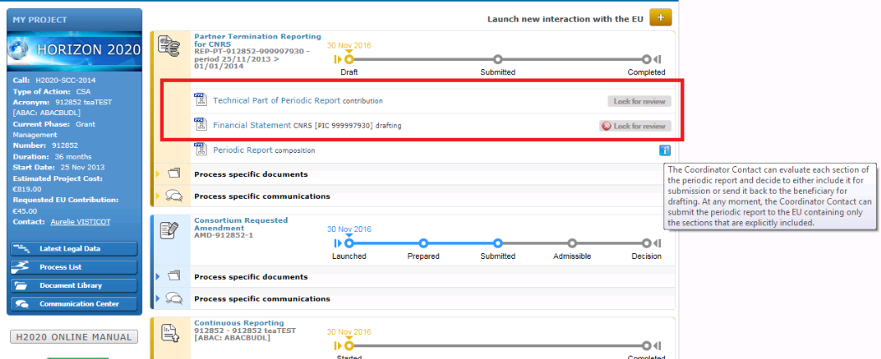
P-GMS – termination reporting

Slide 39
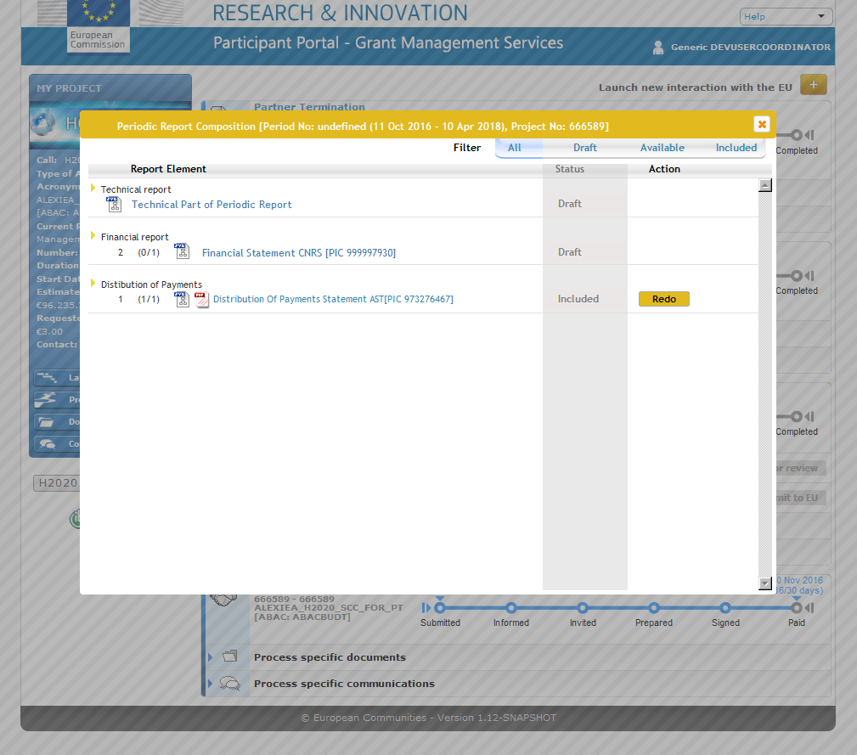
P-GMS – termination reporting coordinator's view

Slide 40
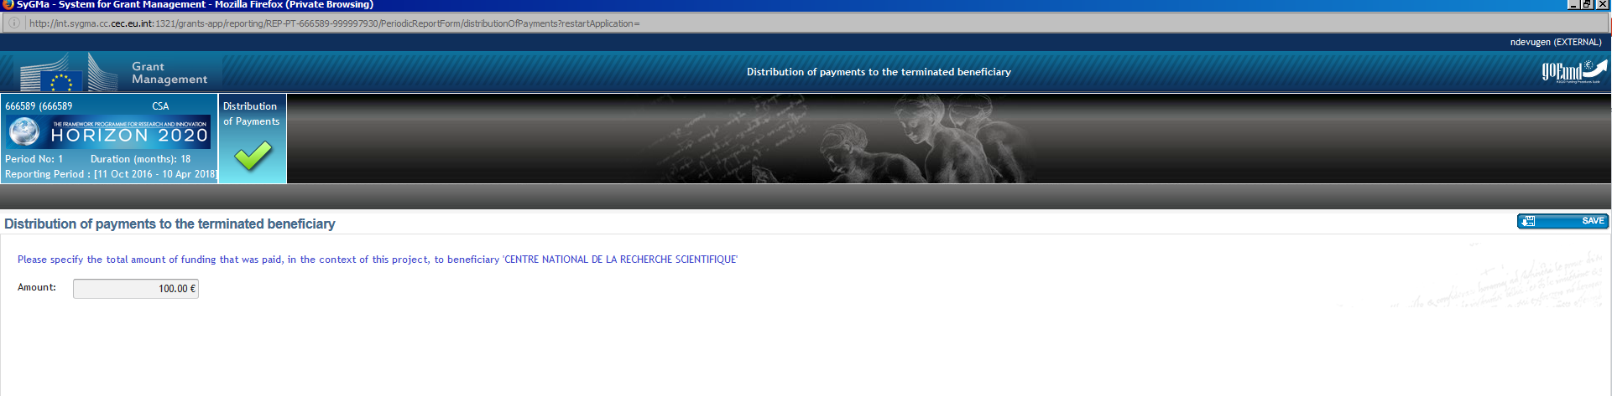
P-GMS – termination reporting coordinator's view

Slide 41
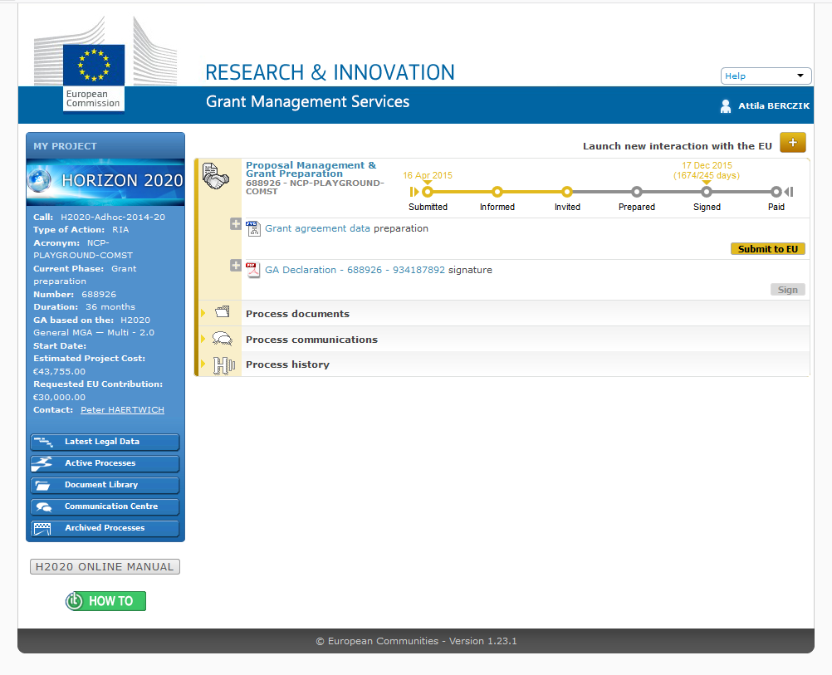

Slide 42
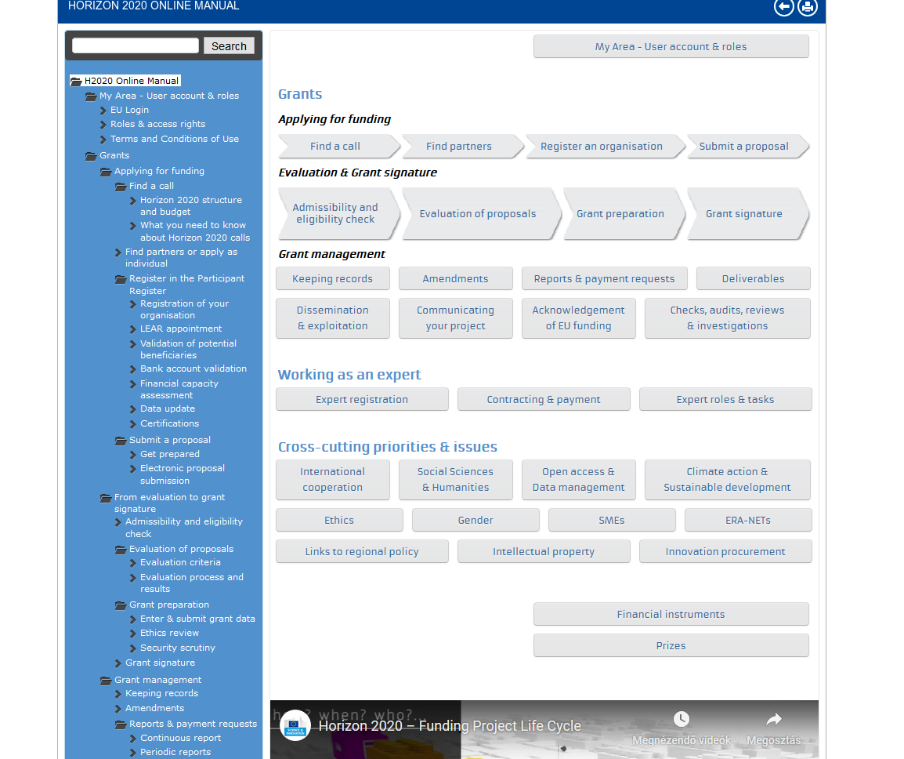

Slide 44
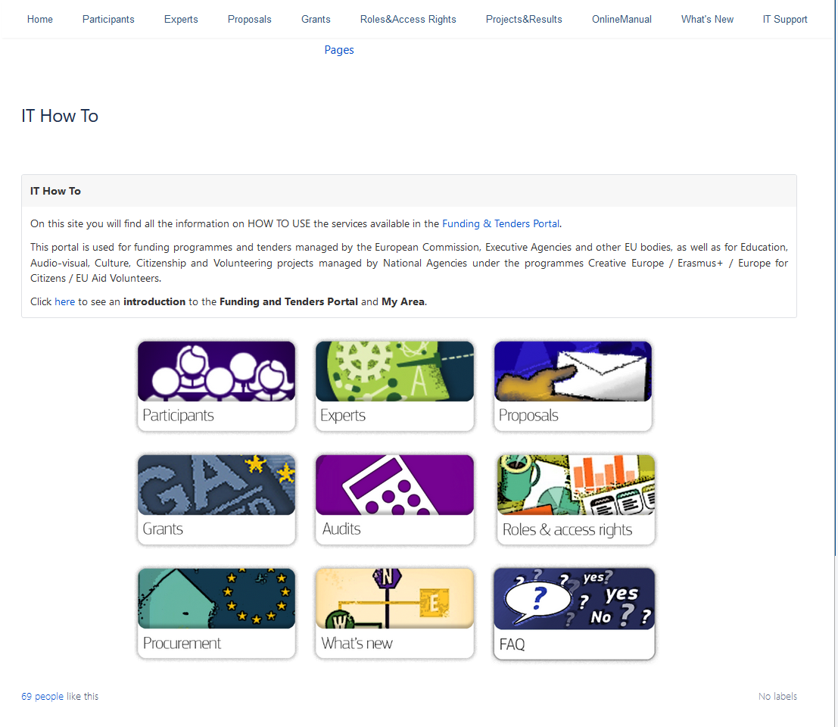

Slide 45

The designed business process and the supporting IT suite helps you to do the right things!
Your role is
TO DO THINGS RIGHT!

