Slide 1
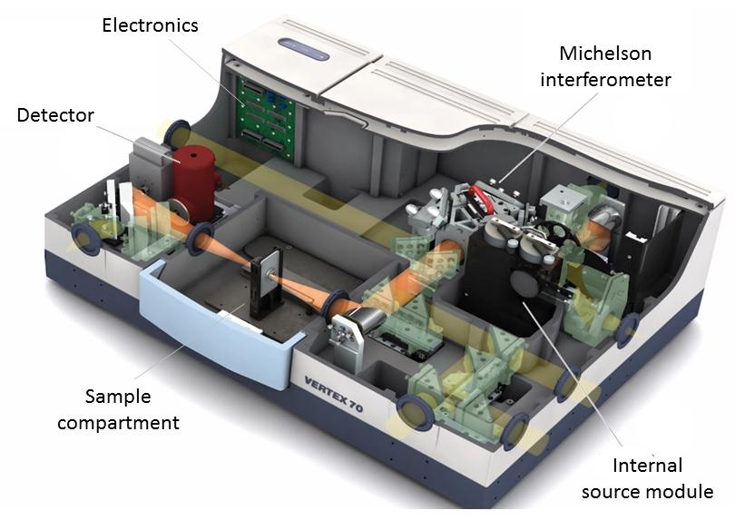
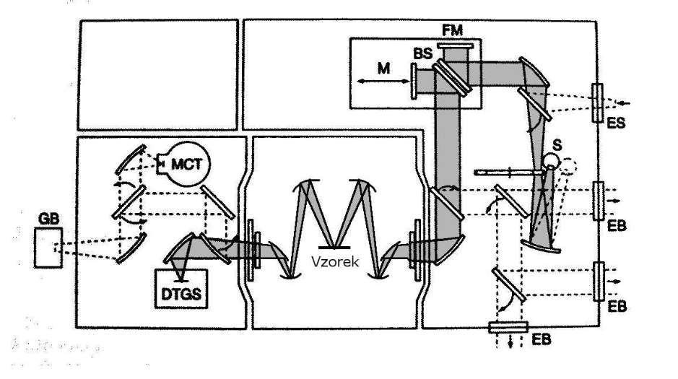
Bruker FTIR Vertex 80v
Light source: Hg-arc lamp
Beamsplitter: Multilayer
Detector: DLaTGS
AOI: cca 10°
Mode: Reflectance (vs Au mirror)
Vacuum: 1.6 mbar

Slide 2
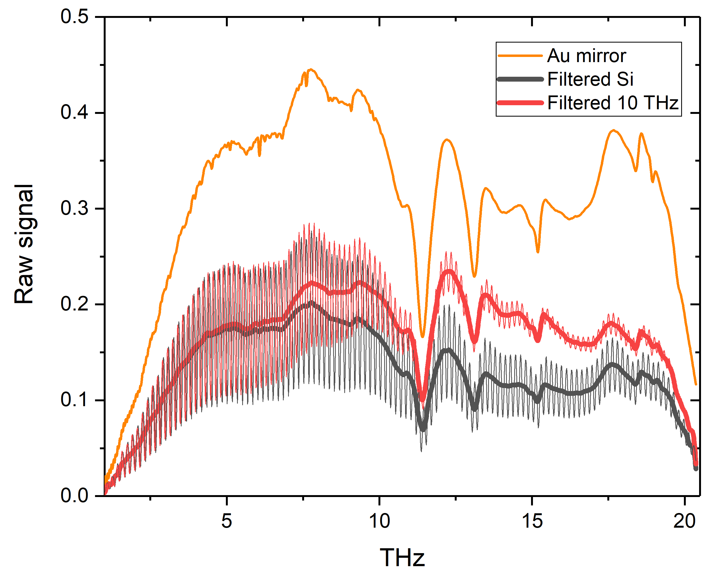
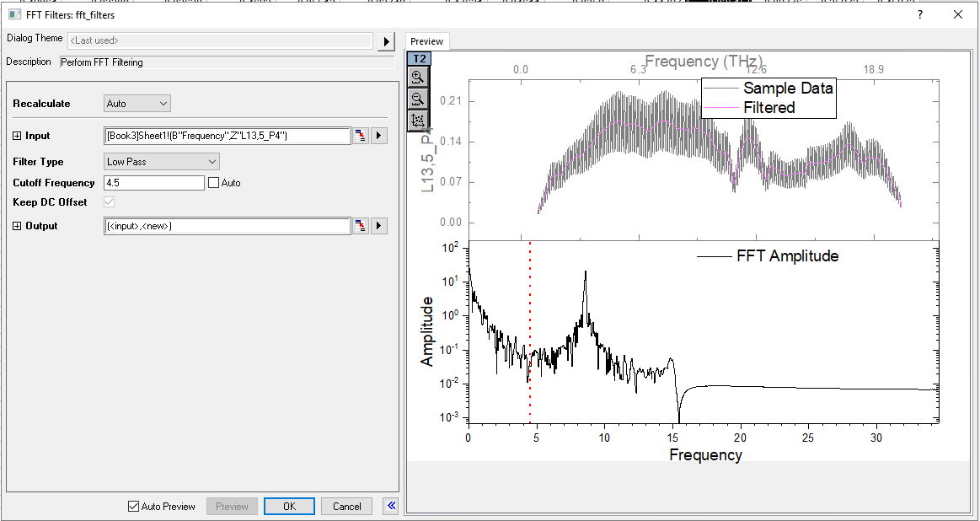
Here are raw FTIR reflectance spectra (Bruker Vertex 80v) of the Au mirror (orange), reference Si substrate sample without antennas (grey), and 10 THz antenna array (red). Our samples show strong Fabry-Perot oscillations that we discard by low-pass FFT filtering (corresponding thick lines). Such filtered spectra of the antenna arrays are then divided by the filtered spectrum of the reference to get relative reflectance shown on slides below. Note that dividing by the Au mirror signal gives similar results (apart from small linear background) and that transmittance measurements (not shown) are fully complementary to these results.

Slide 3
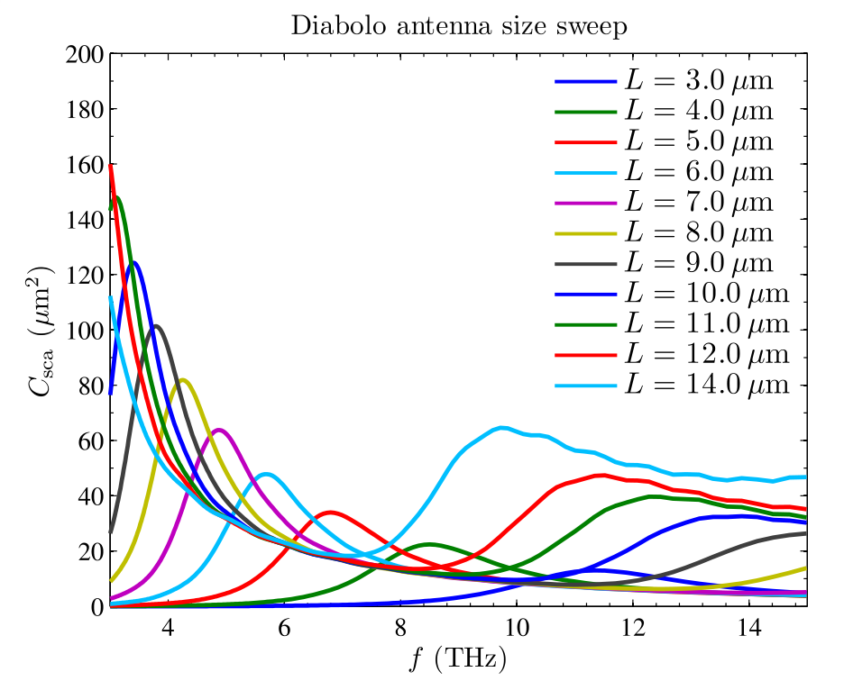
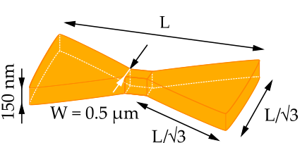
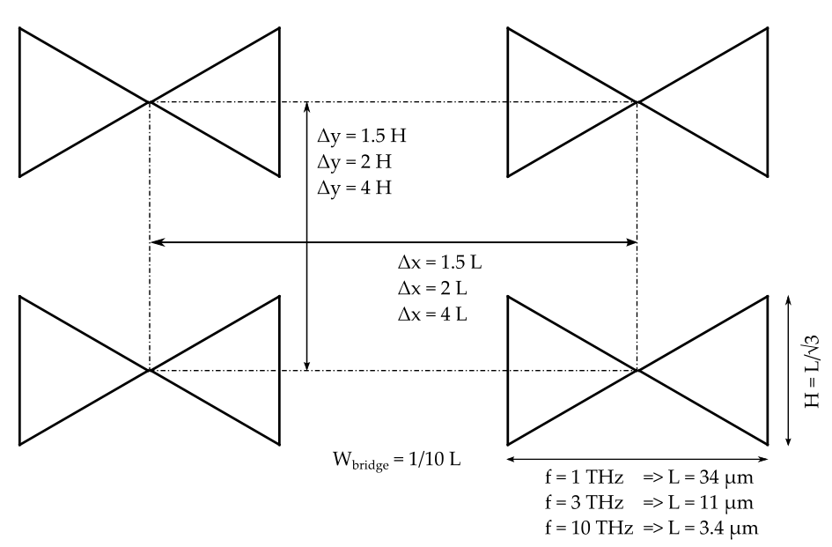
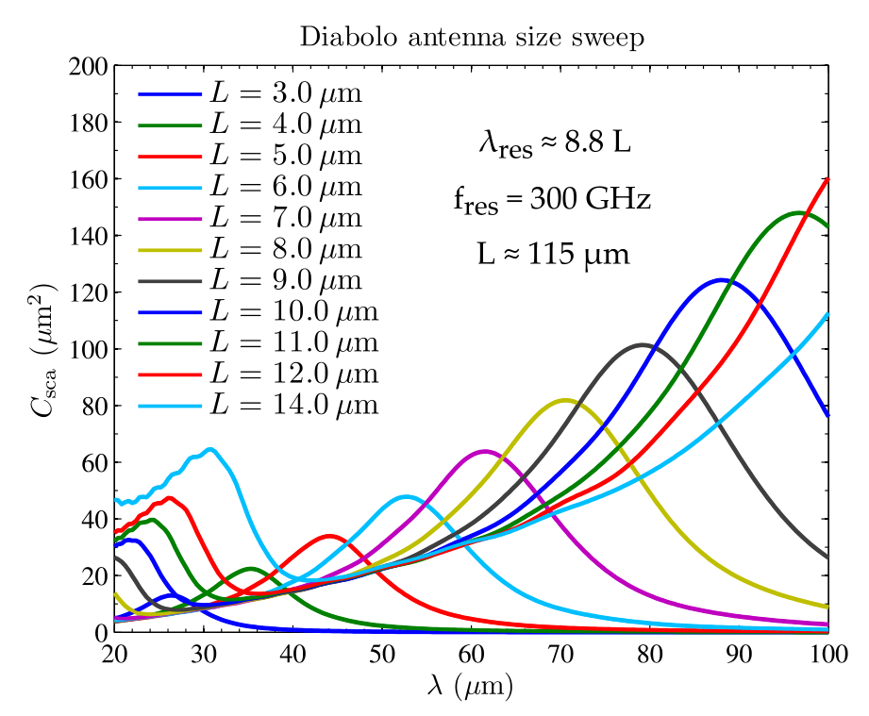
2018-03-21 Diabolo PETER FTIR Simulations
substrate: FZ Si 100, resistivity 300 - 500 Ωcm
Based on numerical simulations
Nine arrays of gold nanoantennas for FTIR experiments were designed and fabricated for three frequencies (1, 3, 10 THz) and three pitches (1.5, 2, 4 Δx/Δy)

Slide 4
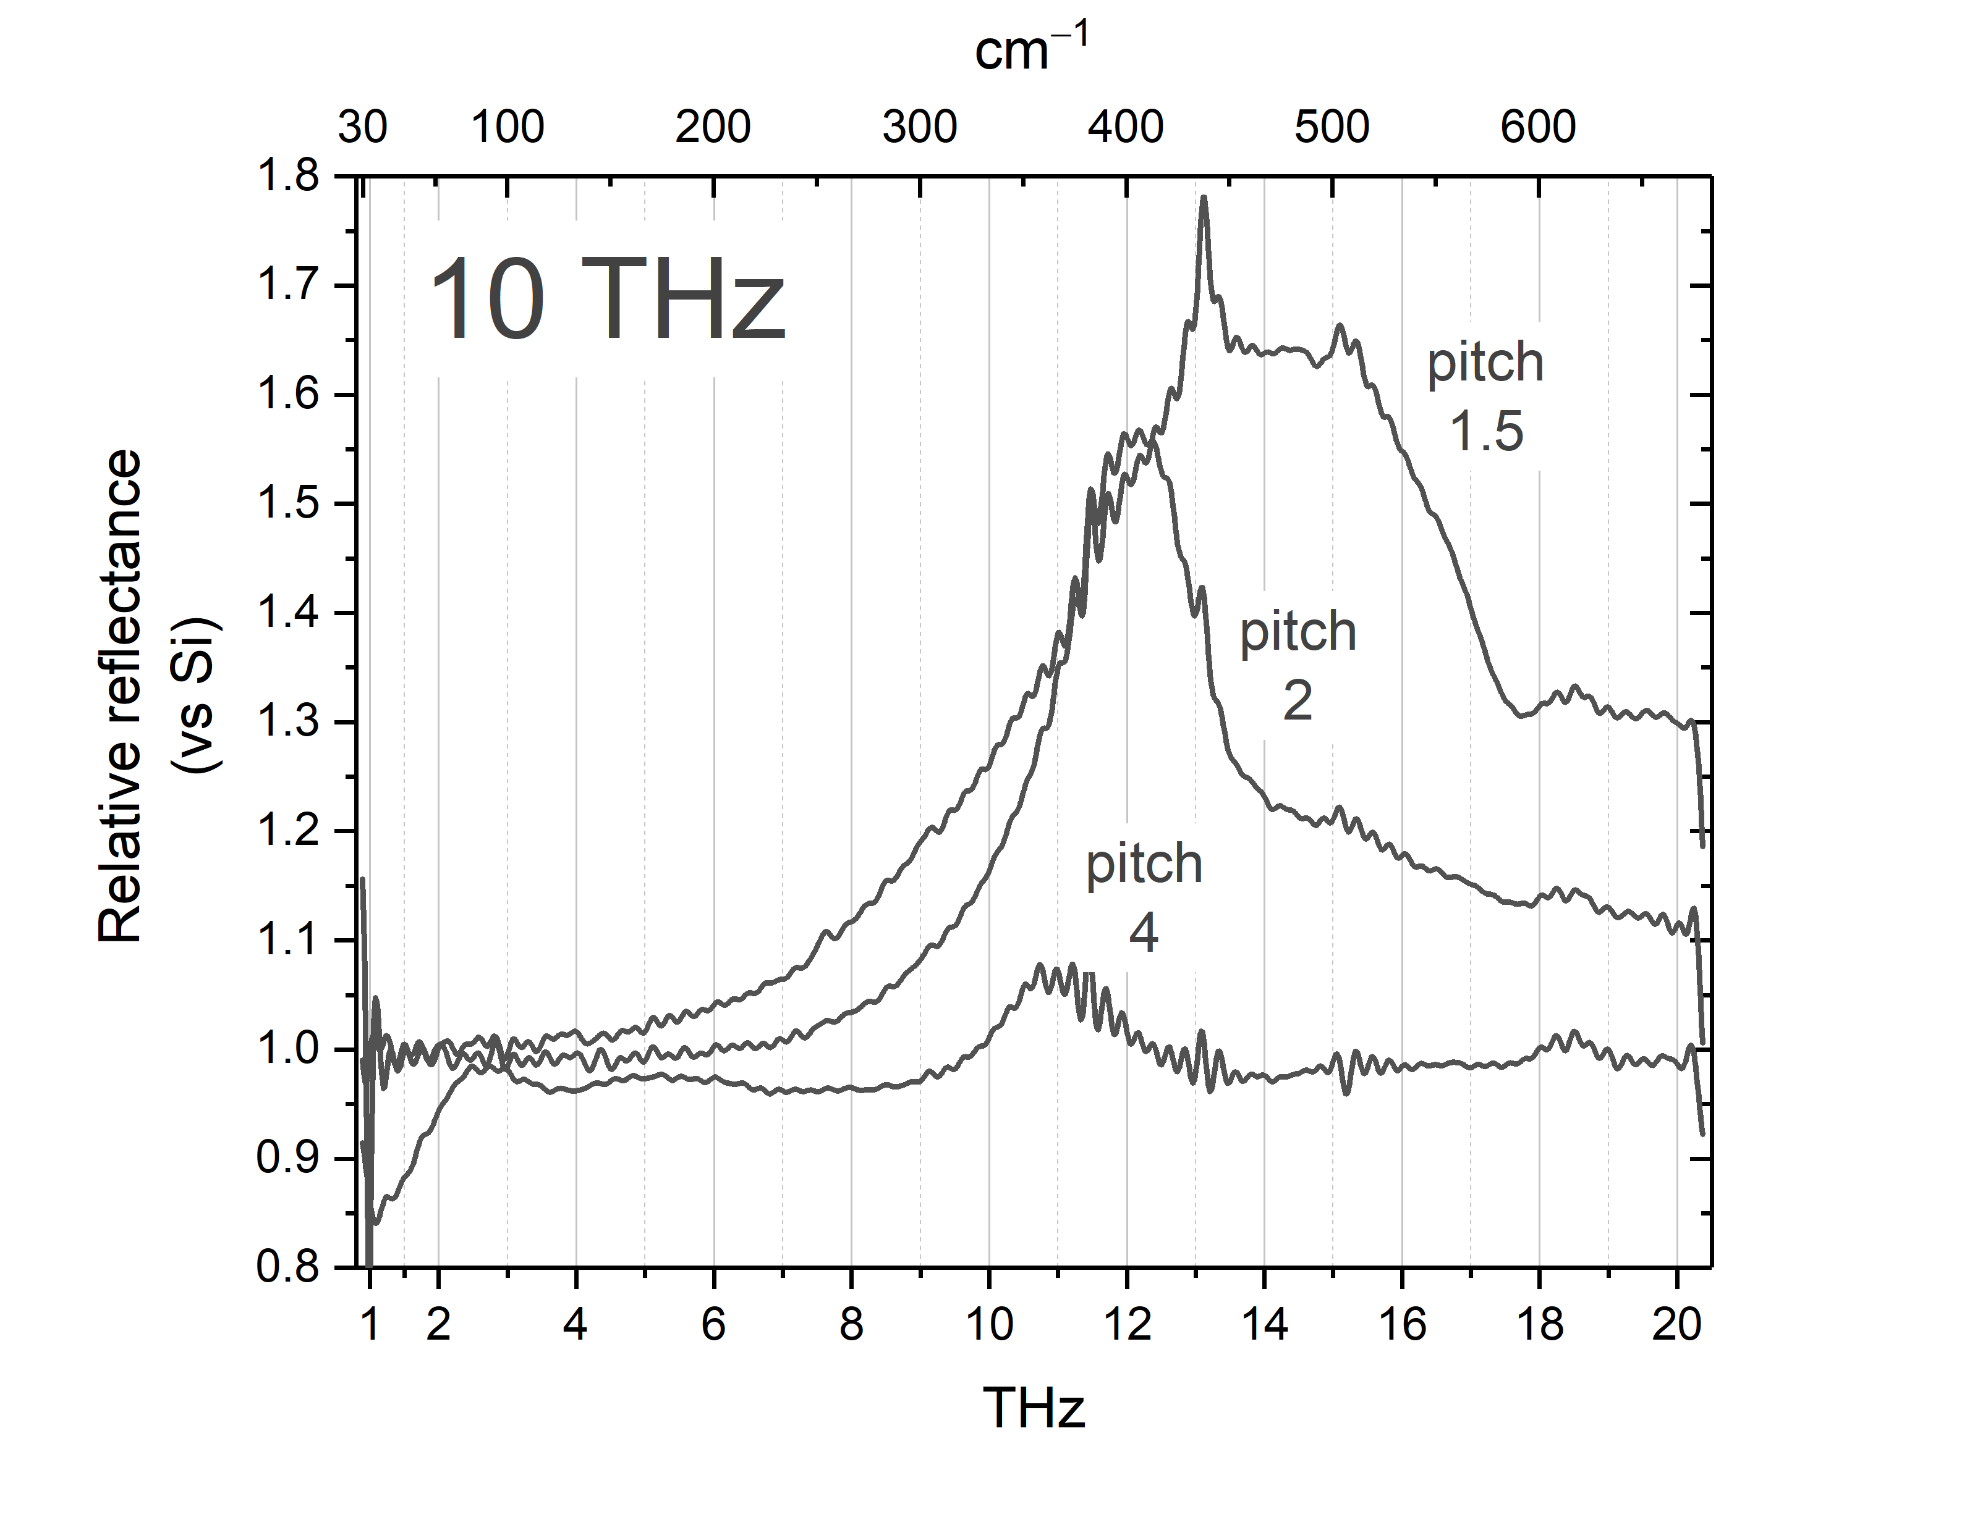
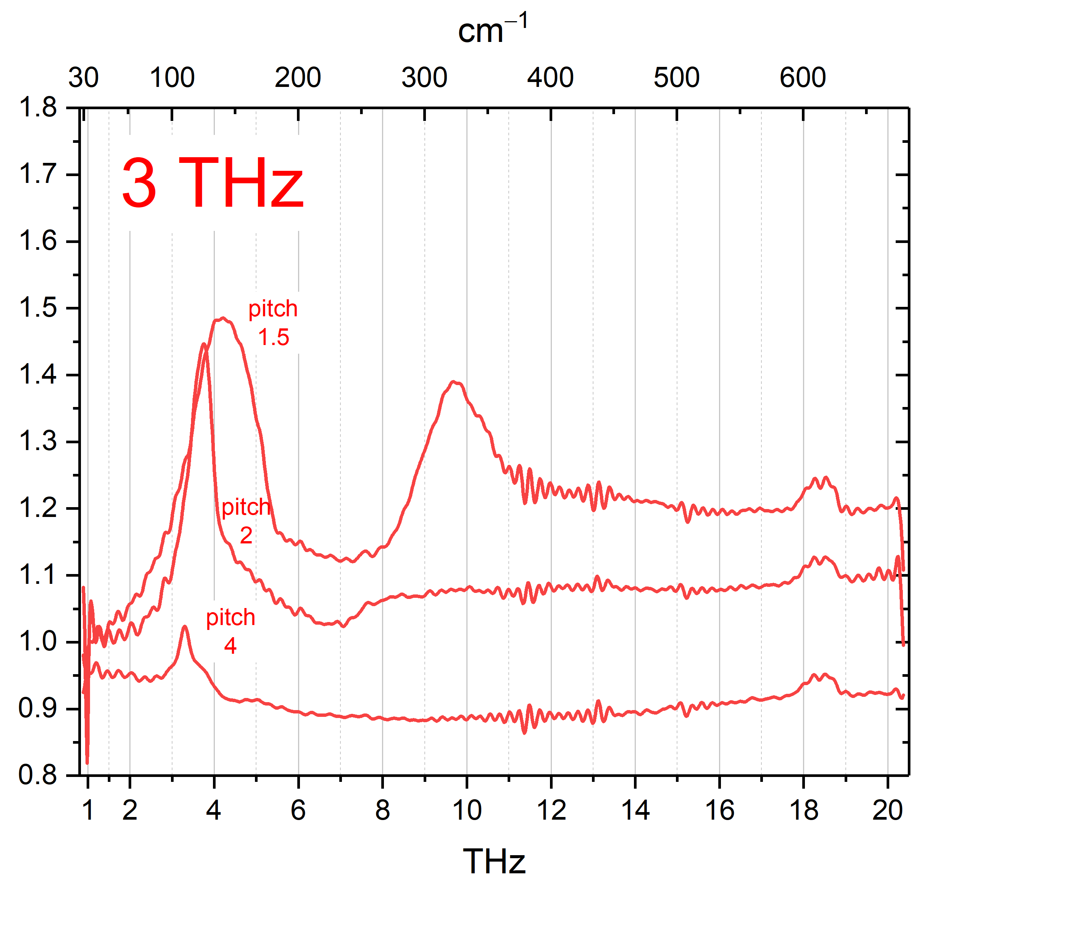
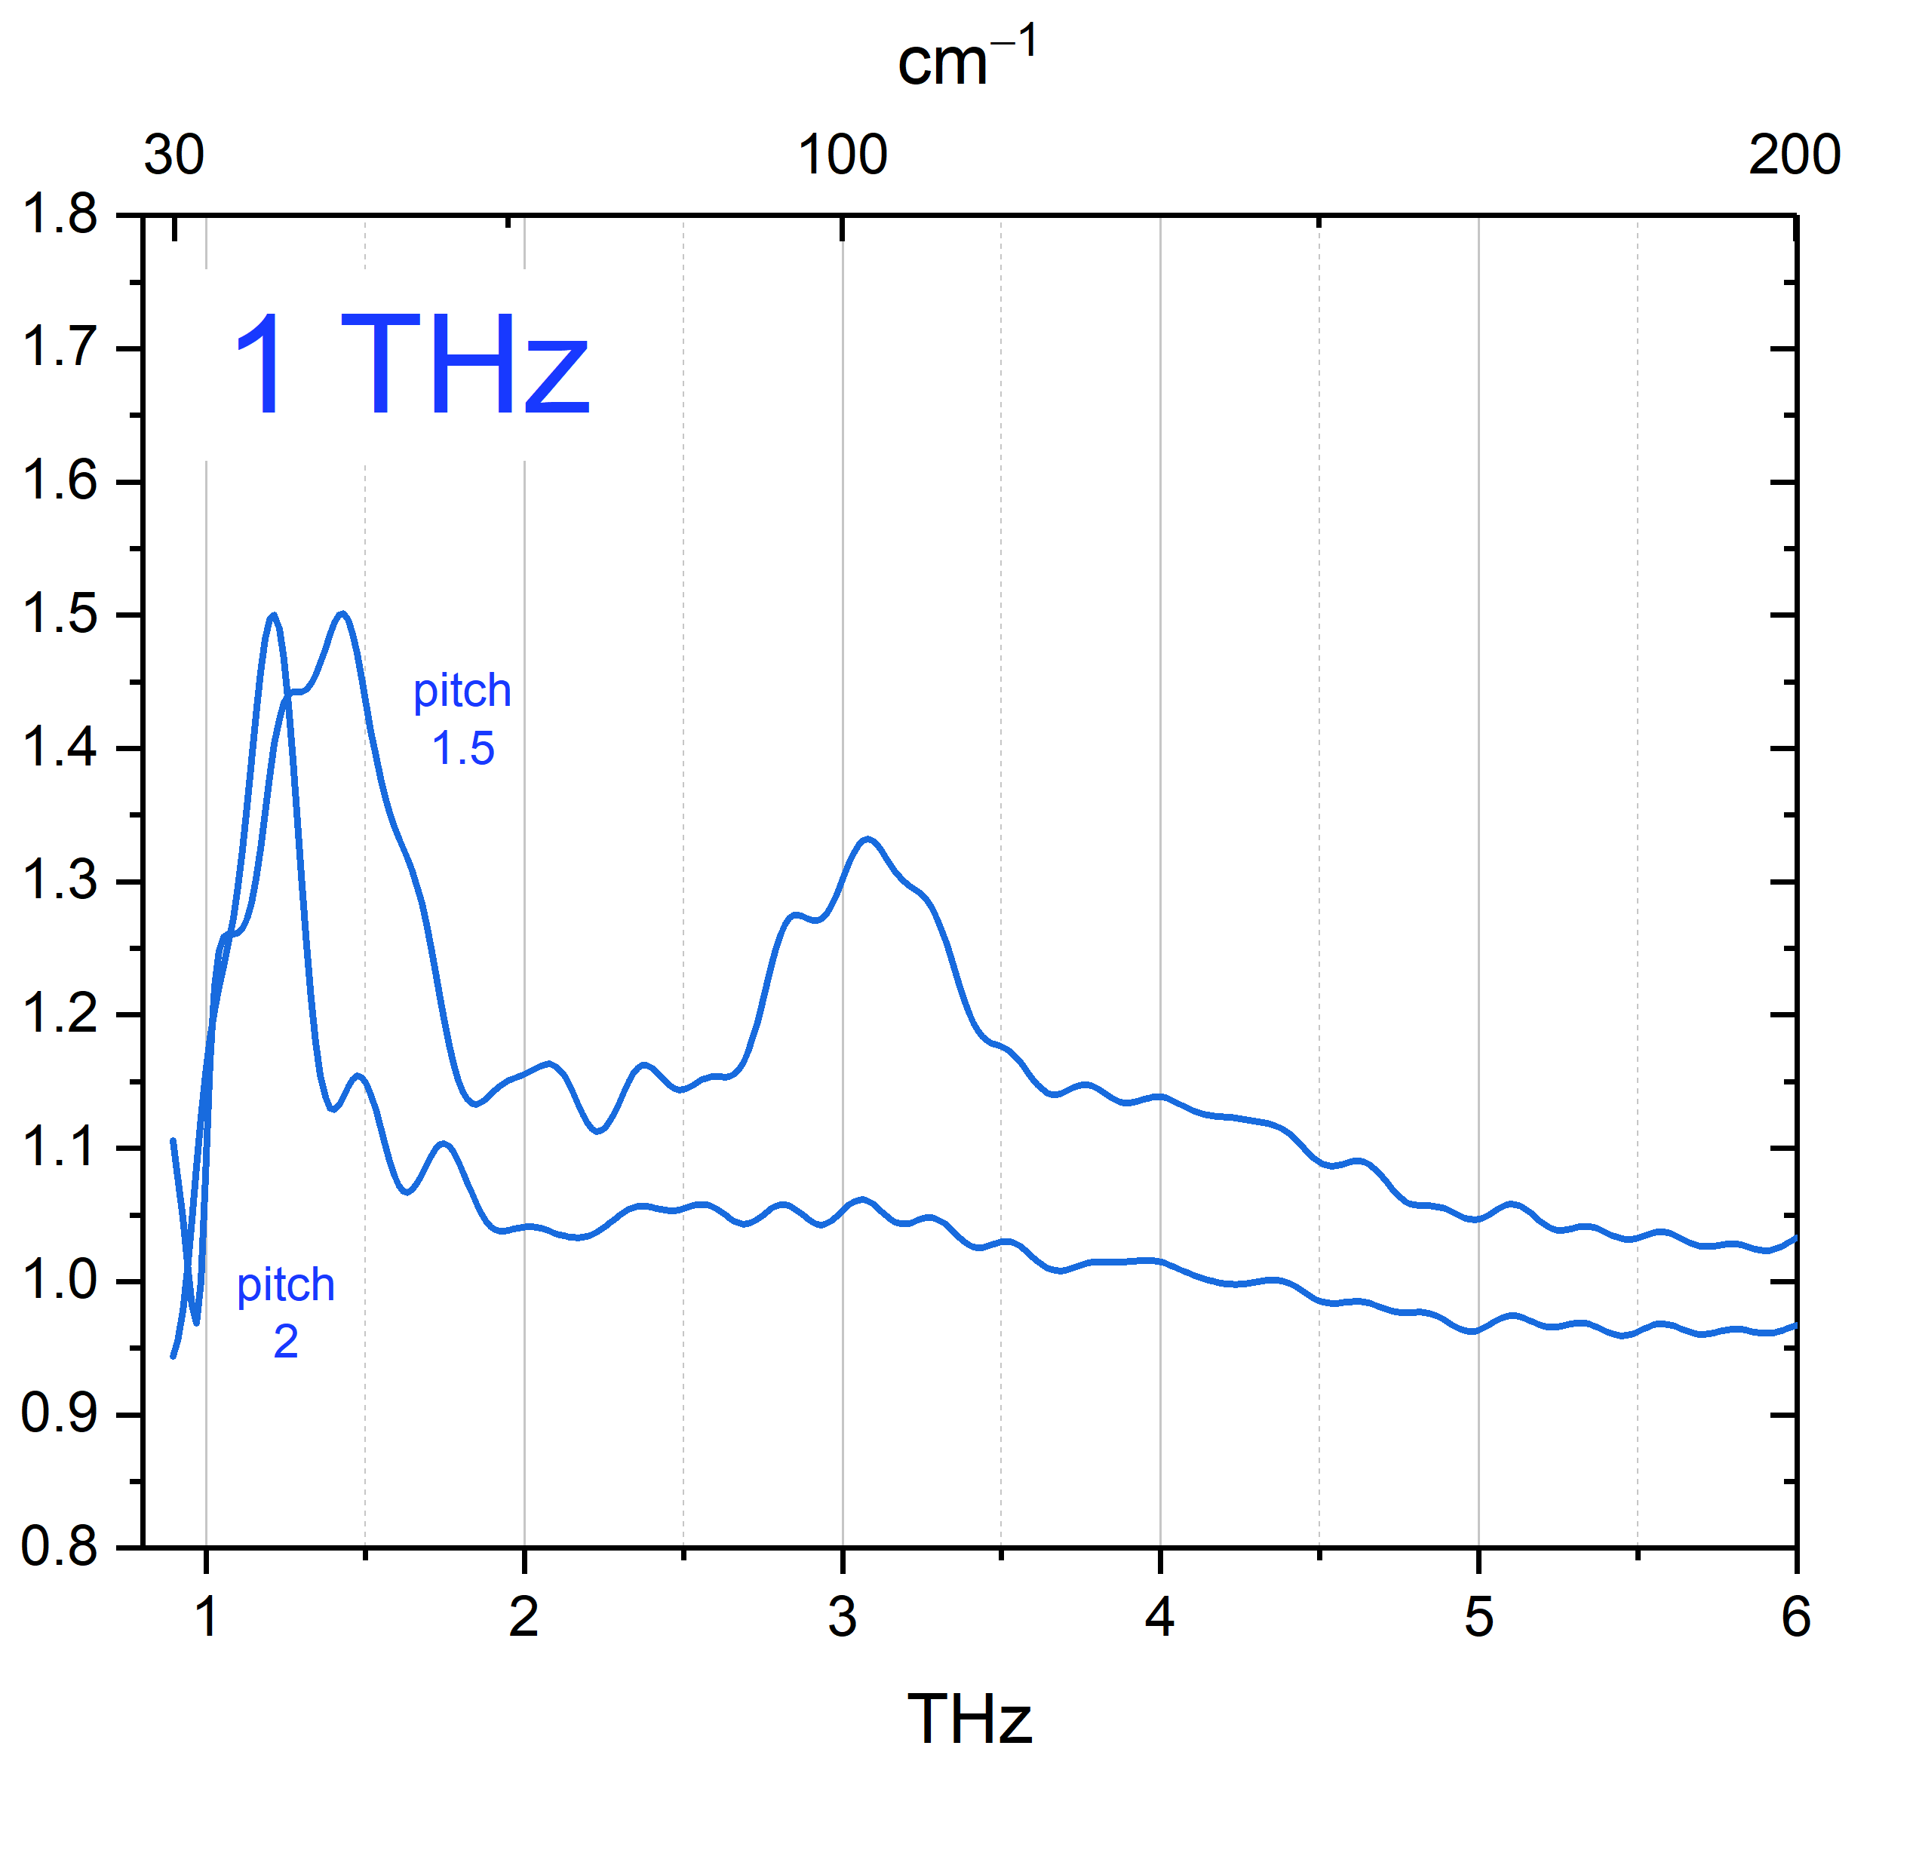
2018-03-21 Diabolo PETER FTIR

Slide 5
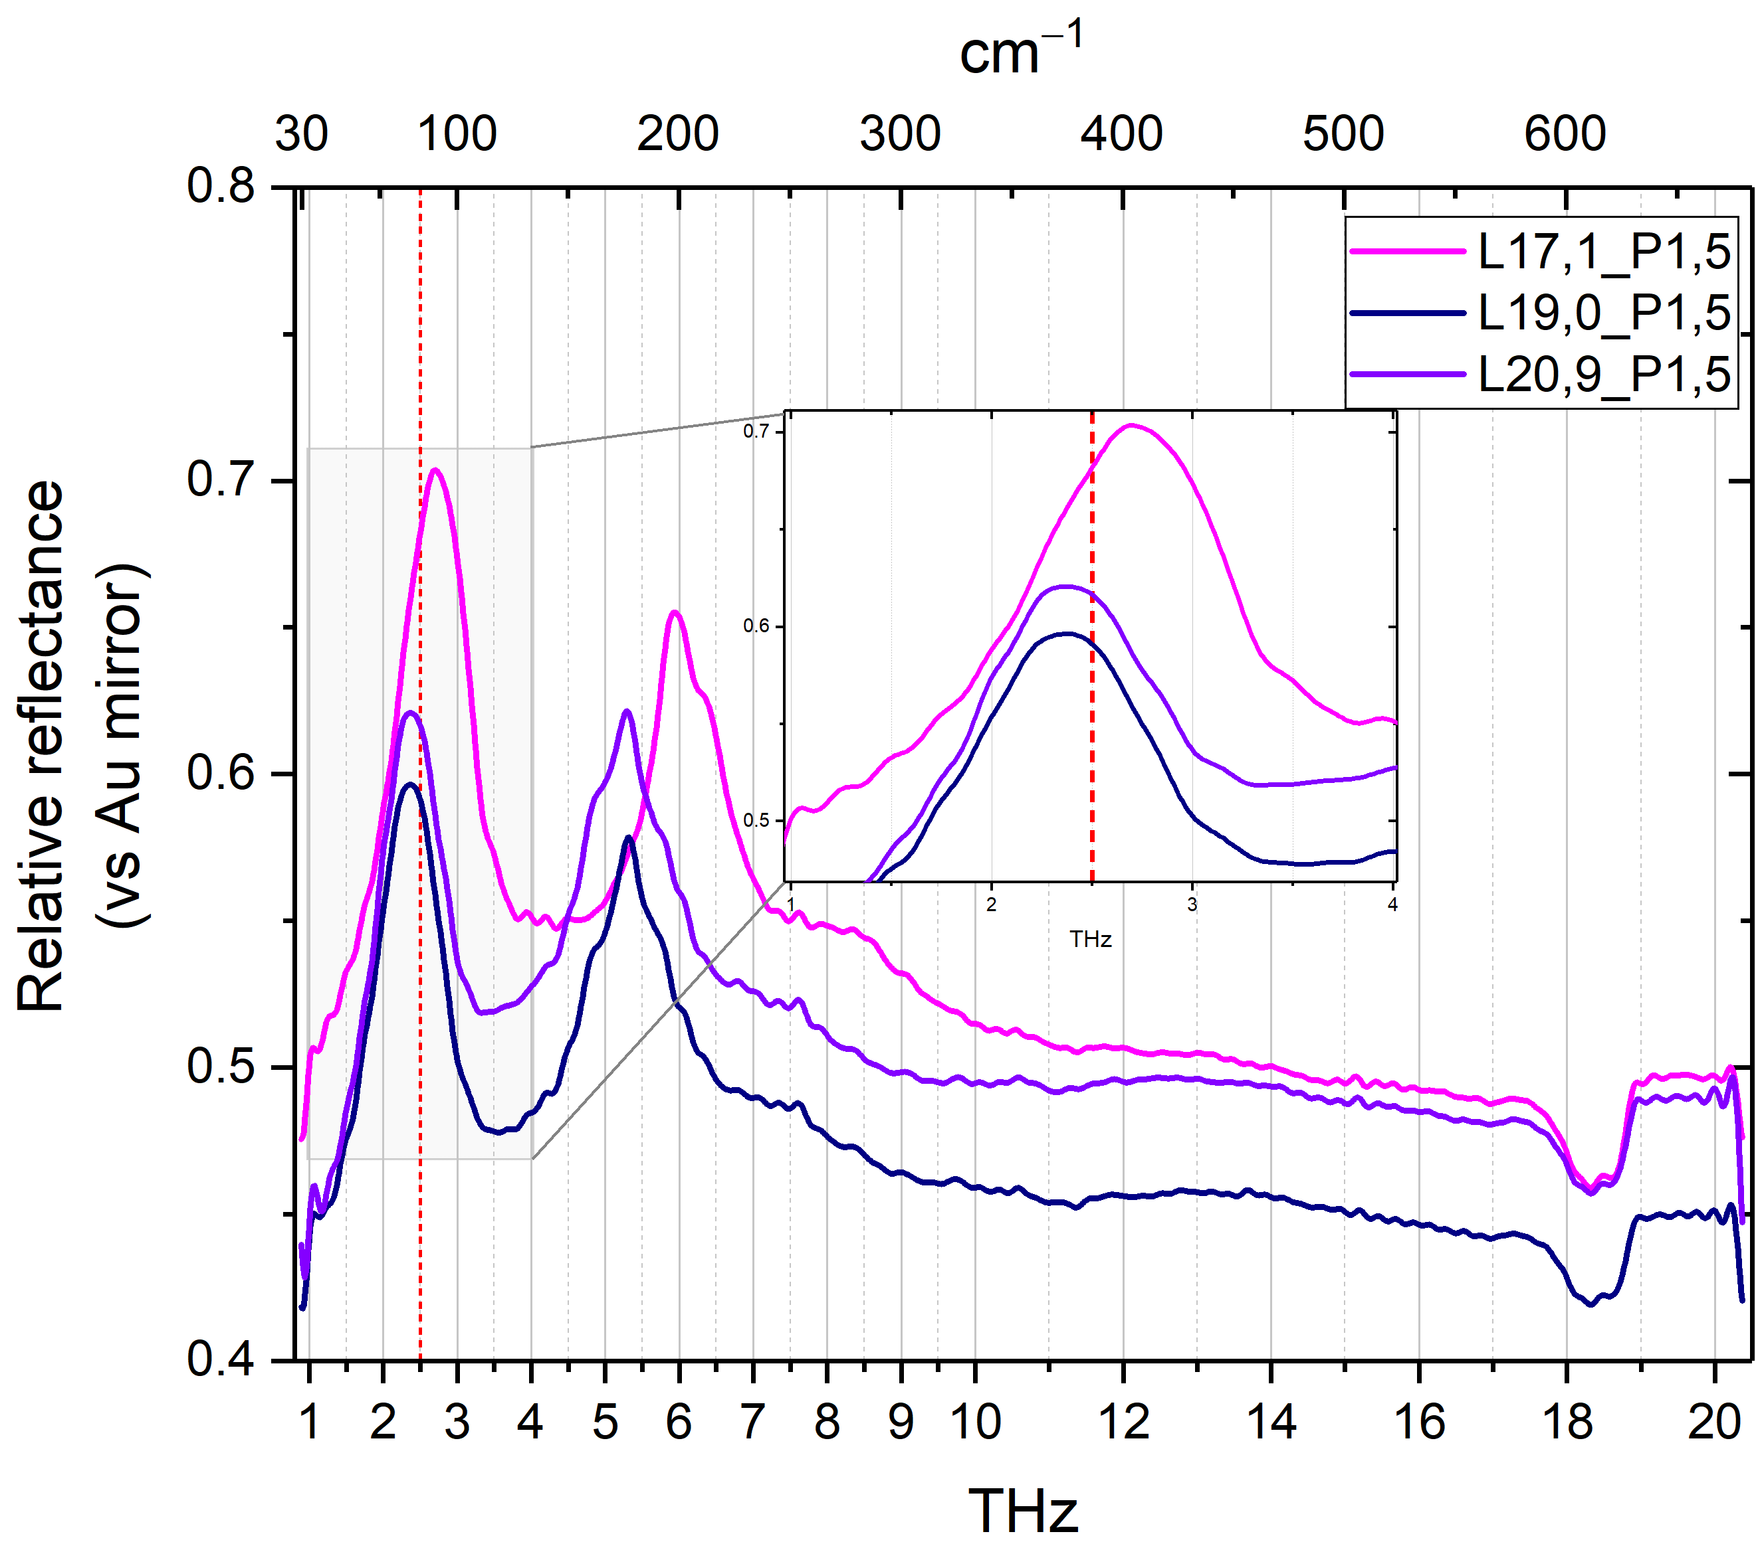
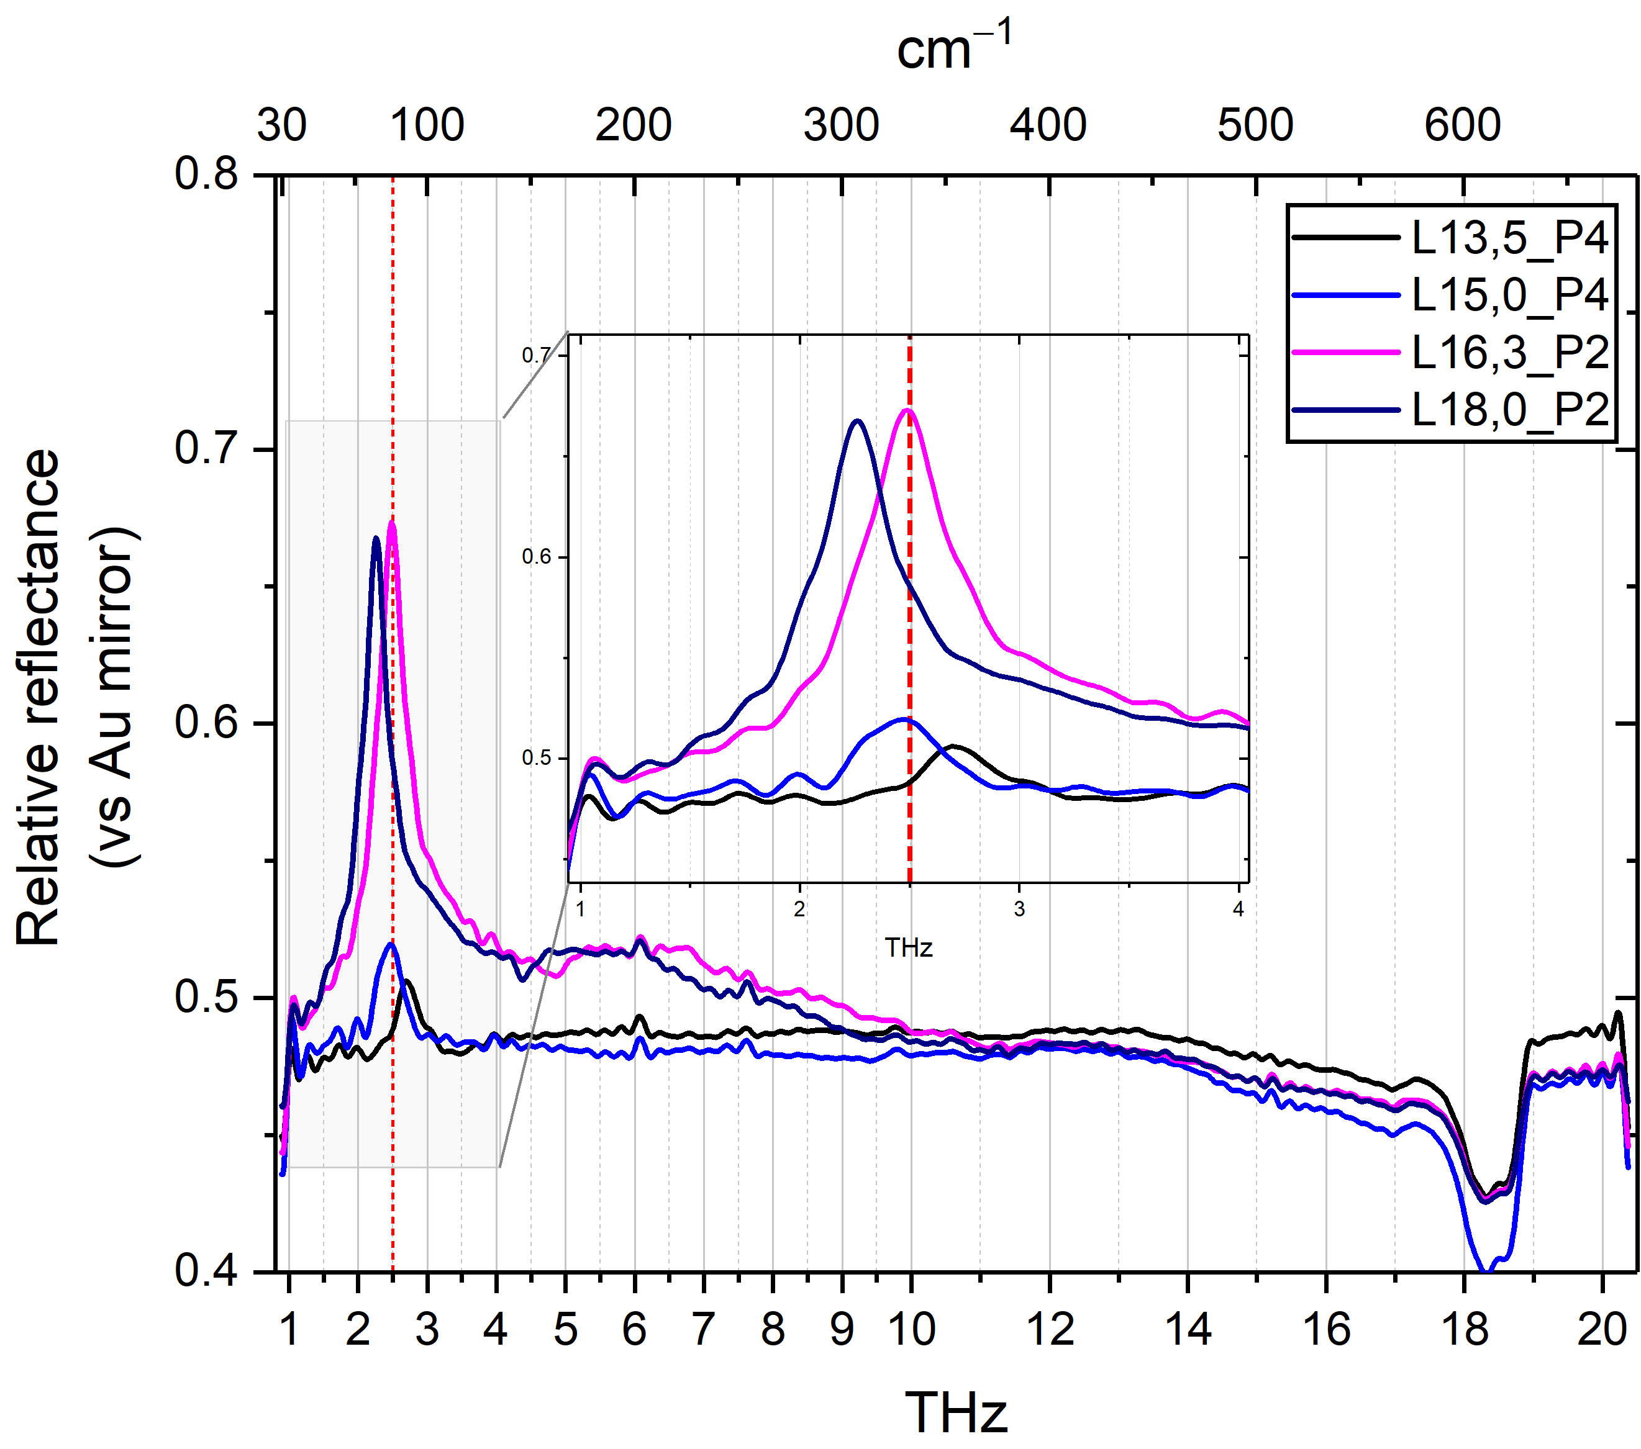
2018-10-01 2.5THz Diabolo Antenna arrays

