Slide 1

Plasmon Enhanced Terahertz Electron Paramagnetic Resonance (PETER)
Rainer Hillenbrand
CIC nanoGUNE and Ikerbasque
San Sebastian, Spain
29/01/2018, Kick-off meeting, Brno

Slide 2

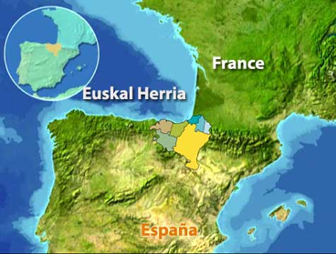
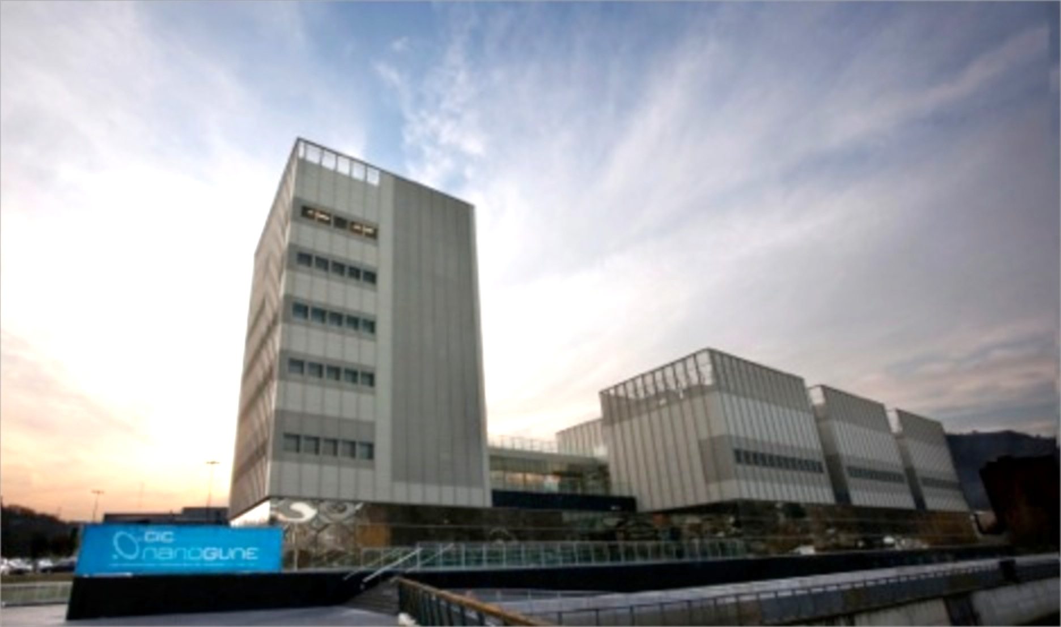
San Sebastian, Basque Country
San Sebastian, Basque Country
CIC nanoGUNE

Slide 3
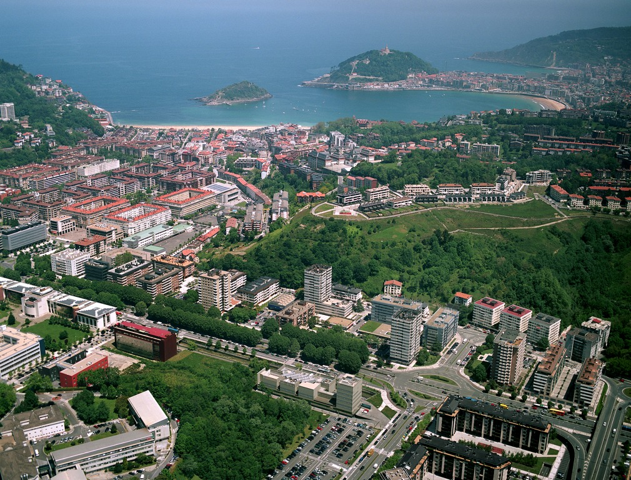
nanoGUNE

Slide 4
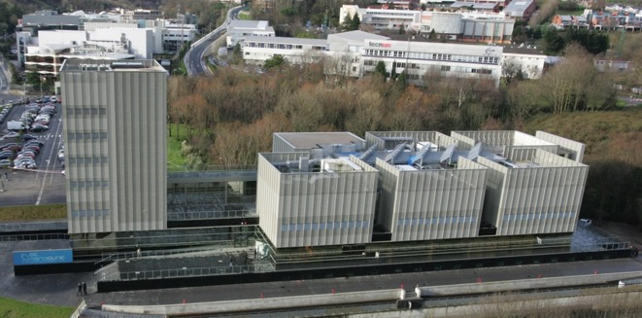
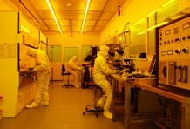
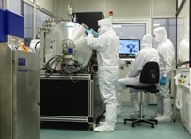
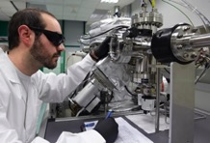
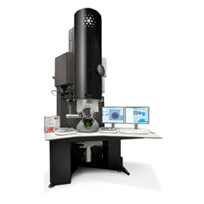
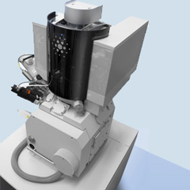
CIC nanoGUNE
Private no-profit organization devoted to basic research
Founded in 2006 by the Basque Region government
      New dedicated building with state-of-the-art equipment
Operations started 1st December 2008
Host of several spin-off companies
    10 Groups:
      Nanomagnetism: A. Berger and P. Vavassori
      Nanooptics: R. Hillenbrand
      Self-Assembly: A. Bittner
      Nanobiomechanics R. Perez-Jimenez
      Nanodevices: L. Hueso
      Theory: E. Artacho
      Electron Microscopy: A. Chuvilin
      Nanomaterials: M. Knetz
      Nanoimaging: J.I. Pascual
      Nanoengineering: A. Seifert

Slide 5
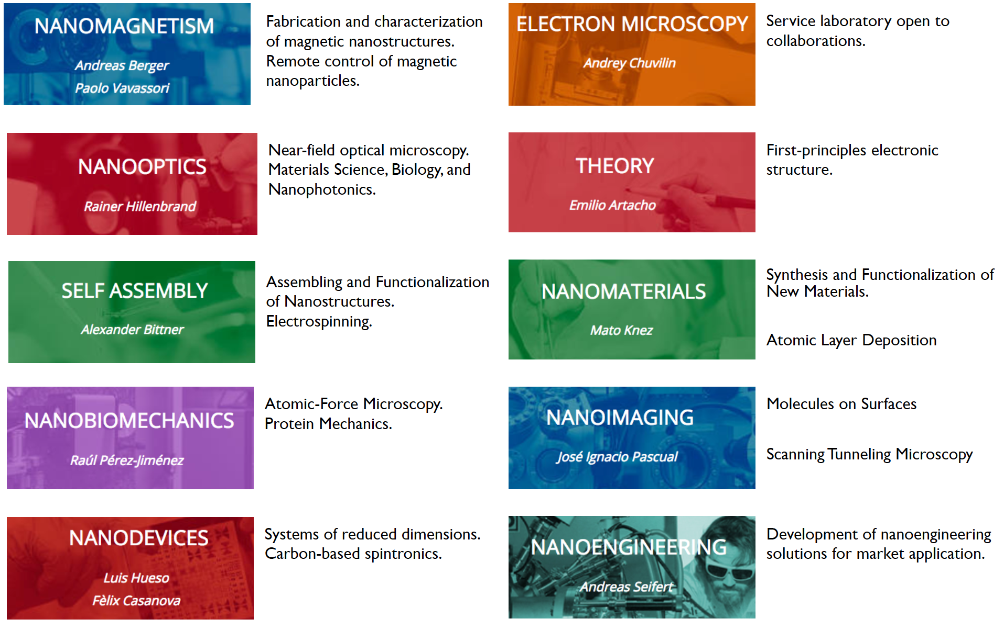
Research Groups and Topics

Slide 6
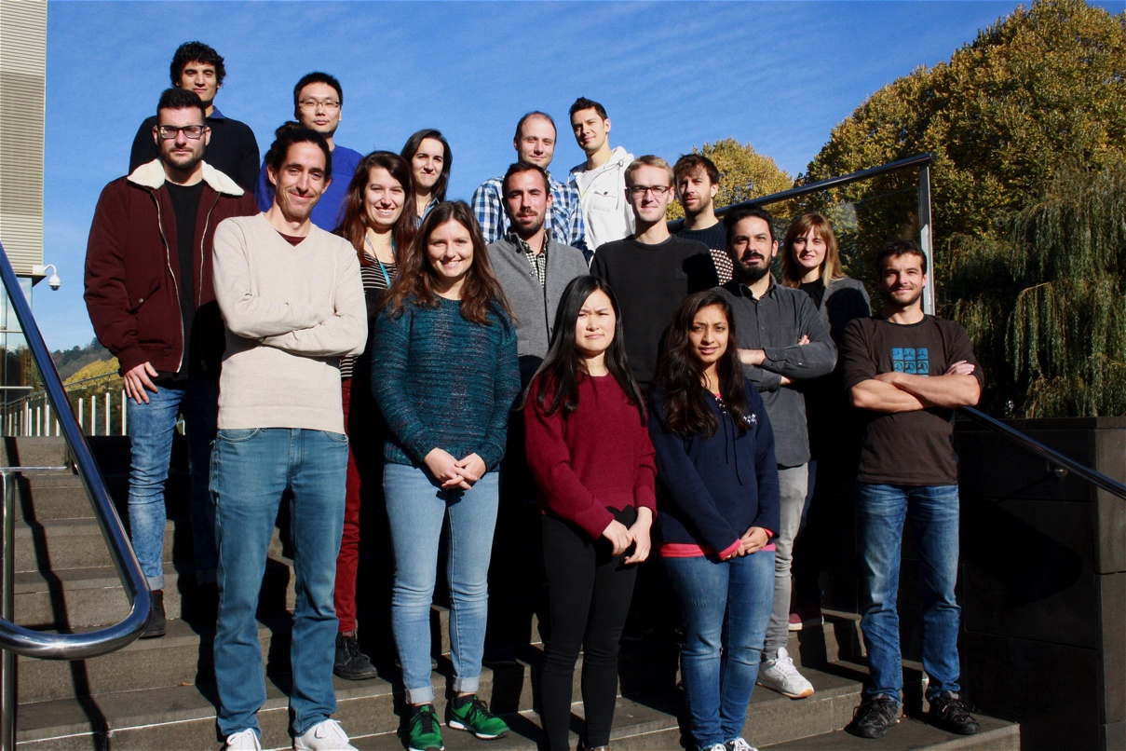
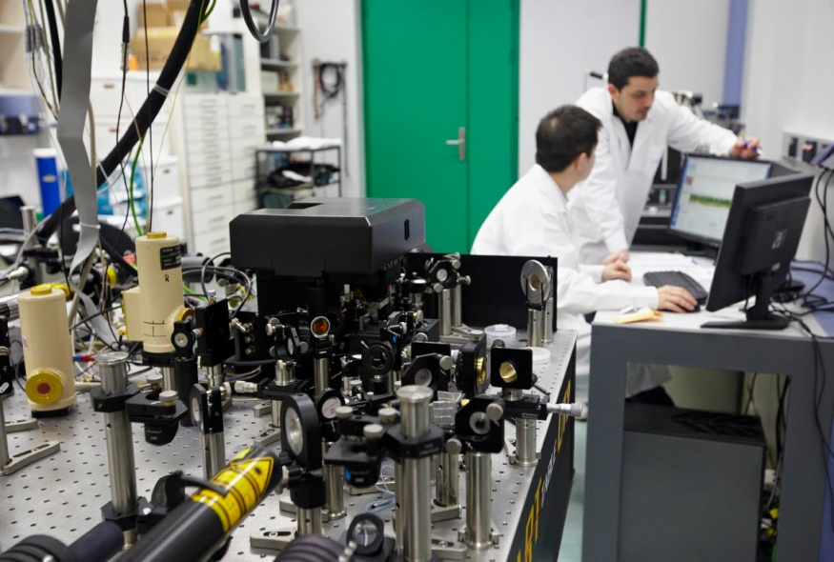
Nanooptics Group at nanoGUNE
2017
Currently 17 group members
3 optics labs
3 near-field microscopes

Slide 7
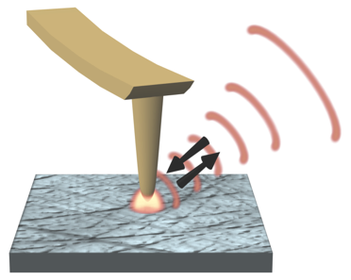
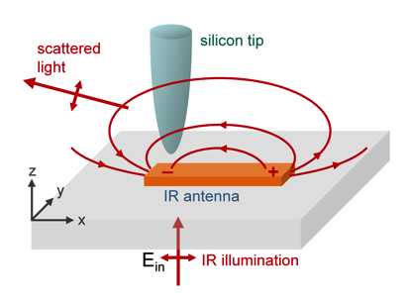
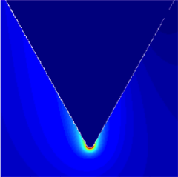
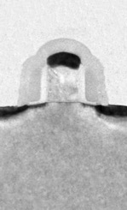




Scattering-type scanning near-field optical microscopy
(s-SNOM) allows for nanoscale optical imaging
focused laser beam illuminates tip
Ultramicroscopy 57, 313 (1995)
Opt. Lett. 20, 1924 (1995)
Science 269, 1083 (1995)
Nature 399, 134 (1999)
Nature 418, 159 (2002)
AFM tip
backscattered light
is recorded
nanoscale resolved optical images
sample
Dielectric tips (s-SNOM)
Metal tips (Tip-enhanced s-SNOM)
100 nm
Topography
air
gold tip
E
metal
tip
Optical amplitude
Optical phase
TEM
IR
–
+
Nano Lett. 8, 3766 (2008)
λ = 10 µm
Nature Photon. 3, 287 (2009)
Local dielectric properties, chemical composition, conductivity
Near-field distribution of plasmonic and photonic structures

Slide 8
IR/THz s-SNOM can map materials and free-carriers with nanoscale resolution
substructure of single 65 nm-transistor can be characterized with IR-THz s-SNOM
s-SNOM offers nanoscale spatial resolution at IR and THz frequencies
We already achieve 40 nm resolution at 118 µm ( = λ/3000)
Enables quantitative and nanoscale resolved mapping of free carriers
A. Huber, F. Keilmann, J. Wittborn, R. J. Aizpurua, R. Hillenbrand, Nano Lett. 8, 3766 (2008)

Slide 9
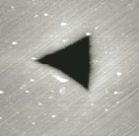
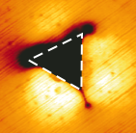
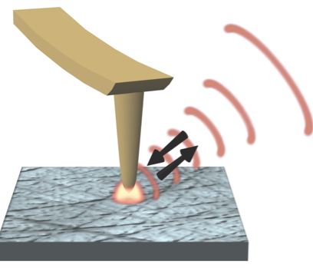
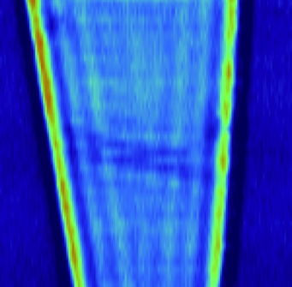
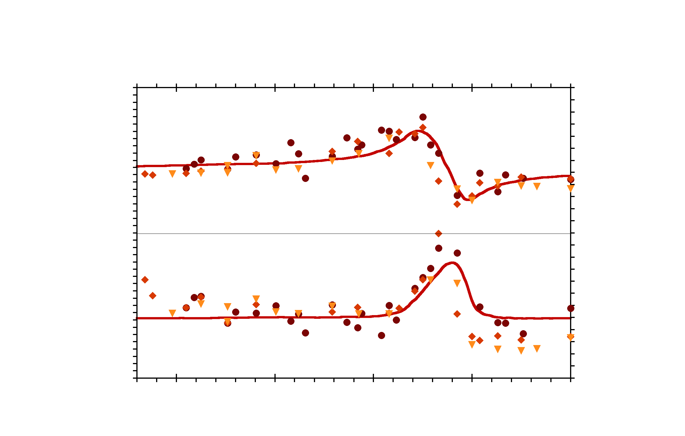
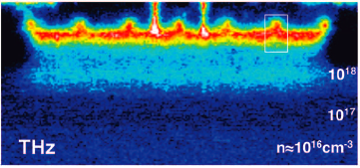
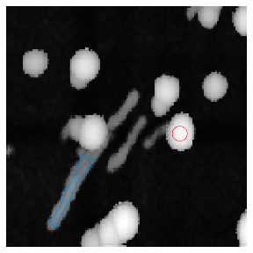
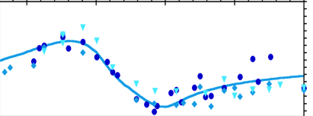
IR/THz-SNOM has wide application potential
Material science
Nature Mater. 3, 606 (2004)
Nature Nanotechnol. 4, 153 (2009)
Nanoscale mapping of e.g. strain, nanocracks
Photonics/Plamonics
Science 313, 1595 (2006)
Nature 487, 77 (2012)
Science 344, 1369 (2014)
Nature Photon. 10, 239–243 (2016)
Nature Nanotechnol. 12, 31 (2017)
Mapping of plasmons
Topography
IR image
1 μm
1 μm
Graphene
SiC
Nature Mater. 10, 352 (2011)
Nature 418, 159 (2002)
Nanoscale (bio)chemical imaging
Nano Lett. 6, 1307 (2006)
Nano Lett. 12, 3973 (2012)
Nature Commun. 4:2890 (2013)
Nature Commun. 8:14402 (2017)
Semiconductor technology
Nano Lett. 8, 3766 (2009)
Nano Lett. 10, 1387 (2011)
Nature Commun. 3:1131 (2012)
Nanoscale free-carrier profiling
Topography
PMMA spectrum
IR signal
200nm
Virus
(Protein)
spectrum
1 μm
500 nm
1600
1650
1700
1750
1800
frequency [cm⁻¹]

Slide 10
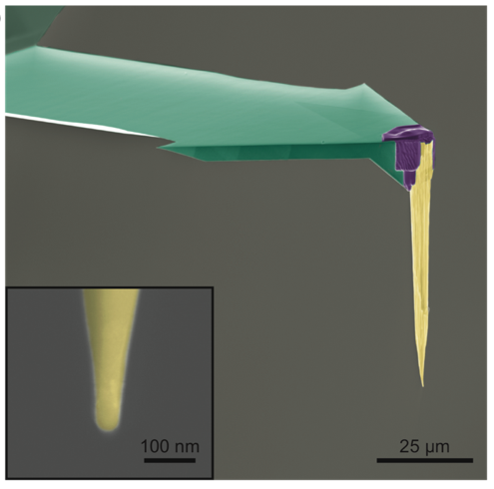
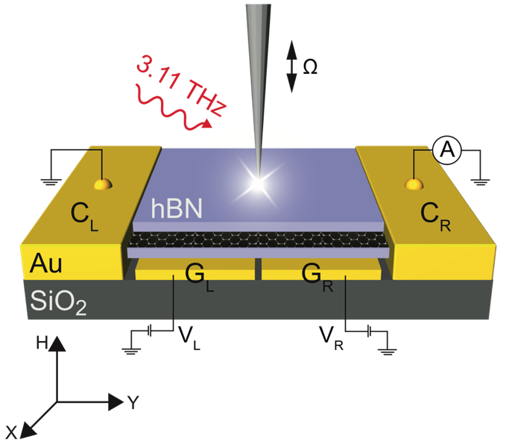
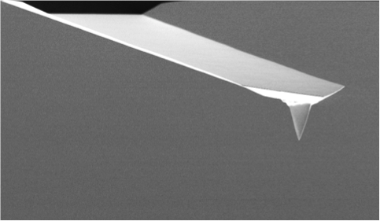
We develop more efficient THz near-field probes
Custom made long AFM tips
cantilever
L≈λ/2
Standard AFM probe
cantilever
→ Use graphene split-gate photodetector to measure the near-field intensity at tip apex to investigate antenna resonances in tip
L<<λ/2
25 µm
Mastel et al., Nano Lett. 17, 11 (2017)
In collaboration with Frank Koppens group, ICFO

Slide 11
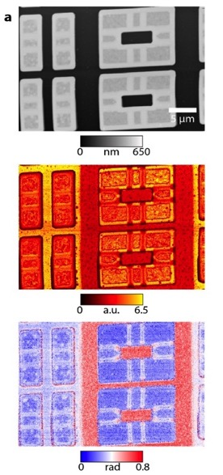
All-electric THz nanoscopy
Experimental Setup
Demonstration
Topography
near-field amplitude
near-field phase
➔ use Schottky Diode for all-electrical Terahertz generation and heterodyne detection of near-field scattered signal
➔ THz near-field nanoscopy can distinguish carrier concentration in differently doped Silicon nanostructures
Liewald et al., Optica in press (2018)
In collaboration with Fritz Keilmann and Neaspec GmbH

Slide 12
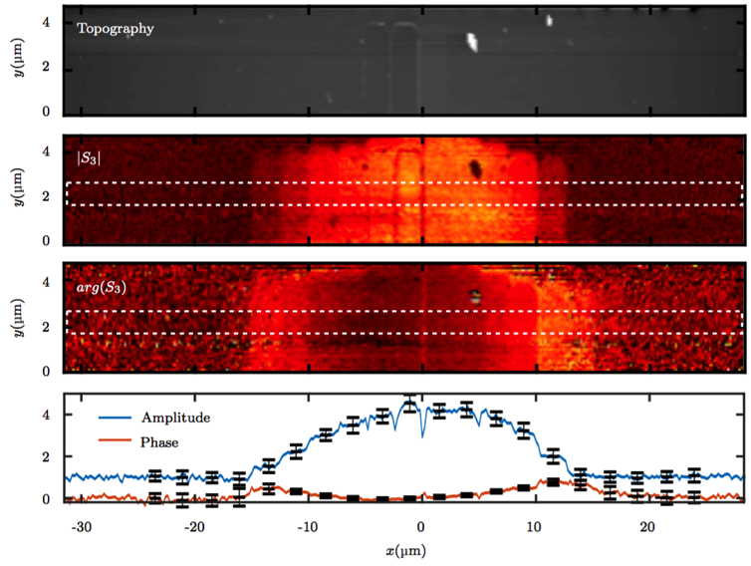
THz near-field microscopy with a bolometer
Experimental Setup
Demonstration
bolometer
Topography
near-field amplitude
THz gas laser
near-field phase
➔ Bolometer and synthetic holography method for recording THz near-field images
➔ THz near-field nanoscopy can distinguish carrier concentration in staircase p- and n-doped Silicon nanostructures
Maissen et al., in preparation
In collaboration with Ken Wood, QMC Technologies
Notes:
So we fabricated such probes, which you see a false color scanning electron microscopy image on the right. For comparison on the left you see a standard AFM probe, with a tip length much smaller than the wavelength of THz radiation. The custom made probe was fabricated with focused ion beam machining. A standard AFM cantilever was used, but the tip replaced with a sharpened Pt/Ir wire, which has now a a length in the order of half the wavelength, in this case around 70 µm. The zoom in shows that the apex diameter is around 50 nm.
Now we wanted to test these probes if they indeed show an improved field enhancement at the tip apex.

Slide 13
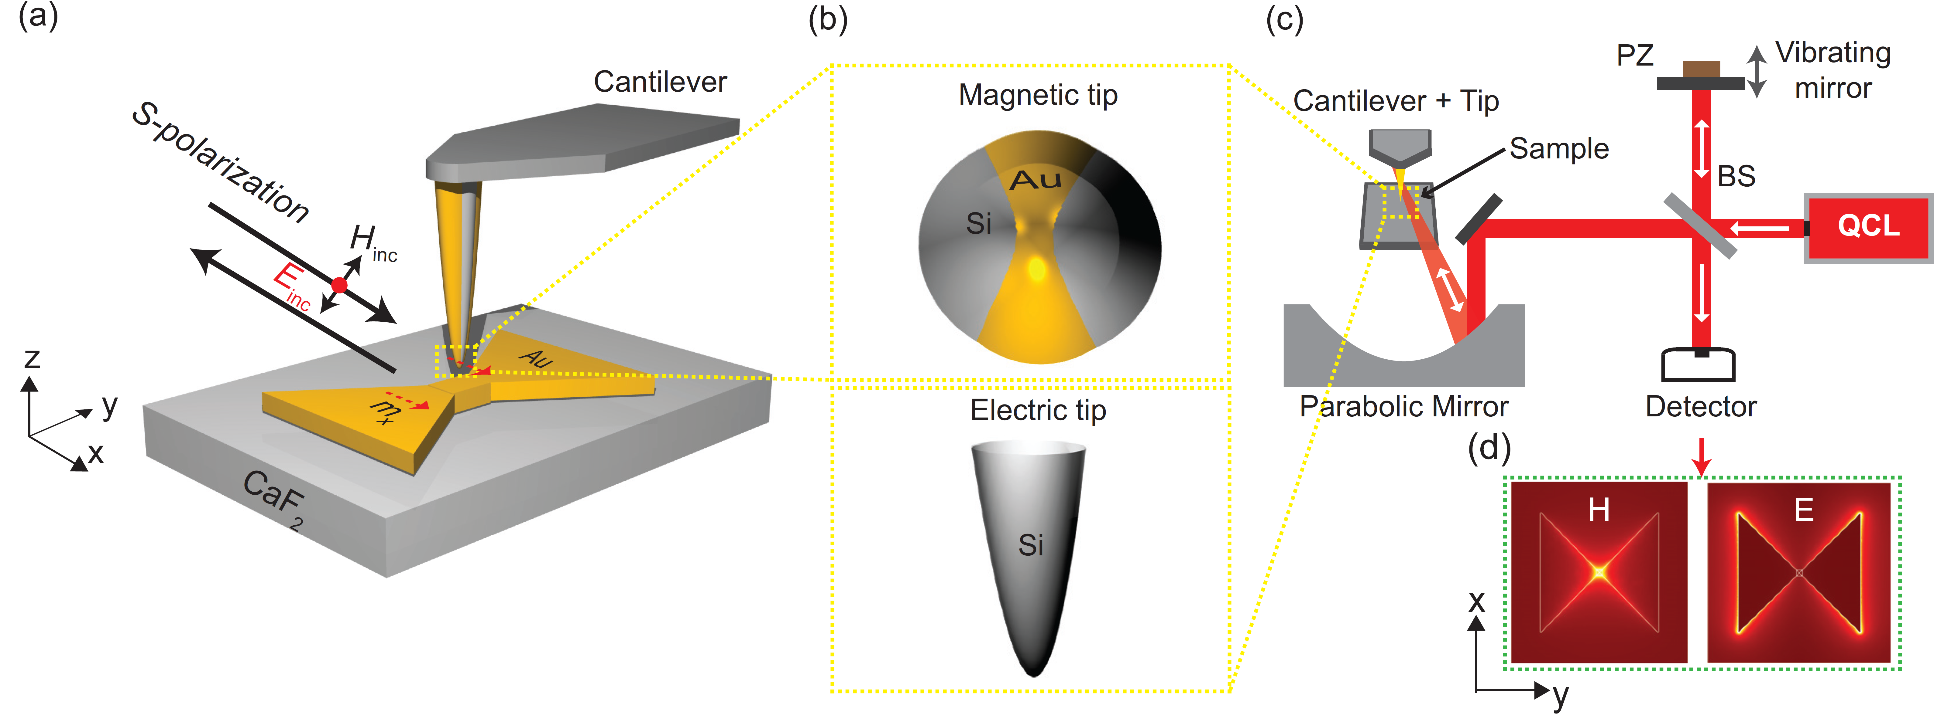
PETER –
Research and development done at nanoGUNE
Antennas and probe tips for PETER
Design
Fabrication
Testing
with test samples at room temperature, without magnetic DC field
Concept
Tips
Existing s-SNOM

Slide 14
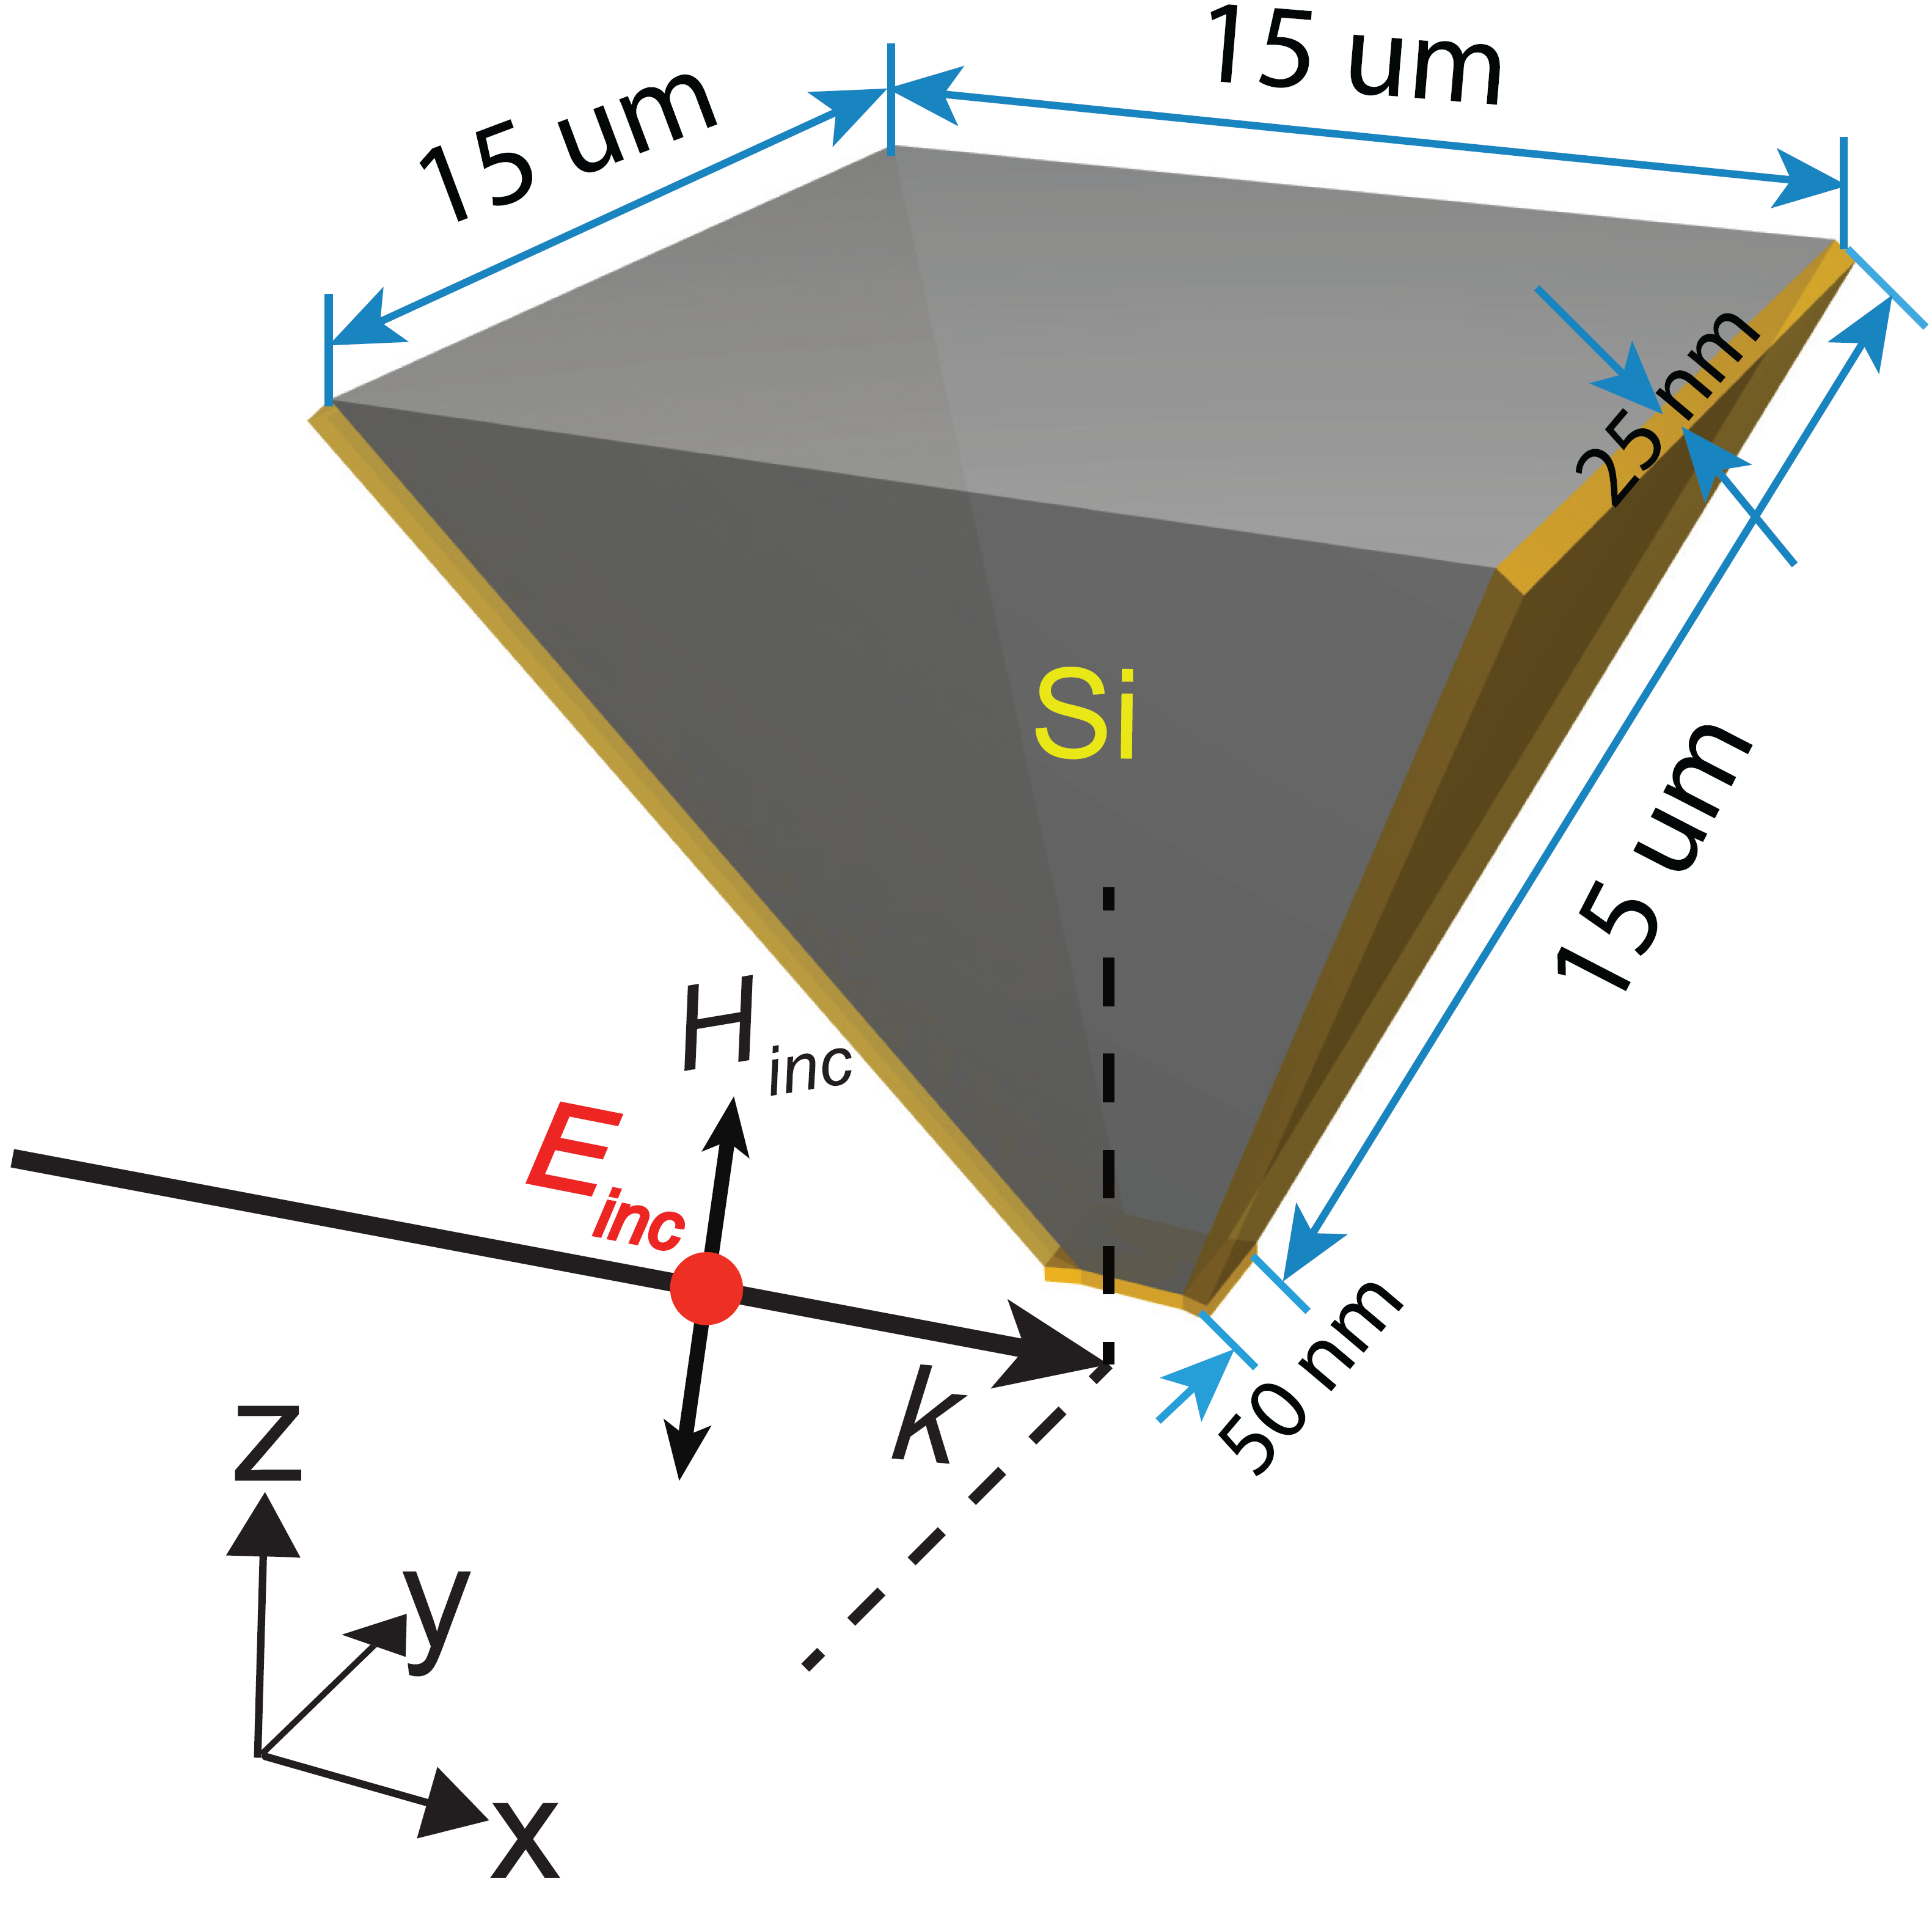
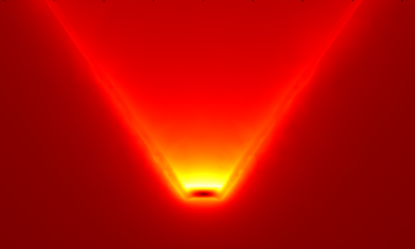
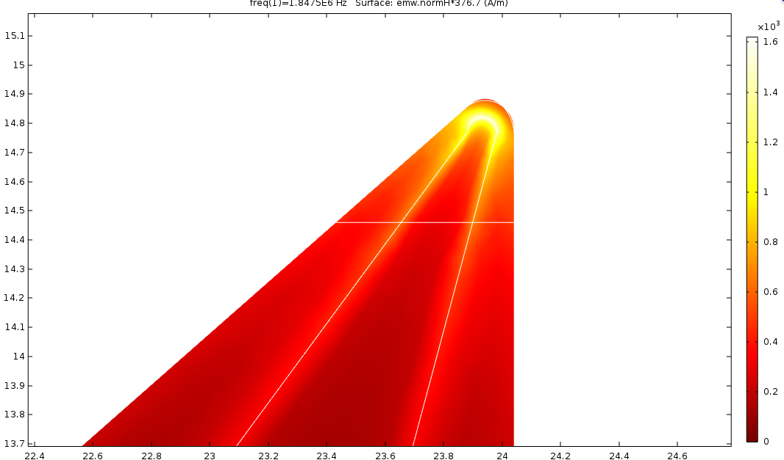
First magnetic near-field probe designs
λ=180 um, H/H₀
6000
H/H0
z
0
x

Slide 15
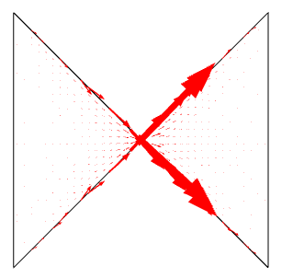
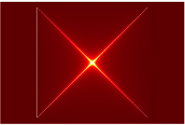

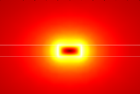
Test sample – planar Diablo antenna
Surface charge
-
+
total current
-
+
y
x
200
Magnetic “hot spots”
H/H0
1340
1340
H/H0
H/H0
H/H0
z
y
0
0
y
x
0

Slide 16
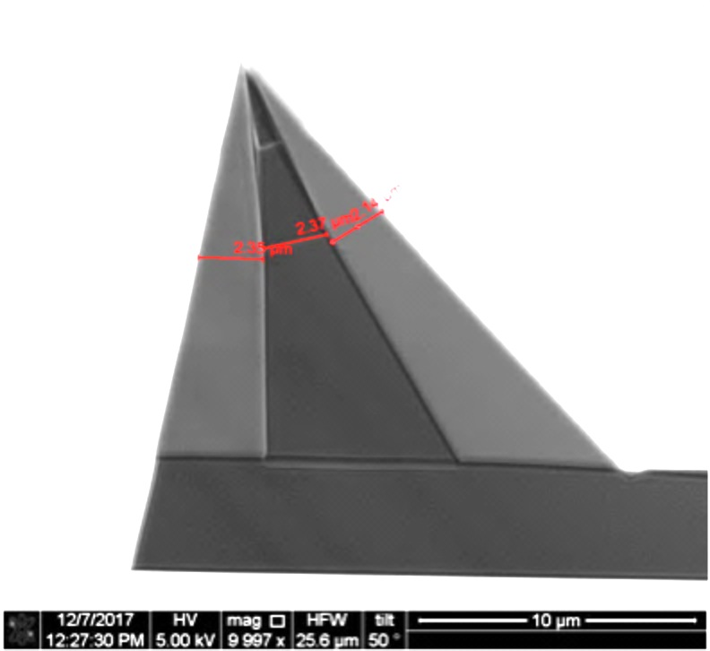
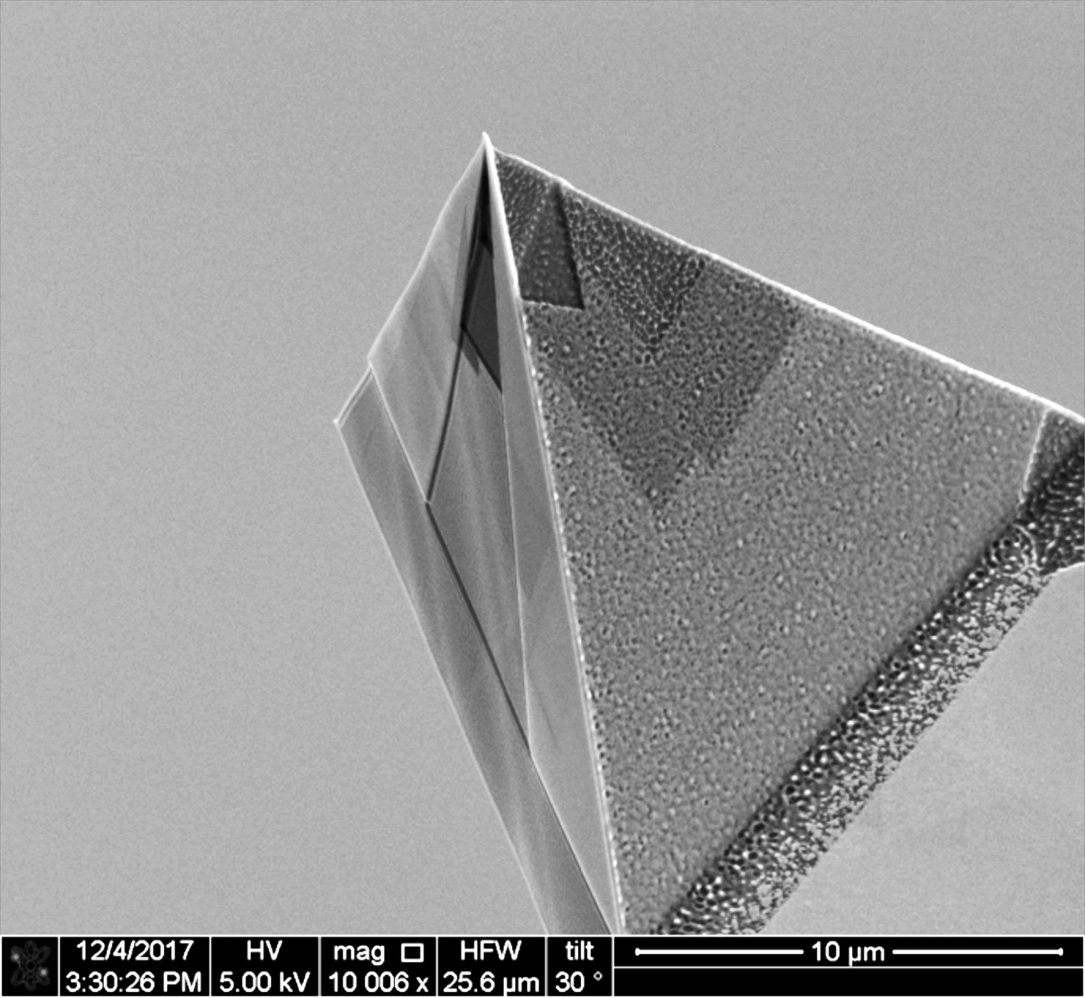
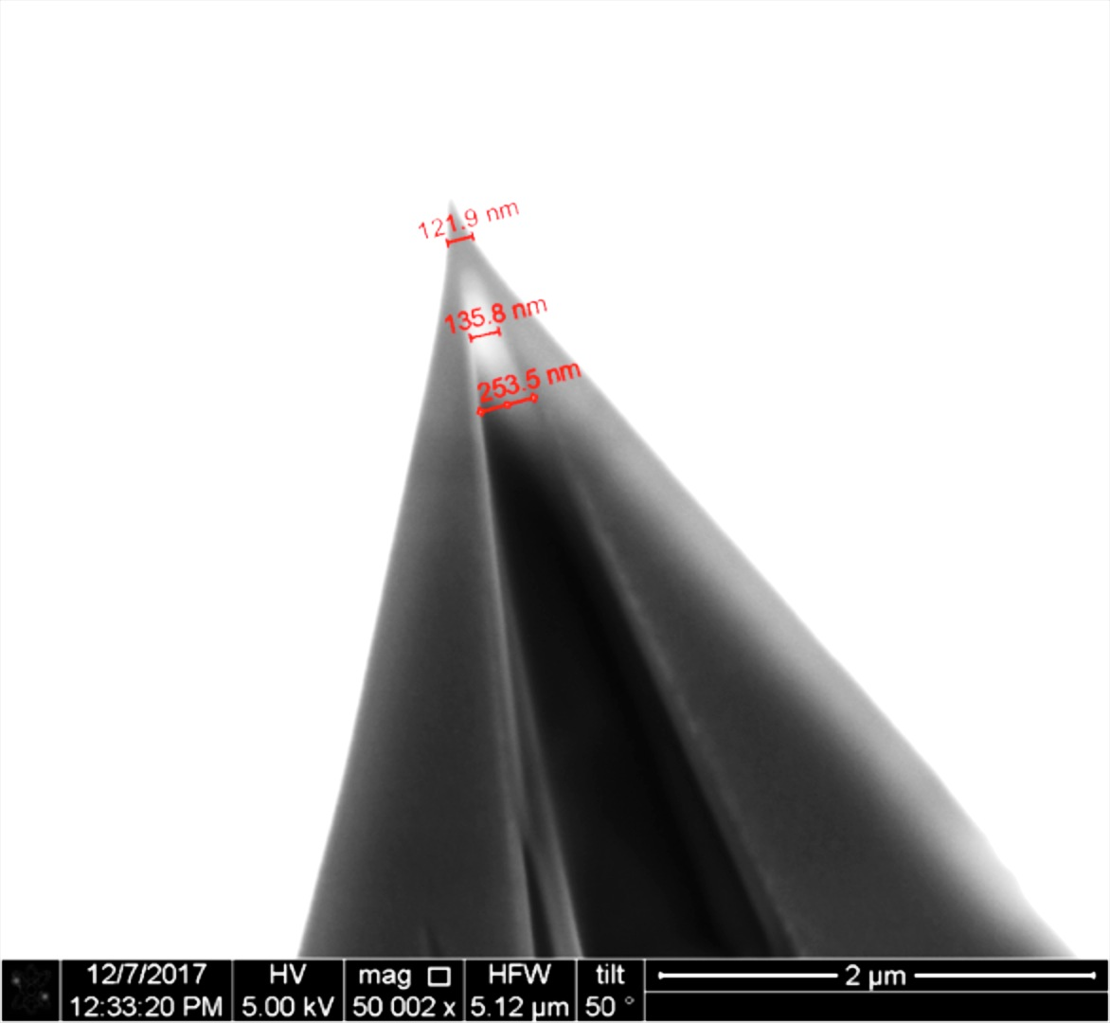
First magnetic near-field probe fabrication tests

