Slide 1

Legal and financial aspects of
PETER #767227

Slide 2
H2020 specifics
Time recording system of both personnel and equipment
  Personnel timesheets
  Depreciation timesheets (instrument logs)
Flat-rate of 25 % for indirect costs (!!! 25 % of actually incurred direct costs!)
Keeping of all records and receipts related to the implementation and costs eligibility for five years after the payment of the balance
Certificates on the Financial Statement – each beneficiary; final financial report; external auditor or Public Officer; template: Annex 5 of the GA
Payment of balance: 60 days after the end of project for the final report; then 90 days for the EC to transfer the money
Budget transfer between categories and beneficiaries doesn‘t require an amendment, however, if the change means a redistribution of Tasks (see DoA), then amendment is needed (in special cases, a pre-approval by the PO suffices)
If you don‘t spend the whole grant amount, you can apply for a project time extension to organize a dissemination event.

Slide 3
Eligible expenditures
What EU says:
What EU means:
actually incurred by the beneficiary
incurred during project period (1 exception*)
indicated in the Annex 2 of GA
described in Annex 1 of GA
identifiable and verifiable
compliant with national law on taxes and social security
compliant with the principle of efficiency and economy
Invoices addressed to the institution.
Date on the invoice must fall within project duration.
If not, an amendment must be made.
ditto
Keep all the invoices, pay slips, receipts etc.
VAT is eligible if non-refundable. Benefits are eligible if available to all employees.
In tenders, go with „best value for money“ principle, and try to avoid conflict of interest at all costs.
*) costs of preparing the final financial report after the end of the project

Slide 4
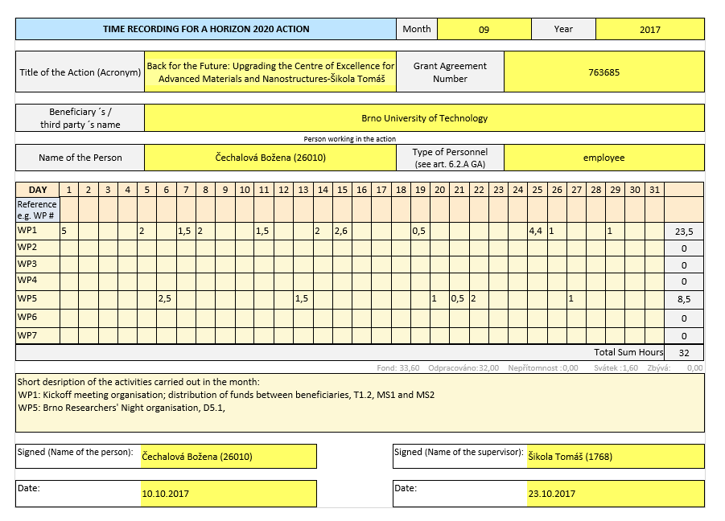
Time Recording for the Action
Minimum requirements:
Title and number of the action
Beneficiary‘s full name
Full name, signature and date of the signature of the employee
Daily record of the hours worked for the action
Supervisors full name and signature
Description of work with reference to the WP and Tasks (in Annex 1)
Information must match records of annual leave, sick leave and work related travels – cross-check with the HR department

Slide 5
Upcoming Deliverables
Number | Title | Beneficiary | Nature | Due Date
D3.1 | Project website, visual identity, and social media | BUT | public | 2 (Feb)
D3.2 | Initial Quality Management Plan | BUT | public | 3 (Mar)
D3.3 | Interim CDE Plan | BUT | public | 4 (Apr)
D3.4 | Data Management Plan | BUT | public | 6 (Jun)
D1.1 | Concept of PS | NGU | public | 6 (Jun)
D2.1 | Specifications of PE EPR microscope | USTUTT | public | 6 (Jun)

Slide 6
Quality Management
Summary of milestones and deliverables (WHAT and WHEN)
Project organization structure (WHO)
  Steering Committee
  Work Package Leaders
  Project Management
Responsibilities (WHO and WHAT)
Project Process Control (WHO and WHEN)
  Work progress monitoring – schedule of meetings
  Budget monitoring – approval of expenditures
  Quality Assessment – review workflow
  Risk management
Standards and protocols – definition (templates) (HOW)

Slide 7
CDE Plan
Protocols on internal project communication
  Mailing list
  Doodle
  Google disc / Dropbox / Office 365 online (BUT servers)
Communication and Dissemination Plan – means, KPIs, timeline
Management of the CDE activities

Slide 8
Data Management
Data specification (WHAT)
Open Research Data Pilot: not everything needs to be made accessible
  Raw research data used to publish a scientific paper (gold open access)
  Papers published in scientific journals (green open access)
  Deliverables with the dissemination level set as „public“ (restricted access)
  Non-publishable data (Intellectual Property) – need to be specified in the DMP
Metadata – clear and consistent naming of datafiles
Data depository
  ResearchGate for open access
  Intranet on the project website for restricted access
IPR protection – specified in the Consortium Agreement
Ethical issues – protection of personal data (if any)

Slide 9
Summer School
WHEN? (MS – month 10 – October?)
HOW LONG?
EVENT NAME?
INVITED TALKS – WHO?

Slide 10

Visual Identity
Project Logo
Project website – www.peter-instruments.eu
Dissemination Materials – poster, flyers, brochure, video clip
Report templates, presentation templates

Slide 11
Gantt Chart

Slide 12
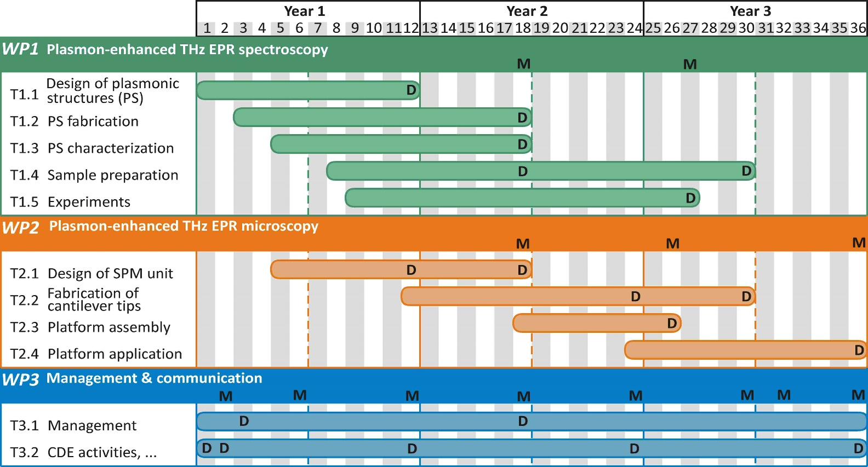
Work Plan

