Slide 1
Plasmon Enhanced Terahertz Electron Paramagnetic Resonance (PETER)
Horizon 2020 – FET-Open
Partners: BUT, Univ. of Stuttgart (USTUTT), NANOGUNE, Thomas Keating
Period: 1/2018 – 12/2020
Grant: 2,898,683.75 EUR
Funding scheme: RIA
Proposal Nr: 767227
Activity: FETOPEN-RIA-2017-1

Slide 2
Horizon 2020 – FET (Future Emerging Technologie) - Open
Long-term vision: a new, original or radical long-term vision of technology-enabled possibilities going far beyond the state of the art
Breakthrough S&T target: scientifically ambitious and technologically concrete breakthroughs, plausibly attainable within the life-time of the project.
Foundational: the breakthroughs must have the potential to become the basis for a new line of technology not currently available.
Novelty: new ideas and concepts, rather than the application or incremental refinement of well established ones.
High-risk: the potential of a new technological direction depends on a whole range of factors that cannot be apprehended from a single disciplinary viewpoint.
Interdisciplinary: the proposed collaborations must go beyond current mainstream collaboration configurations in joint S&T research, and must aim to advance different scientific and technological disciplines together and in synergy towards a breakthrough.

Slide 3
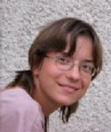

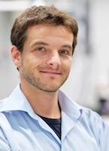
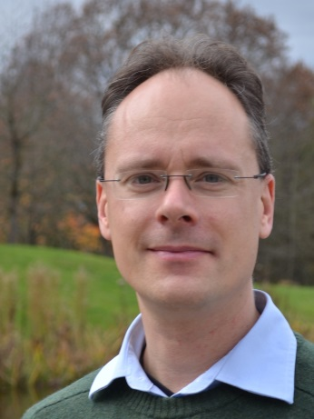
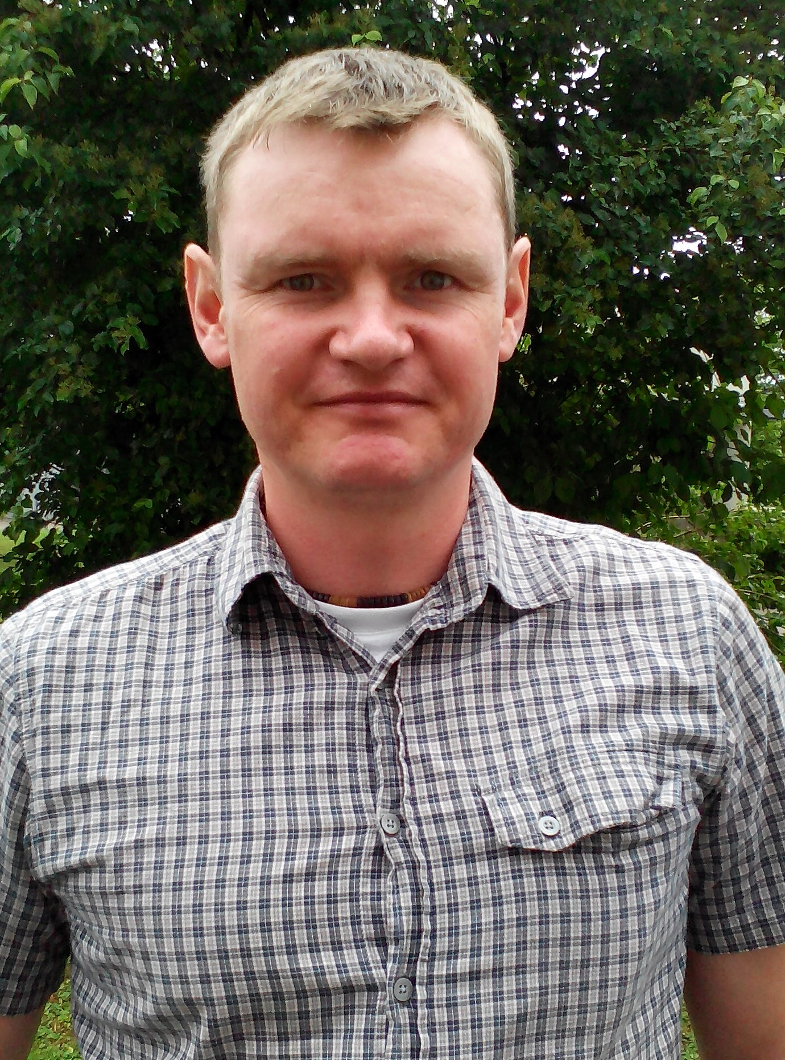
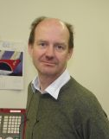
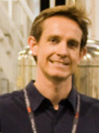
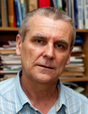
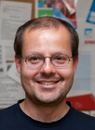
Plasmon Enhanced THz Electron Paramagnetic Resonance
Partners
Rainer Hillenbrand, CIC nanoGUNE, Tolosa Hiribidea, 76, E-20018, Donostia - San Sebastian, Spain, r.hillenbrand@nanogune.eu
Joris van Slageren, Petr Neugebauer, Institute of Physical Chemistry, University of Stuttgart, Pfaffenwaldring 55, 70569 Stuttugart, Germany, slageren@ipc.uni-stuttgart.de, petr.neugebauer@ipc.uni-stuttgart.de
Richard Wylde, Kevin Pike, Thomas Keating Ltd, Station Mills, Billingshurst, West Sussex, RH14 9SH, UK, R.Wylde@terahertz.co.uk, K.Pike@terahertz.co.uk
Tomáš Šikola, Vlastimil Křápek, Jan Čechal, CEITEC and Institute of Physical Engineering, Brno University of Technology, Purkyňova 123, 612 00 Brno, Czech Republic, sikola@fme.vutbr.cz, Vlastimil.Krapek@ceitec.vutbr.cz, Cechal@fme.vutbr.cz,
Božena Čechalová – project manager
Jan
Čechal
Ceitec BUT, Bozena.Cechalova@ceitec.vutbr.cz
Rainer Joris Petr Richard Kevin Tomáš Vlastimil
Hillenbrand van Slageren Neugebauer Wylde Pike Šikola Křápek

Slide 4
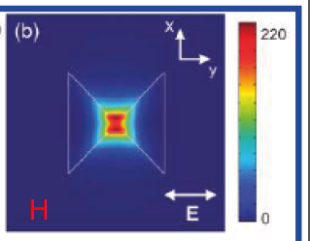
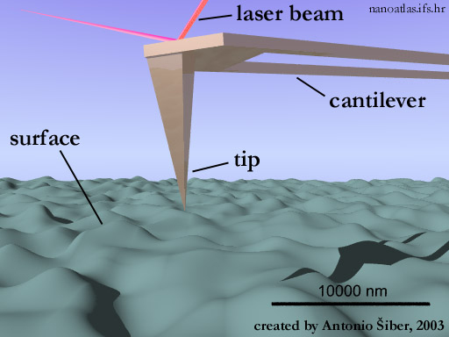
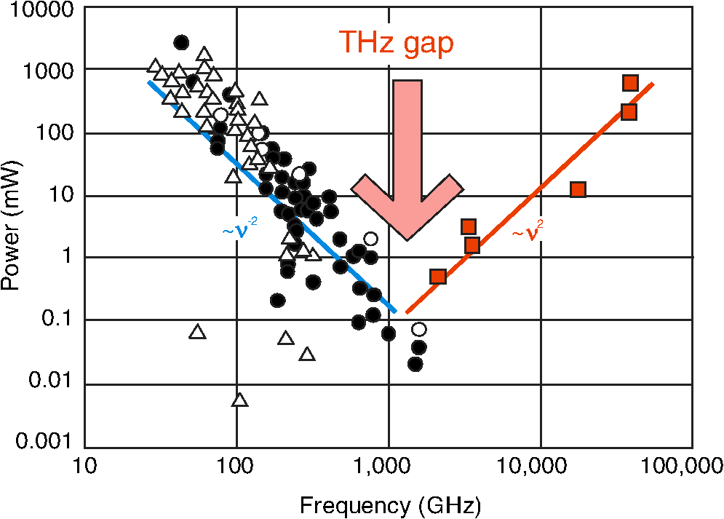
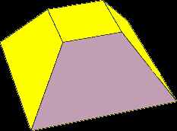
Plasmon Enhanced THz Electron Paramagnetic Resonance
Overview
General aim:
Combine advantages of high-frequency electron paramagnetic resonance with scanning probe microscopy. Achieve a working prototype.
Novelty
First magnetic field enhancement with
plasmonic antennas (localization beyond diffraction limit)
First scanning probe HFEPR (spatial resolution < 1 µm) .
Closing of the THz gap (higher sensitivity)
AFM
Opt. Eng. 52(3), 033203 (Mar 15, 2013). doi:10.1117/1.OE.52.3.033203

Slide 5
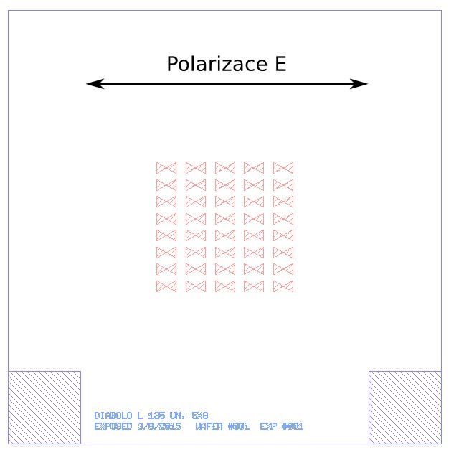
Plasmon Enhanced Electron Paramagnetic Resonance
PE THz EPR spectroscopy
Sample for spectroscopy (antenna arrays on Si)

Slide 6
Plasmon Enhanced THz Electron Paramagnetic Resonance
Overview
General aim:
Combine advantages of high-frequency electron paramagnetic resonance with scanning probe microscopy. Achieve a working prototype.
Novelty
First magnetic field enhancement with
plasmonic antennas (localization beyond diffraction limit)
First scanning probe HFEPR (spatial resolution < 1 µm) .
Closing of the THz gap (higher sensitivity)
AFM
Opt. Eng. 52(3), 033203 (Mar 15, 2013). doi:10.1117/1.OE.52.3.033203

Slide 7
THz Source
PETER schematic configuration
Detector
Interferometer
(modulation-vibration of tip)
THz pickup waveguide
THz excitation waveguide
Z-axis
THz SNOM tip alignment
Sample
Cryostat (2-4 K) and high magnetic field (up to 14 T)
Z-axis
Y-axis
Sample scanning stage
X-axis

Slide 8
Horizon 2020 - FET

Slide 9
Plasmon Enhanced THz Electron Paramagnetic Resonance
Budget
Partner | Personal Costs k€ | Durable Eq. | Other Goods/Services | Travel | Indirect costs | Total
NanoGune | 340 | 60 | 60 | 30 | 123 | 613
USTUTT | 268 | 300 | 65 | 15 | 162 | 810
TK | 538 | 0 | 55 | 37 | 158 | 788
CEITEC BUT | 278 | 115 | 124 | 33 | 138 | 688
Total |  |  |  |  |  | 2900

Slide 10
Plasmon Enhanced THz Electron Paramagnetic Resonance
Work Packages
WP No | Work Package Title | Lead Part. No | Lead Participant Short Name | Person-Months | Start Month | End Month
1 | PE THz EPR spectroscopy | 3 | NGU | 123.5 | M1 | M30
2 | PE THz EPR microscopy | 2 | USTUTT | 130.7 | M5 | M36
3 | Management, CDE | 1 | BUT | 59.4 | M1 | M36

Slide 11
Plasmon Enhanced THz Electron Paramagnetic Resonance
TOPIC : Teaming Phase 1
Thank you!

Slide 12
PETER - Gantt Chart

Slide 13
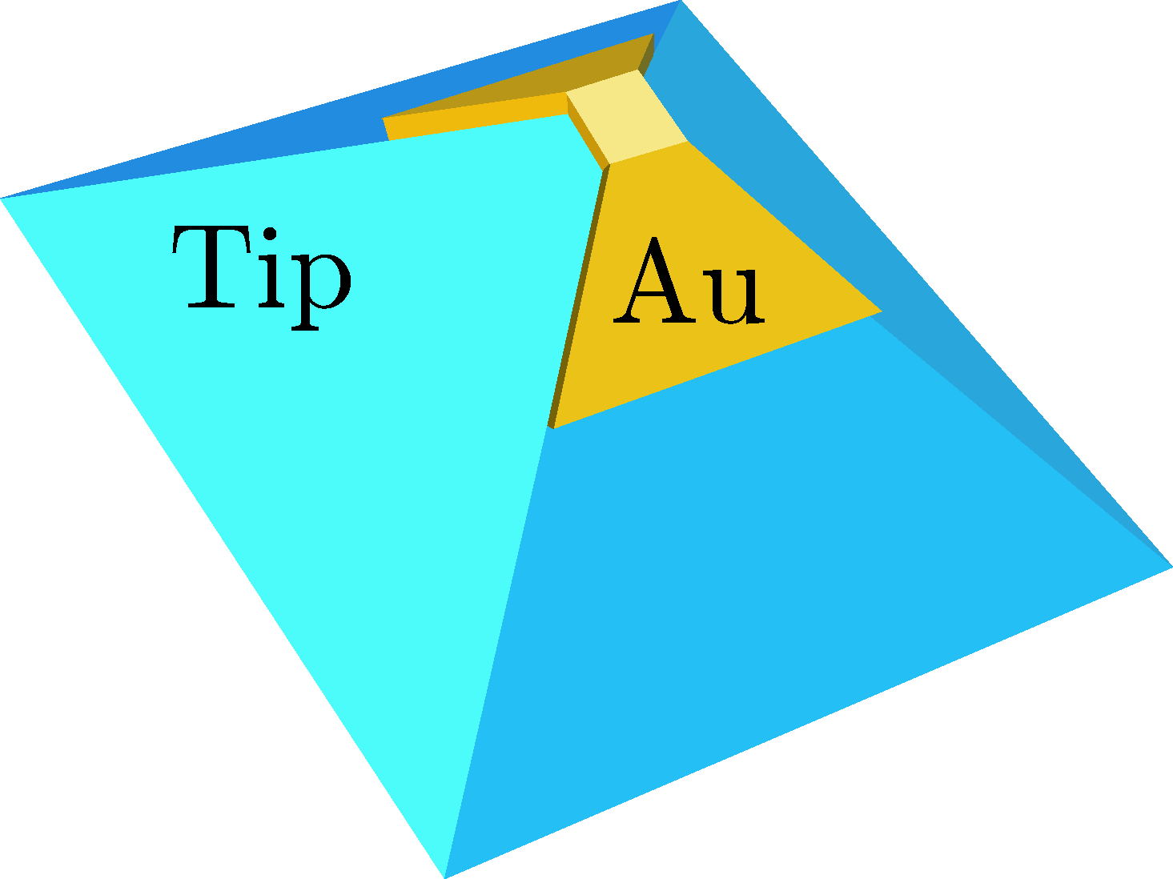
The role of BUT (together with NANOGUNE and USTUTT)
PE THz EPR spectroscopy
Design and Fabrication of Plasmonic Structures. Lead NanoGune
Preliminary work by CEITEC/BUT.
Types: diabolo, split-ring, swiss roll.
Au and/or graphene. Discussion point
Testing at USTUTT

Slide 14
Plasmon Enhanced Electron Paramagnetic Resonance
PE THz EPR spectroscopy
Sample for spectroscopy (antenna arrays on Si)

Slide 15
Plasmon Enhanced Electron Paramagnetic Resonance
PE THz EPR spectroscopy
Diabolo Antenna Resonance Tests
Array Field: 1.3 x 1.3 mm²

Slide 16
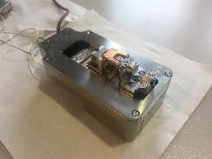
The role of BUT (together with Thomas Keating and NANOGUNE)
PE THz EPR microscopy
Design and Optimization of Platform for PE THz EPR microscopy
Design of an SPM unit
Fabrication of cantilever tips
Assembly and optimization of the platform
Room temperature testing
Low temperature testing
AFM

Slide 17
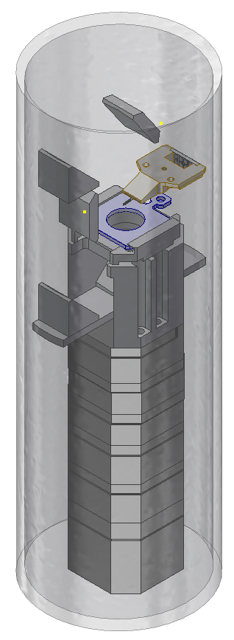
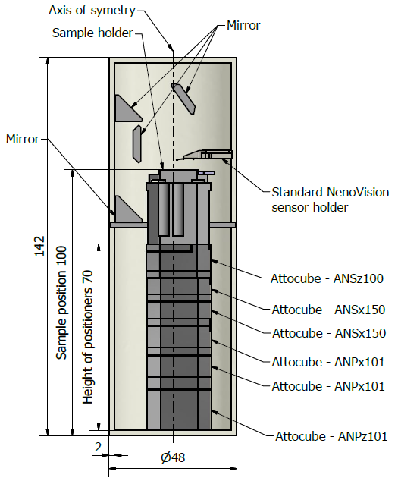
Project PETER – MECHANICAL DESIGN – draft

Slide 18
Plasmon Enhanced THz Electron Paramagnetic Resonance
TOPIC : Teaming Phase 1
Thank you!

Slide 19
PETER - Gantt Chart

Slide 20
TOPIC : Teaming Phase 1
Horizon 2020 project: FET-Open
Topic identifier: | FETOPEN-01-2018-2020: FET/Open Challenging Current Thinking
Publication date: | 27 October 2017
Types of action:
DeadlineModel: Opening date: 07 Nov. 2017 | Multiple cut-off Cut-off dates: |  | 16 May 2018 17:00:00 24 January 2019 17:00:00 18 September 2019 17:00:00 13 May 2020 17:00:00
Thank you!

