Slide 1

Plasmon Enhanced Terahertz Electron Paramagnetic Resonance
Prof. Joris van Slageren
Institute of Physical Chemistry
University of Stuttgart

Slide 2


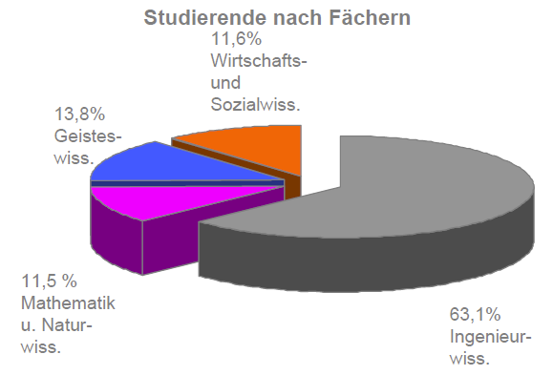

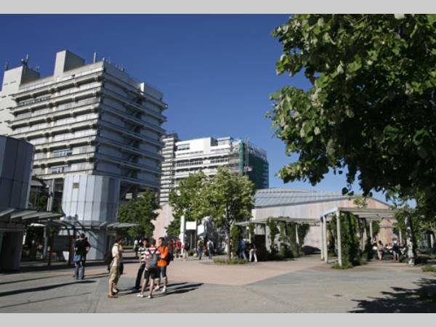
Stuttgart
Stuttgart City:
613.392 Inhabitants (31 Dec. 2011)
University of Stuttgart
founded 1829
26,000 Students
Chemistry (170/y),
Food Chemistry,
Materials Science
Chemistry State Examination for teachers

Slide 3
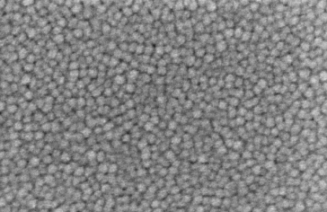
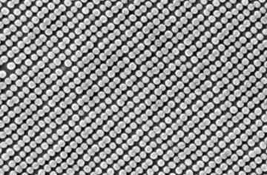
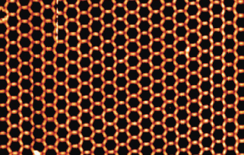
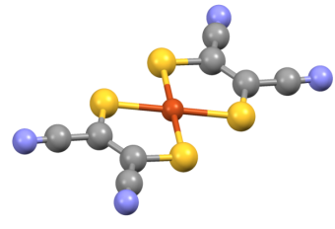

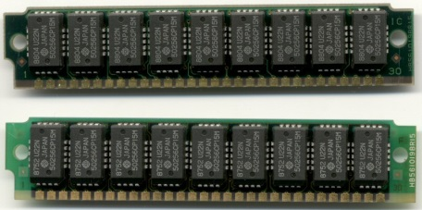
Van Slageren Group
Research Areas
Molecular Nanomagnets
Molecular Quantum Bits
1 μm
1 μm
Standard Hard Disk
Bit Patterned Medium
10 nm
Molecular Surface Array
Standard Bit
Molecular Quantum Bit

Slide 4
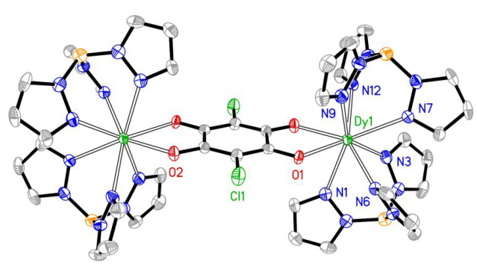
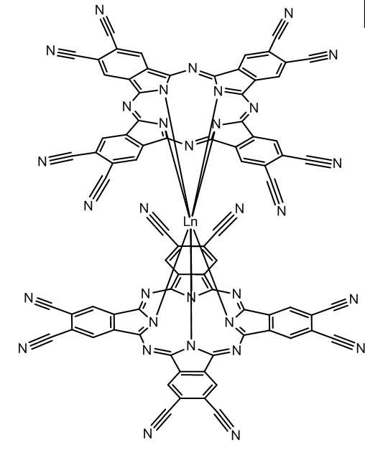
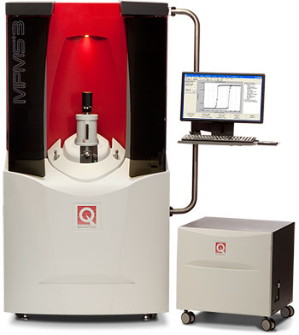
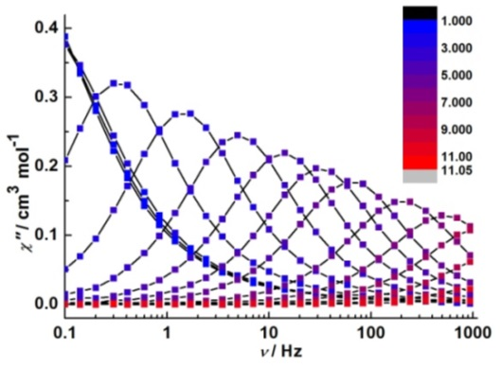
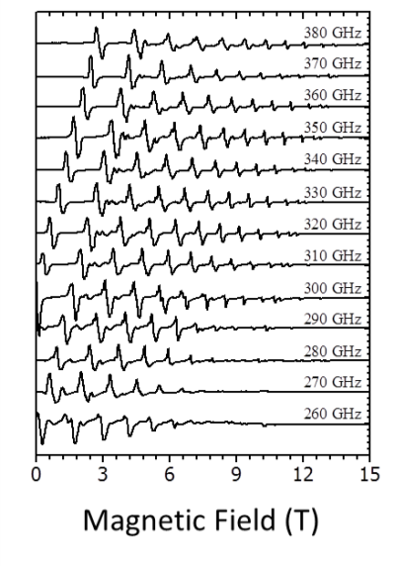
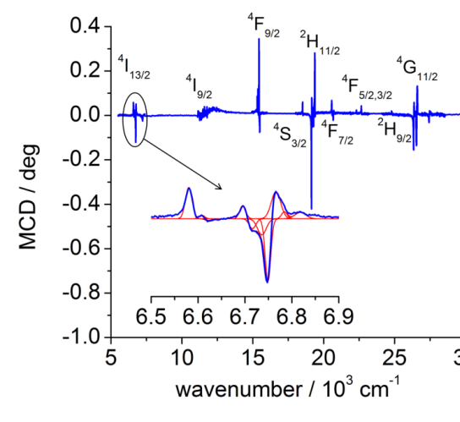
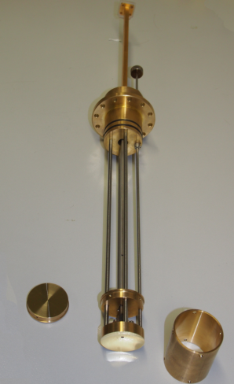
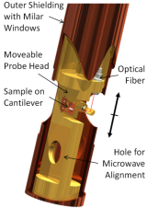
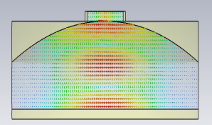
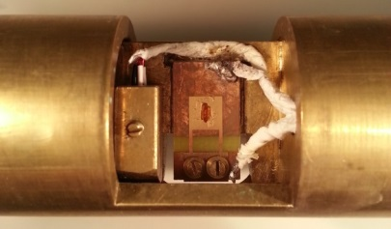
Van Slageren Group Competences
Materials Development
Chemical Synthesis
Magnetism
Spectroscopy
microwave, THz, UV/Vis/NIR)
Method Development

Slide 5
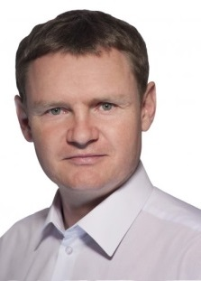
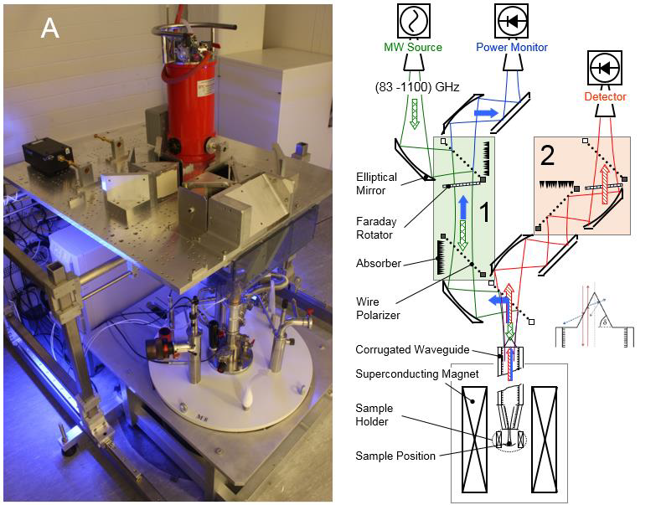
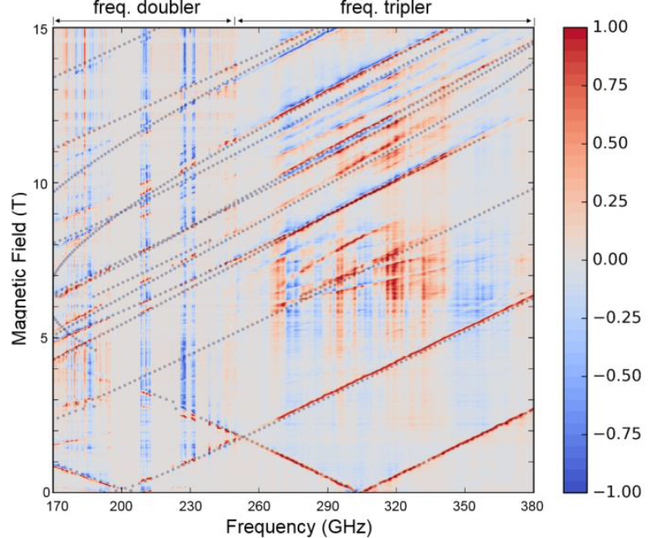
Van Slageren Group Competences
THz Frequency Domain Magnetic Resonance and High-Frequency EPR
Gapless frequency coverage
Fast sweeping
Nat. Commun. 2014, 5, 5304; Chem. Sci. 2016, 7, 4347-4354; Nat. Commun. 2014, 5, 5243; J. Am. Chem. Soc. 2015, 137, 13114 - 13120; Chem. Eur. J. 2014, 20, 3475-3486; Dalton Trans. 2016, 45, 8394-8403; Inorg. Chem. 2016, 55, 11944-11953; Chem. Eur. J. 2016, 22, 13884-13893; Chem. Sci. 2018.

Slide 6
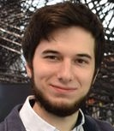
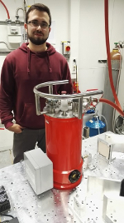
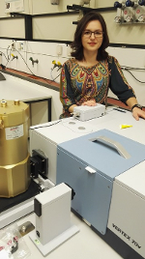
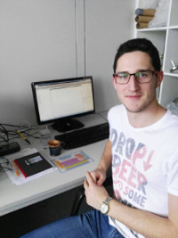
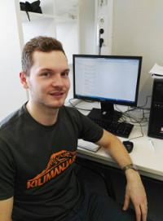
Previous Collaboration BUT-USTUTT
Postdoc
Dr.-Ing. Petr Neugebauer (now at CEITEC)
ERASMUS Students
Michal Kern (now PhD in Van Slageren group)
Jan Vaverka
Marek Tuček (now PhD in Neugebauer group)
Jana Midlíková
Jakub Hrubý
Martin Schneider
Joint Papers
J. Rozbořil, Y. Rechkemmer, D. Bloos, F. Münz, C. N. Wang, P. Neugebauer, J. Čechal, J. Novák, J. van Slageren, Dalton Trans. 2016, 45, 7555-7558.

Slide 7
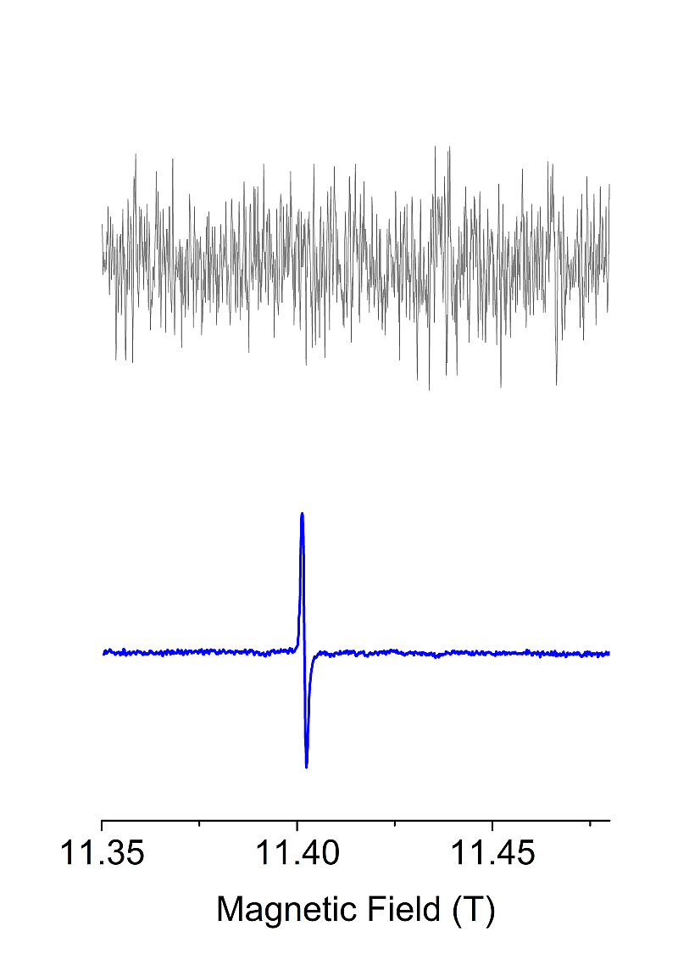

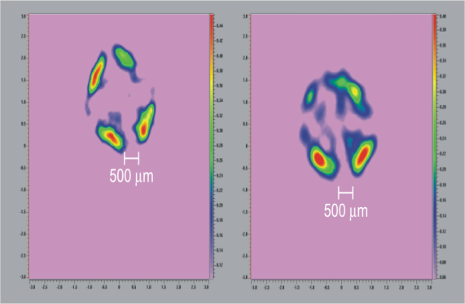
PETER-Concept
Plasmon Enhanced Terahertz Electron Paramagnetic Resonance
Increasing of sensitivity
Enabling imaging.

Slide 8
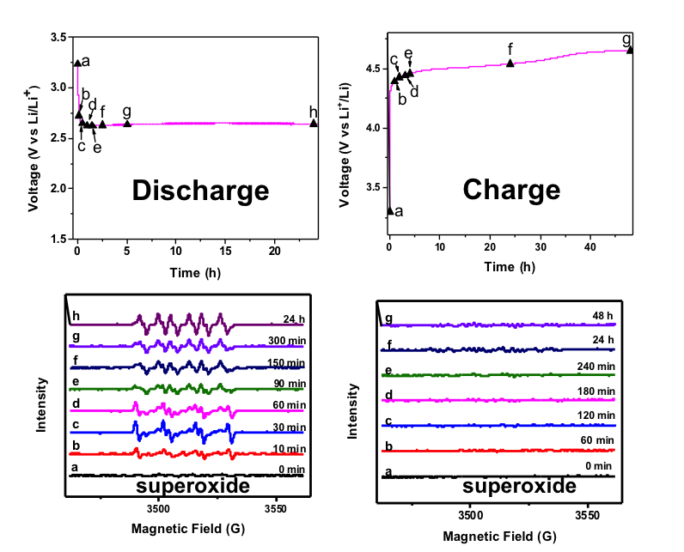
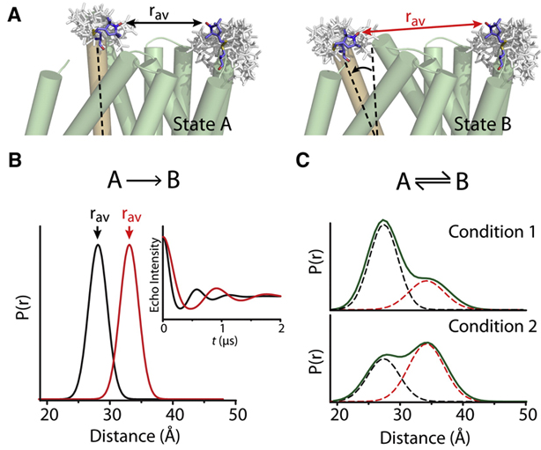
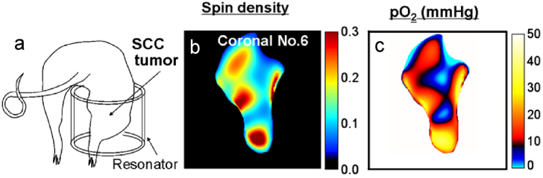
PETER-Concept
Applications of EPR
Electron paramagnetic resonance concerns the interaction of unpaired electrons with microwave and Terahertz radiation.
It is a very powerful technique, because it
only looks at the paramagnetic center and
thus allows to look "inside" the sample, without destroying it.
It can be used to look at live animals.

Slide 9

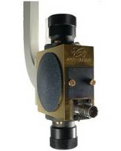
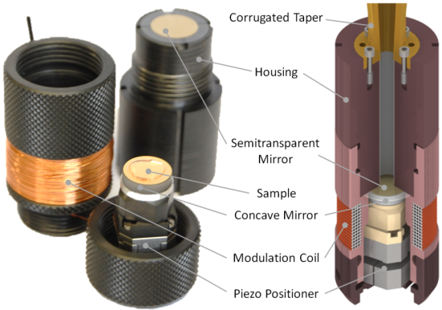
PETER-Concept
10 GHz
100 GHz
1 THz
Increasing the sensitivity
EPR is an insensitive technique (magnetodipolar transitions).
One solution is to go to higher frequencies
A second solution is to use a resonating structure

Slide 10
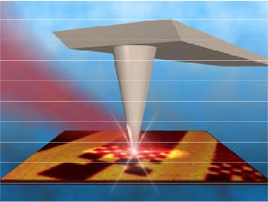
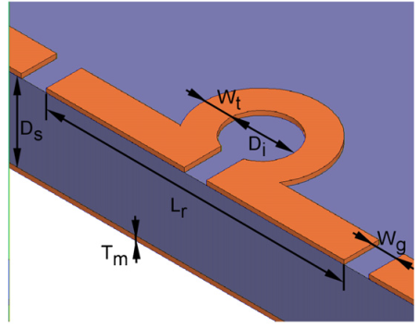
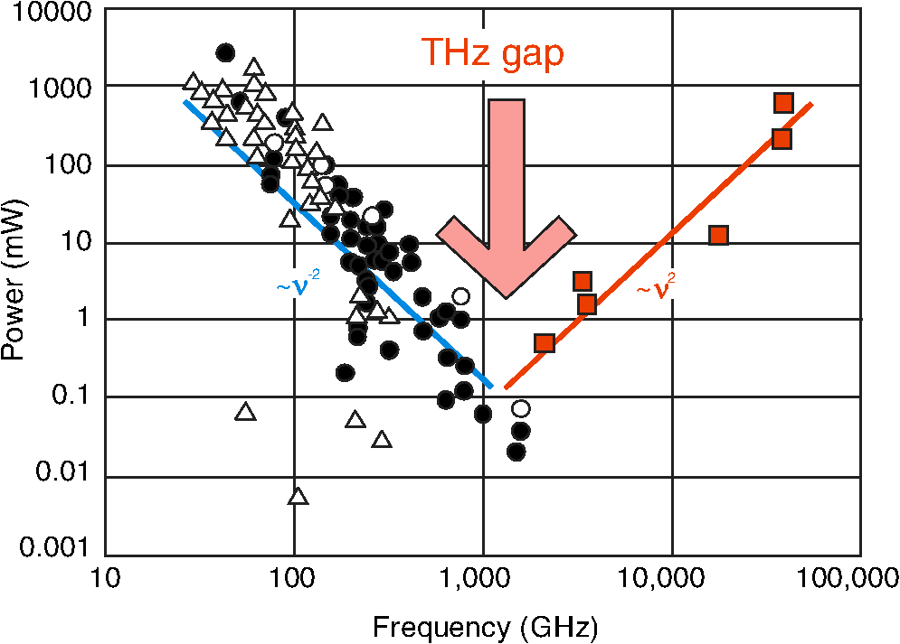
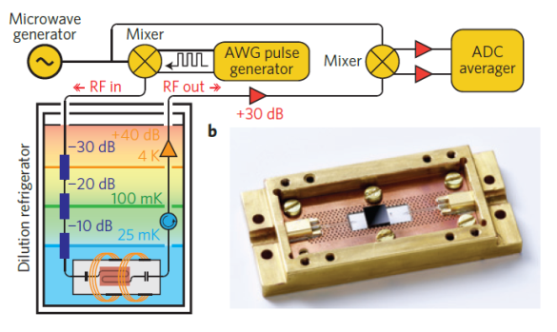
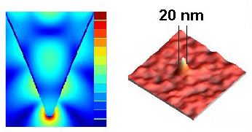
PETER-Concept
Imaging methods
For small length scales, microresonators can be use. These cannot be easily extended to THz frequencies.
At higher frequencies scanning tip measurements in the nearfield can be used for vibrational excitations (electric dipole transitions).
The latter are also very successful for high resolution imaging
THz gap

Slide 11
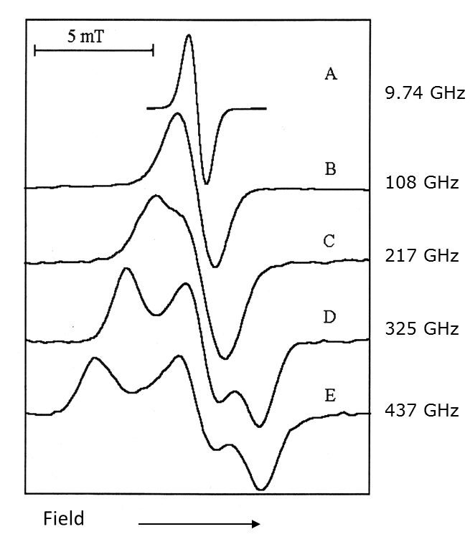
PETER-Concept
Combing microstructures with scanning tips
In PETER we will combine the microstructure and scanning tip approaches to deliver a highly sensitive THz EPR imaging microscope.
For highest spatial and spectral resolution, we should use high frequencies.
This is challenging because radiation sources are weaker.
Also, we will need high magnetic fields. For typical radicals ~3.5 Tesla/100 GHz, i.e. 35 Tesla at 1 THz.
A compromise is found in
330 (11.8 T for radicals) and
660 GHz (for metal centers ).

Slide 12
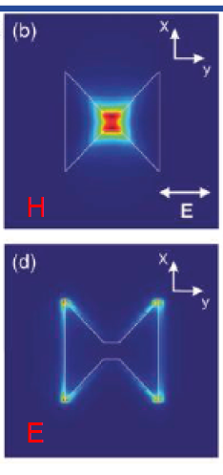
PETER-Concept
Combing microstructures with scanning tips
We will use plasmonic microstructures especially designed to enhance the Terahertz magnetic field, for example diabolo-type
These should give a 10⁴-fold magnetic field field (B) enhancement.
The electric field (E) enhancement should be negligible.
B-field
E-field

Slide 13
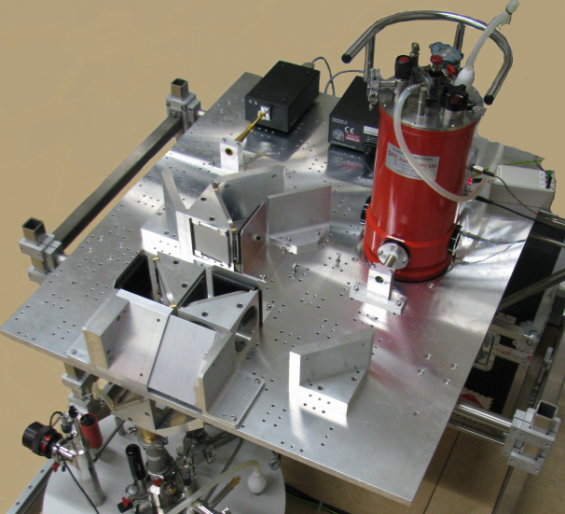
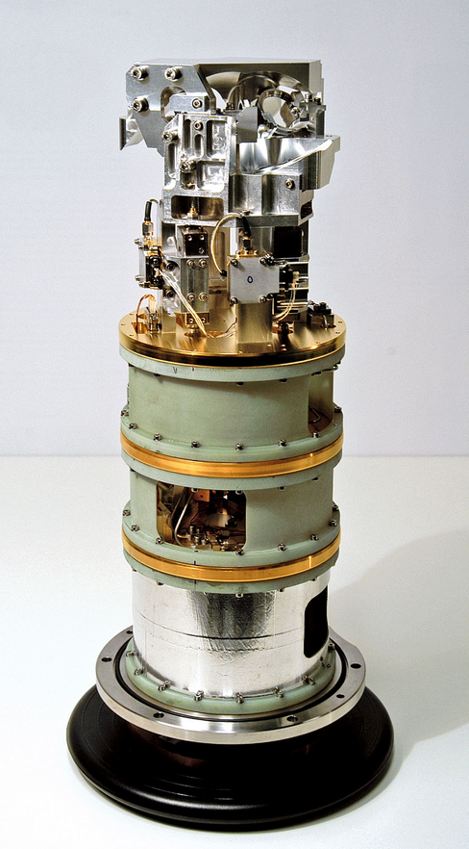
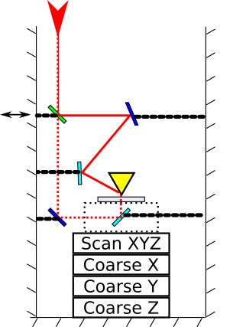
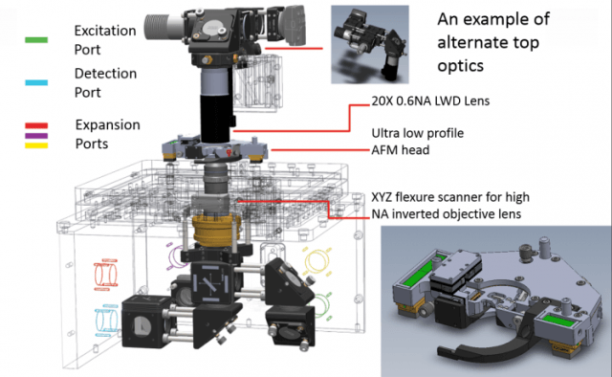
PETER-Concept
Combing microstructures with scanning tips
In the probe we will combine THz quasi optics and scanning probe hardware.
Both bottom and top irradiation will be explored.

Slide 14
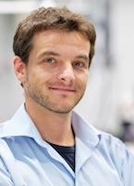
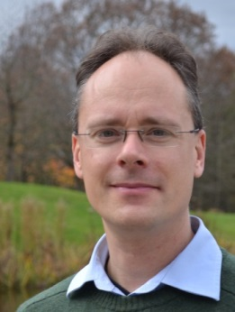
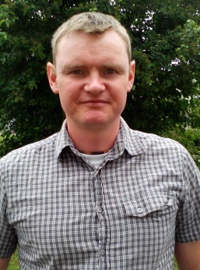
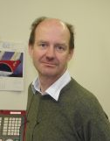
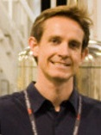
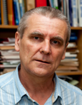

Plasmon-Enhanced Electron Paramagnetic Resonance
Partners
Prof. Dr. Rainer Hillenbrand, CIC nanoGUNE, Tolosa Hiribidea, 76, E-20018, Donostia - San Sebastian, Spain, r.hillenbrand@nanogune.eu
Prof. Dr. Joris van Slageren, Institute of Physical Chemistry, University of Stuttgart, Pfaffenwaldring 55, 70569 Stuttugart, Germany, slageren@ipc.uni-stuttgart.de
Dr. Richard Wylde, Dr. Kevin Pike, Thomas Keating Ltd, Station Mills, Billingshurst, West Sussex, RH14 9SH, UK, R.Wylde@terahertz.co.uk, K.Pike@terahertz.co.uk
Prof. Dr. Tomáš Šikola, Dr. Vlastimil Křápek, Dr. Petr Neugebauer, CEITEC and Institute of Physical Engineering, Brno University of Technology, Purkyňova 123, 612 00 Brno, Czech Republic, sikola@fme.vutbr.cz, Vlastimil.Krapek@ceitec.vutbr.cz
Rainer Joris Petr Richard Kevin Tomáš Vlastimil
Hillenbrand van Slageren Neugebauer Wylde Pike Šikola Křápek

Slide 15
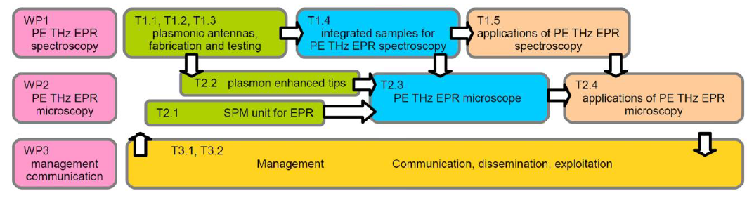
PETER
Plasmon Enhanced Terahertz Electron Paramagnetic Resonance
Leading of WP2
Leading Tasks 1.3, 1.5, 2.4

Slide 16




PETER
Plasmon Enhanced Terahertz Electron Paramagnetic Resonance
First very preliminary results

Slide 17





PETER
Plasmon Enhanced Terahertz Electron Paramagnetic Resonance
Use of Rare Earth Orthoferrites (TmFeO₃) for testing:
Collective modes in relevant frequency range: testing in zero field at ambient temperatures.
Local crystal field excitations to test sensitivity
K. Zhang, K. Xu, X. Liu, Z. Zhang, Z. Jin, X. Lin, B. Li, S. Cao, G. Ma, Sci. Rep. 23648 (2016)

Slide 18



PETER
Plasmon Enhanced Terahertz Electron Paramagnetic Resonance
Prototype testing
1 μm

