Slide 1
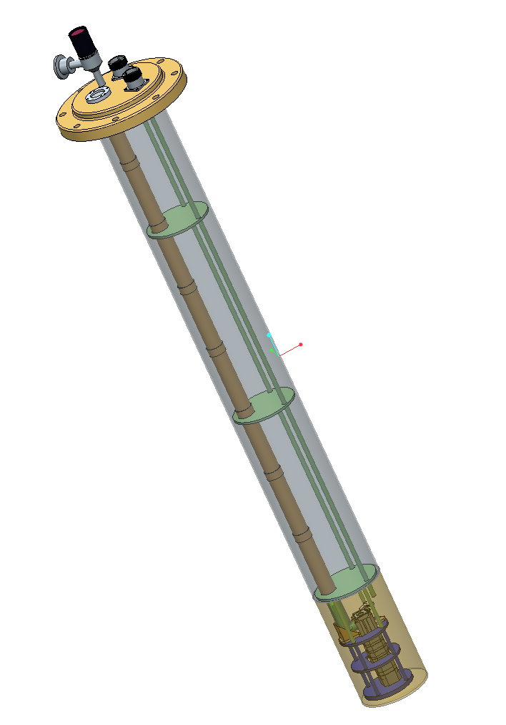
TK quick update
02/10/2018

Slide 2
What TK is manufacturing
Materials testing bench – sent to Stuttgart
Titanium mirrors and baseplate to interface with NenoVision frame
350 GHz corrugated waveguide
Probe interface with VTI
Remaining probe supports
QO bench
2nd QO configuration for probe
Modulation coil?
Completed
In progress
Design stage

Slide 3
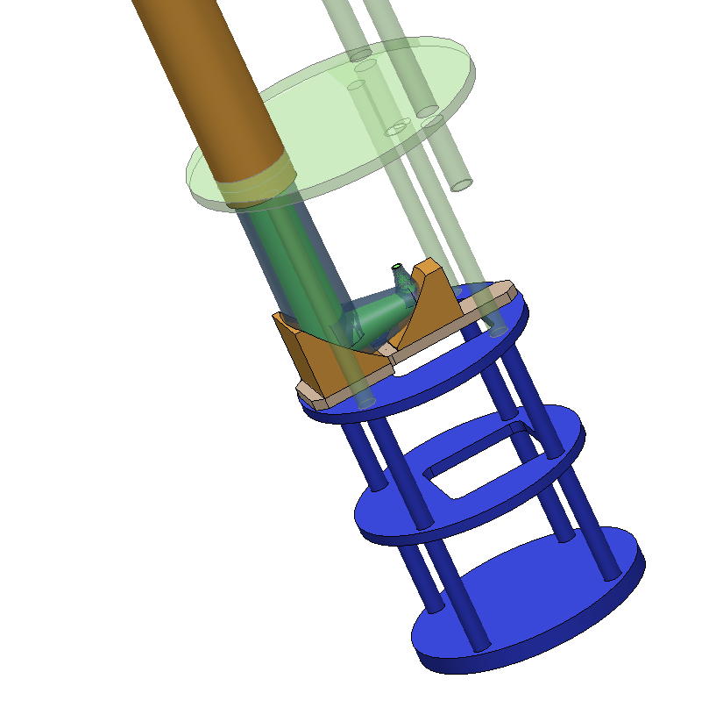
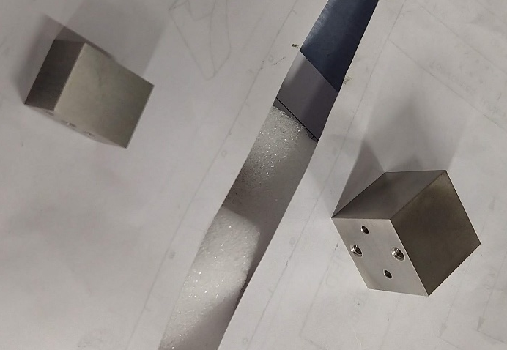
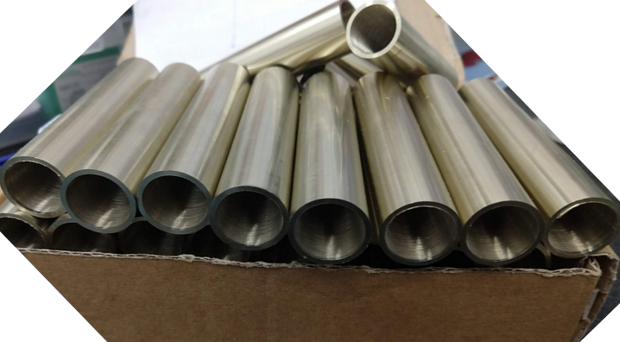
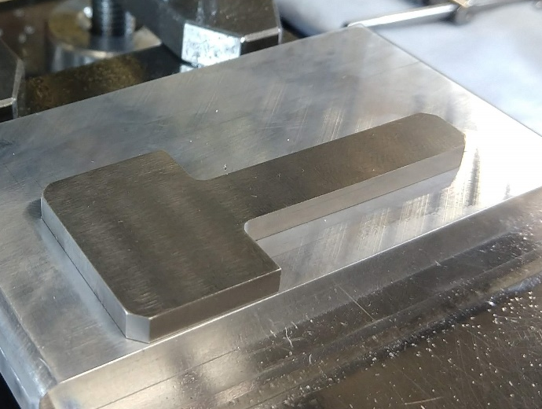
Manufacturing work in progress
Titanium mirrors
350 GHz waveguide
Baseplate

Slide 4
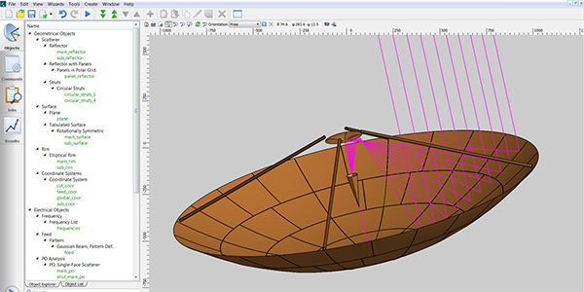
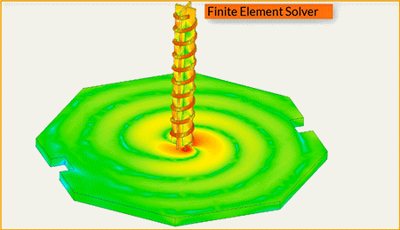
Microwave analysis through waveguide and mirrors in probe
GRASP
HFSS
Good for large electric surfaces and lots of empty space
Utilizes surfaces
Calculation methods
  Physical optics (PO)
  Geometric optics (GTD)
  Moment of methods (MoM)
Near & far field analyses
Good for materials interactions
Interfacing with thermal and structural analyses
Utilizes solid structures
Calculation methods
  Finite element method (FEM)
  Method of moments (MoM)
  Shooting and bouncing rays (SBR)
Near & far field analyses

Slide 5
GRASP analyses in progress
Microwaves through a bent waveguide – exaggerated and within manufacturing tolerances
EPR signal return coupling to the waveguide resulting from maximal tilt at the interface of titanium and brass frames of the probe support
Tilt comes from here

