Slide 1
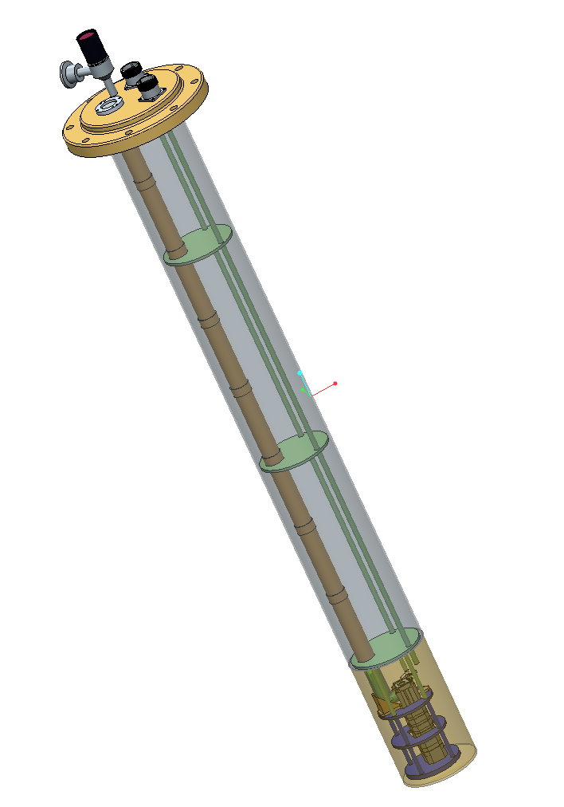

TK quick update
12/11/2018

Slide 2
What TK is manufacturing
Materials testing bench – sent to Stuttgart
Titanium mirrors and baseplate to interface with NenoVision frame
350 GHz corrugated waveguide (assembly remaining)
Probe interface with VTI
Remaining probe supports
QO bench - approval
2nd QO configuration for probe – initial approval
Modulation coil - approval
Completed
In progress
Design stage
Design stage - approval

Slide 3
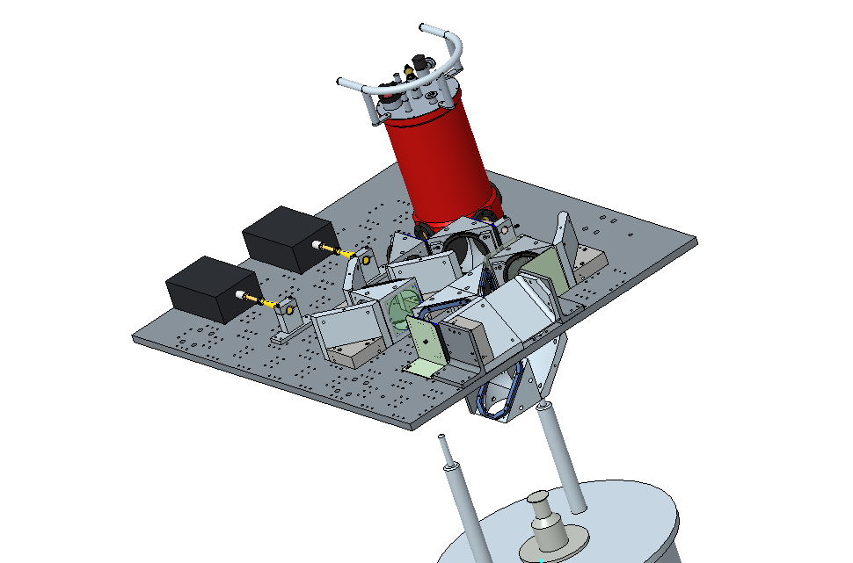
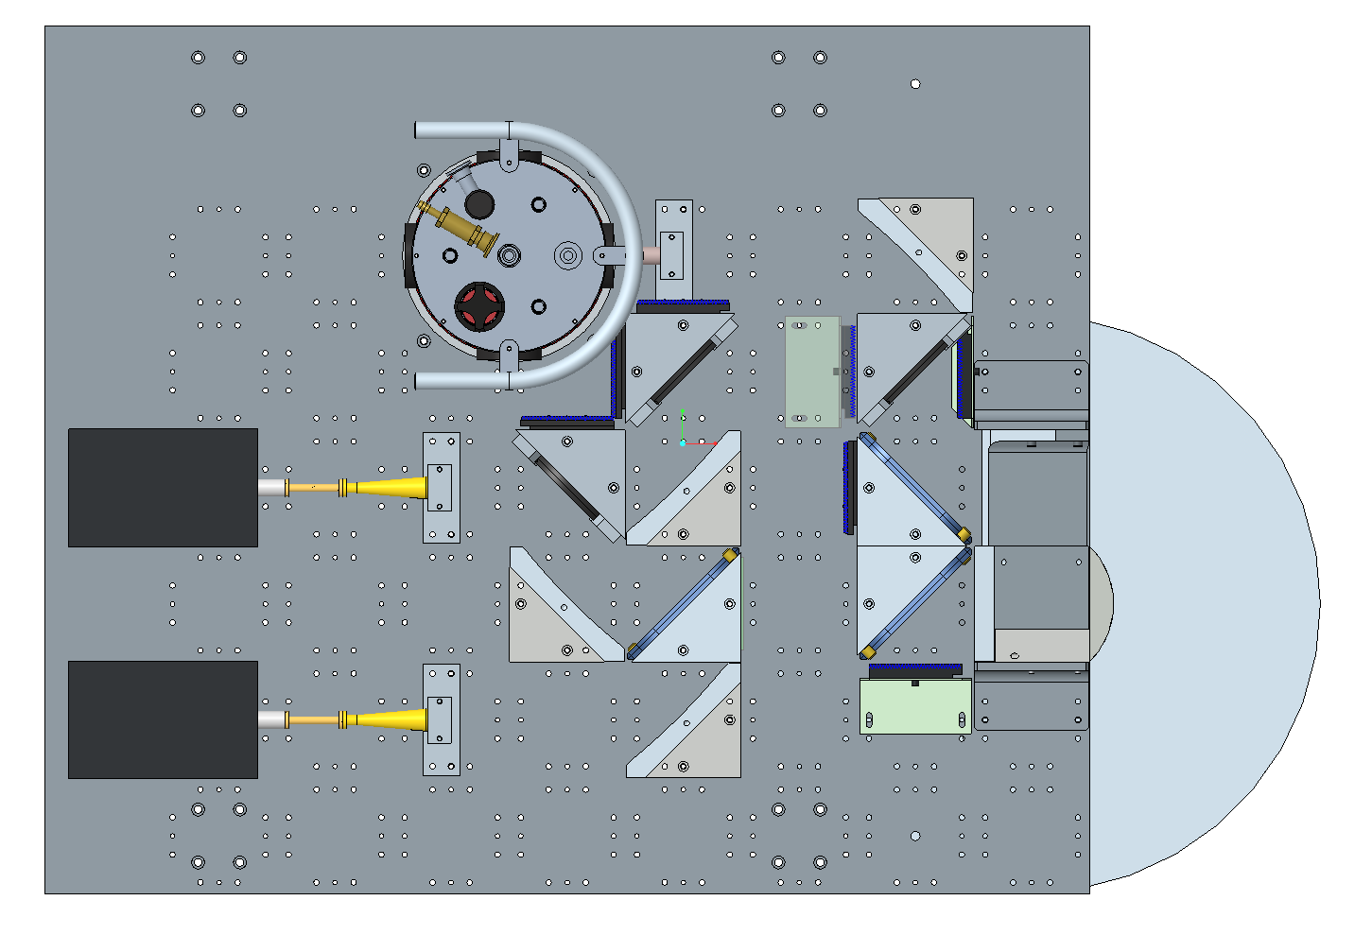
Quasi Optical Bench

Slide 4
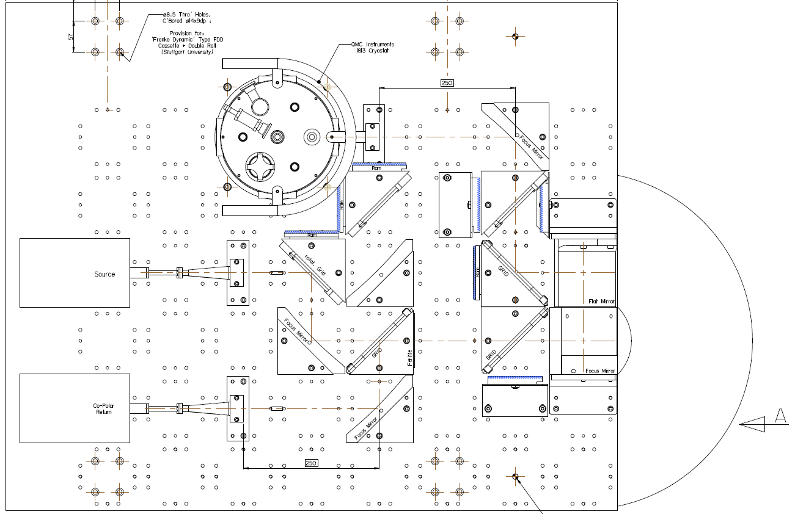
Quasi optical bench drawing

Slide 5
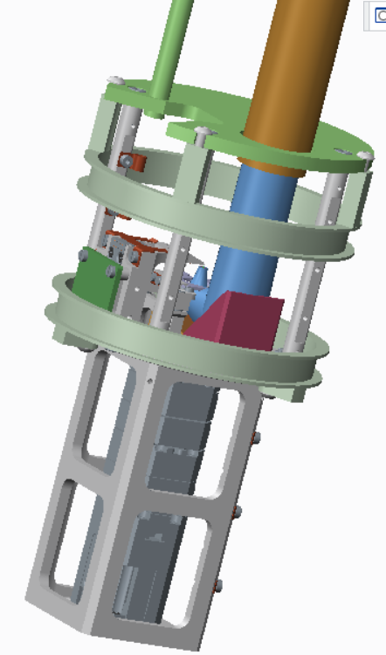
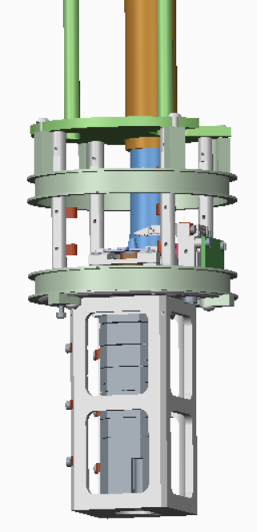
Helmholtz modulation coil design
AWG 20 wire
17 turns per coil
Mod. ν (kHz) | Mod. Amp. (G)
1 | 4
10 | 2
100 | 1

Slide 6
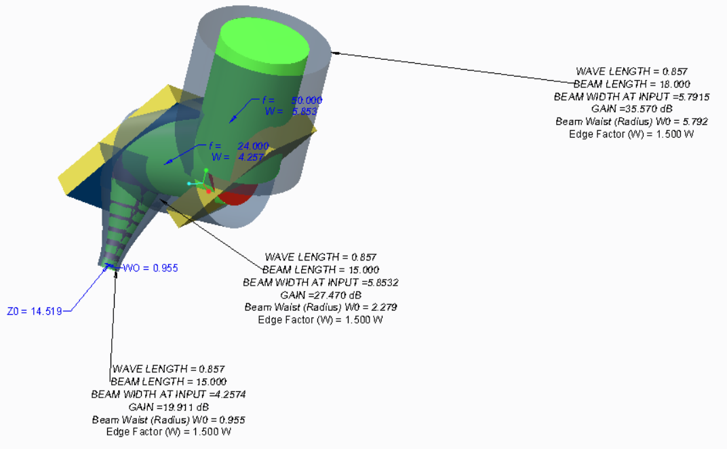
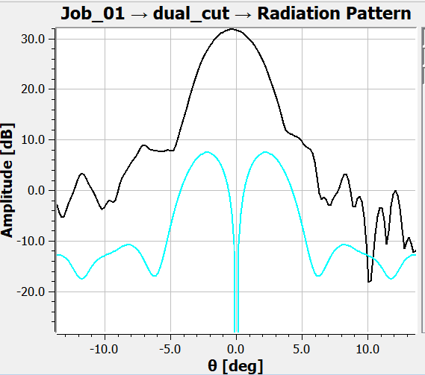
2nd MW Approach
2 compound angle mirrors
Beam waist at sample ~ 1 mm
Co-polar
Cross-polar

Slide 7
Arbitrary waveform generator
Advantageous for the PETER project
  Easier rapid scanning capabilities
  Relevant for commercialization prospects
  Possibility to reduce standing wave effects

