Slide 1


Progresses on
Project
UNISTUTT
3rd of December 2020

Slide 2
Progresses on
Project
UNISTUTT
3rd of December 2020
E
X
P
E
M
N
T
E
R
I

Slide 3
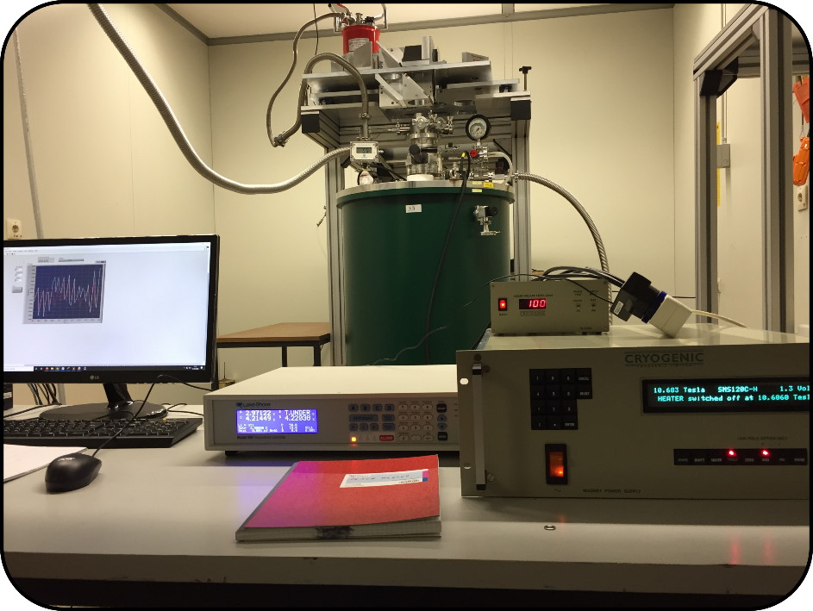
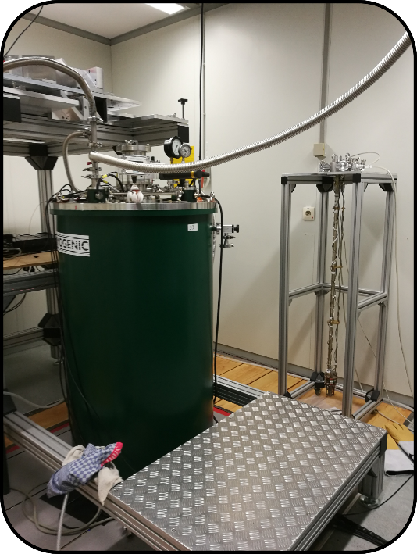
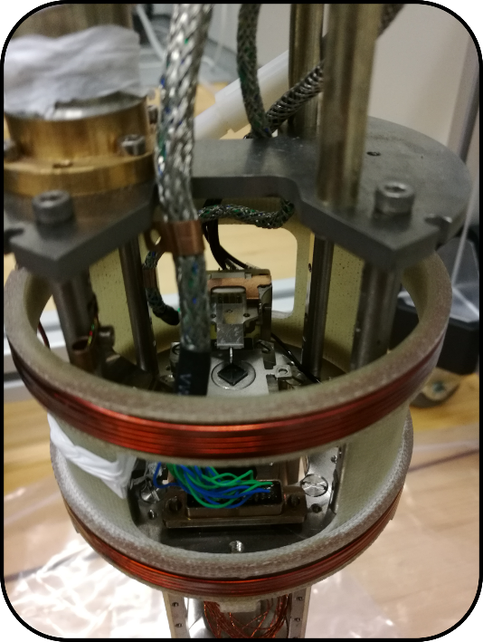
PETER laboratory
Microwave waveguide
PETER sample rod
with SPM unit
SPM probe + probe holder
Bolometer
Microwave quasi-optics
Sample
Superconducting magnet, 0 - 12 T (Cryogenic Ltd.)
with cryostat enabling EPR measurements from 4 K to RT
SPM unit
Piezoscanner + stepping motors
Coils for magnetic field modulation

Slide 4
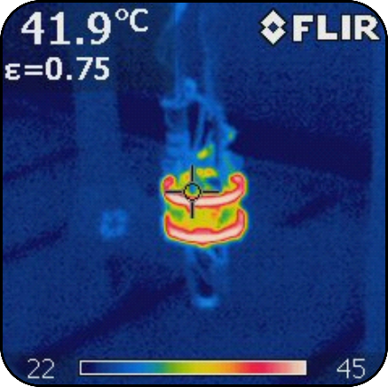
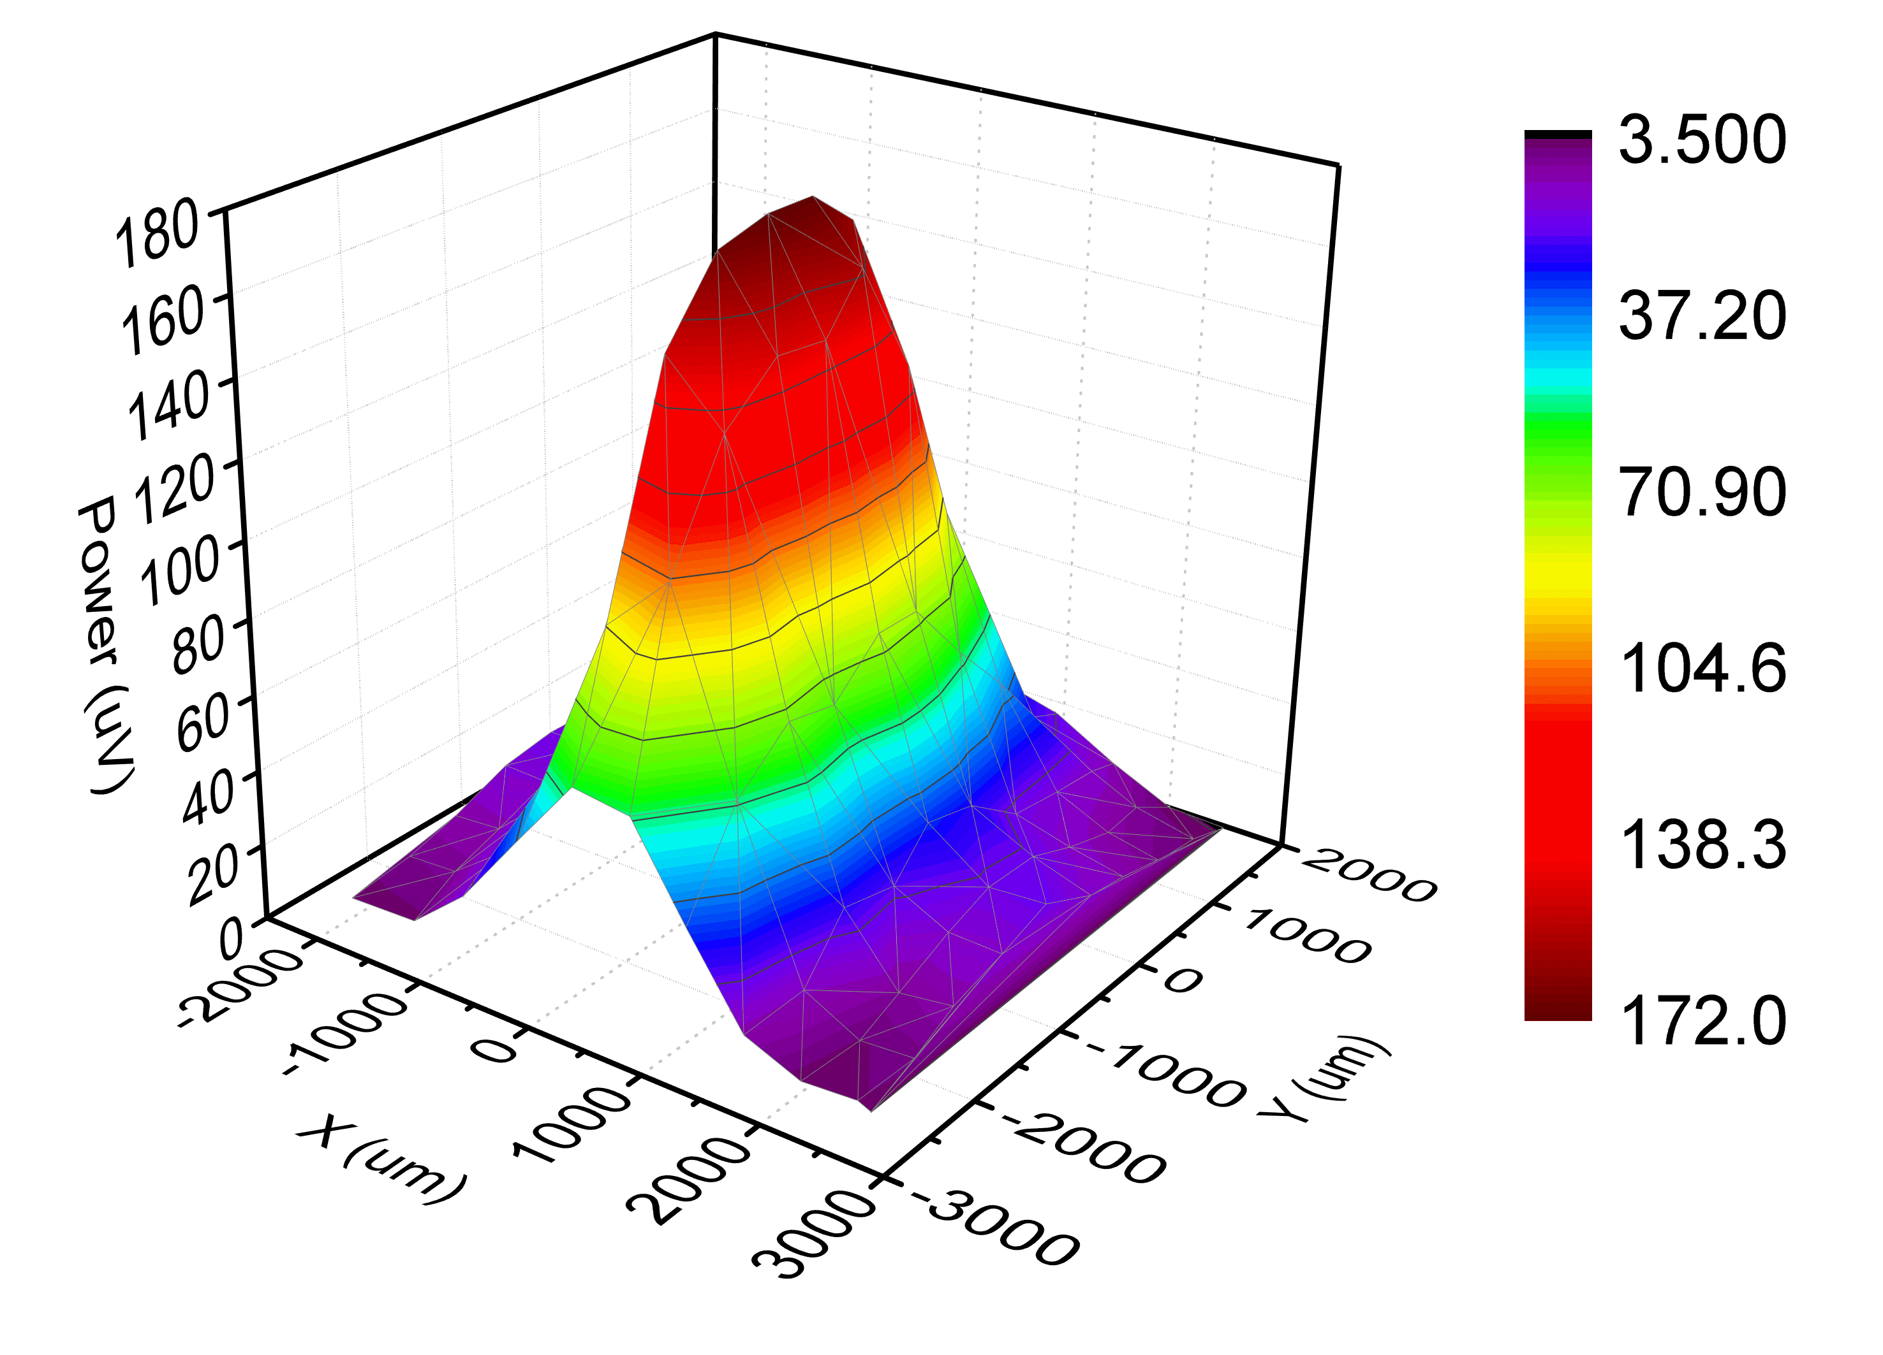
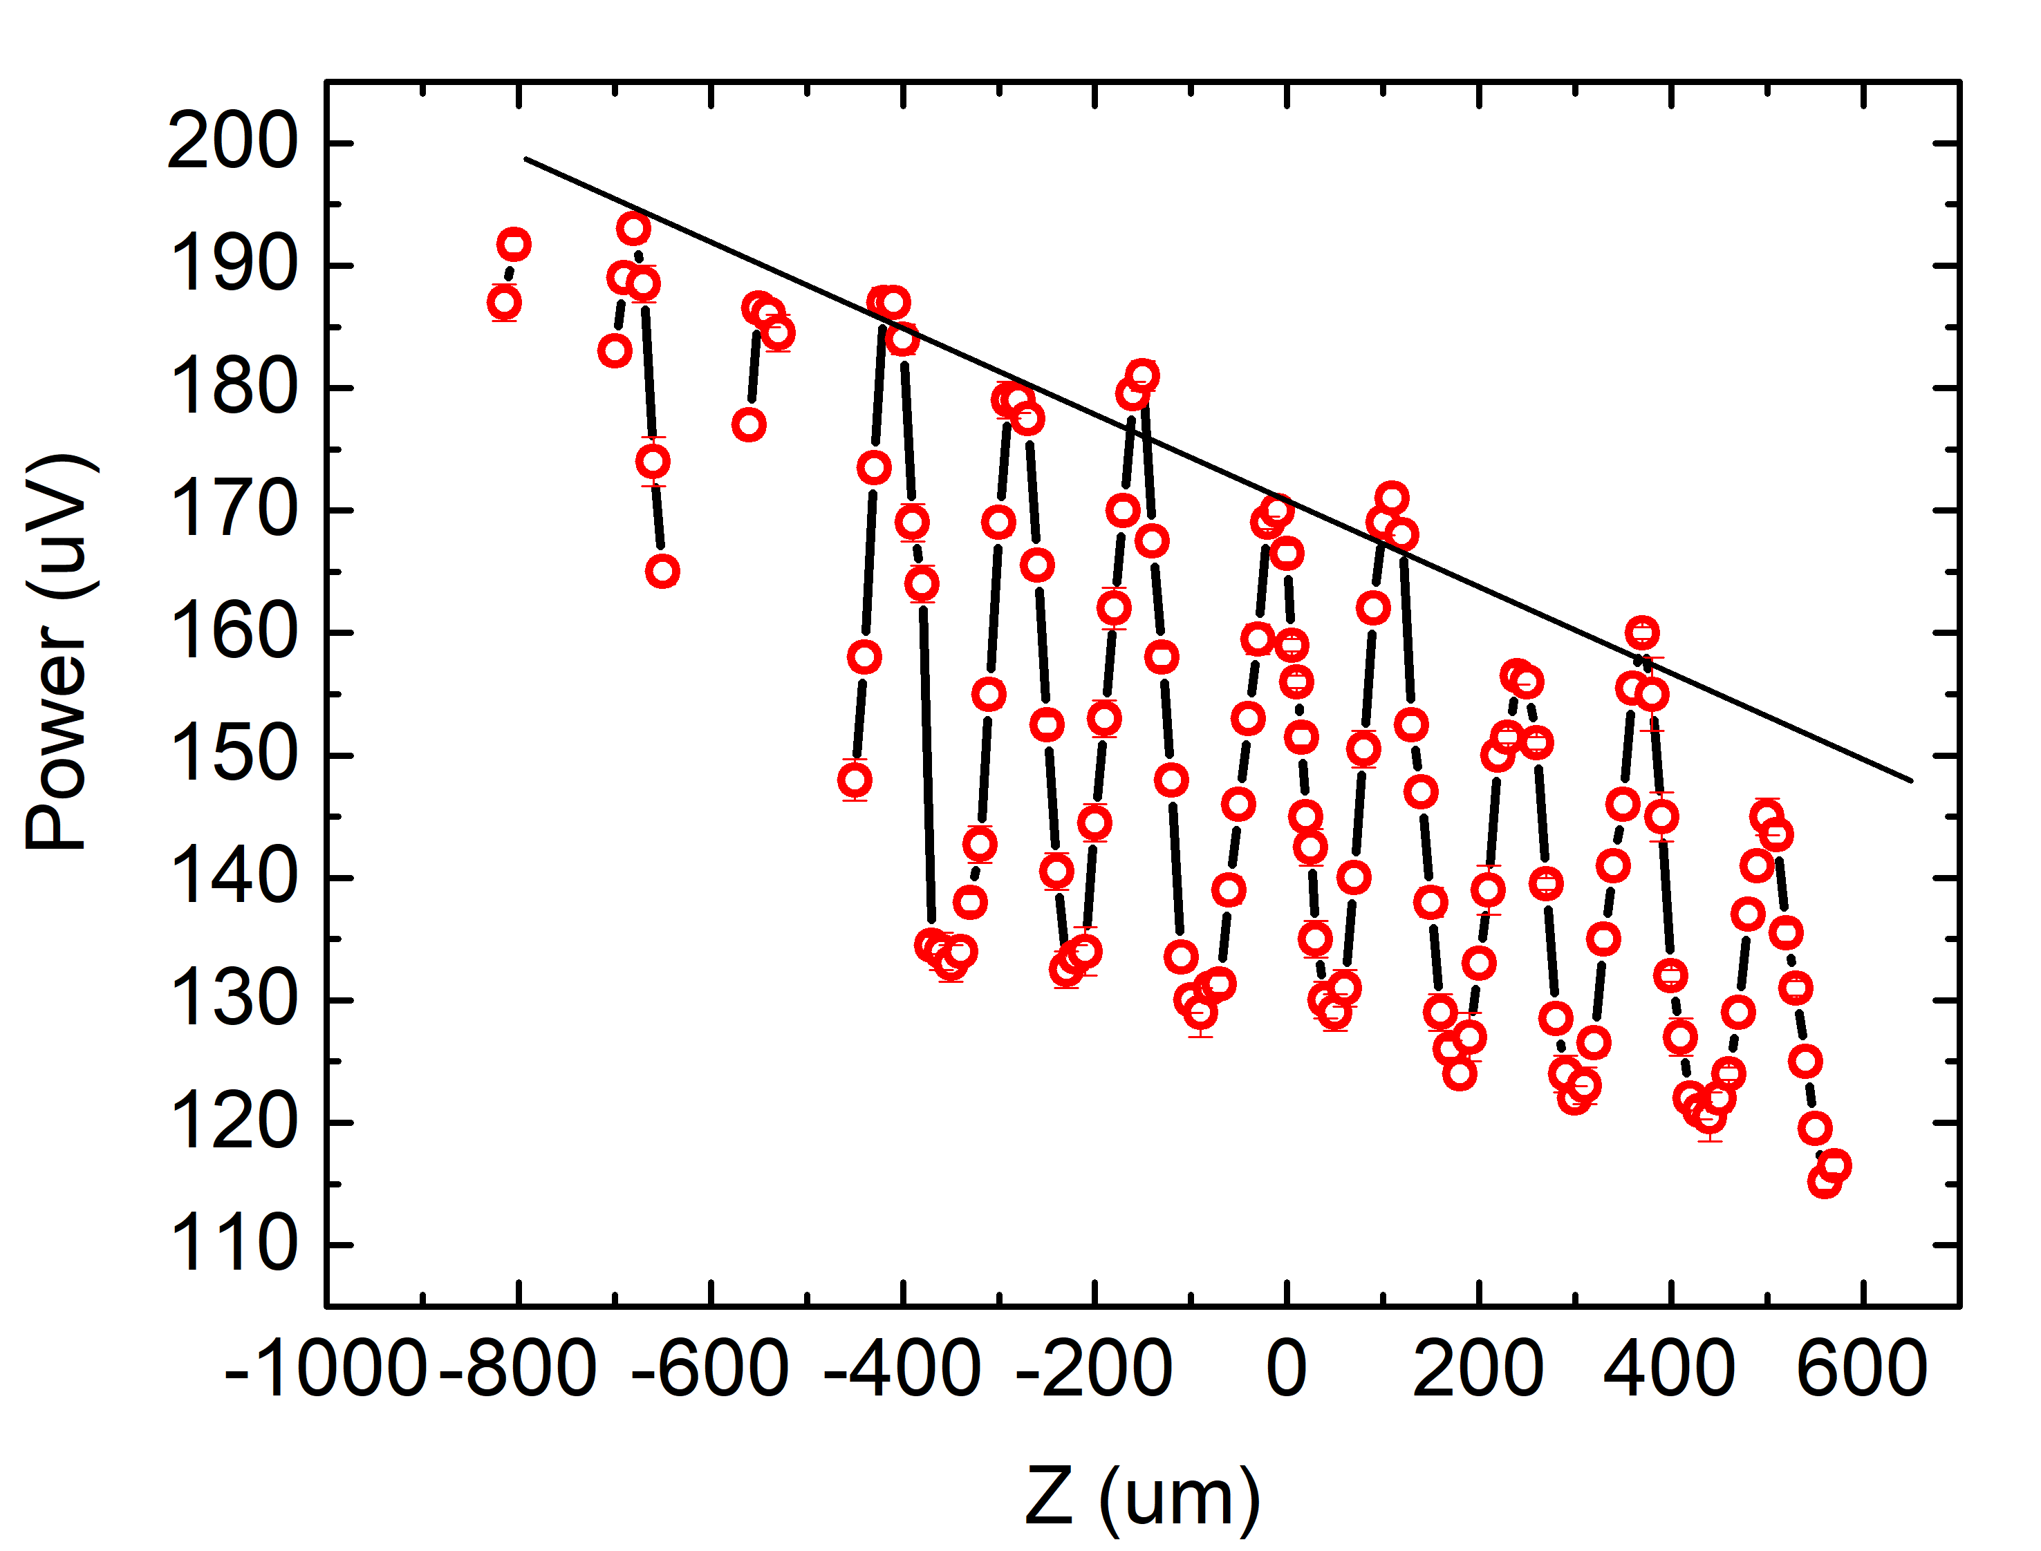
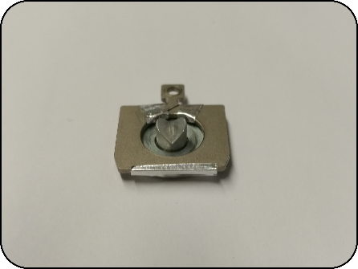
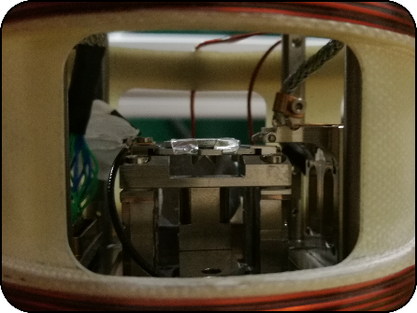
Testing of PETER setup (Alisa and Richard visit)
42°C after few min at 4 A and 2V – cca 10 G
Alignment of microwave quasi-optics, heating test of the modulation coil
Detection and mapping of cross-polar signal – roof mirror mounted on SPM sample stage
(inside the cryostat)
XY scan of cross-polar signal
Z scan of cross-polar signal
Roof mirror

Slide 5
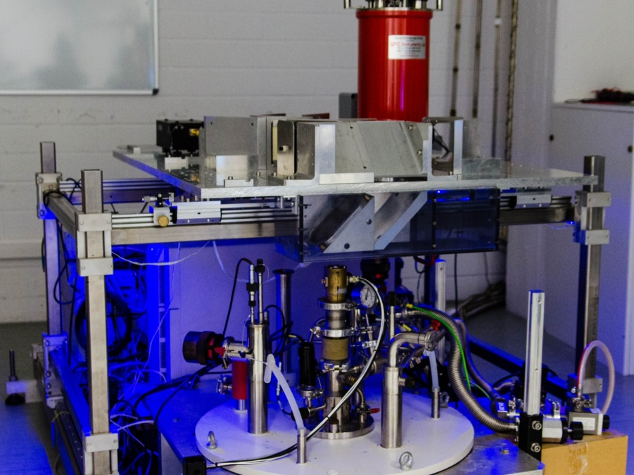
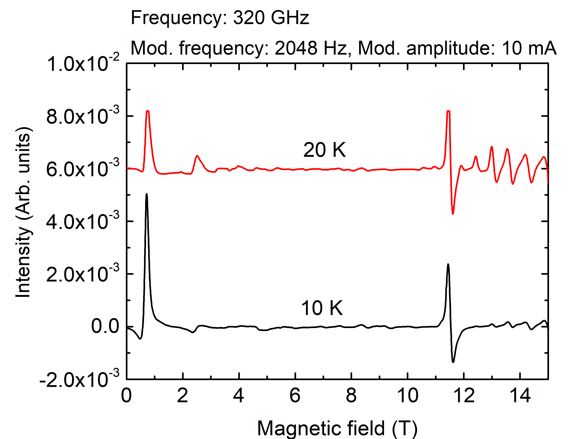
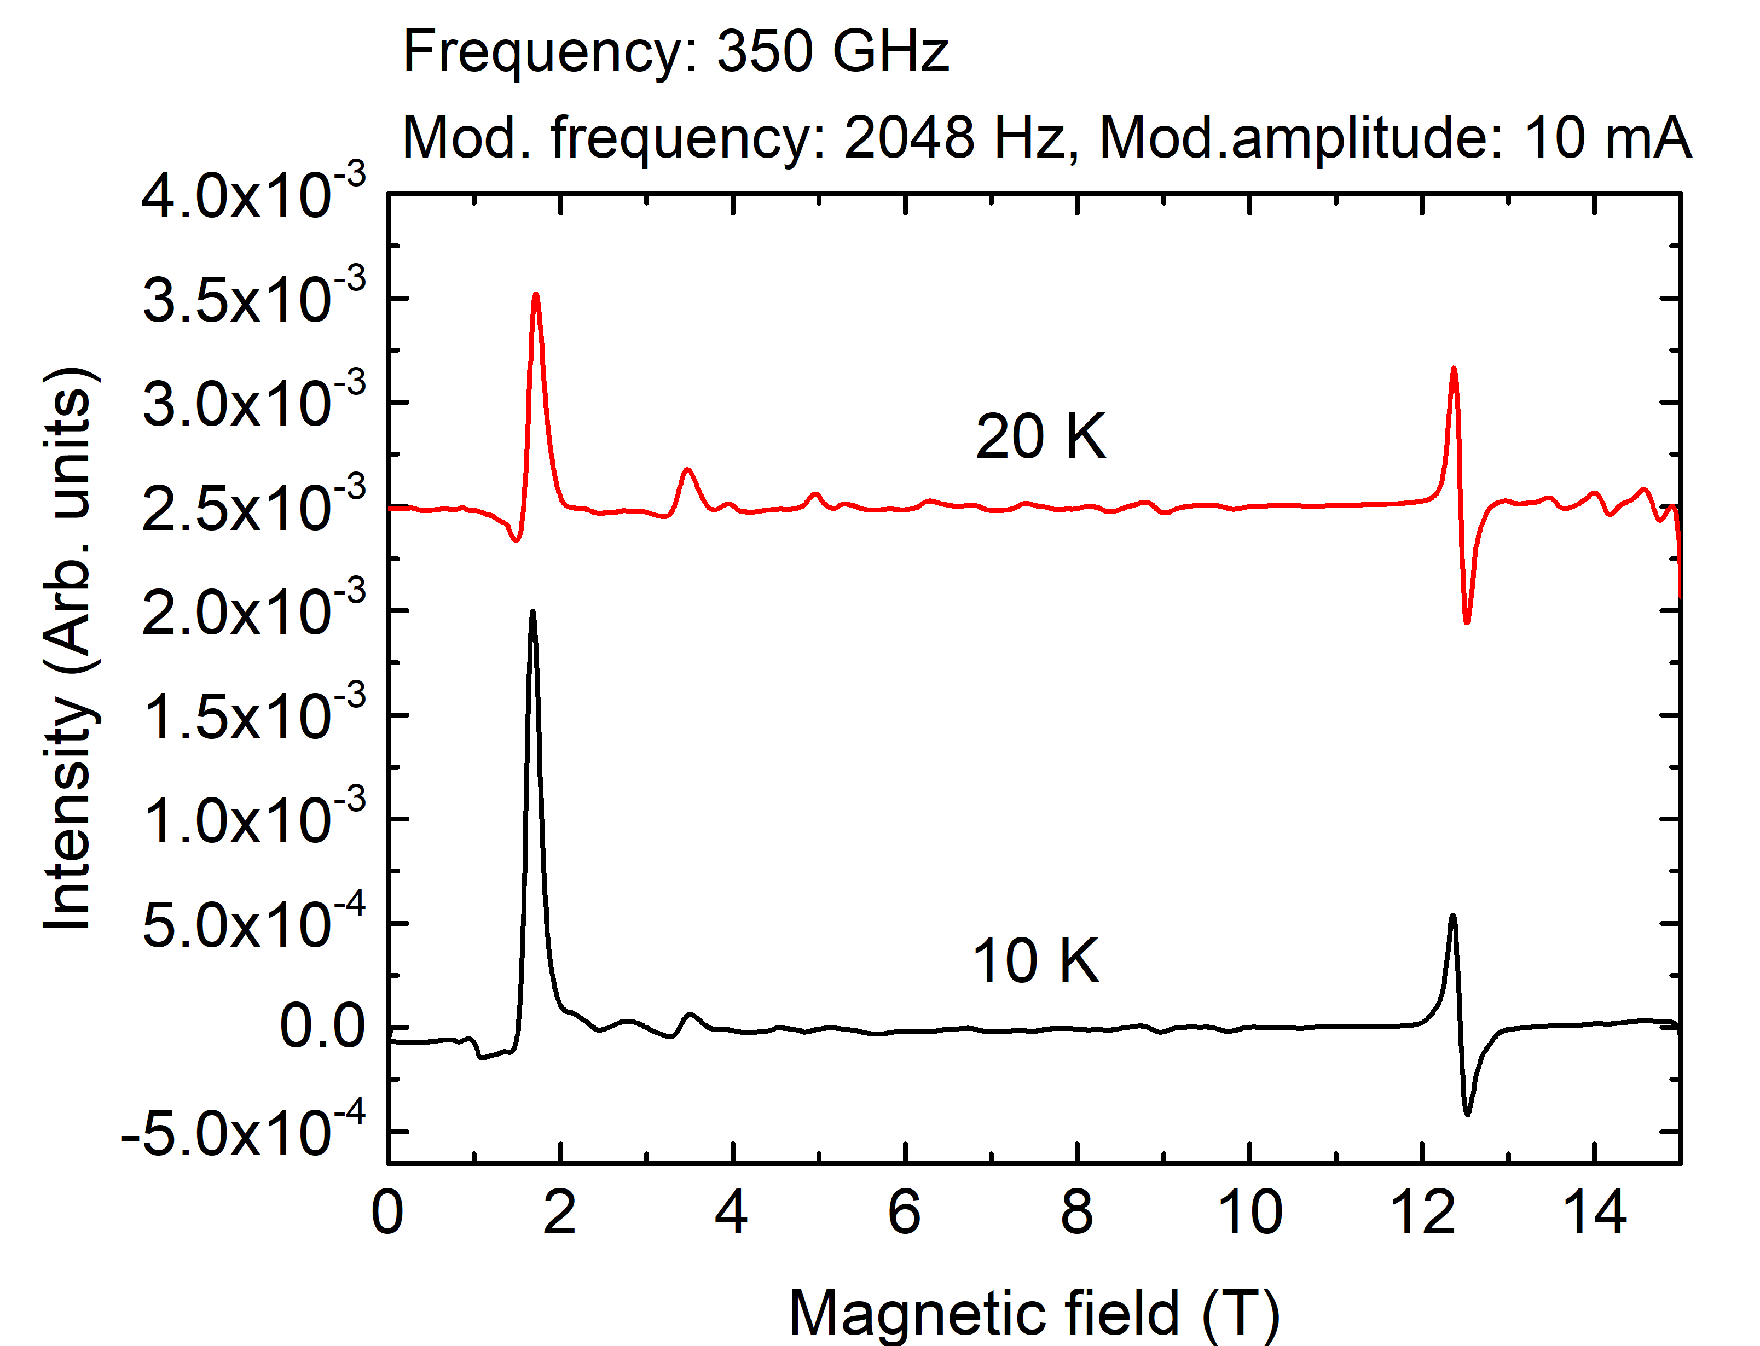
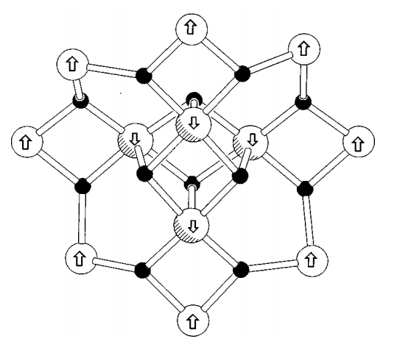
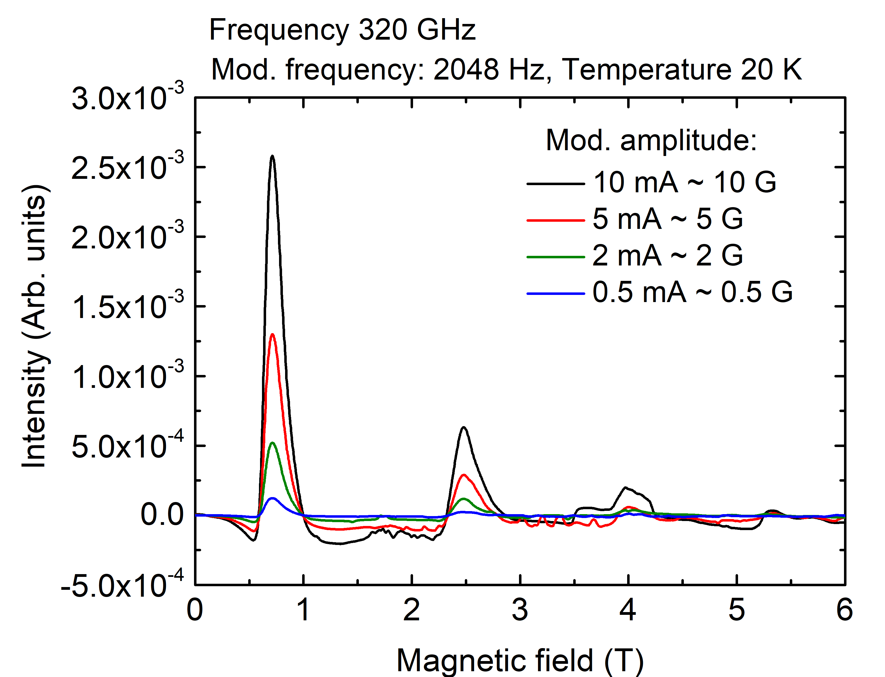
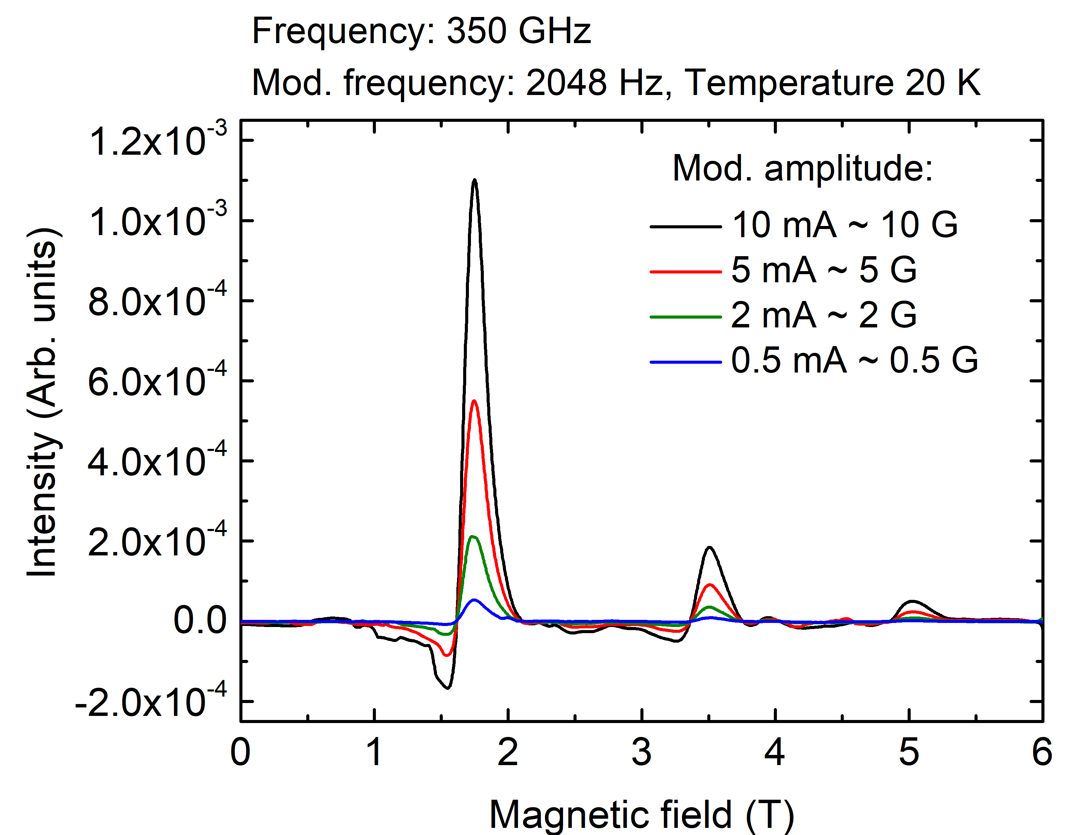
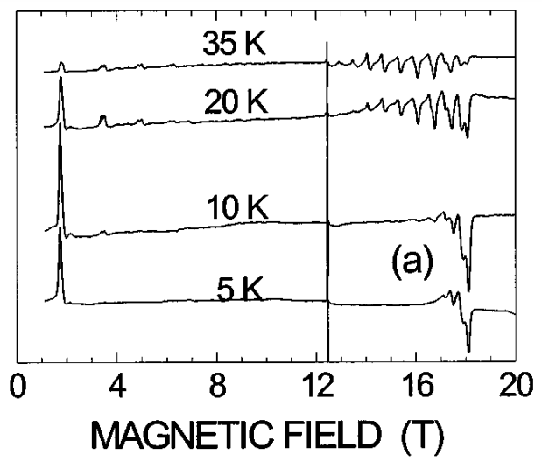
Measurement of Mn12ac (reference sample) on HFEPR setup – test sample for PETER setup
Mn12ac
Frequency: 350 GHz
Phys. Rev. B 56, 8192 (1997)

Slide 6
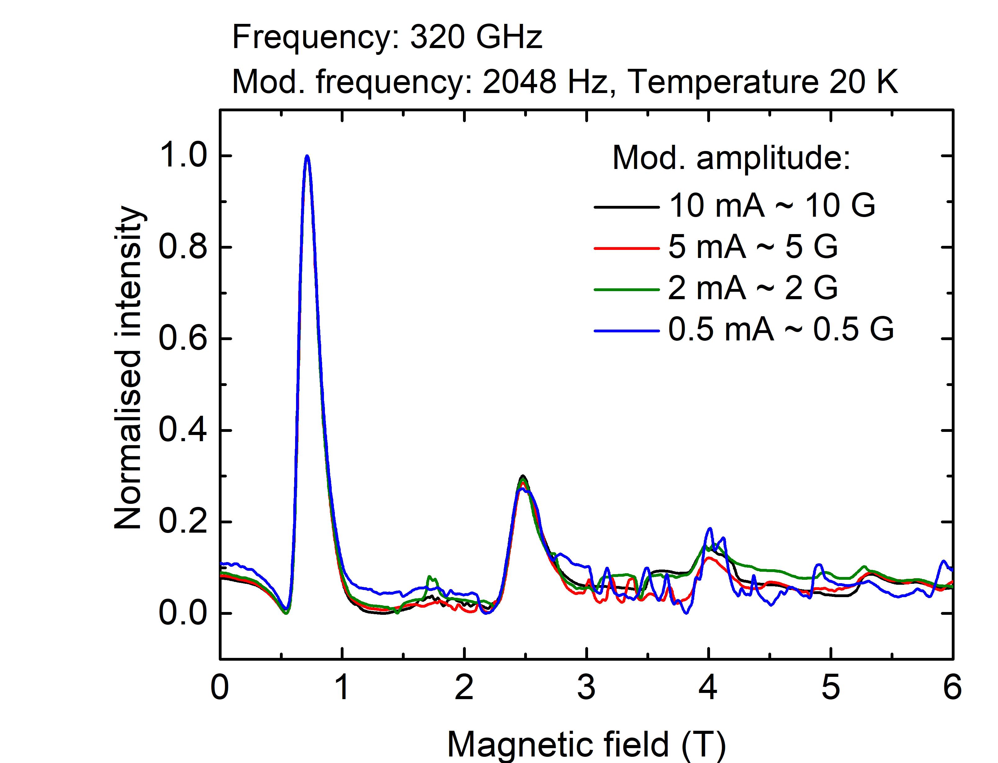
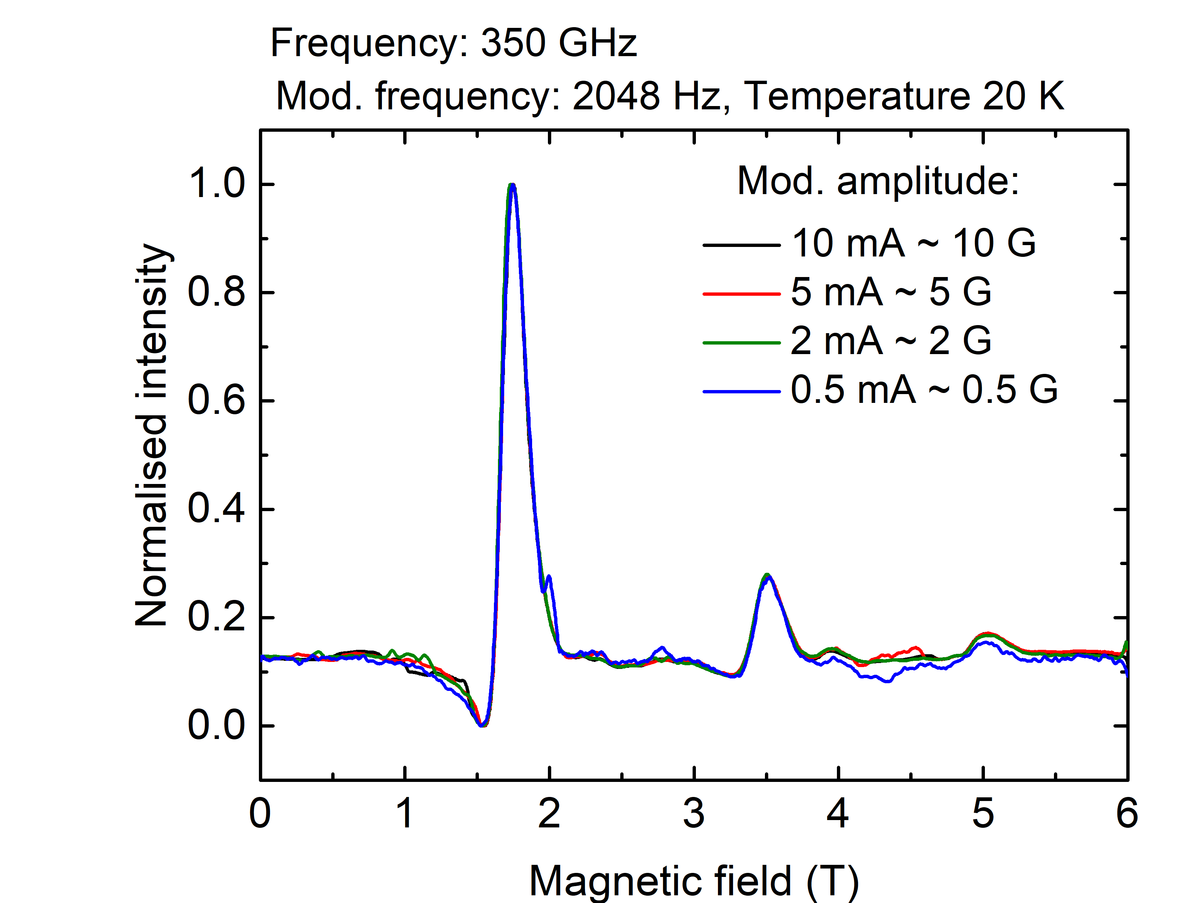
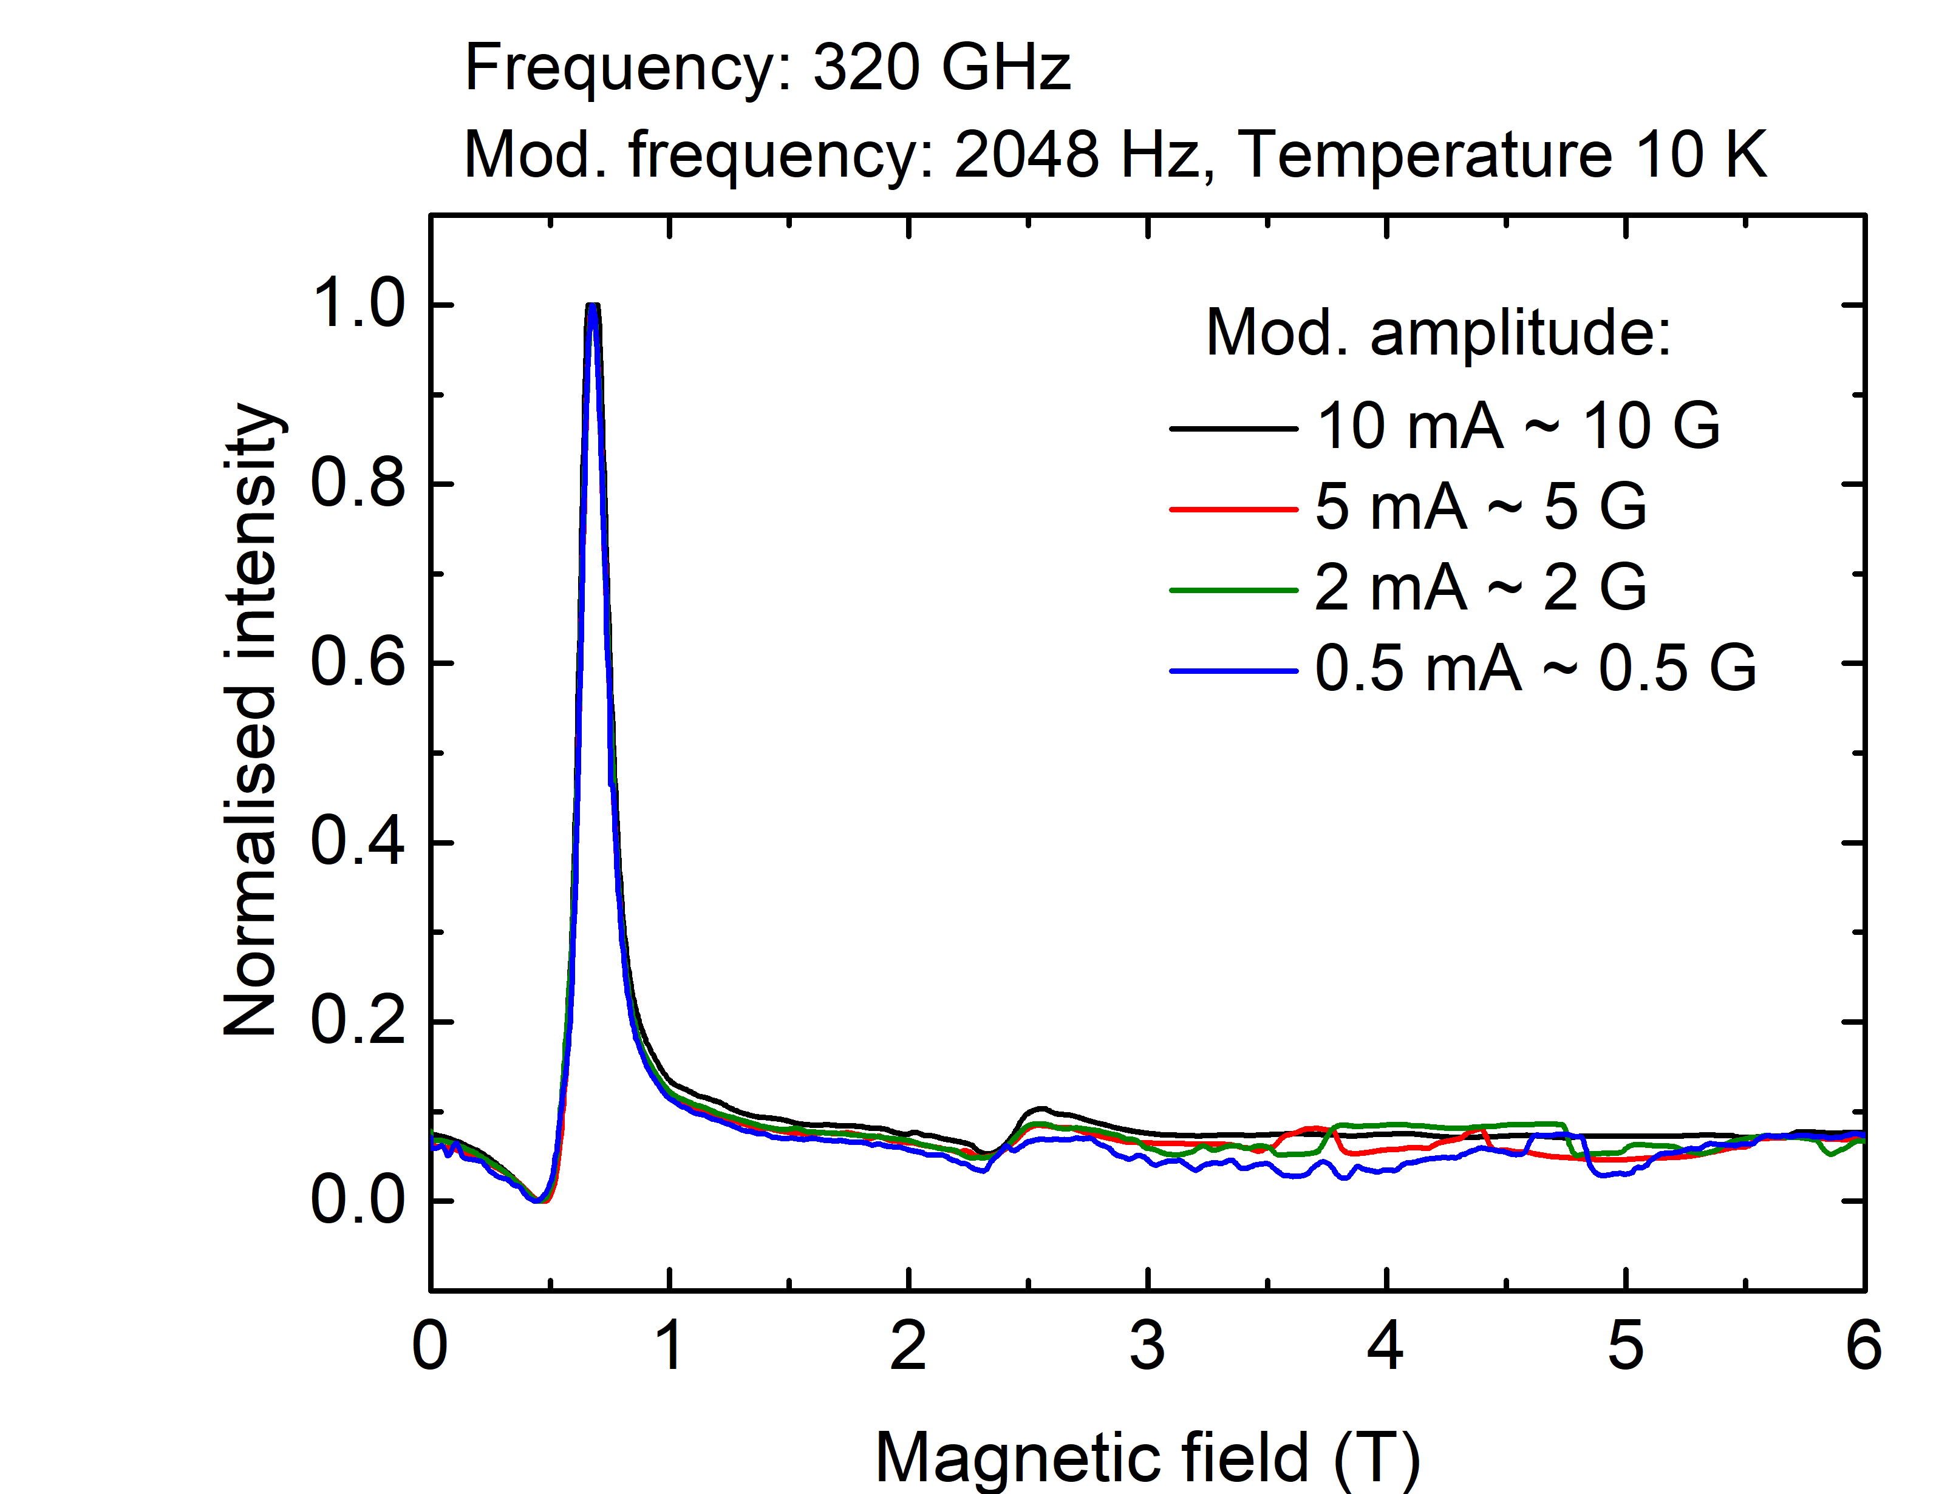
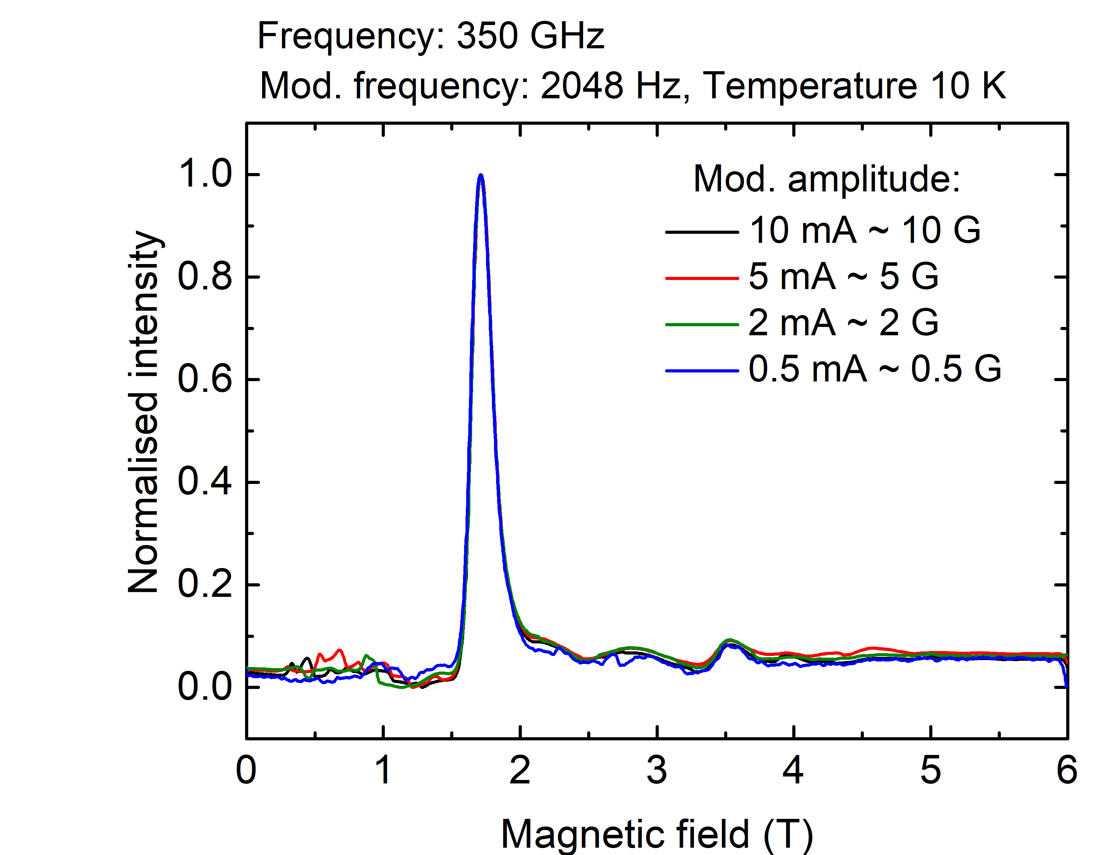
Measurement of Mn12ac (reference sample) on HFEPR setup – test sample for PETER setup
Mn12ac
Frequency: 350 GHz
Phys. Rev. B 56, 8192 (1997)

Slide 7
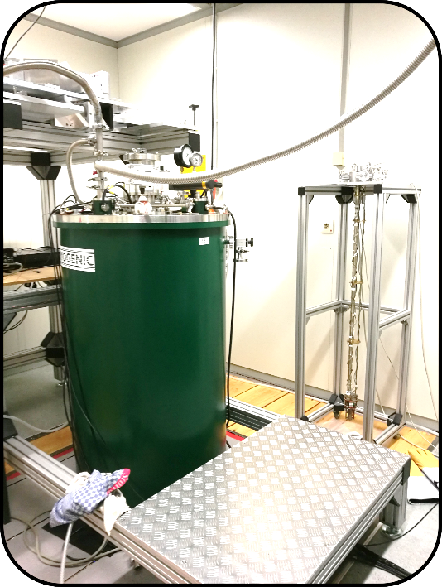
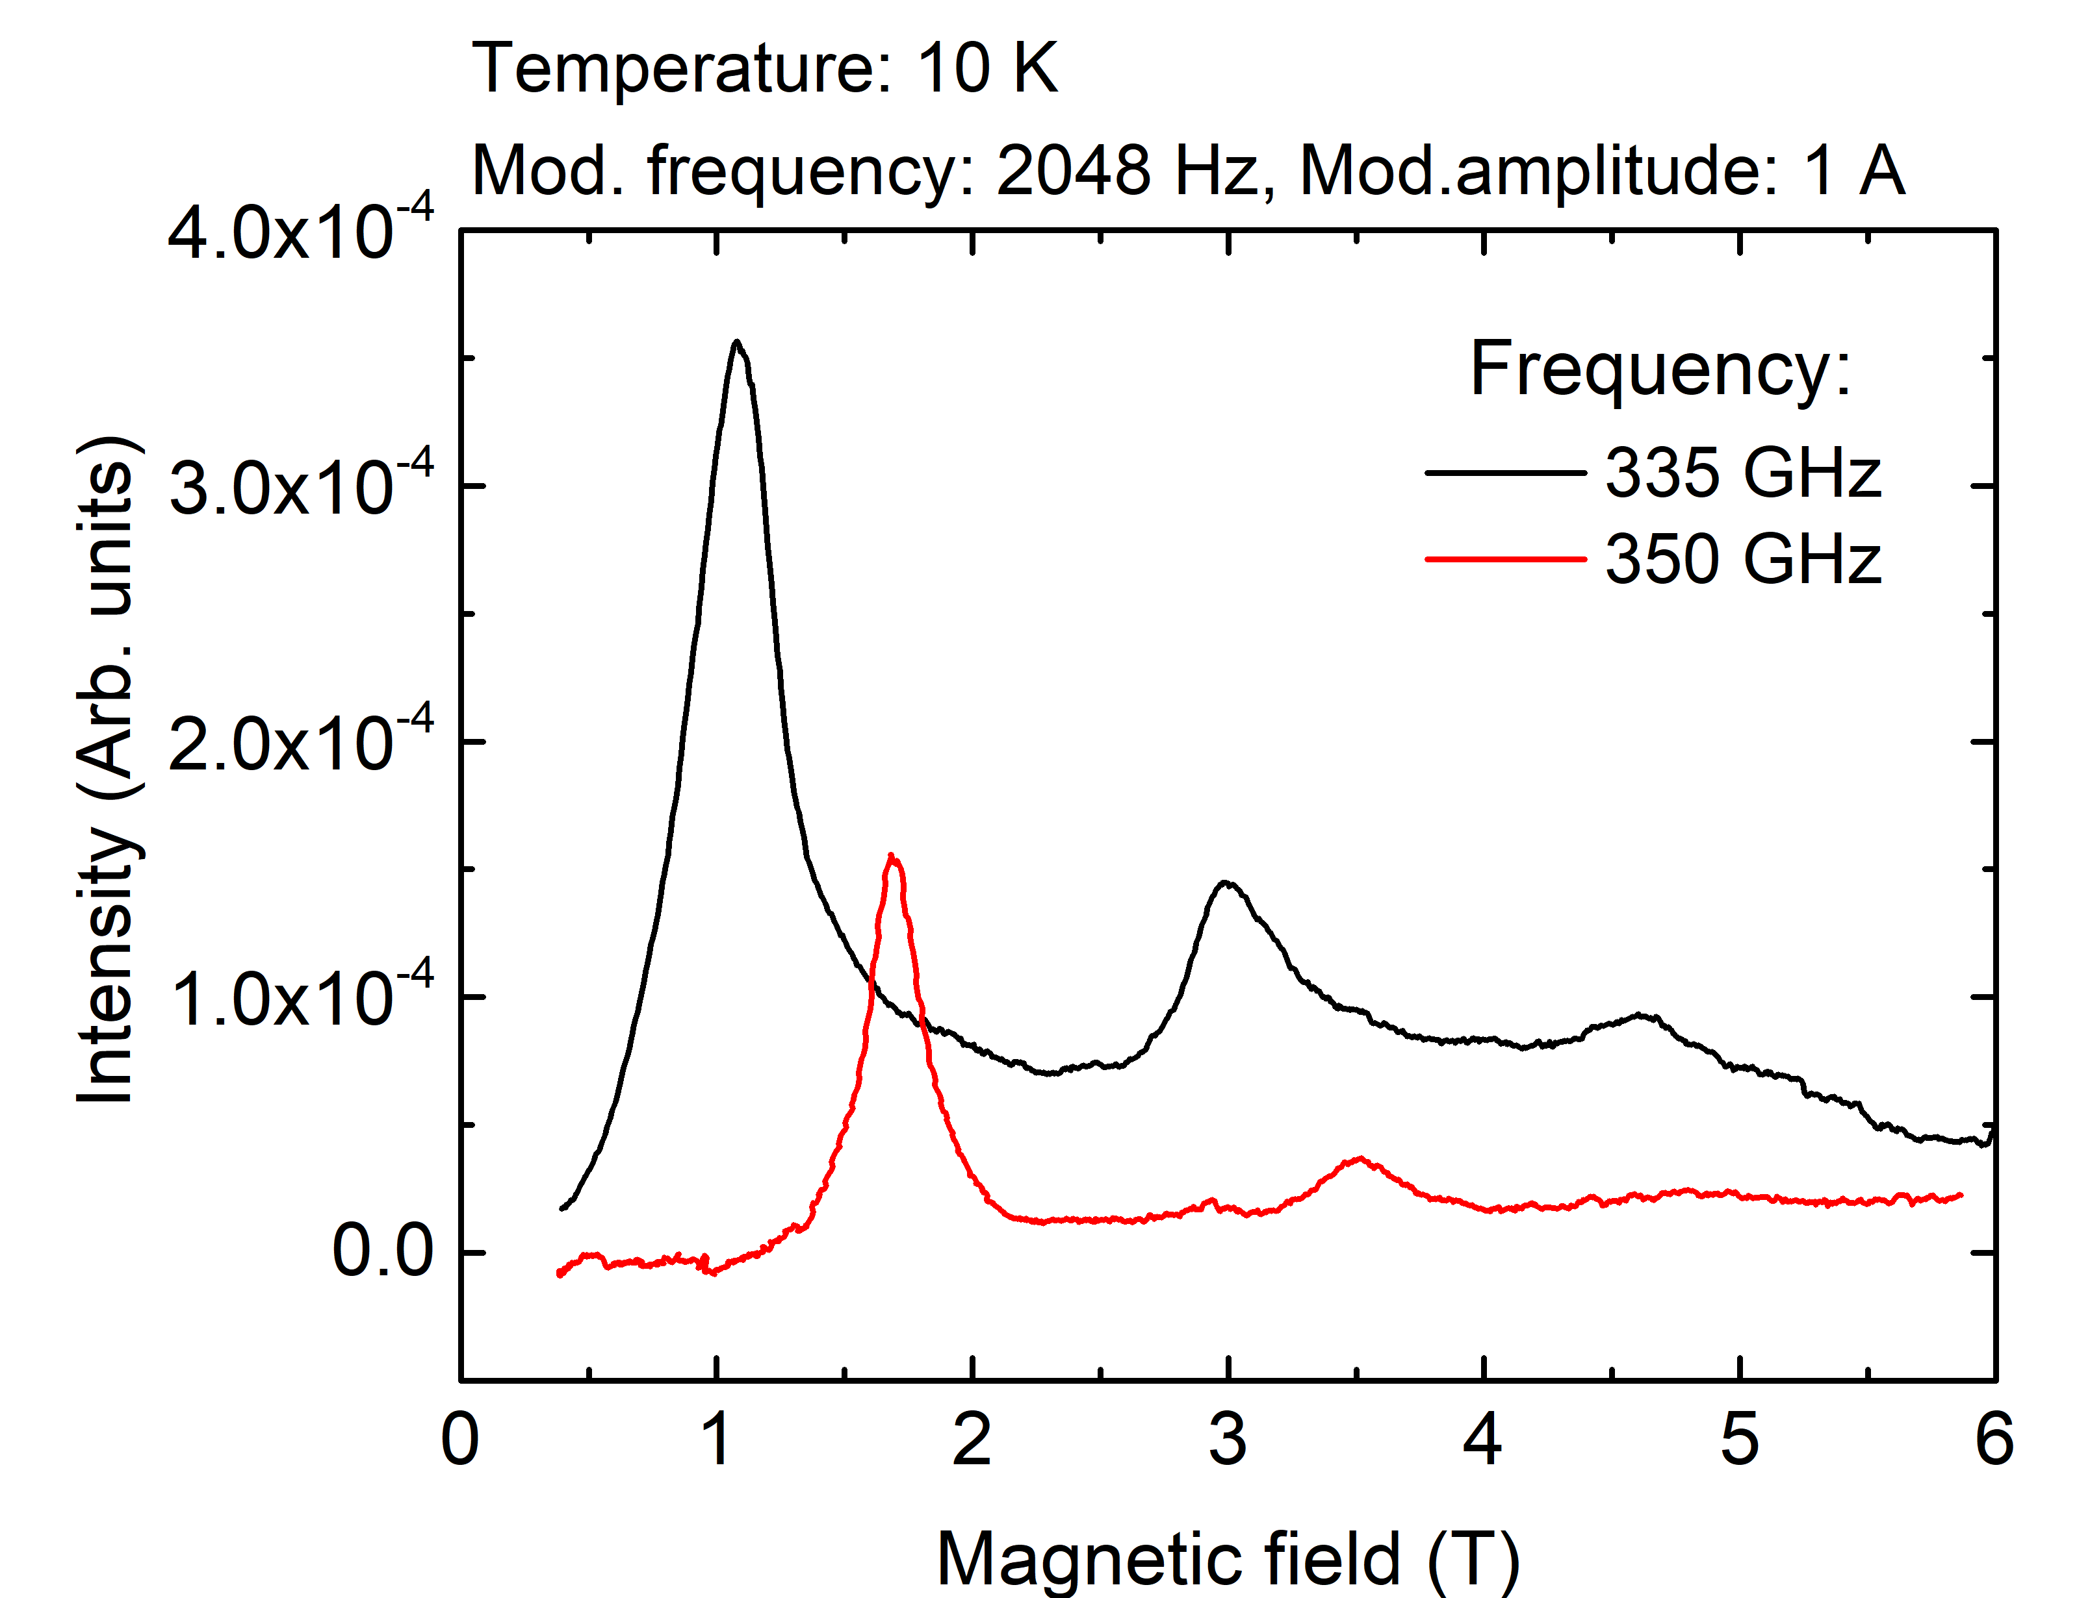
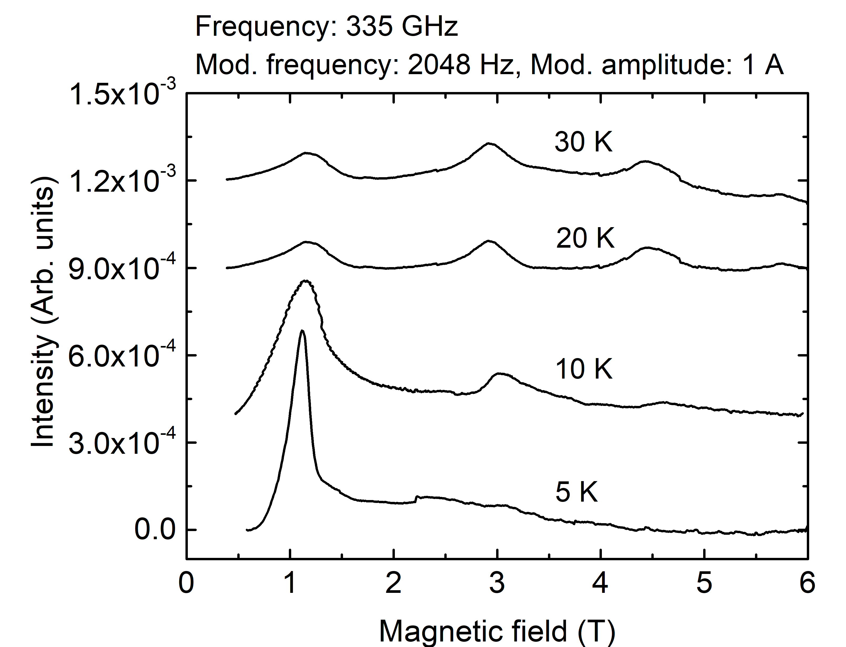
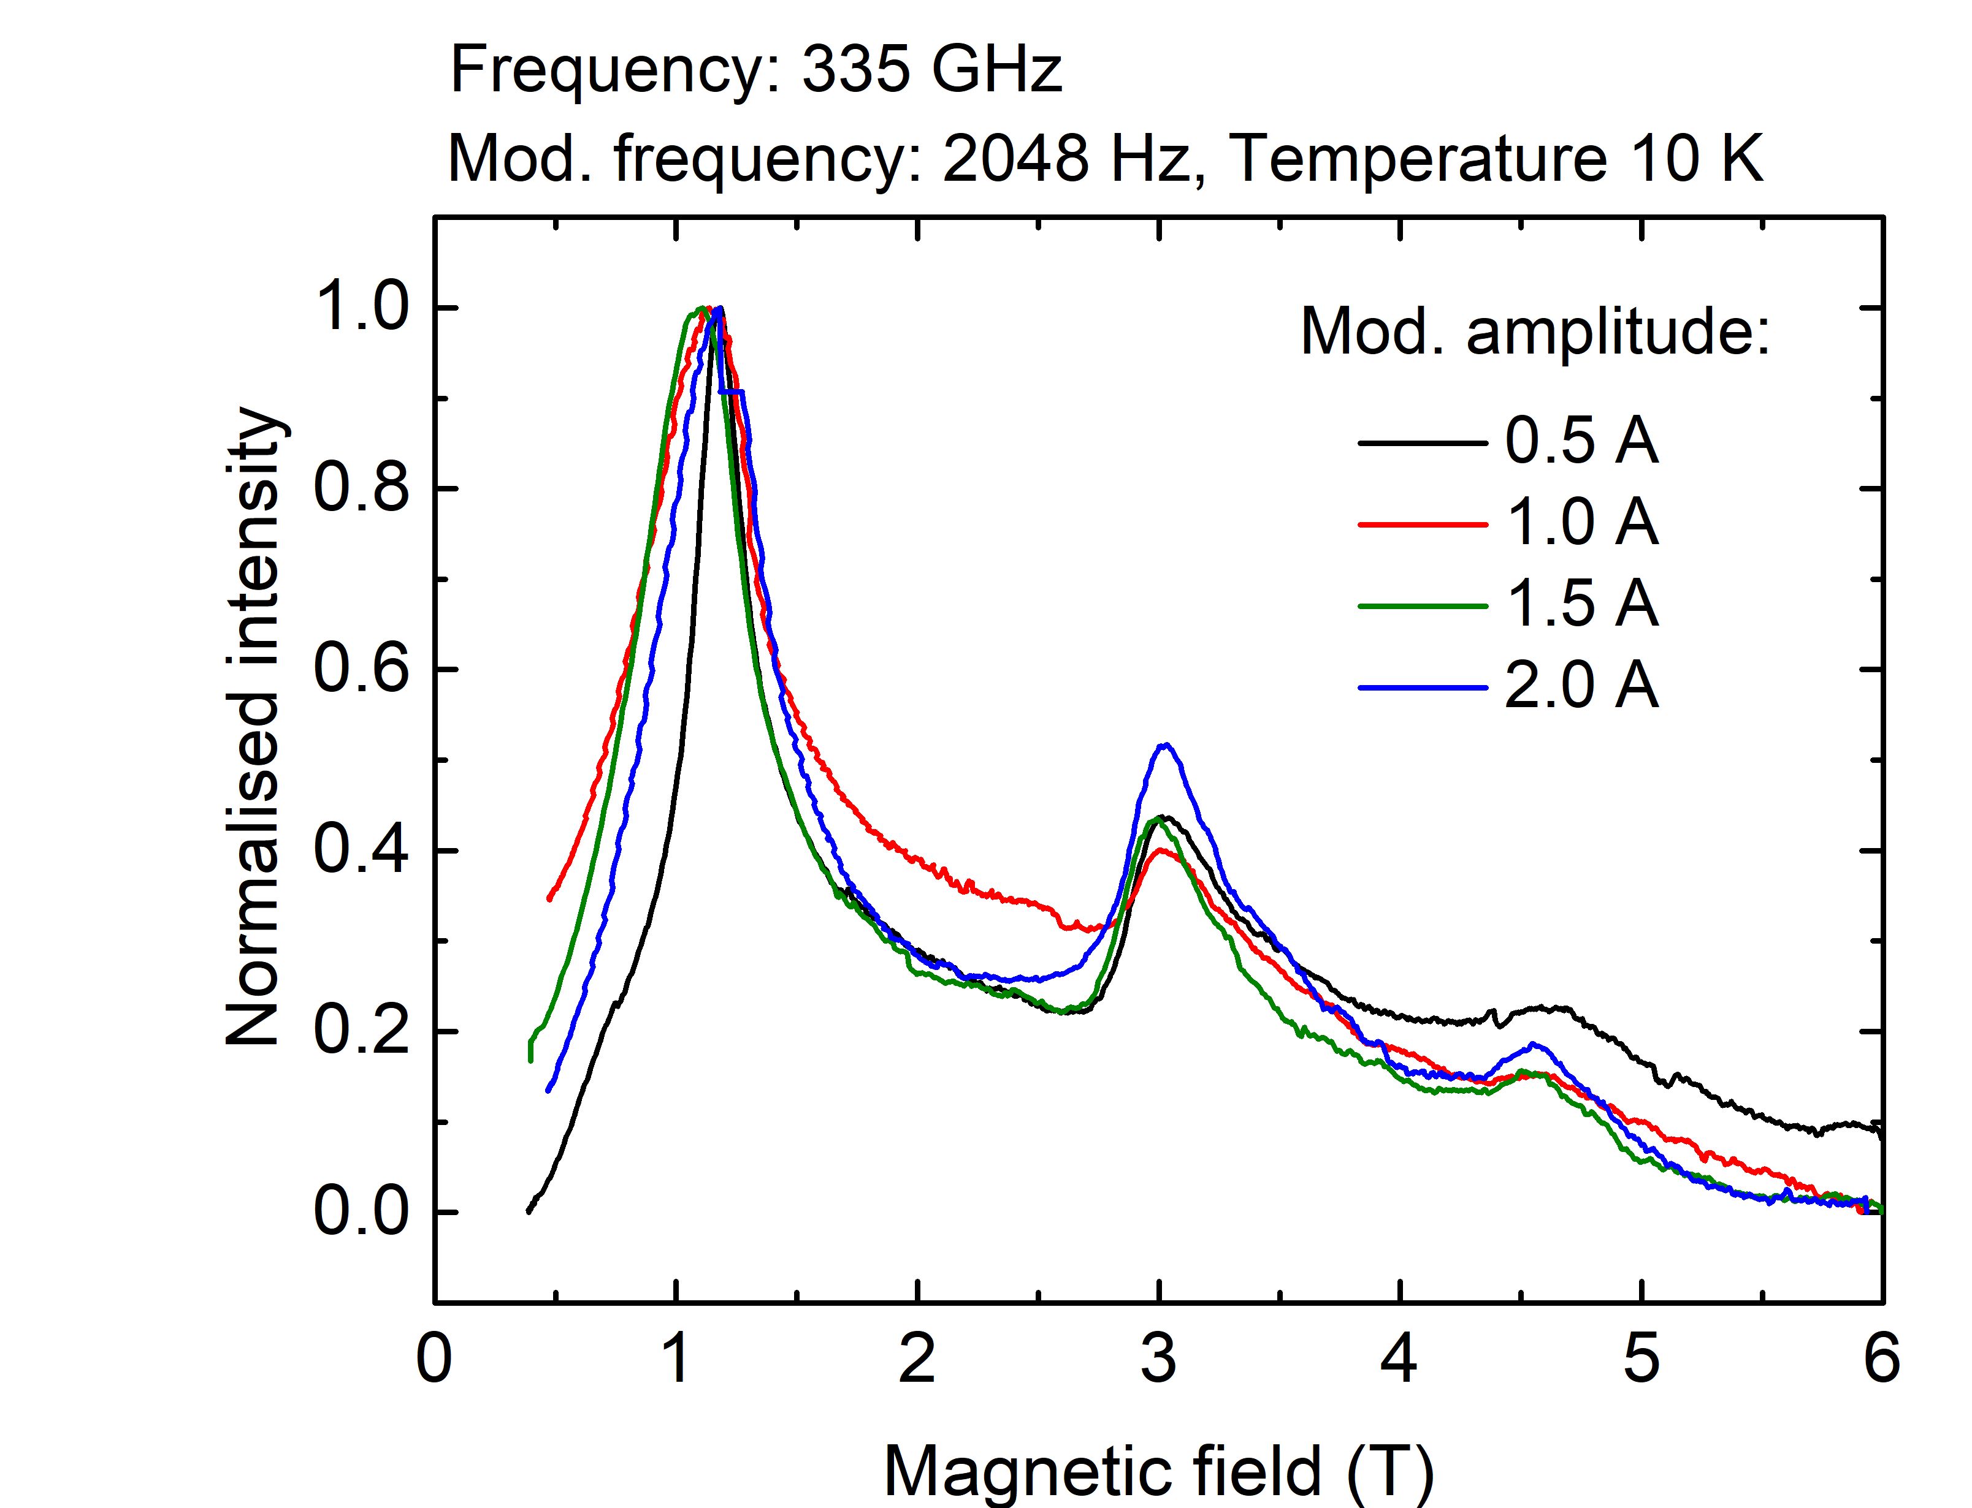
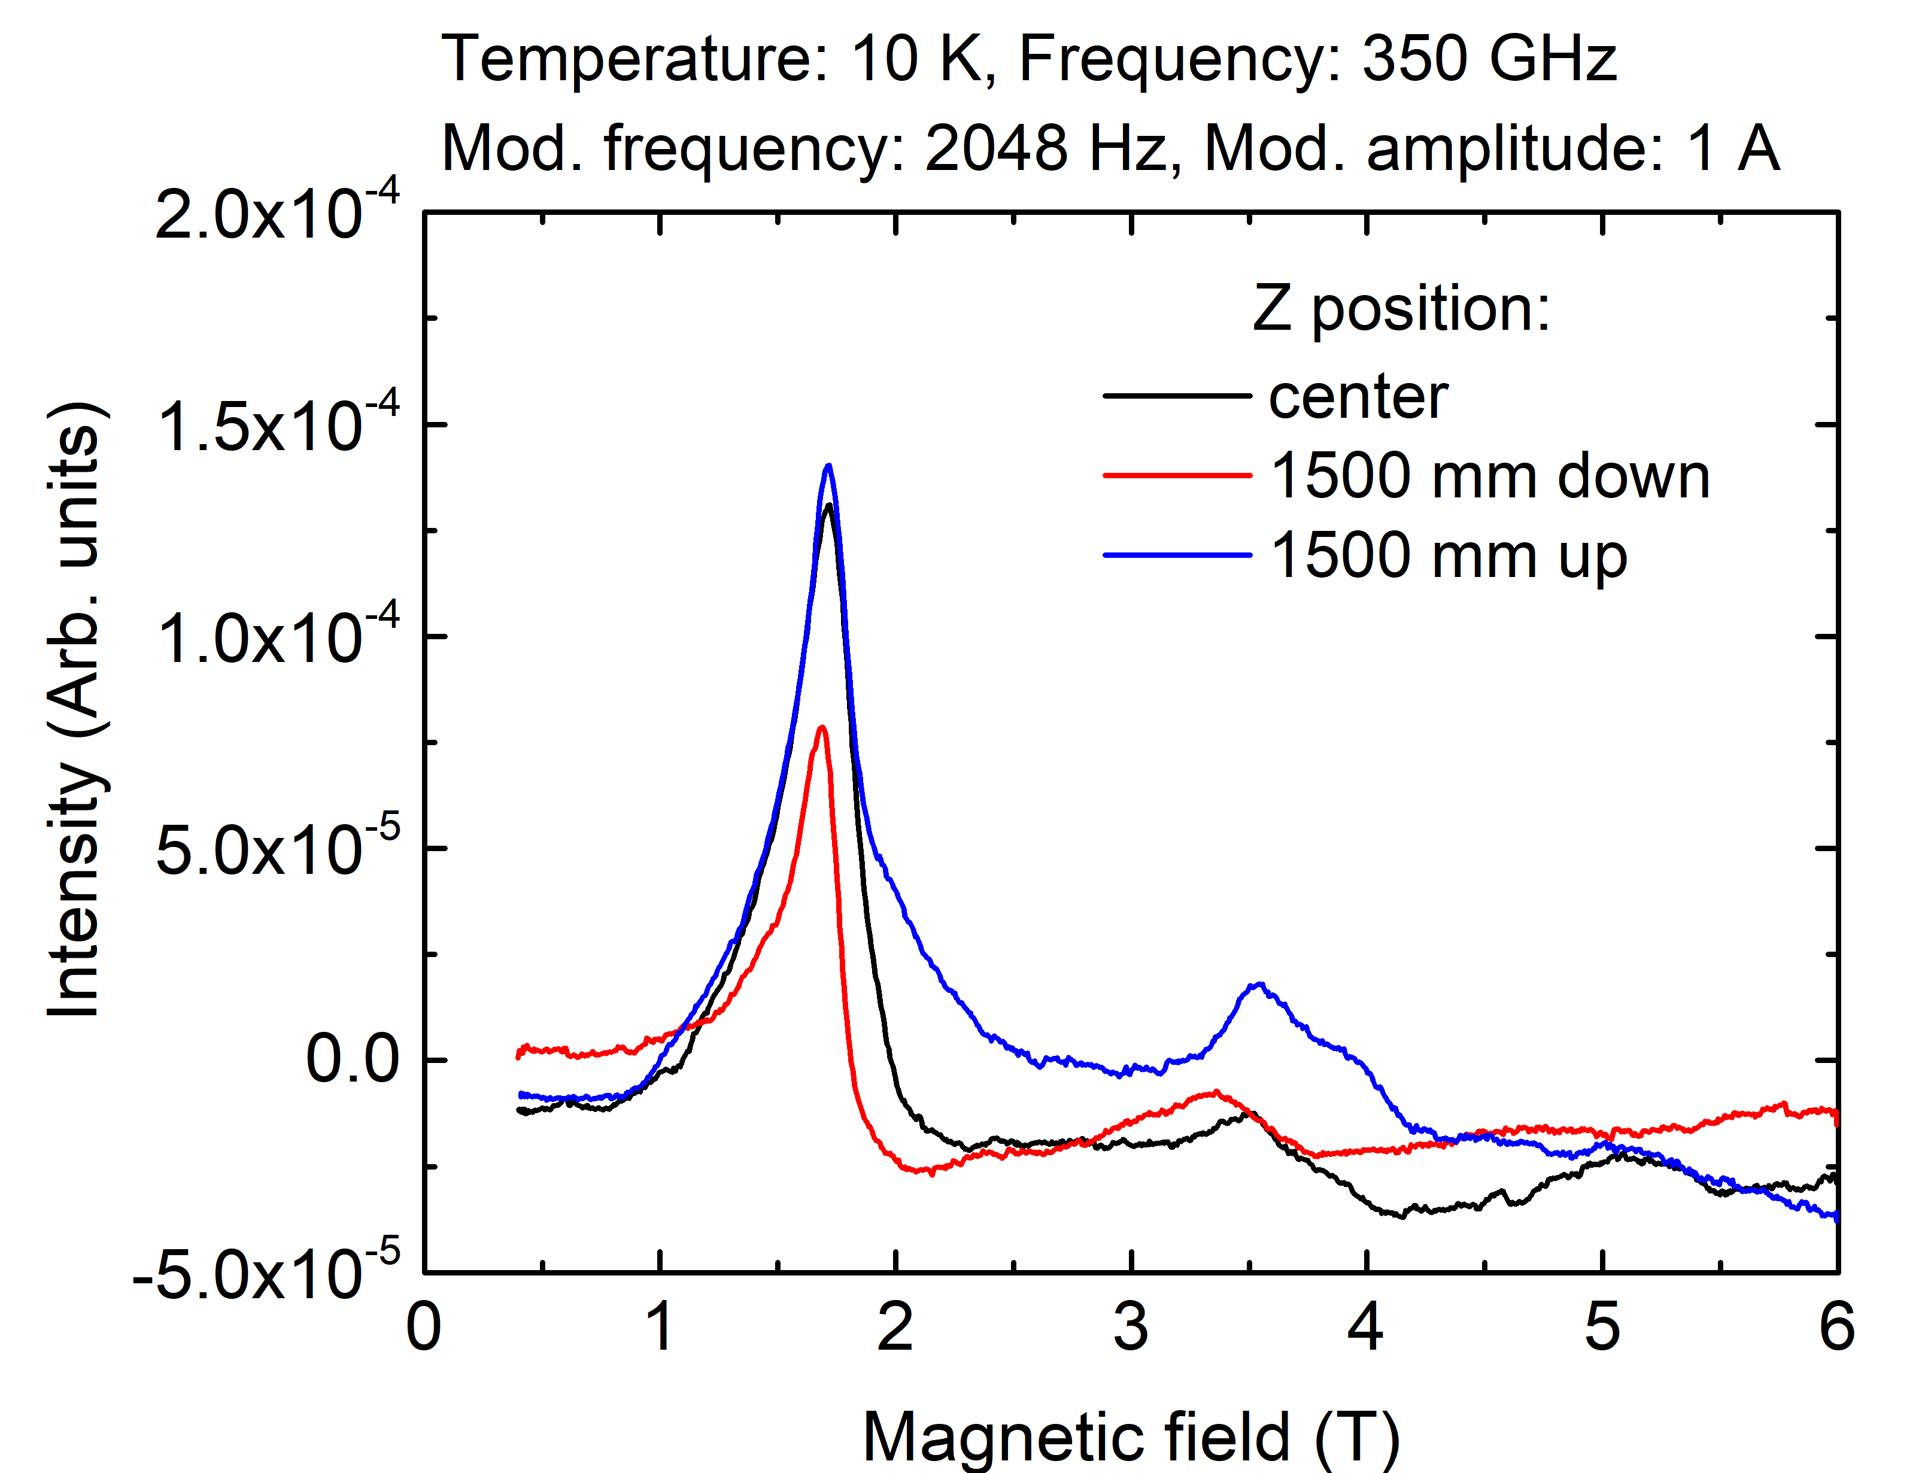
Measurement of Mn12ac (reference sample) on PETER setup
HFEPR
Frequency: 350 GHz
Phys. Rev. B 56, 8192 (1997)

Slide 8
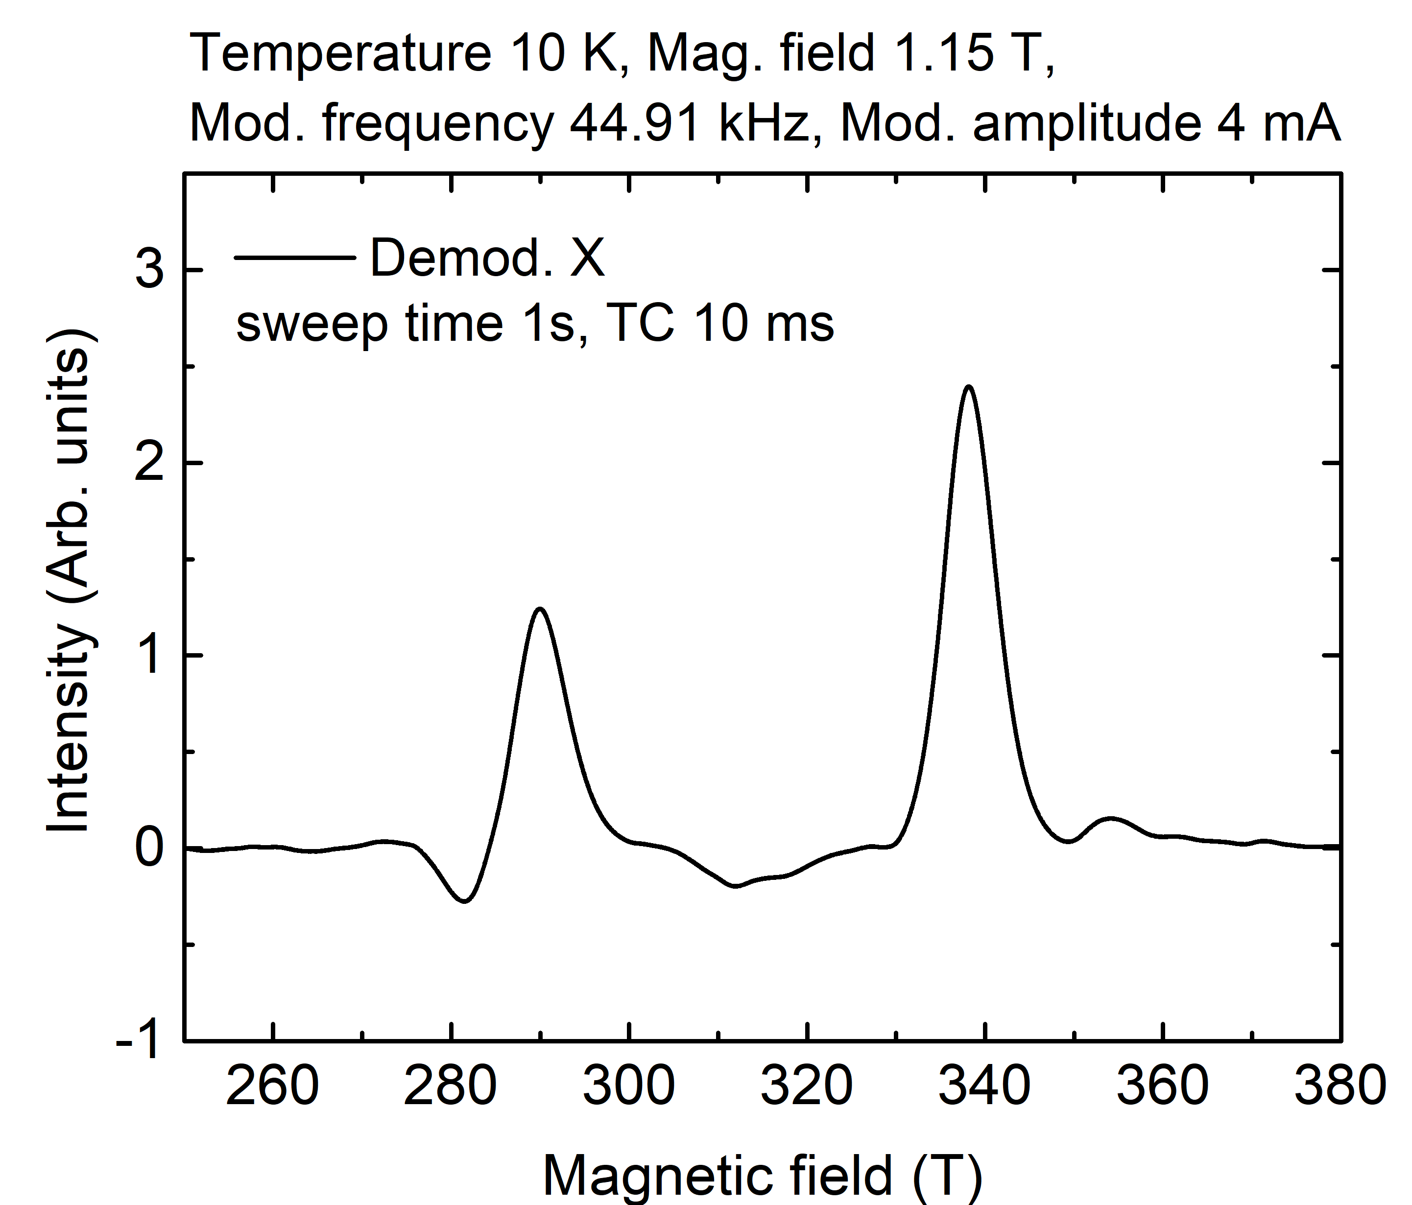
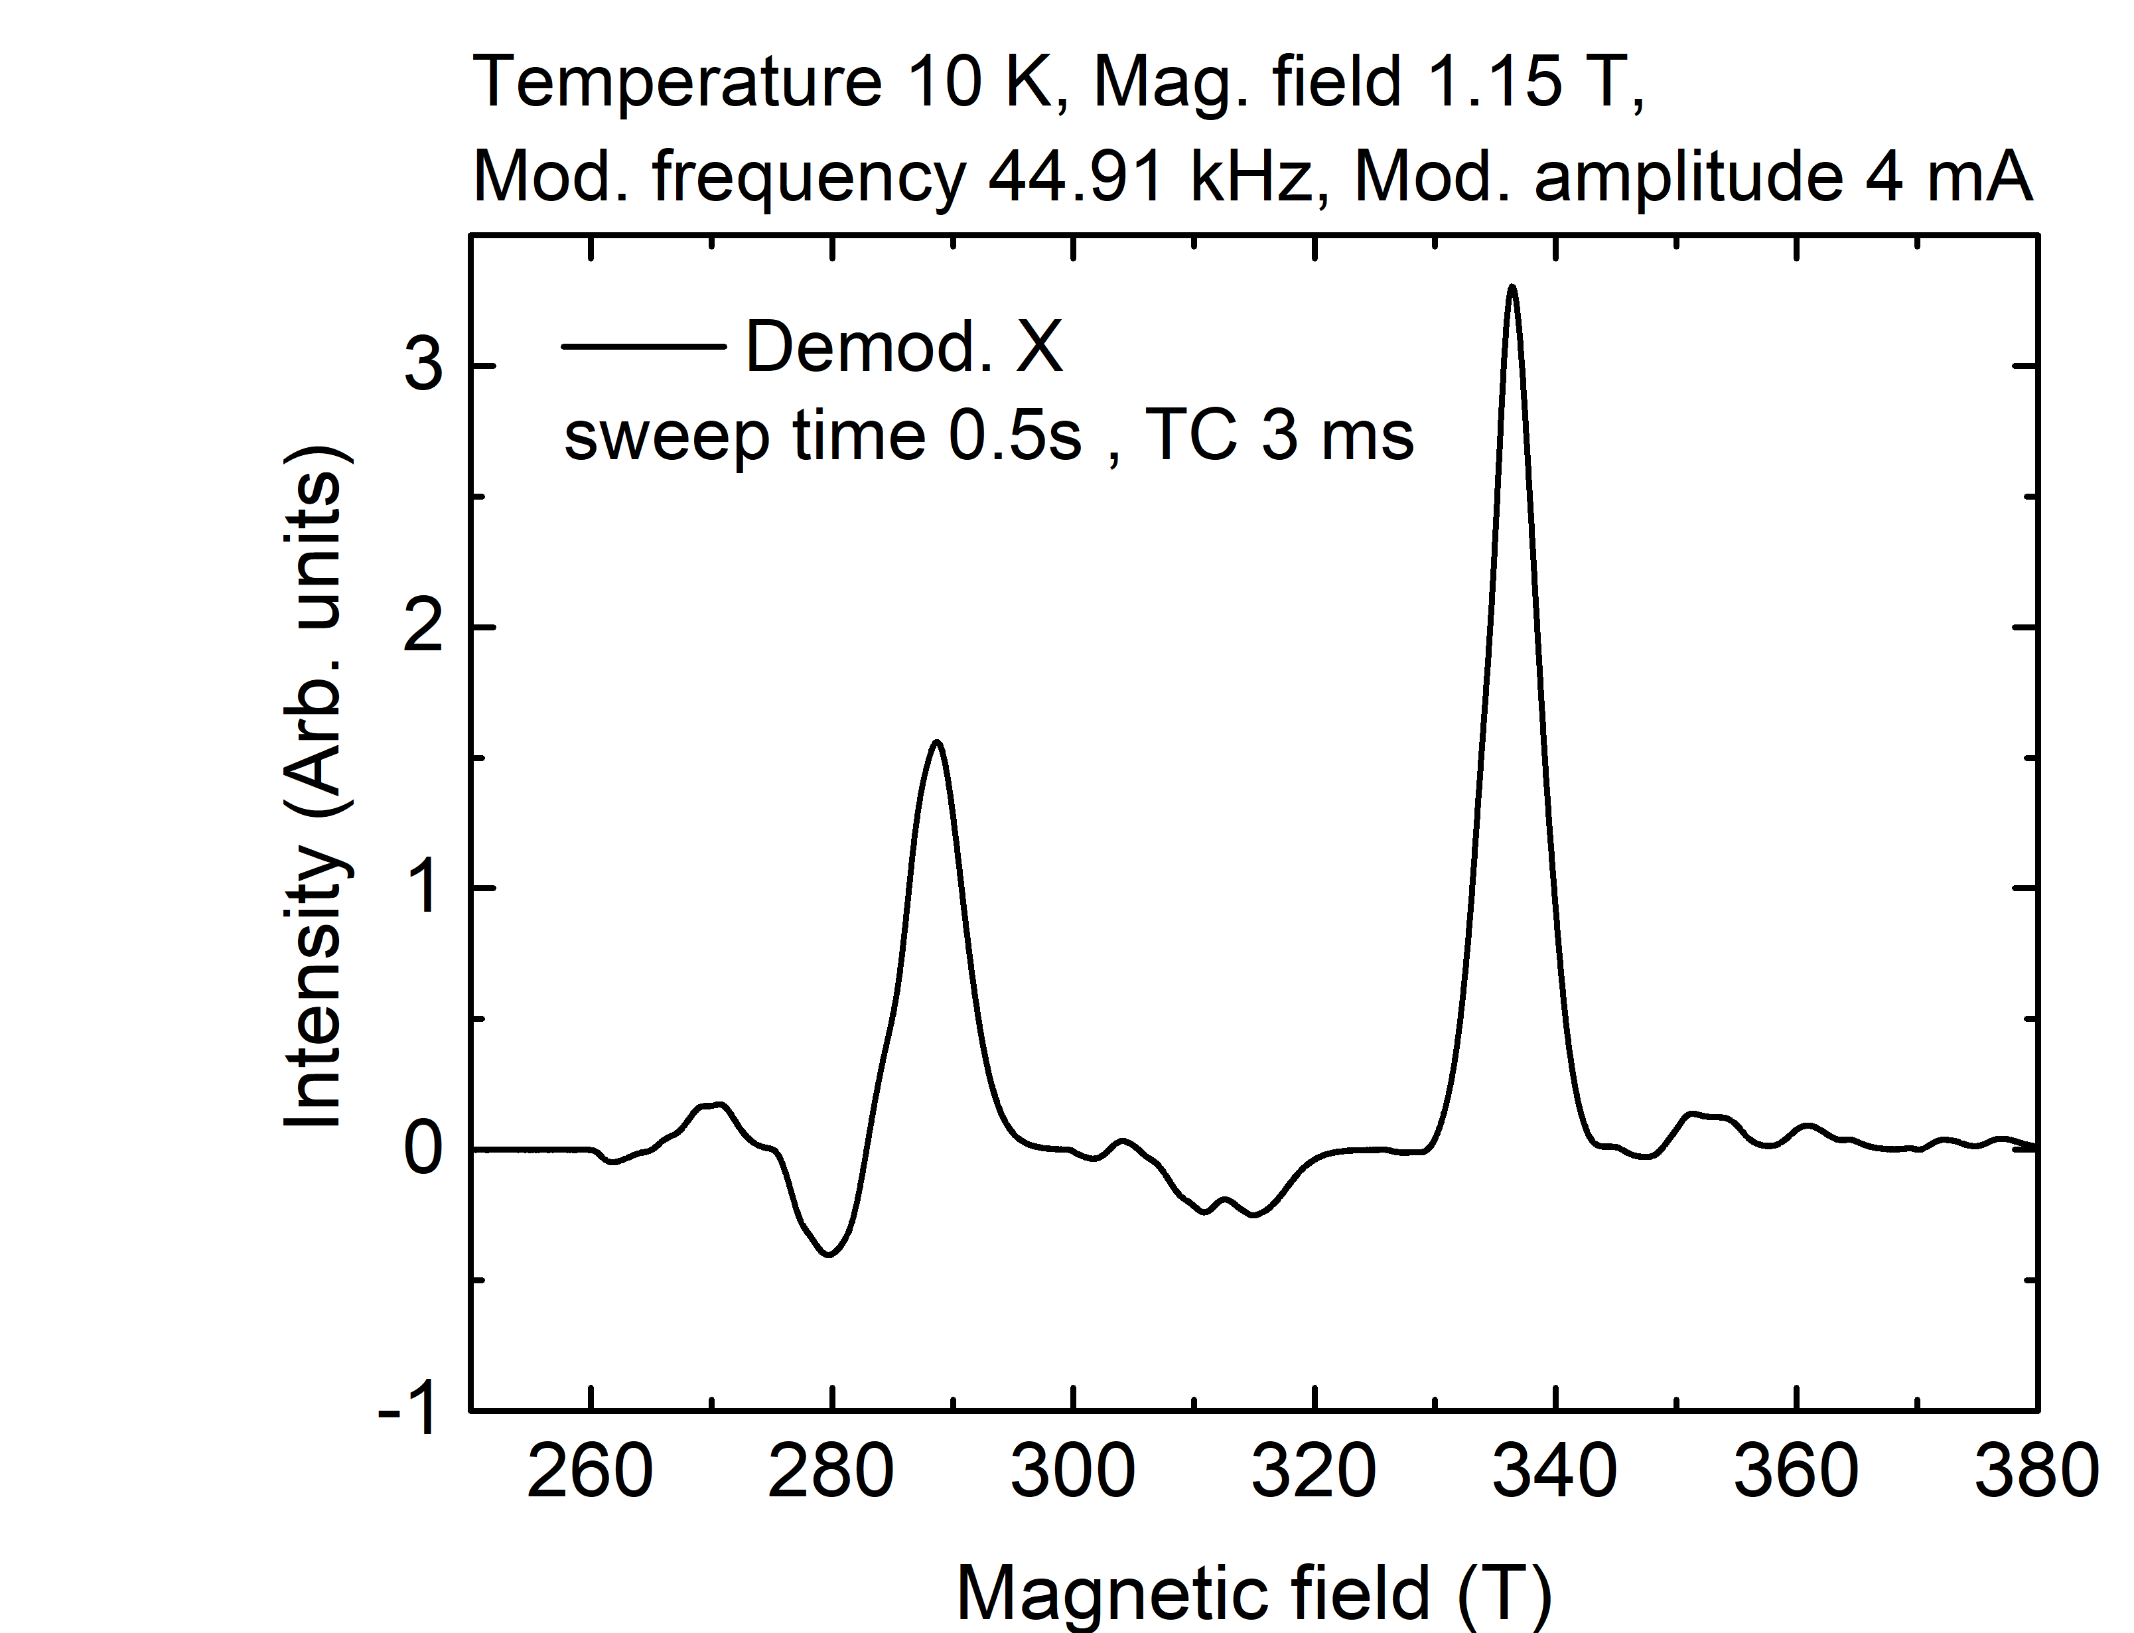
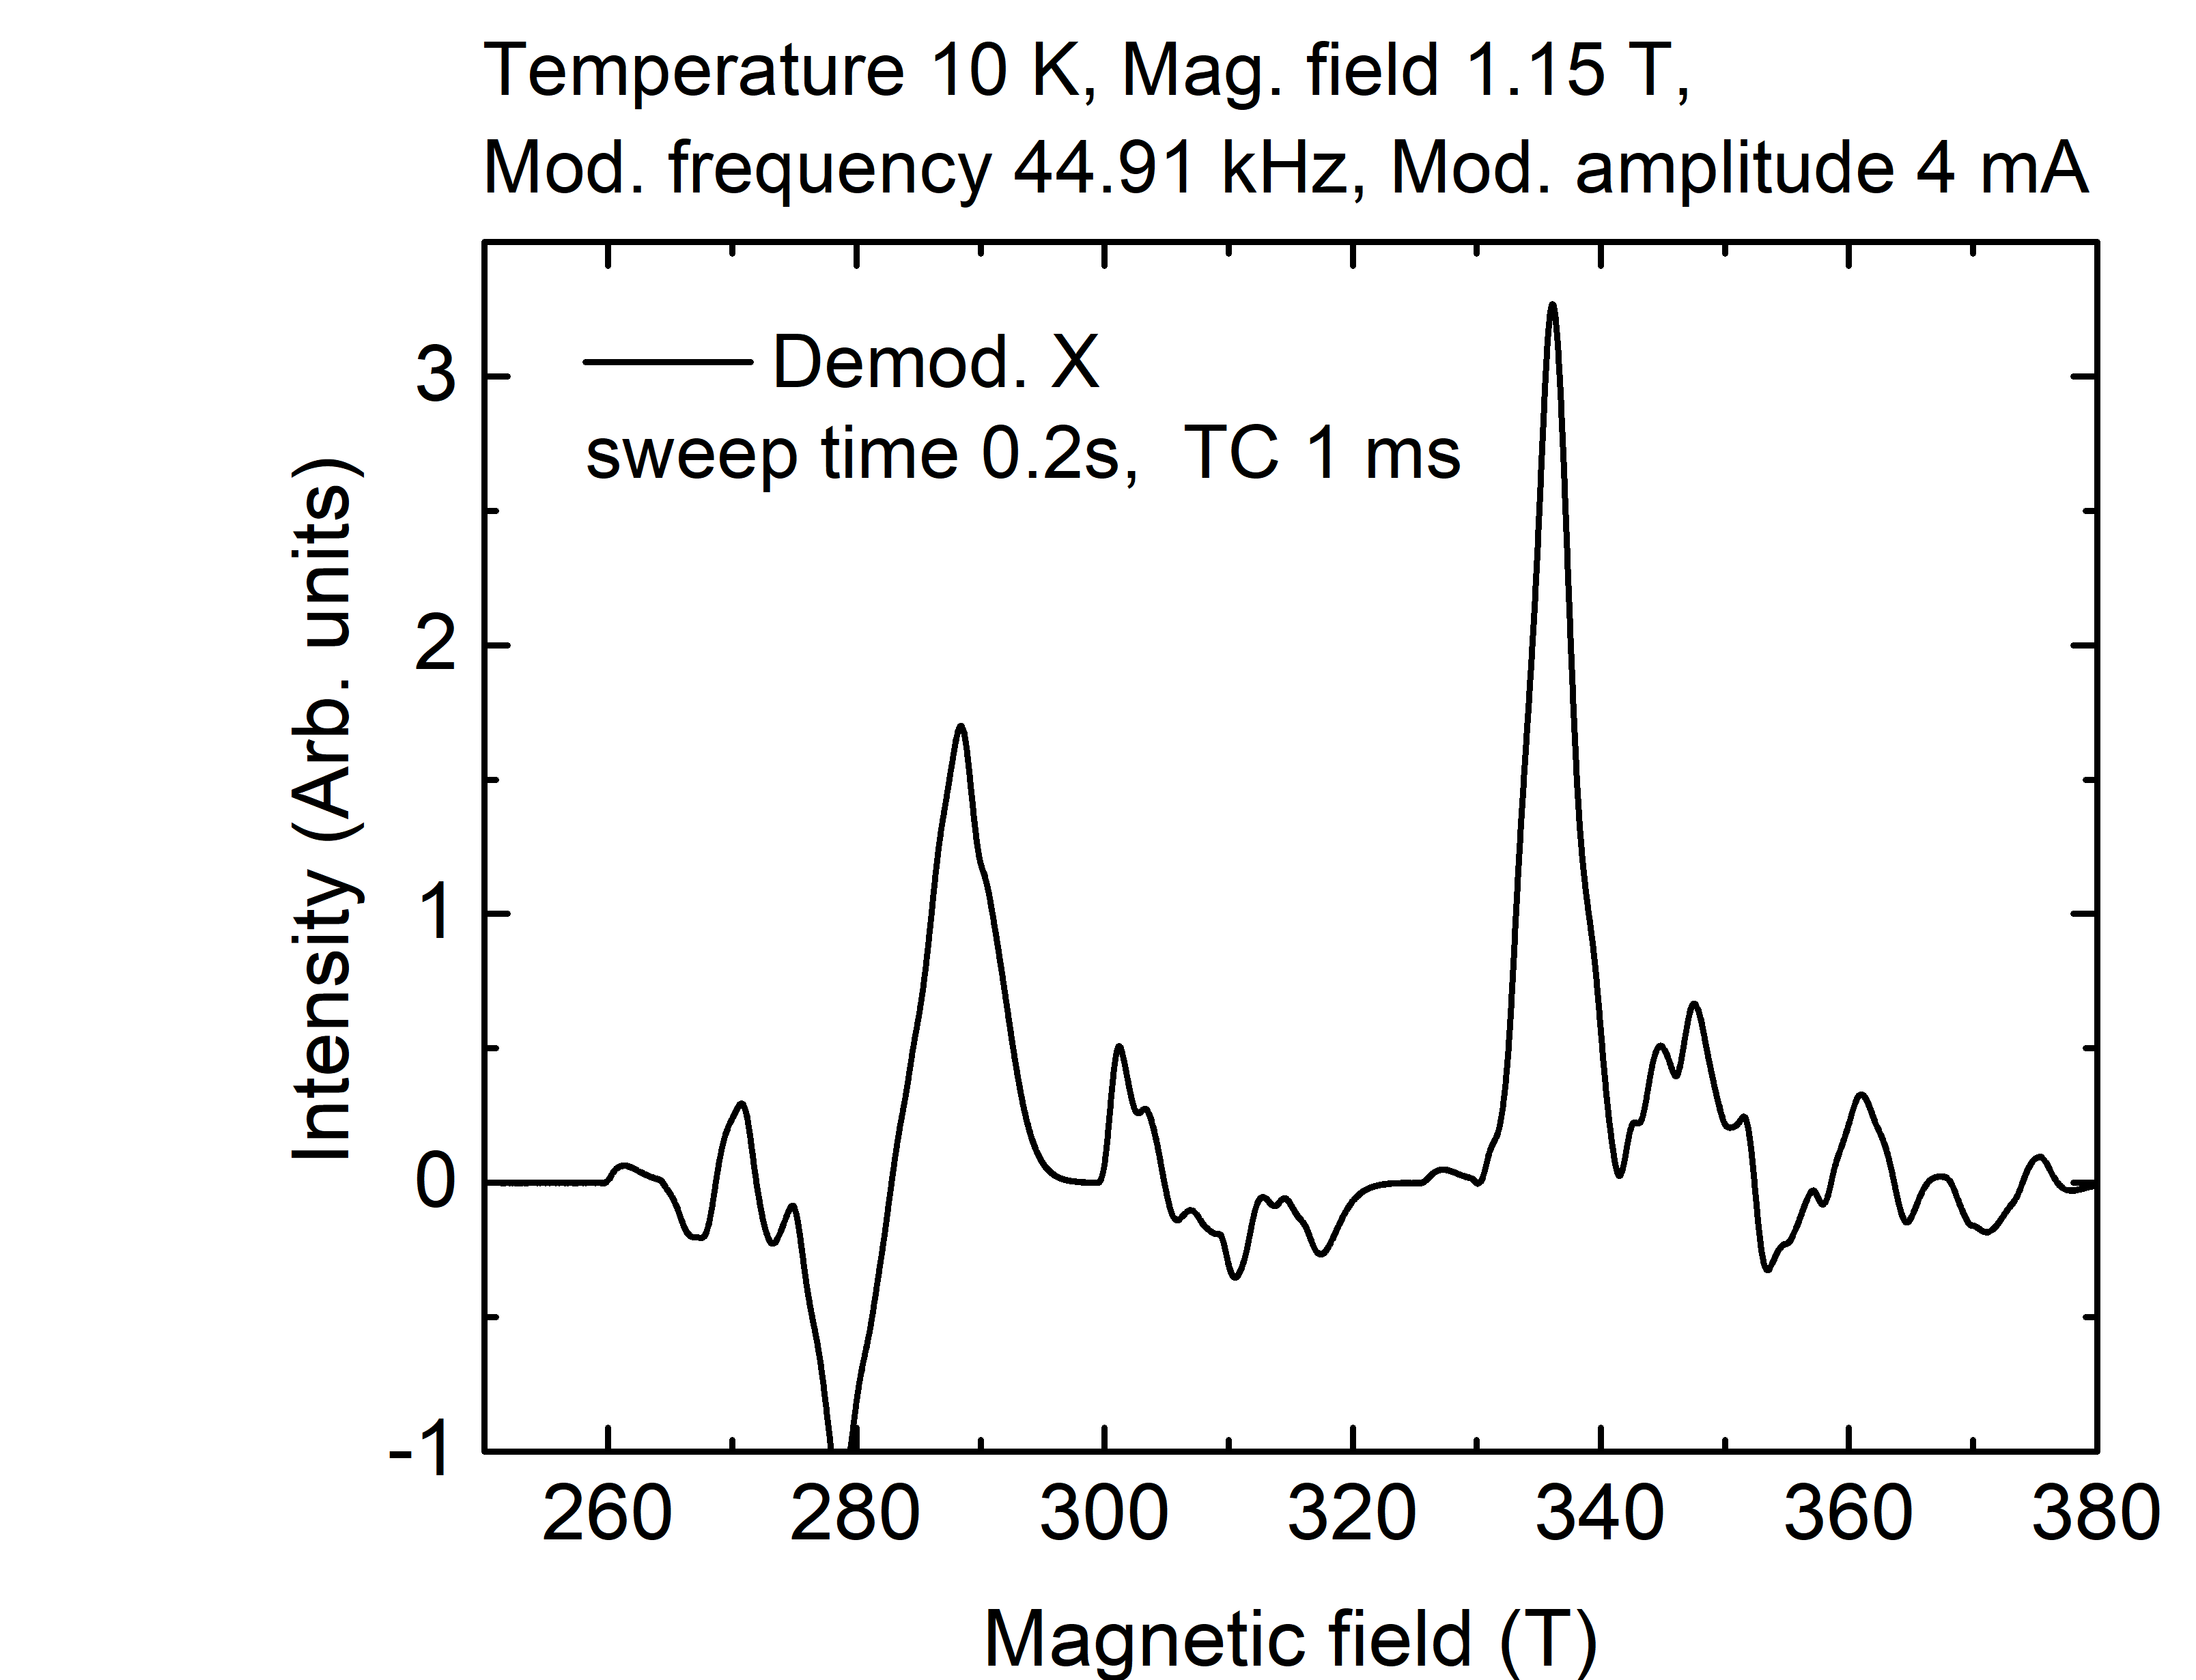
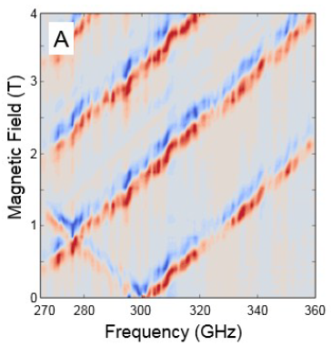
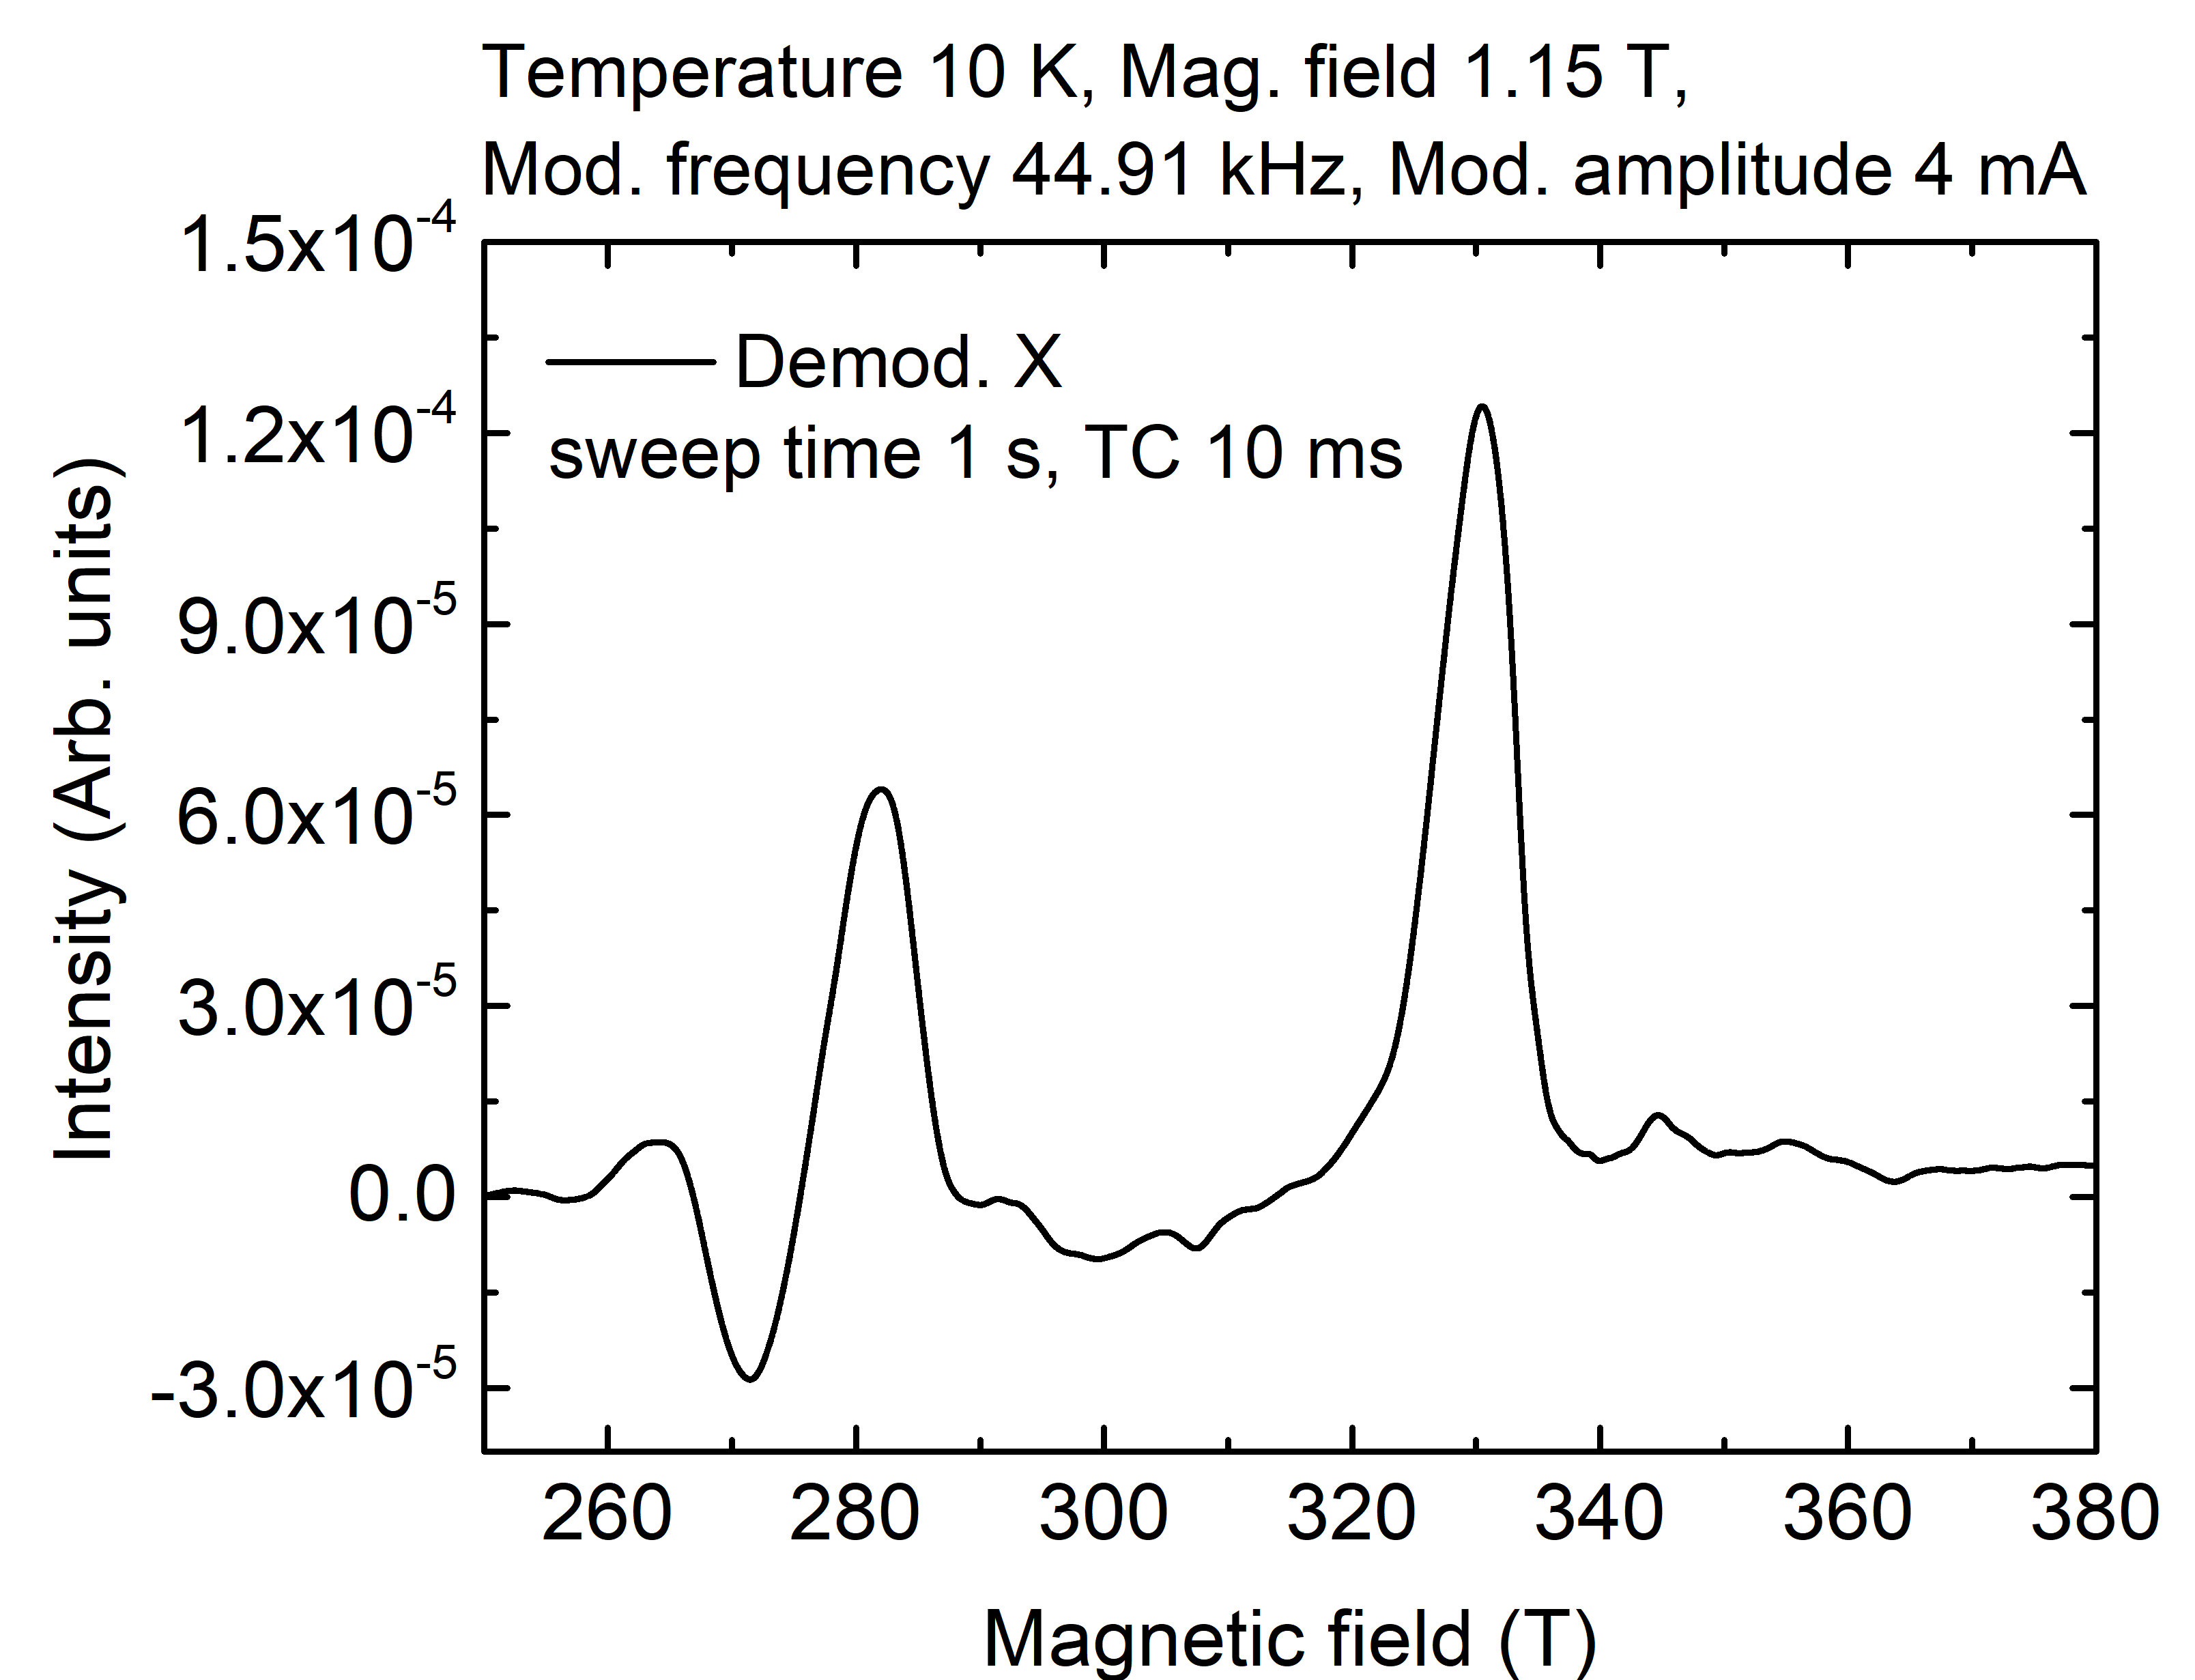
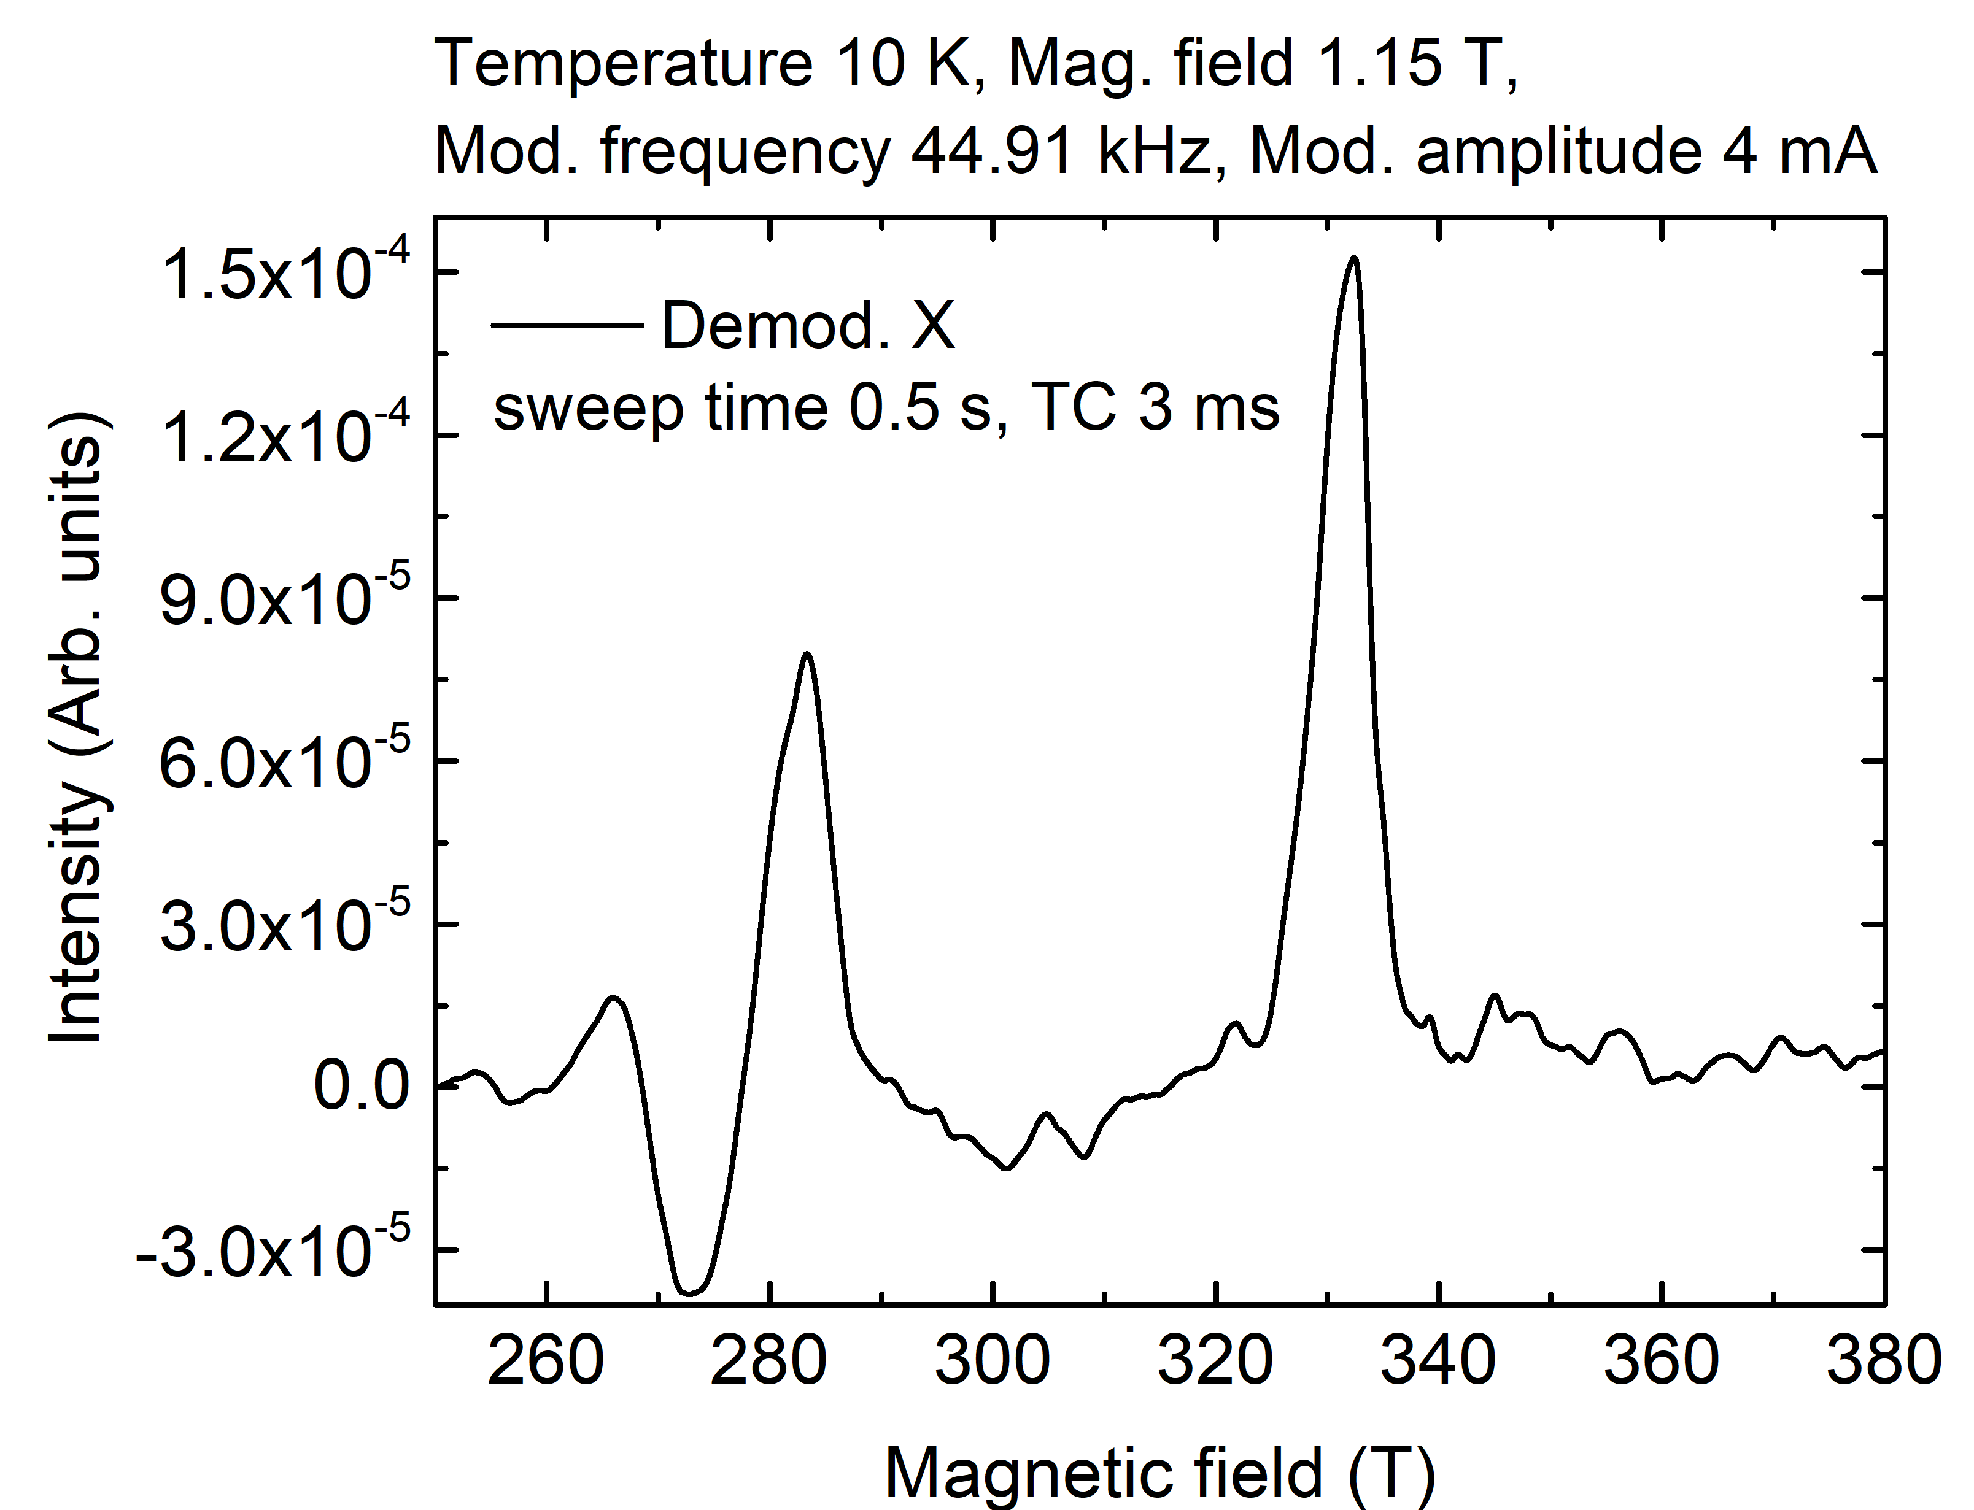
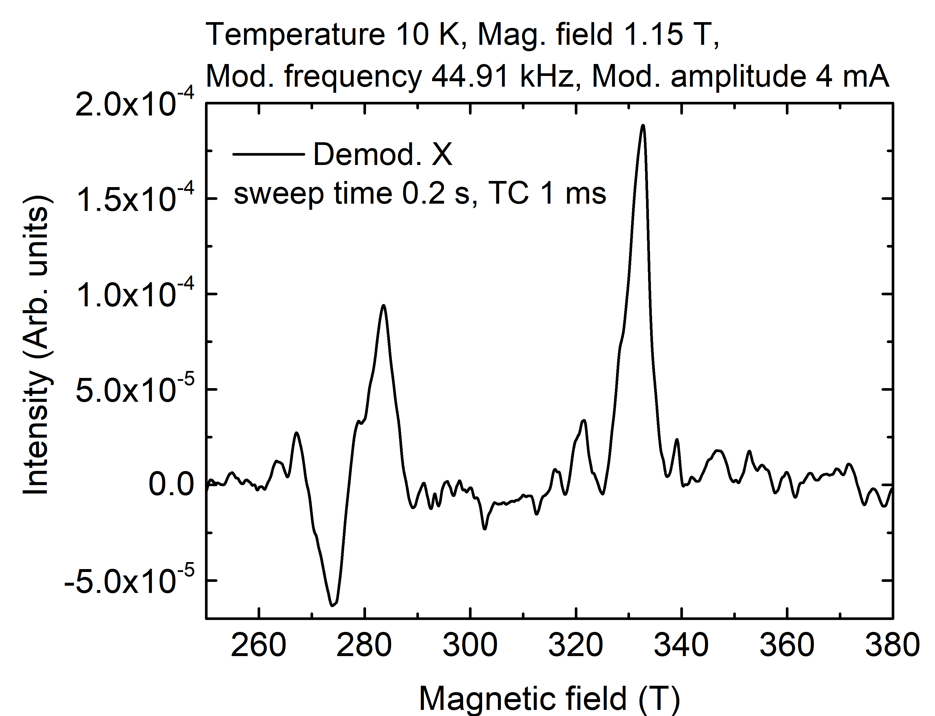
FDMR Measurement of Mn12ac (reference sample) on HFEPR setup – test sample for PETER setup
Stanford lock-in amplifier
Zurich Instruments lock-in amplifier
PCCP, 20, 15528 (2018)

Slide 9
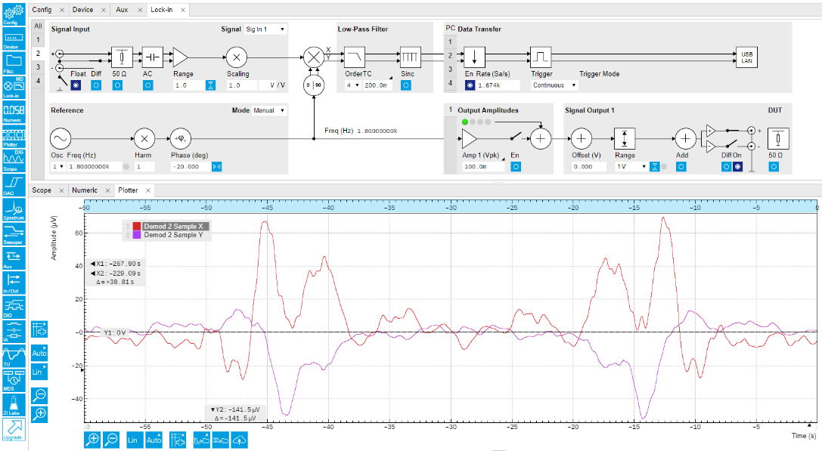
FDMR Measurement of Mn12ac (reference sample) on PETER setup
Magnetic field 1.1 T , Mod. Frequency 1.8 kHz, Mod. Amp 1 A, Temperature 10 K
EPR measurement in field domain:
Measured on PETER setup with
Stanford lock-in amplifier
380 GHz
280 GHz
380 GHz
Time (s)
60 s

Slide 10
Progresses on
Project
UNISTUTT
3rd of December 2020
S I M U L A T I O N S

Slide 11
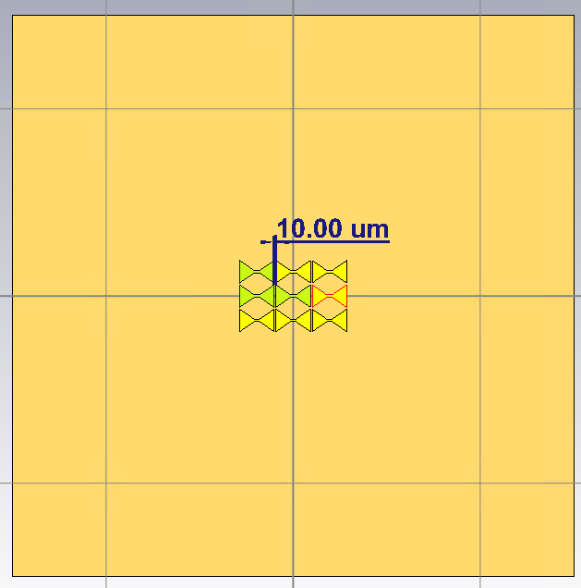
Array 3x3 - Gap sweep
SIMULATION 1:
Sweep 25 – 1000 um with steps 25 um
In-plane field averaged over this antenna

Slide 12
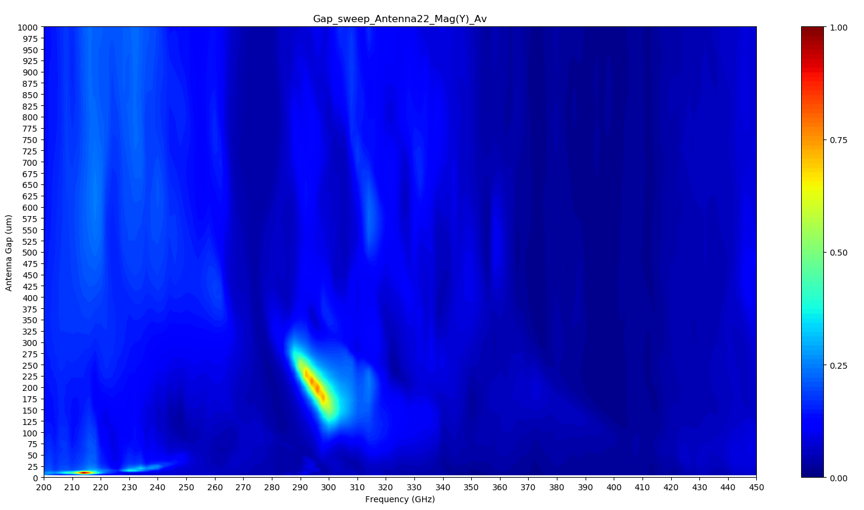
Array 3x3 – Antennas gap sweep

Slide 13
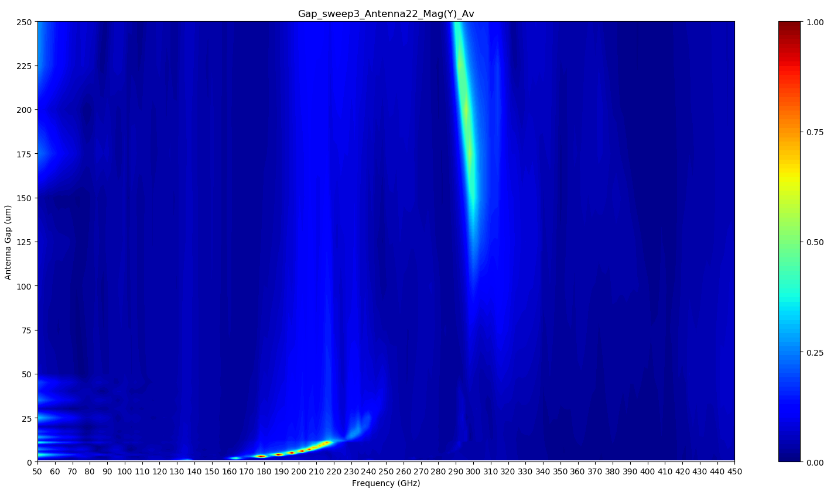
Array 3x3 - Gap sweep

Slide 14
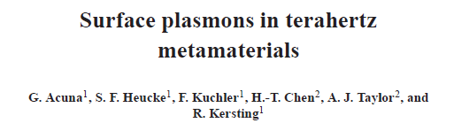
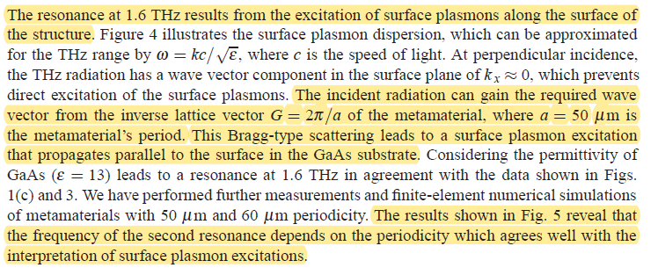
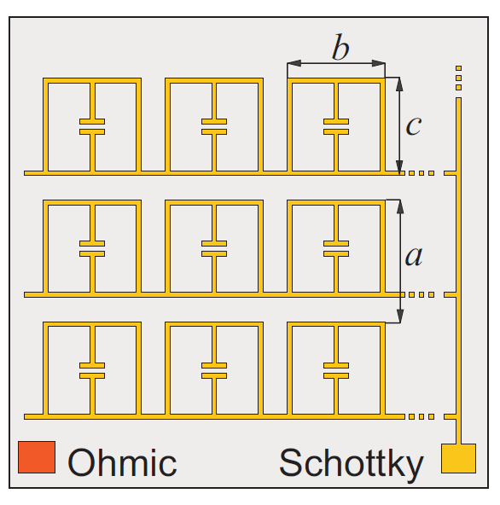
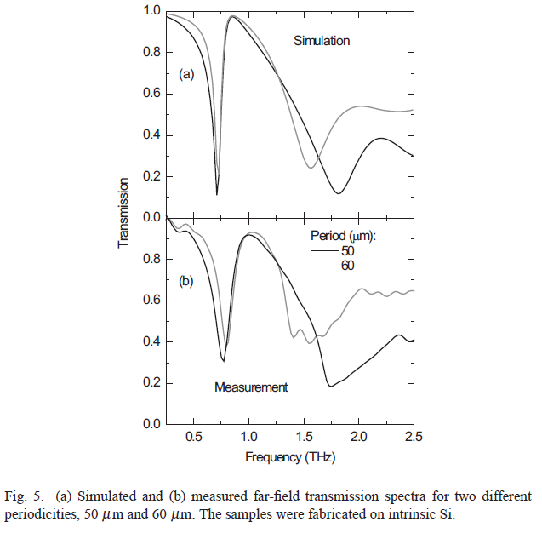
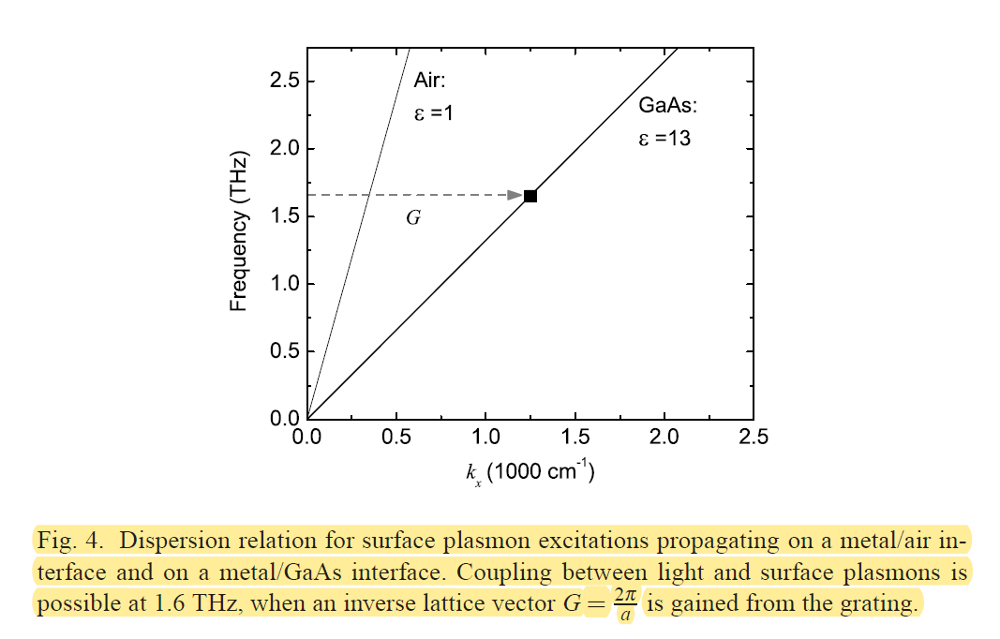
Array 3x3 - Gap sweep – Analysis of Plasmonic modes

Slide 15
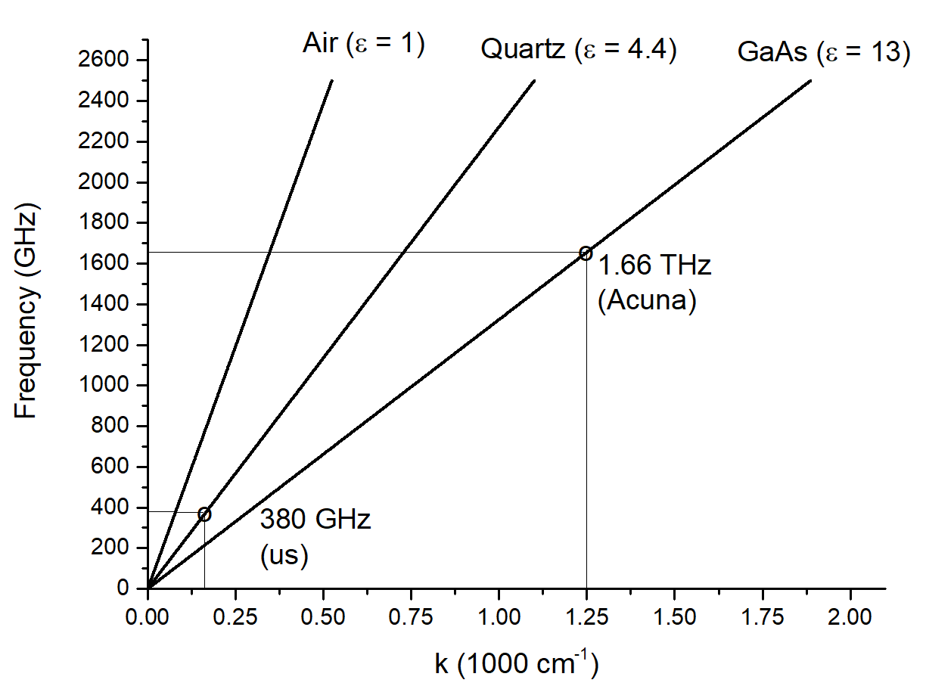
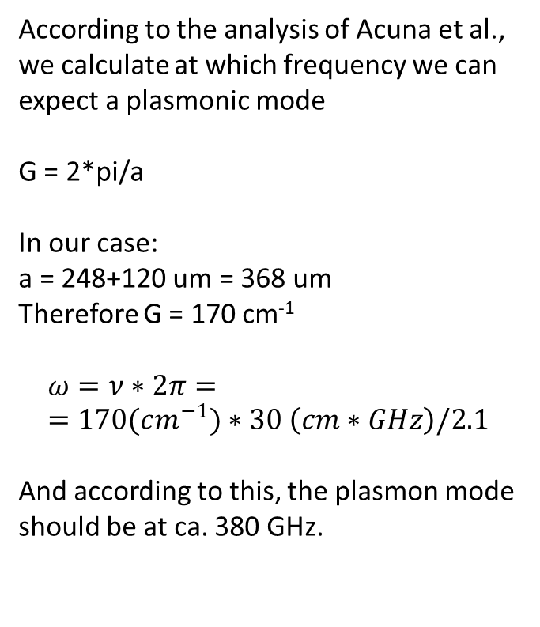
Array 3x3 - Gap sweep – Analysis of Plasmonic modes
According to the analysis of Acuna et al., we calculate at which frequency we can expect a plasmonic mode
G = 2*pi/a
In our case:
a = 248+120 um = 368 um
Therefore G = 170 cm⁻¹
$$ω=ν∗2π= =170(cm^{−1})∗30 \left(cm∗GHz\right)/2.1$$
And according to this, the plasmon mode should be at ca. 380 GHz.

Slide 16
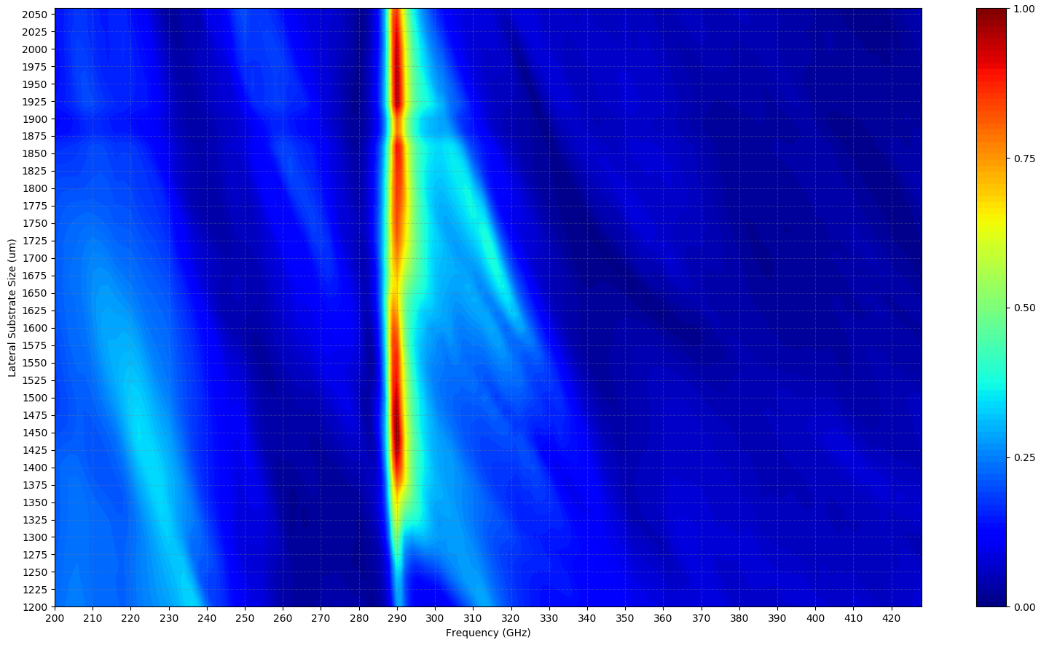
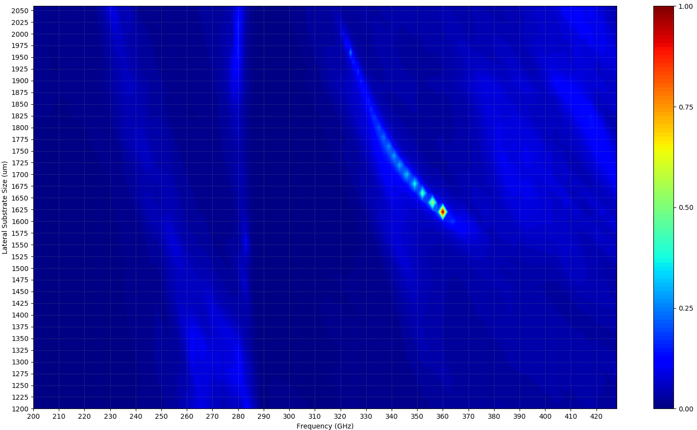
Array 3x3 – Substrate lateral size sweep
direct
inverse

Slide 17
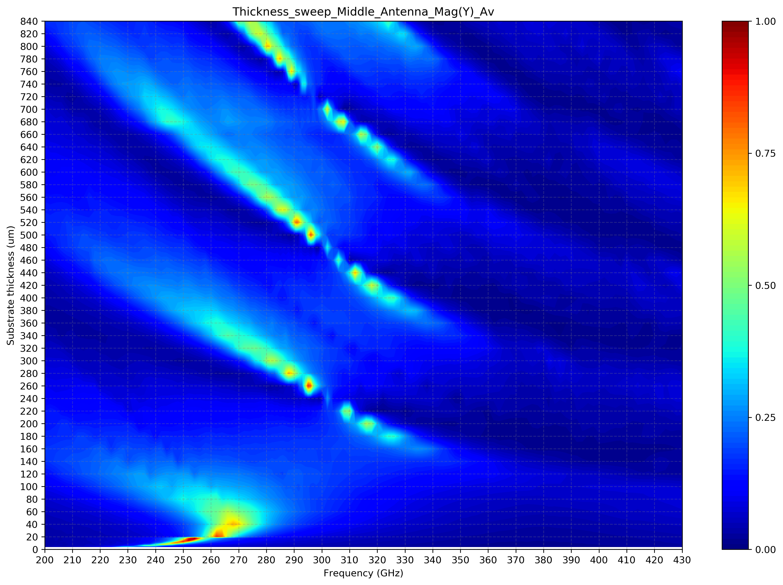
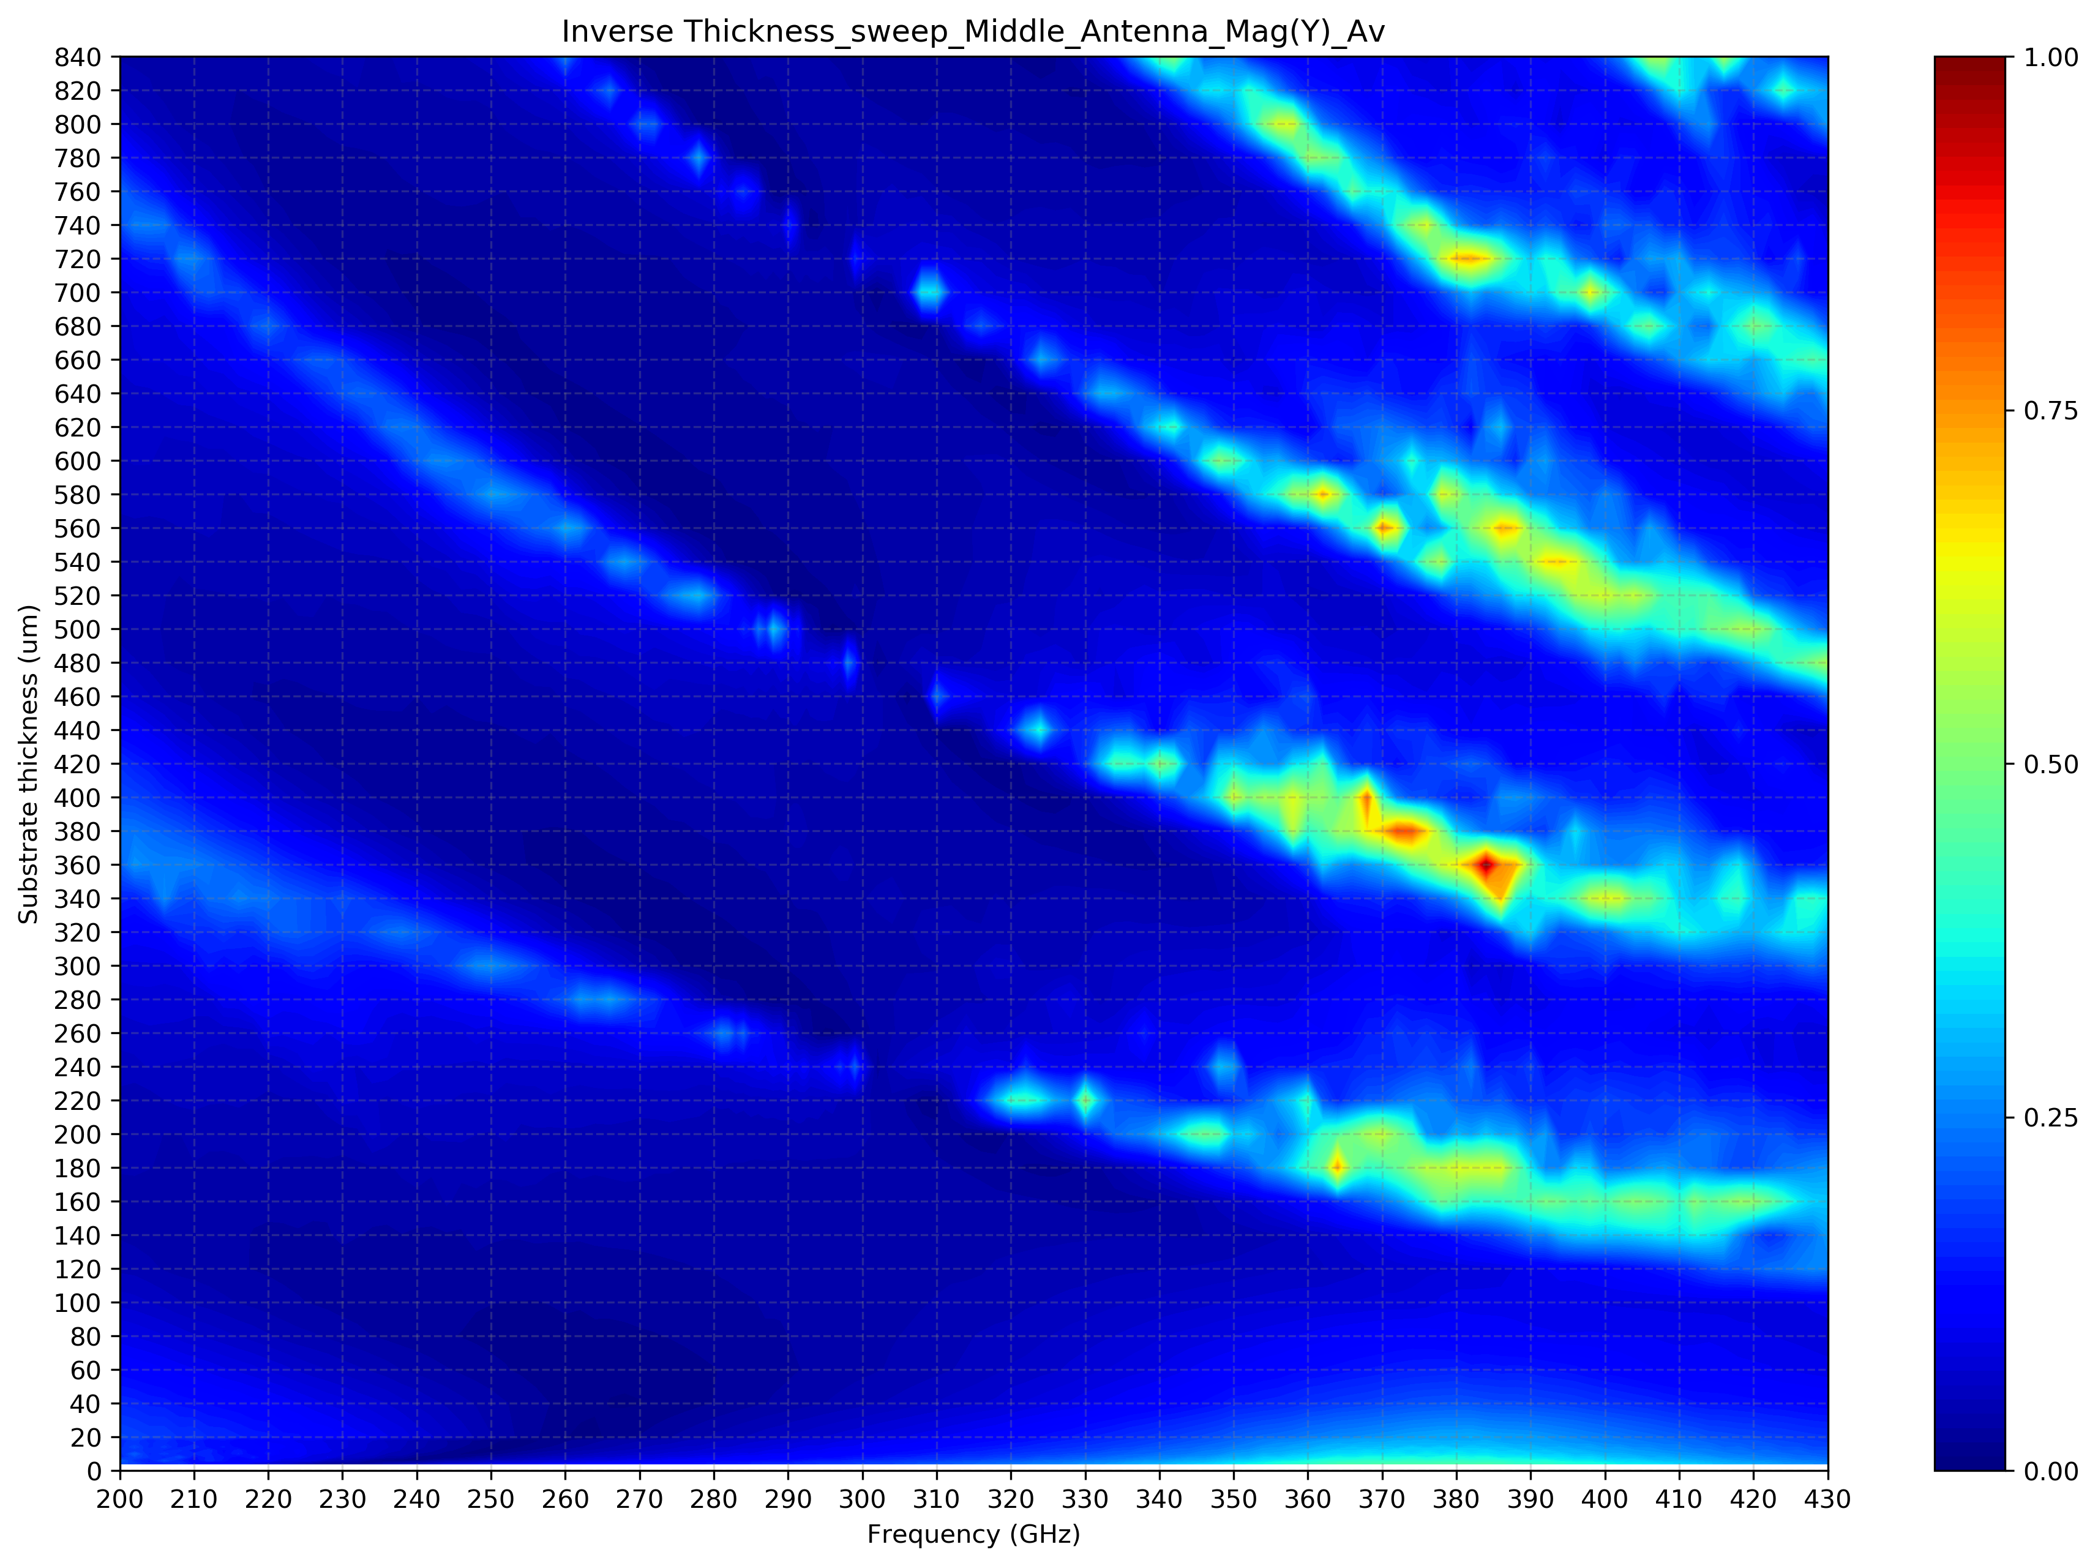
Array 7x7 – Substrate thickness sweep

Slide 18
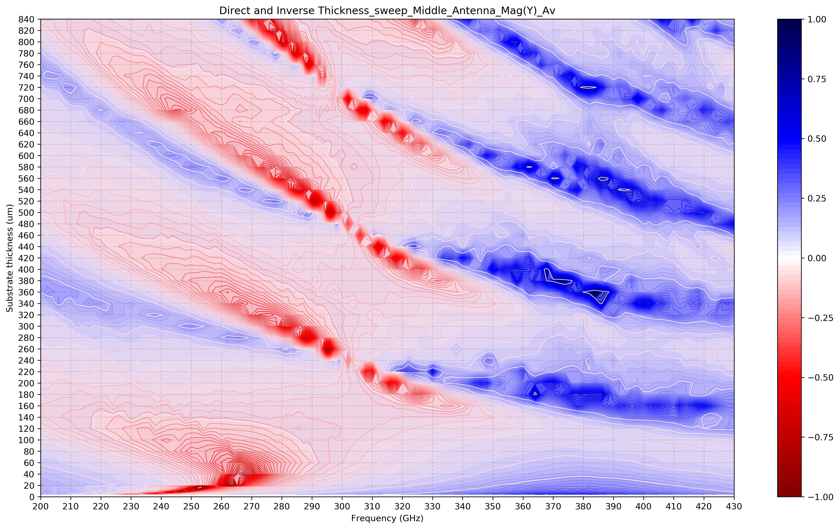
Array 7x7 – Substrate thickness sweep

Slide 19
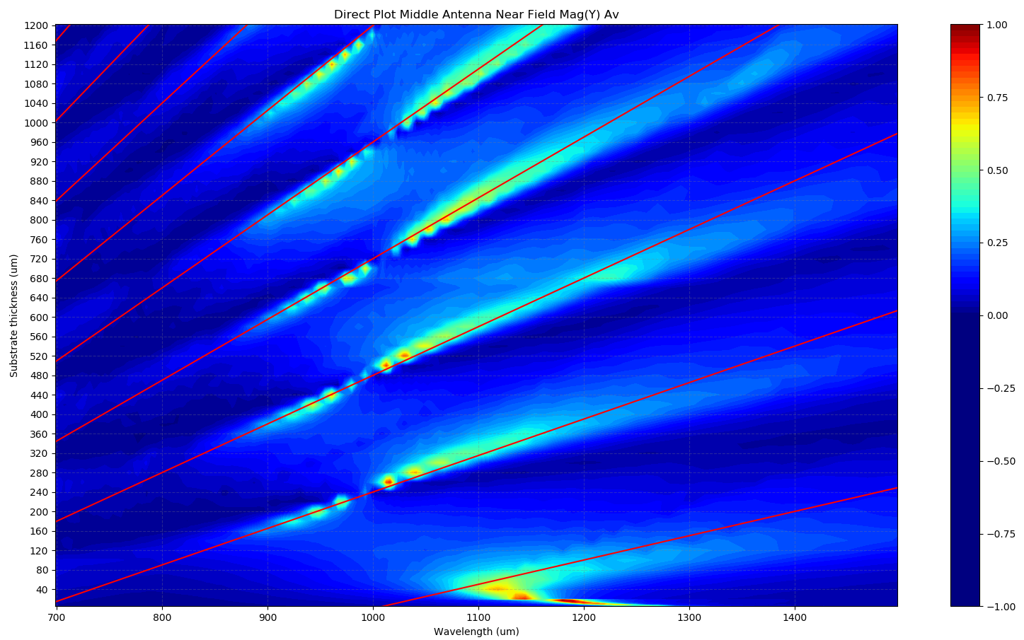







Array 7x7 – Substrate thickness sweep
$$n=7$$
$$n=6$$
$$n=5$$
Red lines are given by:
$y=n⋅\left(\frac{λ}{4}−10\right)−\frac{λ}{2}$
$$n=4$$
$$n=3$$
$$n=2$$

Slide 20
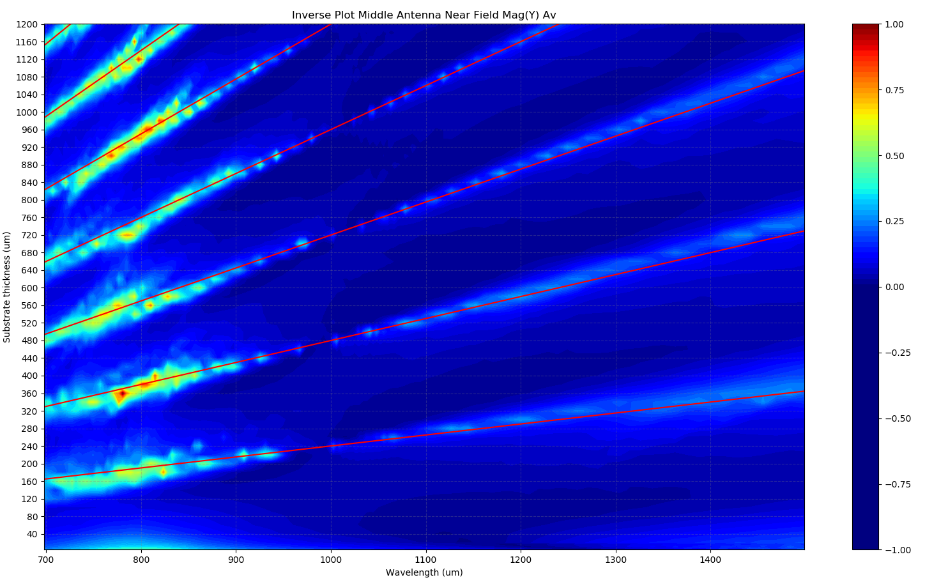


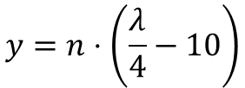





Array 7x7 – Substrate thickness sweep
$$n=7$$
$$n=6$$
$$n=5$$
$$n=4$$
Red lines are given by:
$$n=3$$
$$y=n⋅\left(\frac{λ}{4}−10\right)$$
$$n=2$$
$$n=1$$
More from Martin H.

